Slide 1
AZ-204T00A: Developing solutions for Microsoft Azure

Slide 2
Welcome
Thank you for joining us today
We’ve worked together with the Microsoft Partner Network and Microsoft IT Academies to bring you a world-class learning experience. At the end of class, please complete an evaluation of today’s experience. We value your feedback!
Microsoft Certified Trainers + Instructors
Your instructor is a premier technical and instructional expert who meets ongoing certification requirements
Customer Satisfaction Guarantee
Our partners offer a satisfaction guarantee, and we hold them accountable for it
Certification Exam Benefits
After training, consider pursuing a Microsoft Certification to help distinguish your technical expertise and experience. Ask your instructor about available exam promotions and discounts
We wish you a great learning experience and ongoing career success!

Slide 3
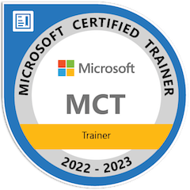
Hello! Instructor Introduction
Instructor: Nabh Tomar
Microsoft Certified Trainer
GTech Learn
Experience: 8+ Years
Technical Summary
Microsoft Power Platform
Microsoft Business Applications
  Dynamics CRM | ERP
  Dynamics 365
  Microsoft Azure / Office 365
  Exchange Server / Powershell

Slide 4
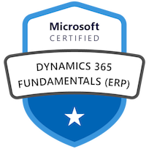
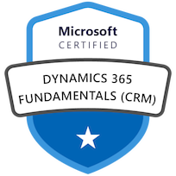
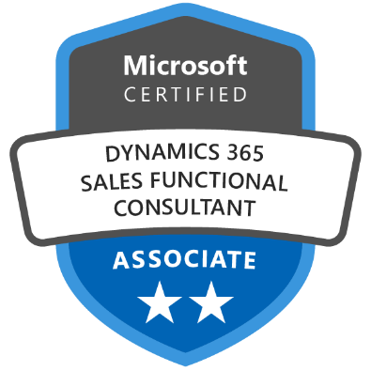







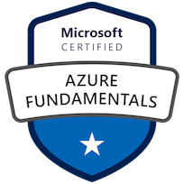

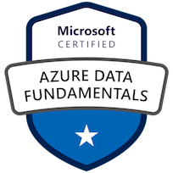



Slide 5

Hello! Student Introductions
Your name
Company affiliation
Title/function
Microsoft Azure experience
Your expectations for the course

Slide 6
About this course: Prerequisites
This course assumes you have already acquired the following skills and experience
At least one year of experience developing scalable solutions through all phases of software development.
Be skilled in at least one cloud-supported programming language. Much of the course focuses on C#, .NET Framework, HTML, and using REST in applications.
Have a base understanding of Azure and cloud concepts, services, and the Azure Portal.
Are familiar with PowerShell and/or Azure CLI.
Notes:
Be sure to ask your students about their level of experience. Have they used Azure?
Microsoft Learn has a series of Fundamental modules for Azure, networking, and security. More modules are added every day and can help students ramp up on Azure basics. https://docs.microsoft.com/en-us/learn/browse/?term=fundamentals

Slide 7
Cloud Developer role
Microsoft Azure Developers design, build, test, and maintain cloud solutions, such as applications and services, partnering with cloud solution architects, cloud DBAs, cloud administrators, and clients to implement these solutions.
Notes:
Each year Microsoft reviews each role to determine what tasks are included in a typical day. Ask students what areas are most important for their jobs. What are they most interested in?

Slide 8
Microsoft Certifications
Certifications give you a professional edge by providing globally recognized industry endorsed evidence of skills mastery, demonstrating your abilities and willingness to embrace new technologies
Exam AZ-900: Microsoft Azure Fundamentals
Microsoft Certified: Azure Developer Associate
Microsoft Certified: Azure Solutions Architect Expert
Designed for candidates looking to demonstrate foundational level knowledge of cloud services and how those services are provided
Designed for Azure Developers who design, build, test, and maintain cloud solutions, such as applications and services.
Designed for Azure Solutions Architects who create solutions for compute, network, storage, and security
Notes:
AZ-204 Exam page - https://docs.microsoft.com/en-us/learn/certifications/exams/az-204

Slide 9
AZ-204 Certification Areas
Study Areas | Weights
Develop Azure compute solutions | 25-30%
Develop for Azure storage | 15 – 20%
Implement Azure security | 20 – 25%
Monitor, troubleshoot, and optimize Azure solutions | 15-20%
Connect to and consume Azure services and third-party services | 15-20%
Percentages indicate the relative
weight of each area on the exam
The higher the percentage, the more questions you are likely to see in that area
Notes:
AZ-204 Exam page - https://docs.microsoft.com/en-us/learn/certifications/exams/az-204

Slide 10
About this Course: Course Outline
Module 01: Create Azure App Service web apps
Module 02: Implement Azure Functions
Module 03: Develop solutions that use Blob storage
Module 04: Develop solutions that use Azure Cosmos DB storage
Module 05: Implement infrastructure as a service solutions
Module 06: Implement user authentication and authorization
Module 07: Implement secure cloud solutions

Slide 11
About this Course: Course Outline (continued)
Module 08: Implement API Management
Module 09: Develop event-based solutions
Module 10: Develop message-based solutions
Module 11: Instrument solutions to support monitoring and logging
Module 12: Integrate caching and content delivery within solutions

Slide 12
Closing slide

