Slide 1
Module 01: Create Azure App Service web apps

Slide 2
Lesson 1: Explore Azure App Service

Slide 3
Examine Azure App Service
Azure App Service is an HTTP-based service for hosting web applications, REST APIs, and mobile back ends.
Built-in auto scale support
Supports scale up/down or scale out/in.
Depending on the usage of the web app, you can scale your app up/down the resources of the underlying machine that is hosting your web app.
Continuous integration/ deployment support
Azure DevOps, GitHub, Bitbucket, FTP, or a local Git repository on your development machine.
Deployment slots
You can easily add deployment slots to an App Service web app.
App Service on Linux
Hosts web apps natively on Linux for supported application stacks.
Run custom Linux containers (also known as Web App for Containers).
Notes:
App Service on Linux does have some limitations:
App Service on Linux is not supported on Shared pricing tier.
You can't mix Windows and Linux apps in the same App Service plan.
Historically, you could not mix Windows and Linux apps in the same resource group. However, all resource groups created on or after January 21, 2021 do support this scenario. Support for resource groups created before January 21, 2021 will be rolled out across Azure regions (including National cloud regions) soon.
The Azure portal shows only features that currently work for Linux apps. As features are enabled, they're activated on the portal.

Slide 4
Examine Azure App Service plans (1 / 2)
Introduction
An App Service plan defines a set of compute resources for a web app to run.
One or more apps can be configured to run on the same computing resources (or in the same App Service plan).
The pricing tier of an App Service plan
Shared compute
Dedicated compute
Isolated
Consumption
How does my app run and scale?
In the Free and Shared tiers, an app receives CPU minutes on a shared VM instance and can't scale out.
In other tiers, an app runs on all the VM instances configured in the App Service plan.
What if my app needs more capabilities or features?
Your App Service plan can be scaled up and down at any time.
Notes:
If your app is in the same App Service plan with other apps, you may want to improve the app's performance by isolating the compute resources.

Slide 5
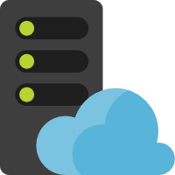

Examine Azure App Service plans (2 / 2)
Web app
App Service plan
Web app
Web app
Notes:
Because you pay for the computing resources your App Service plan allocates, you can potentially save money by putting multiple apps into one App Service plan. You can continue to add apps to an existing plan as long as the plan has enough resources to handle the load. However, keep in mind that all the apps in an App Service plan share the same compute resources. To determine whether the new app has the necessary resources, you must understand the capacity of the existing App Service plan, and the expected load for the new app. Overloading an App Service plan can potentially cause downtime for your new and existing apps.

Slide 6
Deploy to App Service
Every development team has unique requirements that can make implementing an efficient deployment pipeline difficult on any cloud service. App Service supports both automated and manual deployment.
Automated deployment
Azure DevOps
GitHub
Bitbucket
Manual deployment
Git
CLI
Zipdeploy
FTP/S
Use deployment slots
Whenever possible, use deployment slots when deploying a new production build.
Notes:
Azure DevOps: You can push your code to Azure DevOps, build your code in the cloud, run the tests, generate a release from the code, and finally, push your code to an Azure Web App.
GitHub: Azure supports automated deployment directly from GitHub. When you connect your GitHub repository to Azure for automated deployment, any changes you push to your production branch on GitHub will be automatically deployed for you.
Bitbucket: With its similarities to GitHub, you can configure an automated deployment with Bitbucket.
Git: App Service web apps feature a Git URL that you can add as a remote repository. Pushing to the remote repository will deploy your app.
CLI: webapp up is a feature of the az command-line interface that packages your app and deploys it. Unlike other deployment methods, az webapp up can create a new App Service web app for you if you haven't already created one.
Zipdeploy: Use curl or a similar HTTP utility to send a ZIP of your application files to App Service.
FTP/S: FTP or FTPS is a traditional way of pushing your code to many hosting environments, including App Service.

Slide 7
Explore authentication and authorization in App Service
Azure App Service provides built-in authentication and authorization support, so you can sign in users and access data by writing minimal or no code in your web app, API, and mobile back end, and also Azure Functions.
Why use the built-in authentication
Saves time by providing out-of-the-box authentication with federated identity providers.
Allows you to focus on the rest of your application.
Identity providers enabled by default
Microsoft Identity Platform
Facebook
Google
Twitter
How it works
The authentication and authorization module run in the same sandbox as your application code. When it's enabled, every incoming HTTP request passes through it before being handled by your application code.
Authentication flow
Sign user in
Post-authentication
Establish authenticated session
Serve authenticated content
Authorization behavior
Allow unauthenticated requests
Require authentication
Notes:
Azure App Service allows you to integrate a variety of auth capabilities into your web app or API without implementing them yourself. It’s built directly into the platform and doesn’t require any particular language, SDK, security expertise, or even any code to utilize. You can integrate with multiple login providers. For example, Azure AD, Facebook, Google, Twitter.
Authentication flow
The authentication flow is the same for all providers, but differs depending on whether you want to sign in with the provider's SDK.
Without provider SDK: The application delegates federated sign-in to App Service. This is typically the case with browser apps, which can present the provider's login page to the user. The server code manages the sign-in process, so it is also called server-directed flow or server flow.
With provider SDK: The application signs users in to the provider manually and then submits the authentication token to App Service for validation. This is typically the case with browser-less apps, which can't present the provider's sign-in page to the user. The application code manages the sign-in process, so it is also called client-directed flow or client flow. This applies to REST APIs, Azure Functions, JavaScript browser clients, and native mobile apps that sign users in using the provider's SDK.

Slide 8
Discover App Service networking features
Multitenant App Service networking features
Azure App Service is a distributed system. All the roles in an App Service deployment exist in a multitenant network.
Inbound features
App-assigned address
Access restrictions
Service endpoints
Private endpoints
Outbound features
Hybrid Connections
Gateway-required VNet Integration
VNet Integration
Single-tenant networking
Azure App Service Environment hosts Isolated SKU plans directly in your Azure virtual network. There are two deployment types for an App Service Environment.
External: Exposes the hosted apps by using an IP address that is accessible on the internet.
Internal load balancer: Exposes the hosted apps on an IP address inside your virtual network.
Notes:
There are two main deployment types for Azure App Service. The multitenant public service hosts App Service plans in the Free, Shared, Basic, Standard, Premium, PremiumV2, and PremiumV3 pricing SKUs.
Because there are many different customers in the same App Service scale unit, you can't connect the App Service network directly to your network.
Instead of connecting the networks, you need features to handle the various aspects of application communication.
There is also the single-tenant App Service Environment (ASE) hosts Isolated SKU App Service plans directly in your Azure virtual network.
Regional virtual network integration: When you connect to virtual networks in the same region, you must have a dedicated subnet in the virtual network you're integrating with.
Gateway-required virtual network integration: When you connect directly to virtual networks in other regions or to a classic virtual network in the same region, you need an Azure Virtual Network gateway created in the target virtual network.
IP-based SSL needs for your app App-assigned address
Support unshared dedicated inbound address for your app App-assigned address
Restrict access to your app from a set of well-defined addresses Access restrictions
Restrict access to your app from resources in a virtual network Service endpoints, Private endpoints
Expose your app on a private IP in your virtual network:Private endpoints

Slide 9
Exercise: Create a static HTML web app by using Azure Cloud Shell
Login to Azure and download
the sample app
Create the web app
Update and redeploy the app
Clean up resources
Notes:
Students can perform this exercise in their lab environments. Step-by-step instructions are included in the student manual.

Slide 10
Lesson 2: Configure web app settings

Slide 11
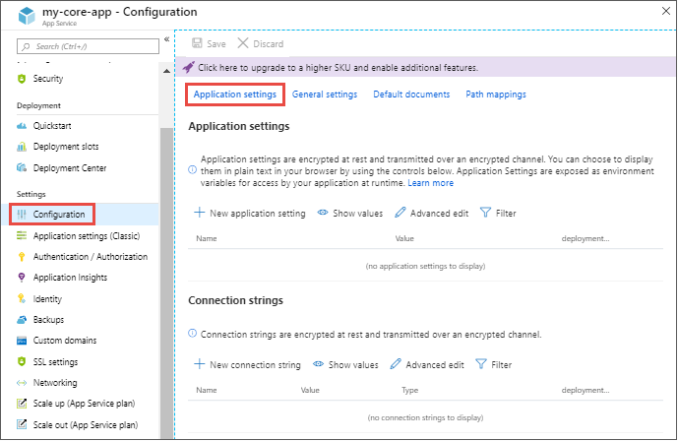
Configure application settings (1 / 2)
In App Service, app settings are passed as environment variables to the application code.
Adding and editing settings
To add a new app setting, click New application setting.
To add or edit app settings in bulk, click the Advanced edit button.
Configure connection strings
Adding and editing connection strings follow the same principles as other app settings and they can also be tied to deployment slots.
Notes:
For ASP.NET and ASP.NET Core developers, setting app settings in App Service are like setting them in `<appSettings>` in *Web.config* or *appsettings.json*, but the values in App Service override the ones in *Web.config* or *appsettings.json*.
You can keep development settings (for example, local MySQL password) in *Web.config* or *appsettings.json*, but production secrets (for example, Azure MySQL database password) safe in App Service.

Slide 12
Configure application settings (2 / 2)
Editing settings in bulk
[
{
"name": "name-1",
"value": "conn-string-1",
"type": "SQLServer",
"slotSetting": false
},
{
"name": "name-2",
"value": "conn-string-2",
"type": "PostgreSQL",
"slotSetting": false
},
...
]
Notes:
You can add and edit settings in bulk by using the format shown above which illustrates setting connection strings.

Slide 13
Configure general settings
Stack settings
The software stack to run the app, including the language and SDK versions.
Platform settings
Configure settings for the hosting platform, including:
Bitness (32-bit or 64-bit)
WebSocket protocol
Always On
Managed pipeline version
HTTP version
ARR affinity
Debugging
Enable remote debugging for ASP.NET , ASP.NET Core, or Node.js apps.
Incoming client certificates
Require client certificates in mutual authentication. TLS mutual authentication is used to restrict access to your app by enabling different types of authentication for it.
Notes:
Platform settings: Lets you configure settings for the hosting platform, including:
Bitness: 32-bit or 64-bit.
WebSocket protocol: For ASP.NET SignalR or socket.io, for example.
Always On: Keep the app loaded even when there’s no traffic. By default, Always On is not enabled and the app is unloaded after 20 minutes without any incoming requests. It’s required for continuous WebJobs or for WebJobs that are triggered using a CRON expression.
Managed pipeline version: The IIS pipeline mode. Set it to Classic if you have a legacy app that requires an older version of IIS.
HTTP version: Set to 2.0 to enable support for HTTPS/2 protocol.
ARR affinity: In a multi-instance deployment, ensure that the client is routed to the same instance for the life of the session. You can set this option to Off for stateless applications.

Slide 14
Configure path mappings
Linux and containerized apps
You can add custom storage for your containerized app. Containerized apps include all Linux apps and Windows and Linux custom containers running on App Service.
Windows apps (uncontainerized)
For Windows apps, you can customize the IIS handler mappings and virtual applications and directories.
Handler mappings let you add custom script processors to handle requests for specific file extensions.
Notes:
Linux and containerized apps
Configure your custom storage as follows:
Name: The display name.
Configuration options: Basic or Advanced.
Storage accounts: The storage account with the container you want.
Storage type: Azure Blobs or Azure Files. Windows container apps only support Azure Files.
Storage container: For basic configuration, the container you want.
Share name: For advanced configuration, the file share name.
Access key: For advanced configuration, the access key.
Mount path: The absolute path in your container to mount the custom storage.
Windows apps
Configure the handler as follows:
Extension: The file extension you want to handle, such as *.php or handler.fcgi.
Script processor: The absolute path of the script processor to you. Requests to files that match the file extension are processed by the script processor. Use the path D:\home\site\wwwroot to refer to your app's root directory.
Arguments: Optional command-line arguments for the script processor.

Slide 15
Enable diagnostic logging
Enable application logging (Windows)
Add log messages in code
Enable application logging (Linux/Container)
Stream logs
Enable web server logging
Access log files
Notes:
Enable application logging (Windows)
To enable application logging for Windows apps in the Azure portal, navigate to your app and select App Service logs.
Select On for either Application Logging (Filesystem) or Application Logging (Blob), or both. The Filesystem option is for temporary debugging purposes, and turns itself off in 12 hours. The Blob option is for long-term logging, and needs a blob storage container to write logs to.
You can also set the Level of details.
When finished, select Save.
Enable application logging (Linux/Container)
In Application logging, select File System.
In Quota (MB), specify the disk quota for the application logs. In Retention Period (Days), set the number of days the logs should be retained.
When finished, select Save.
Enable web server logging
For Web server logging, select Storage to store logs on blob storage, or File System to store logs on the App Service file system.
In Retention Period (Days), set the number of days the logs should be retained.
When finished, select Save.

Slide 16
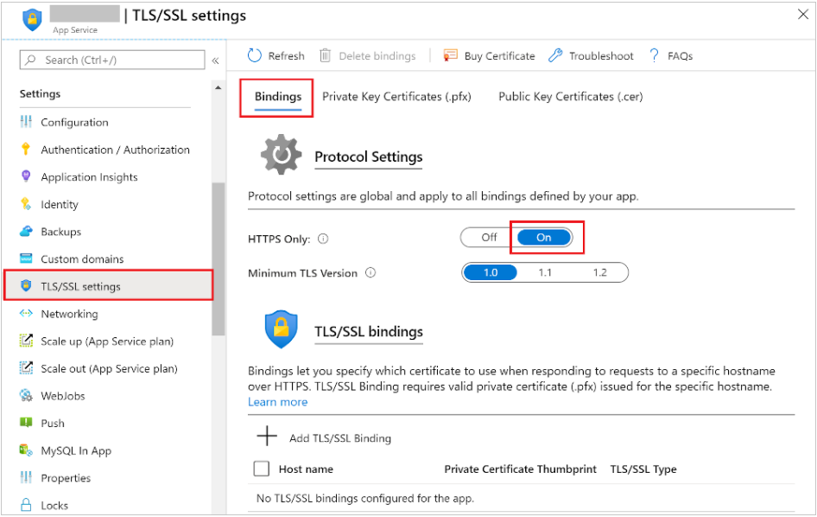
Configure security certificates
Options for adding certificates in App Service
Free App Service managed certificate
Purchase an App Service certificate
Import a certificate from Key Vault
Upload a private certificate
Upload a public certificate
Notes:
A certificate uploaded into an app is stored in a deployment unit that is bound to the app service plan's resource group and region combination (internally called a webspace). This makes the certificate accessible to other apps in the same resource group and region combination.
Notes on certificates:
Free App Service managed certificate: A private certificate that's free of charge and easy to use if you just need to secure your custom domain in App Service.
Purchase an App Service certificate: A private certificate that's managed by Azure. It combines the simplicity of automated certificate management and the flexibility of renewal and export options.
Import a certificate from Key Vault: Useful if you use Azure Key Vault to manage your certificates.
Upload a private certificate: If you already have a private certificate from a third-party provider, you can upload it.
Upload a public certificate: Public certificates are not used to secure custom domains, but you can load them into your code if you need them to access remote resources.

Slide 17
Manage app features
Basic concepts
Feature flag
Feature manager
Filter
Feature flag usage in code
if (featureFlag)
bool featureFlag = true;
bool featureFlag = isBetaUser();
if (featureFlag) {
} else {
}
Feature flag declaration
Each feature flag has two parts: a name and a list of one or more filters
The feature manager supports appsettings.json as a configuration source for feature flags.
Feature flag repository
Azure App Configuration is designed to be a centralized repository for feature flags.
You can use it to define different kinds of feature flags and manipulate their states
Easily access these feature flags from your application
Notes:
Feature flag: A feature flag is a variable with a binary state of on or off. The feature flag also has an associated code block. The state of the feature flag triggers whether the code block runs or not.
Feature manager: A feature manager is an application package that handles the lifecycle of all the feature flags in an application. The feature manager typically provides additional functionality, such as caching feature flags and updating their states.
Filter: A filter is a rule for evaluating the state of a feature flag. A user group, a device or browser type, a geographic location, and a time window are all examples of what a filter can represent.

Slide 18
Lesson 3: Scale apps in Azure App Service

Slide 19
Examine autoscale factors
What is autoscaling?
Autoscaling is a cloud system or process that adjusts available resources based on the current demand. Autoscaling performs scaling in and out, as opposed to scaling up and down.
Azure App Service Autoscaling
Autoscaling in Azure App Service monitors the resource metrics of a web app as it runs. It detects situations where additional resources are required to handle an increasing workload, and ensures those resources are available before the system becomes overloaded.
When should you consider autoscaling?
Autoscaling provides elasticity for your services.
Autoscaling improves availability and fault tolerance.
Autoscaling works by adding or removing web servers.
Autoscaling isn't the best approach to handling long-term growth.
The number of instances of a service is also a factor.
Notes:
Autoscaling rules
Autoscaling makes its decisions based on rules that you define. A rule specifies the threshold for a metric, and triggers an autoscale event when this threshold is crossed. Autoscaling can also deallocate resources when the workload has diminished.
Per-app scaling can be enabled at the App Service plan level to allow for scaling an app independently from the App Service plan that hosts it. This way, an App Service plan can be scaled to 10 instances, but an app can be set to use only five. Per-app scaling is available only for Standard, Premium, Premium V2, Premium V3, and Isolated pricing tiers.

Slide 20
Identify autoscale factors
Autoscaling enables you to specify the conditions under which a web app should be scaled out, and back in again. Effective autoscaling ensures sufficient resources are available to handle large volumes of requests at peak times, while managing costs when the demand drops.
Autoscaling and the App Service Plan
Autoscale actions
Autoscale conditions
Pairing autoscale rules
Metrics for autoscale rules
Combining autoscale rules
How an autoscale rule analyzes metrics
Notes:
Autoscale conditions
You indicate how to autoscale by creating autoscale conditions. Azure provides two options for autoscaling:
Scale based on a metric, such as the length of the disk queue, or the number of HTTP requests awaiting processing.
Scale to a specific instance count according to a schedule. For example, you can arrange to scale out at a particular time of day, or on a specific date or day of the week. You also specify an end date, and the system will scale back in at this time.
Metrics for autoscale rules
Autoscaling by metric requires that you define one or more autoscale rules. An autoscale rule specifies a metric to monitor, and how autoscaling should respond when this metric crosses a defined threshold. The metrics you can monitor for a web app are:
CPU Percentage. This metric is an indication of the CPU utilization across all instances. A high value shows that instances are becoming CPU-bound, which could cause delays in processing client requests.
Memory Percentage. This metric captures the memory occupancy of the application across all instances. A high value indicates that free memory could be running low, and could cause one or more instances to fail.
Disk Queue Length. This metric is a measure of the number of outstanding I/O requests across all instances. A high value means that disk contention could be occurring.
Http Queue Length. This metric shows how many client requests are waiting for processing by the web app. If this number is large, client requests might fail with HTTP 408 (Timeout) errors.
Data In. This metric is the number of bytes received across all instances.
Data Out. This metric is the number of bytes sent by all instances.
Combining autoscale rules
A single autoscale condition can contain several autoscale rules (for example, a scale-out rule and the corresponding scale-in rule). However, the autoscale rules in an autoscale condition don't have to be directly related. You could define the following four rules in the same autoscale condition:
If the HTTP queue length exceeds 10, scale out by 1
If the CPU utilization exceeds 70%, scale out by 1
If the HTTP queue length is zero, scale in by 1
If the CPU utilization drops below 50%, scale in by 1

Slide 21
Enable autoscale in App Service
Enable autoscaling
To get started with autoscaling navigate to to your App Service plan in the Azure portal and select Scale out (App Service plan) in the Settings group in the left navigation pane.
Add scale conditions
Once you enable autoscaling, you can edit the automatically created default scale condition, and you can add your own custom scale conditions.
Create scale rules
A metric-based scale condition contains one or more scale rules. You use the Add a rule link to add your own custom rules.
Monitor autoscaling activity
The Azure portal enables you to track when autoscaling has occurred through the Run history chart. This chart shows how the number of instances varies over time, and which autoscale conditions caused each change.
Notes:
Note: Not all pricing tiers support autoscaling. The development pricing tiers are either limited to a single instance (the F1 and D1 tiers), or they only provide manual scaling (the B1 tier). If you've selected one of these tiers, you must first scale up to the S1 or any of the P level production tiers.

Slide 22
Explore autoscale best practices
Ensure the maximum and minimum values are different and have an adequate margin between them
Choose the appropriate statistic for your diagnostics metric
Choose the thresholds carefully for all metric types
Considerations for scaling when multiple rules are configured in a profile
Always select a safe default instance count
Configure autoscale notifications
Notes:
Autoscale concepts
An autoscale setting scales instances horizontally, which is out by increasing the instances and in by decreasing the number of instances. An autoscale setting has a maximum, minimum, and default value of instances.
An autoscale job always reads the associated metric to scale by, checking if it has crossed the configured threshold for scale-out or scale-in.
All thresholds are calculated at an instance level. For example, "scale out by one instance when average CPU > 80% when instance count is 2", means scale-out when the average CPU across all instances is greater than 80%.
All autoscale successes and failures are logged to the Activity Log. You can then configure an activity log alert so that you can be notified via email, SMS, or webhooks whenever there is activity.

Slide 23
Lesson 4: Explore Azure App Service deployment slots

Slide 24
Explore staging environments
When you deploy your web app, web app on Linux, mobile back end, or API app to Azure App Service, you can use a separate deployment slot instead of the default production slot when you're running in the Standard, Premium, or Isolated App Service plan tier.
Deploying your application to a non-production slot has the following benefits:
You can validate app changes in a staging deployment slot before swapping it with the production slot.
Deploying an app to a slot first and swapping it into production makes sure that all instances of the slot are warmed up before being swapped into production.
After a swap, the slot with previously staged app now has the previous production app.

Slide 25
Examine slot swapping (1 / 2)
Applies the following settings from the target slot (e.g., the production slot) to all instances of the source slot:
Slot-specific app settings and connection strings, if applicable.
Continuous deployment settings, if enabled.
App Service authentication settings, if enabled.
If auto swap is enabled with custom warm-up, trigger Application Initiation by making an HTTP request to the application root ("/") on each instance of the source slot.
If all instances on the source slot are warmed up successfully, swap the two slots by switching the routing rules for the two slots.
Wait for every instance in the source slot to complete its restart.
If local cache is enabled, trigger local cache initialization by making an HTTP request to the application root ("/") on each instance of the source slot.
Now that the source slot has the pre-swap app previously in the target slot, perform the same operation by applying all settings and restarting the instances.

Slide 26
Examine slot swapping (2 / 2)
The following table shows the settings that change when you swap slots.
Settings that are swapped | Settings that aren't swapped
General settings, such as framework version, 32/64-bit, web sockets | Publishing endpoints
App settings (can be configured to stick to a slot) | Custom domain names
Connection strings (can be configured to stick to a slot) | Non-public certificates and TLS/SSL settings
Handler mappings | Scale settings
Public certificates | WebJobs schedulers
WebJobs content | IP restrictions
Hybrid connections * | Always On
Virtual network integration * | Diagnostic log settings
Service endpoints * | Cross-origin resource sharing (CORS)
Azure Content Delivery Network *
Features marked with an asterisk (*) are planned to be unswapped.
Notes:
Features marked with an asterisk (*) are planned to be unswapped.
To make settings swappable, add the app setting WEBSITE_OVERRIDE_PRESERVE_DEFAULT_STICKY_SLOT_SETTINGS in every slot of the app and set its value to 0 or false. These settings are either all swappable or not at all. You can't make just some settings swappable and not the others.

Slide 27
Swap deployment slots
You can swap deployment slots on your app's Deployment slots page and the Overview page.
Manually swapping deployment slots
Configure auto swap
Specify custom warm-up
Roll back and monitor a swap
Notes:
Manually swapping deployment slots
To swap deployment slots:
Go to your app's Deployment slots page and select Swap. The Swap dialog box shows settings in the selected source and target slots that will be changed.
Select the desired Source and Target slots. Usually, the target is the production slot. Also, select the Source Changes and Target Changes tabs and verify that the configuration changes are expected. When you're finished, you can swap the slots immediately by selecting Swap.
When you're finished, close the dialog box by selecting Close.
Swap with preview (multi-phase swap)
Before you swap into production as the target slot, validate that the app runs with the swapped settings. The source slot is also warmed up before the swap completion, which is desirable for mission-critical applications.
To swap with preview:
Follow the steps above in Swap deployment slots but select Perform swap with preview.
The dialog box shows you how the configuration in the source slot changes in phase 1, and how the source and target slot change in phase 2.
When you're ready to start the swap, select Start Swap.
When phase 1 finishes, you're notified in the dialog box. Preview the swap in the source slot by going to https://<app_name>-<source-slot-name>.azurewebsites.net.
When you're ready to complete the pending swap, select Complete Swap in Swap action and select Complete Swap.
To cancel a pending swap, select Cancel Swap instead.
When you're finished, close the dialog box by selecting Close.

Slide 28
Route traffic in App Service
Route production traffic automatically
To route production traffic automatically:
Go to your app's resource page and select Deployment slots.
In the Traffic % column of the slot you want to route to, specify a percentage (between 0 and 100) to represent the amount of total traffic you want to route. Select Save.
Route production traffic manually
In addition to automatic traffic routing, App Service can route requests to a specific slot.
This is useful when you want your users to be able to opt in to or opt out of your beta app.
To route production traffic manually, you use the x-ms-routing-name query parameter.
Notes:
By default, all client requests to the app's production URL (http://<app_name>.azurewebsites.net) are routed to the production slot.
You can route a portion of the traffic to another slot.
This feature is useful if you need user feedback for a new update, but you're not ready to release it to production.

Slide 29
Lab 01: Build a web application on Azure platform as a service offerings
http://aka.ms/az204labs
Duration
Lab 04: Constructing a polyglot data solution
http://aka.ms/az204labs

Slide 30
Closing slide

