Slide 1

Unit – 3 Parsing Theory (I)
Compiler Design (CD)
GTU # 2170701
Prof. Dixita B. Kagathara
Computer Engineering Department
dixita.kagathara@darshan.ac.in
+91 - 97277 47317 (CE Department)

Slide 2
Topics to be covered
Role of parser
Context free grammar
Derivation & Ambiguity
Left recursion & Left factoring
Classification of parsing
Backtracking
LL(1) parsing
Recursive descent paring
Shift reduce parsing
Operator precedence parsing
LR parsing

Looping

Slide 3
Role of Parser

Slide 4
Role of parser
Token
Parsetree
Source program
Lexical analyzer
Parse tree
Rest of front end
IR
Parser
Get next token
Symbol table
Parser obtains a string of token from the lexical analyzer and reports syntax error if any otherwise generates syntax tree.
There are two types of parser:
Top-down parser
Bottom-up parser

Slide 5
Context free grammar

Slide 6
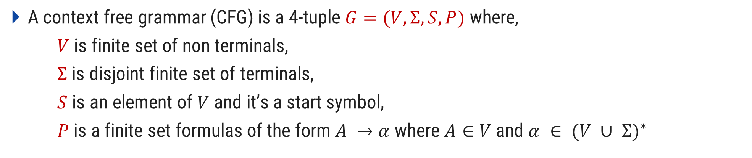
Context free grammar
A context free grammar (CFG) is a 4-tuple $G=(V,Σ,S,P)$where,
$V$ is finite set of non terminals,
$Σ$ is disjoint finite set of terminals,
$S$ is an element of $V$ and it’s a start symbol,
$P$ is a finite set formulas of the form $A →α$ where $A∈V$ and $α ∈ {(V ∪ Σ)}^{∗}$
Nonterminal symbol:
The name of syntax category of a language, e.g., noun, verb, etc.
The It is written as a single capital letter, or as a name enclosed between < … >, e.g., A or <Noun>
<Noun Phrase> → <Article><Noun>
<Article> → a | an | the
<Noun> → boy | apple

Slide 7
Context free grammar
A context free grammar (CFG) is a 4-tuple $G=(V,Σ,S,P)$where,
$V$ is finite set of non terminals,
$Σ$ is disjoint finite set of terminals,
$S$ is an element of $V$ and it’s a start symbol,
$P$ is a finite set formulas of the form $A →α$ where $A∈V$ and $α ∈ {(V ∪ Σ)}^{∗}$
Terminal symbol:
A symbol in the alphabet.
It is denoted by lower case letter and punctuation marks used in language.
<Noun Phrase> → <Article><Noun>
<Article> → a | an | the
<Noun> → boy | apple

Slide 8
Context free grammar
A context free grammar (CFG) is a 4-tuple $G=(V,Σ,S,P)$where,
$V$ is finite set of non terminals,
$Σ$ is disjoint finite set of terminals,
$S$ is an element of $V$ and it’s a start symbol,
$P$ is a finite set formulas of the form $A →α$ where $A∈V$ and $α ∈ {(V ∪ Σ)}^{∗}$
Start symbol:
First nonterminal symbol of the grammar is called start symbol.
<Noun Phrase> → <Article><Noun>
<Article> → a | an | the
<Noun> → boy | apple

Slide 9
Context free grammar
A context free grammar (CFG) is a 4-tuple $G=(V,Σ,S,P)$where,
$V$ is finite set of non terminals,
$Σ$ is disjoint finite set of terminals,
$S$ is an element of $V$ and it’s a start symbol,
$P$ is a finite set formulas of the form $A →α$ where $A∈V$ and $α ∈ {(V ∪ Σ)}^{∗}$
Production:
A production, also called a rewriting rule, is a rule of grammar. It has the form of
A nonterminal symbol → String of terminal and nonterminal symbols
<Noun Phrase> → <Article><Noun>
<Article> → a | an | the
<Noun> → boy | apple

Slide 10
Example: Grammar
Write terminals, non terminals, start symbol, and productions for following grammar.
E → E O E| (E) | -E | id
O → + | - | * | / | ↑
Terminals: id + - * / ↑ ( )
Non terminals: E, O
Start symbol: E
Productions: E → E O E| (E) | -E | id
O → + | - | * | / | ↑

Slide 11
Derivation & Ambiguity

Slide 12
Derivation
Derivation is used to find whether the string belongs to a given grammar or not.
Types of derivations are:
Leftmost derivation
Rightmost derivation

Slide 13

Leftmost derivation
A derivation of a string $W$ in a grammar $G$ is a left most derivation if at every step the left most non terminal is replaced.
Grammar: S→S+S | S-S | S*S | S/S | a Output string: a*a-a
S
→S-S
→S*S-S
→a*S-S
→a*a-S
→a*a-a
S
Parse tree represents the structure of derivation
S
-
S
S
*
S
a
a
a
Parse tree
Leftmost Derivation

Slide 14
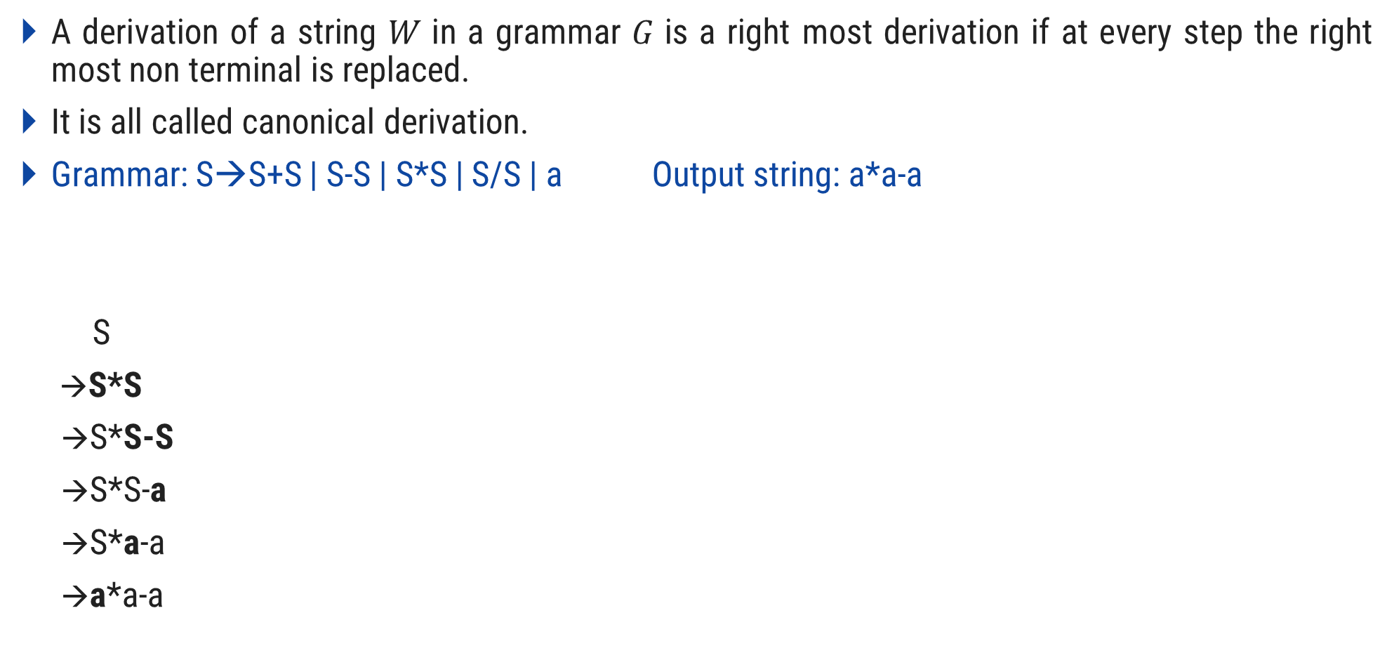
Rightmost derivation
A derivation of a string $W$ in a grammar $G$ is a right most derivation if at every step the right most non terminal is replaced.
It is all called canonical derivation.
Grammar: S→S+S | S-S | S*S | S/S | a Output string: a*a-a
S
→S*S
→S*S-S
→S*S-a
→S*a-a
→a*a-a
S
S
*
S
a
S
-
S
a
a
Rightmost Derivation
Parse Tree

Slide 15
Exercise: Derivation
Perform leftmost derivation and draw parse tree.
S→A1B
A→0A | 𝜖
B→0B | 1B | 𝜖
Output string: 1001
Perform leftmost derivation and draw parse tree.
S→0S1 | 01 Output string: 000111
Perform rightmost derivation and draw parse tree.
E→E+E | E*E | id | (E) | -E
Output string: id + id * id

Slide 16
Ambiguous grammar

Slide 17



Ambiguity
Ambiguity, is a word, phrase, or statement which contains more than one meaning.
A long thin piece of potato
Chip
A small piece of silicon

Slide 18





Ambiguity
In formal language grammar, ambiguity would arise if identical string can occur on the RHS of two or more productions.
Grammar:
$N1→α$
$N2→α$
$α$ can be derived from either N1 or N2
$$N1$$
$$N2$$
Replaced by
$N1$ or $N2$ ?
$$α$$

Slide 19
Ambiguous grammar
Ambiguous grammar is one that produces more than one leftmost or more then one rightmost derivation for the same sentence.
Grammar: S→S+S | S*S | (S) | a Output string: a+a*a
S S
→S*S →S+S
→S+S*S →a+S
→a+S*S →a+S*S
→a+a*S →a+a*S
→a+a*a →a+a*a
Here, Two leftmost derivation for string a+a*a is possible hence, above grammar is ambiguous.
S
S
S
*
S
S
+
S
S
+
S
a
a
S
*
S
a
a
a
a

Slide 20
Exercise: Ambiguous Grammar
Check Ambiguity in following grammars:
S→ aS | Sa | 𝜖 (output string: aaaa)
S→ aSbS | bSaS | 𝜖 (output string: abab)
S→ SS+ | SS* | a (output string: aa+a*)
<exp> → <exp> + <term> | <term>
<term> → <term> * <letter> | <letter>
<letter> → a|b|c|…|z (output string: a+b*c)
Prove that the CFG with productions: S → a | Sa | bSS | SSb | SbS is ambiguous (Hint: consider output string yourself)

Slide 21
Left recursion & Left factoring

Slide 22
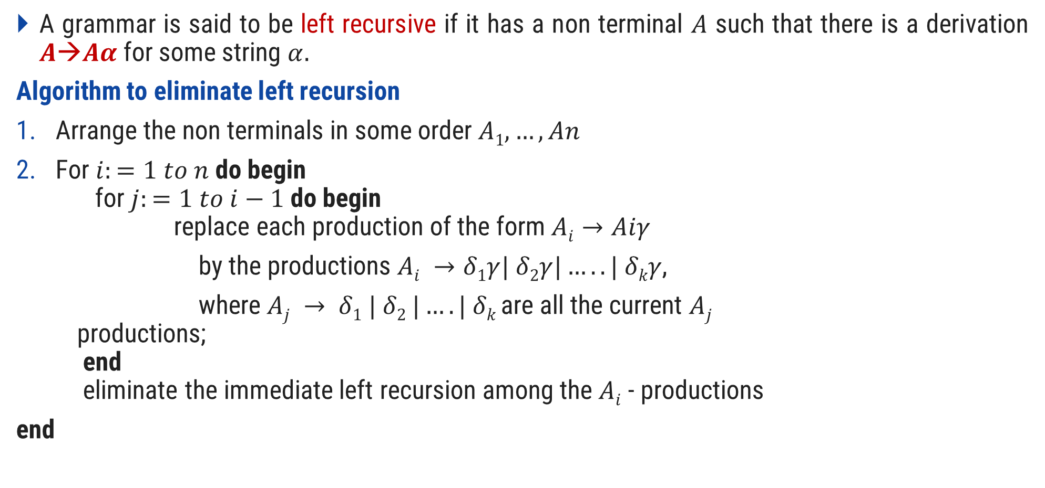
Left recursion
A grammar is said to be left recursive if it has a non terminal $A$ such that there is a derivation $A→Aα$for some string $α.$
Algorithm to eliminate left recursion
Arrange the non terminals in some order $A1,…,An$
For $i:=1 to n$ do begin for $j:=1 to i−1$ do begin replace each production of the form $Ai→Aiγ$
by the productions $Ai →δ1γ| δ2γ|…..| δkγ$,
where $Aj → δ1 | δ2 |….| δk$are all the current $Aj$ productions; end eliminate the immediate left recursion among the $Ai$ - productions
end

Slide 23


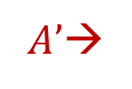






Left recursion elimination
$$A→Aα |$$
$A→$
$$β$$
$$A’$$
$$α$$
$$β$$
$|$𝜖
$A’$→
$$A’$$

Slide 24
Examples: Left recursion elimination
E→E+T | T
E→TE’
E’→+TE’ | ε
T→T*F | F
T→FT’
T’→*FT’ | ε
X→X%Y | Z
X→ZX’
X’→%YX’ | ε

Slide 25
Exercise: Left recursion
A→Abd | Aa | a
B→Be | b
A→AB | AC | a | b
S→A | B
A→ABC | Acd | a | aa
B→Bee | b
Exp→Exp+term | Exp-term | term

Slide 26
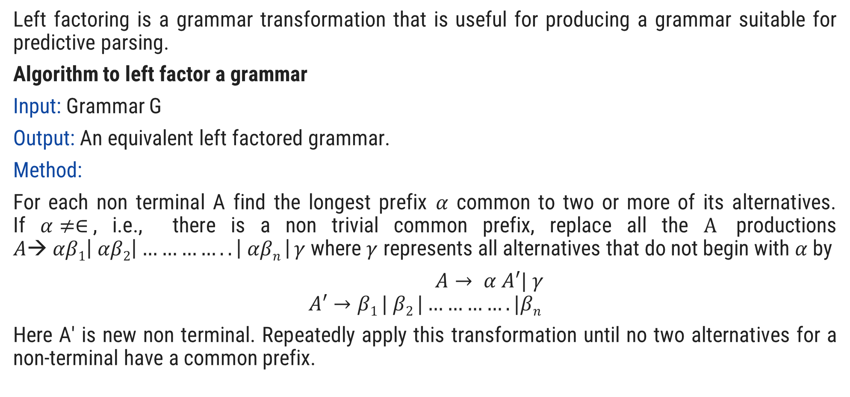
Left factoring
Left factoring is a grammar transformation that is useful for producing a grammar suitable for predictive parsing.
Algorithm to left factor a grammar
Input: Grammar G
Output: An equivalent left factored grammar.
Method:
For each non terminal A find the longest prefix $α$ common to two or more of its alternatives. If $α≠∈$, i.e., there is a non trivial common prefix, replace all the $A$ productions $A→ αβ1\left| αβ2\right|…………..\left| αβn \right| γ$where $γ$ represents all alternatives that do not begin with $α$ by
$A→ α A′| γ$
$$A′→β1 | β2 |………….|βn$$
Here A' is new non terminal. Repeatedly apply this transformation until no two alternatives for a non-terminal have a common prefix.

Slide 27










Left factoring elimination
$A→$
$A→$
$A^{′}$
$$α$$
$$α$$
$$α$$
$$β$$
$$α$$
$$β$$
|
δ
δ
$A^{′}→ |$

Slide 28
Example: Left factoring elimination
S→aAB | aCD
S→aS’
S’→AB | CD
A→ xByA | xByAzA | a
A→ xByAA’ | a
A’→ Є | zA
A→ aAB | aA |a
A→aA’
A’→AB | A | 𝜖
A’→AA’’ | 𝜖
A’’→B | 𝜖

Slide 29
Exercise
S→iEtS | iEtSeS | a
A→ ad | a | ab | abc | x

Slide 30
Parsing

Slide 31
Parsing
Parsing is a technique that takes input string and produces output either a parse tree if string is valid sentence of grammar, or an error message indicating that string is not a valid.
Types of parsing are:
Top down parsing: In top down parsing parser build parse tree from top to bottom.
Bottom up parsing: Bottom up parser starts from leaves and work up to the root.

Slide 32
Classification of parsing methods
Parsing
Top down parsing
Bottom up parsing (Shift reduce)
Back tracking
Operator precedence
Parsing without backtracking (predictive parsing)
LR parsing
SLR
LL(1)
CLR
Recursive
descent
LALR

Slide 33
Backtracking
In backtracking, expansion of nonterminal symbol we choose one alternative and if any mismatch occurs then we try another alternative.
Grammar: S→ cAd Input string: cad
A→ ab | a
S
S
S
c
A
d
c
A
d
c
A
d
Make prediction
Make prediction
a
b
Backtrack
a
Parsing done

Slide 34
Exercise
E→ 5+T | 3-T
T→ V | V*V | V+V
V→ a | b
String: 3-a+b

Slide 35
Parsing Methods
Parsing
Top down parsing
Bottom up parsing (Shift reduce)
Back tracking
Operator precedence
Parsing without backtracking (predictive parsing)
LR parsing
SLR
LL(1)
CLR
Recursive
descent
LALR

Slide 36
LL(1) parser (predictive parser)
LL(1) is non recursive top down parser.
First L indicates input is scanned from left to right.
The second L means it uses leftmost derivation for input string
1 means it uses only input symbol to predict the parsing process.
a | + | b | $
INPUT
X
Y
Z
$
Predictive parsing program
Stack
OUTPUT
Parsing table M

Slide 37
LL(1) parsing (predictive parsing)
Steps to construct LL(1) parser
Remove left recursion / Perform left factoring (if any).
Compute FIRST and FOLLOW of non terminals.
Construct predictive parsing table.
Parse the input string using parsing table.

Slide 38

Rules to compute first of non terminal
If $A→α$and $α$ is terminal, add $α$ to $FIRST(A)$.
If $A→ ∈$, add $∈$to $FIRST(A)$.
If $X$ is nonterminal and $X→Y1 Y2….Yk$is a production, then place $a$ in $FIRST(X)$ if for some $i$, a is in $FIRST(Yi)$, and 𝜖 is in all of $FIRST(Y1),………,FIRST(Y_{i−1} );$that is $Y1…Y_{i−1}⇒ε$. If 𝜖 is in $FIRST(Yj)$ for all $j=1,2,…..,k$then add 𝜖 to $FIRST(X)$.
Everything in $FIRST(Y1)$ is surely in $FIRST(X)$ If $Y1$ does not derive 𝜖, then we do nothing more to $FIRST(X)$, but if $Y1 ⇒ε$, then we add $FIRST(Y2)$ and so on.

Slide 39
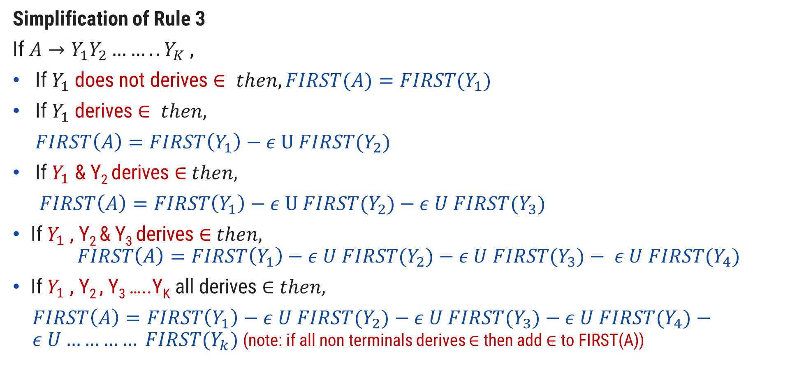
Rules to compute first of non terminal
Simplification of Rule 3
If $A→Y_{1}Y_{2}……..Y_{K}$ ,
If $Y_{1}$ does not derives $∈ then, FIRST(A)=FIRST{(Y}_{1})$
If $Y_{1}$ derives $∈ then,$
$FIRST\left(A\right)=FIRST\left(Y_{1}\right)−ε U FIRST{(Y}_{2})$
If $Y_{1}$ & Y₂ derives ∈$then,$
$FIRST\left(A\right)=FIRST\left(Y_{1}\right)−ε U FIRST{(Y}_{2})$ $− ε U FIRST{(Y}_{3})$
If $Y_{1}$ , Y₂ & Y₃ derives ∈$then,$
$$FIRST\left(A\right)=FIRST\left(Y_{1}\right)−ε U FIRST{(Y}_{2})−ε U FIRST{(Y}_{3})− ε U FIRST{(Y}_{4})$$
If $Y_{1}$ , Y₂ , Y₃ …..Y_{K} all derives ∈ $then,$
$FIRST\left(A\right)=FIRST\left(Y_{1}\right)−ε U FIRST{(Y}_{2})−ε U FIRST{(Y}_{3})−ε U FIRST{(Y}_{4})−ε U………… FIRST{(Y}_{k})$(note: if all non terminals derives ∈ then add ∈ to FIRST(A))

Slide 40

Rules to compute FOLLOW of non terminal
Place $\$ in follow\left(S\right). ($S is start symbol)
If $A→αBβ ,$then everything in $FIRST(β)$ except for 𝜖 is placed in $FOLLOW(B)$
If there is a production$A→αB$ or a production $A→αBβ$ where $FIRST(β)$ contains $ε$ then everything in $FOLLOW\left(A\right)=FOLLOW\left(B\right)$

Slide 41











How to apply rules to find FOLLOW of non terminal?
$$A→αBβ$$
$$β is absent$$
$$β is present$$
$$Rule 3$$
$$β is terminal$$
$$β is Nonterminal$$
$$Rule 2$$
$β does not derives$ 𝜖
$β derives$ 𝜖
$$Rule 2$$
$$Rule 2+Rule 3$$

Slide 42

Rules to construct predictive parsing table
For each production $A→α$ of the grammar, do steps 2 and 3.
For each terminal $a$ in $first(α)$, Add $A→α$ to $M[A,a]$.
If $ε$ is in $first(α)$, Add $A→α$ to $M[A,b]$ for each terminal $b$ in $FOLLOW(B)$. If $ε$ is in $first(α)$, and $\$$ is in $FOLLOW(A)$, add $A→α$ to $M[A,\$]$.
Make each undefined entry of M be error.

Slide 43




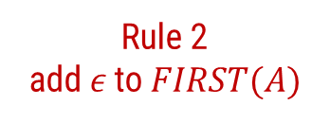

Example-1: LL(1) parsing
S→aBa
B→bB | ϵ
Step 1: Not required
Step 2: Compute FIRST
First(S)
S→aBa
First(B)
B→bB B→𝜖
NT | First
S | { a }
B | {b,𝜖}
S | → | a | B | a
Rule 1
add $α$ to $FIRST(A)$
A | → | $$α$$
FIRST(S)={ a }
B | → | b | B
B | → | 𝜖
Rule 1
add $α$ to $FIRST(A)$
A | → | $$α$$
A | → | $$ε$$
Rule 2
add $ε$ to $FIRST(A)$
FIRST(B)={ b
, 𝜖 }

Slide 44


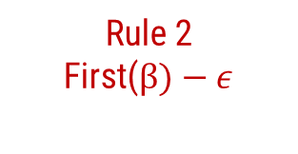
Example-1: LL(1) parsing
S→aBa
B→bB | ϵ
Step 2: Compute FOLLOW
Follow(S)
Follow(B)
S→aBa B→bB
NT | First | Follow
S | {a} | {$}
B | {b,𝜖} | {a}
Rule 1: Place $ in FOLLOW(S)
Follow(S)={ $ }
S | → | a | B | a
B | → | b | B
Rule 3
Follow(A)=follow(B)
A | → | $$α$$ | B | $$β$$
Rule 2
First($β)−ε$
A | → | $$α$$ | B
Follow(B)={ a
}

Slide 45

Example-1: LL(1) parsing
S→aBa
B→bB | ϵ
Step 3: Prepare predictive parsing table
S→aBa
a=FIRST(aBa)={ a }
M[S,a]=S→aBa
NT | First | Follow
S | {a} | {$}
B | {b,𝜖} | {a}
NT | Input Symbol
 | a | b | $
S | S→aBa
B
Rule: 2
A→ $α$
a = first($α$)
M[A,a] = A→ $α$

Slide 46
Example-1: LL(1) parsing
S→aBa
B→bB | ϵ
Step 3: Prepare predictive parsing table
B→bB
a=FIRST(bB)={ b }
M[B,b]=B→bB
NT | First | Follow
S | {a} | {$}
B | {b,𝜖} | {a}
NT | Input Symbol
 | a | b | $
S | S→aBa
B |  | B→bB
Rule: 2
A→ $α$
a = first($α$)
M[A,a] = A→ $α$

Slide 47

Example-1: LL(1) parsing
S→aBa
B→bB | ϵ
Step 3: Prepare predictive parsing table
B→ϵ
b=FOLLOW(B)={ a }
M[B,a]=B→𝜖
NT | First | Follow
S | {a} | {$}
B | {b,𝜖} | {a}
NT | Input Symbol
 | a | b | $
S | S→aBa | Error | Error
B | B→ϵ | B→bB | Error
Rule: 3
A→ $α$
b = follow(A)
M[A,b] = A→ $α$

Slide 48




Example-2: LL(1) parsing
Step 1: Not required
Step 2: Compute FIRST
First(S)
S→aB S→𝜖
S→aB | ϵ
B→bC | ϵ
C→cS | ϵ
NT | First
S | { a, 𝜖 }
B | {b,𝜖}
C | {c,𝜖}
S | → | a | B
S | → | 𝜖
Rule 1
add $α$ to $FIRST(A)$
Rule 2
add $ε$ to $FIRST(A)$
A | → | $$α$$
A | → | $$ε$$
FIRST(S)={ a
, 𝜖 }

Slide 49
Example-2: LL(1) parsing
Step 1: Not required
Step 2: Compute FIRST
First(B)
B→bC B→𝜖
S→aB | ϵ
B→bC | ϵ
C→cS | ϵ
NT | First
S | { a, 𝜖 }
B | {b,𝜖}
C | {c,𝜖}
B | → | b | C
B | → | 𝜖
Rule 1
add $α$ to $FIRST(A)$
Rule 2
add $ε$ to $FIRST(A)$
A | → | $$α$$
A | → | $$ε$$
FIRST(B)={ b
, 𝜖 }

Slide 50
Example-2: LL(1) parsing
Step 1: Not required
Step 2: Compute FIRST
First(C)
C→cS C→𝜖
S→aB | ϵ
B→bC | ϵ
C→cS | ϵ
NT | First
S | { a, 𝜖 }
B | {b,𝜖}
C | {c,𝜖}
C | → | c | S
C | → | 𝜖
Rule 1
add $α$ to $FIRST(A)$
Rule 2
add $ε$ to $FIRST(A)$
A | → | $$α$$
A | → | $$ε$$
FIRST(B)={ c
, 𝜖 }

Slide 51



Example-2: LL(1) parsing
Step 2: Compute FOLLOW
Follow(S)
C→cS
B→bC S→aB
Rule 1: Place $ in FOLLOW(S)
Follow(S)={ $ }
S→aB | ϵ
B→bC | ϵ
C→cS | ϵ
C | → | c | S
Rule 3
Follow(A)=follow(B)
A | → | $$α$$ | B
Follow(S)=Follow(C)
={$}
NT | First | Follow
S | {a,𝜖} | {$}
B | {b,𝜖} | {$}
C | {c,𝜖} | {$}
B | → | b | C
Rule 3
Follow(A)=follow(B)
S | → | a | B
Rule 3
Follow(A)=follow(B)
A | → | $$α$$ | B
A | → | $$α$$ | B
Follow(C)=Follow(B)
={$}
Follow(B)=Follow(S)
={$}

Slide 52

Example-2: LL(1) parsing
Step 3: Prepare predictive parsing table
S→aB
a=FIRST(aB)={ a }
M[S,a]=S→aB
S→aB | ϵ
B→bC | ϵ
C→cS | ϵ
NT | First | Follow
S | {a,𝜖} | {$}
B | {b,𝜖} | {$}
C | {c,𝜖} | {$}
NT | Input Symbol
 | a | b | c | $
S | S→aB
B
C
Rule: 2
A→ $α$
a = first($α$)
M[A,a] = A→ $α$

Slide 53

Example-2: LL(1) parsing
Step 3: Prepare predictive parsing table
S→𝜖
b=FOLLOW(S)={ $ }
M[S,$]=S→𝜖
S→aB | ϵ
B→bC | ϵ
C→cS | ϵ
NT | First | Follow
S | {a} | {$}
B | {b,𝜖} | {$}
C | {c,𝜖} | {$}
NT | Input Symbol
 | a | b | c | $
S | S→aB |  |  | S→𝜖
B
C
Rule: 3
A→ $α$
b = follow(A)
M[A,b] = A→ $α$

Slide 54
Example-2: LL(1) parsing
Step 3: Prepare predictive parsing table
B→bC
a=FIRST(bC)={ b }
M[B,b]=B→bC
S→aB | ϵ
B→bC | ϵ
C→cS | ϵ
NT | First | Follow
S | {a} | {$}
B | {b,𝜖} | {$}
C | {c,𝜖} | {$}
NT | Input Symbol
 | a | b | c | $
S | S→aB |  |  | S→𝜖
B |  | B→bC
C
Rule: 2
A→ $α$
a = first($α$)
M[A,a] = A→ $α$

Slide 55
Example-2: LL(1) parsing
Step 3: Prepare predictive parsing table
B→𝜖
b=FOLLOW(B)={ $ }
M[B,$]=B→𝜖
S→aB | ϵ
B→bC | ϵ
C→cS | ϵ
NT | First | Follow
S | {a} | {$}
B | {b,𝜖} | {$}
C | {c,𝜖} | {$}
NT | Input Symbol
 | a | b | c | $
S | S→aB |  |  | S→𝜖
B |  | B→bC |  | B→𝜖
C
Rule: 3
A→ $α$
b = follow(A)
M[A,b] = A→ $α$

Slide 56
Example-2: LL(1) parsing
Step 3: Prepare predictive parsing table
C→cS
a=FIRST(cS)={ c }
M[C,c]=C→cS
S→aB | ϵ
B→bC | ϵ
C→cS | ϵ
NT | First | Follow
S | {a} | {$}
B | {b,𝜖} | {$}
C | {c,𝜖} | {$}
NT | Input Symbol
 | a | b | c | $
S | S→aB |  |  | S→𝜖
B |  | B→bC |  | B→𝜖
C |  |  | C→cS
Rule: 2
A→ $α$
a = first($α$)
M[A,a] = A→ $α$

Slide 57
Example-2: LL(1) parsing
Step 3: Prepare predictive parsing table
C→𝜖
b=FOLLOW(C)={ $ }
M[C,$]=C→𝜖
S→aB | ϵ
B→bC | ϵ
C→cS | ϵ
NT | First | Follow
S | {a} | {$}
B | {b,𝜖} | {$}
C | {c,𝜖} | {$}
NT | Input Symbol
 | a | b | c | $
S | S→aB | Error | Error | S→𝜖
B | Error | B→bB | Error | B→𝜖
C | Error | Error | C→cS | C→𝜖
Rule: 3
A→ $α$
b = follow(A)
M[A,b] = A→ $α$

Slide 58
Example-3: LL(1) parsing
E→E+T | T
T→T*F | F
F→(E) | id
Step 1: Remove left recursion
E→TE’
E’→+TE’ | ϵ
T→FT’
T’→*FT’ | ϵ
F→(E) | id

Slide 59




Example-3: LL(1) parsing
Step 2: Compute FIRST
First(E)
E→TE’
First(T)
T→FT’
First(F)
F→(E) F→id
E→TE’
E’→+TE’ | ϵ
T→FT’
T’→*FT’ | ϵ
F→(E) | id
E | → | T | E’
Rule 3
First(A)=First(Y1)
A | → | Y₁ | Y₂
FIRST(E)=FIRST(T)
= {(, id }
NT | First
E | { (,id }
T | → | F | T’
Rule 3
First(A)=First(Y1)
E’
A | → | Y₁ | Y₂
T | { (,id }
FIRST(T)=FIRST(F)
= {(, id }
T’
F | { (,id }
F | → | ( | E | )
F | → | id
A | → | $$α$$
Rule 1
add $α$ to $FIRST(A)$
A | → | $$α$$
Rule 1
add $α$ to $FIRST(A)$
FIRST(F)={ (
, id }

Slide 60





Example-3: LL(1) parsing
Step 2: Compute FIRST
First(E’)
E’→+TE’
E’→𝜖
E→TE’
E’→+TE’ | ϵ
T→FT’
T’→*FT’ | ϵ
F→(E) | id
E’ | → | + | T | E’
Rule 1
add $α$ to $FIRST(A)$
A | → | $$α$$
NT | First
E | { (,id }
E’ | { +, 𝜖 }
T | { (,id }
T’
E’ | → | $$ε$$
Rule 2
add $ε$ to $FIRST(A)$
F | { (,id }
A | → | $$ε$$
FIRST(E’)={ +
, 𝜖 }

Slide 61

Example-3: LL(1) parsing
Step 2: Compute FIRST
First(T’)
T’→*FT’
T’→𝜖
E→TE’
E’→+TE’ | ϵ
T→FT’
T’→*FT’ | ϵ
F→(E) | id
T’ | → | * | F | T’
Rule 1
add $α$ to $FIRST(A)$
A | → | $$α$$
NT | First
E | { (,id }
E’ | { +, 𝜖 }
T | { (,id }
T’ | { *, 𝜖 }
T’ | → | $$ε$$
Rule 2
add $ε$ to $FIRST(A)$
F | { (,id }
A | → | $$ε$$
FIRST(T’)={ *
, 𝜖 }

Slide 62

Example-3: LL(1) parsing
Step 2: Compute FOLLOW
FOLLOW(E)
F→(E)
E→TE’
E’→+TE’ | ϵ
T→FT’
T’→*FT’ | ϵ
F→(E) | id
Rule 1: Place $ in FOLLOW(E)
NT | First | Follow
E | { (,id } | { $,) }
E’ | { +, 𝜖 }
F | → | ( | E | )
Rule 2
T | { (,id }
A | → | $$α$$ | B | $$β$$
T’ | { *, 𝜖 }
F | { (,id }
FOLLOW(E)={ $,
) }

Slide 63


Example-3: LL(1) parsing
E→TE’
E’→+TE’ | ϵ
T→FT’
T’→*FT’ | ϵ
F→(E) | id
Step 2: Compute FOLLOW
FOLLOW(E’)
E→TE’
E’→+TE’
NT | First | Follow
E | → | T | E’
Rule 3
E | { (,id } | { $,) }
A | → | $$α$$ | B
E’ | { +, 𝜖 } | { $,) }
T | { (,id }
T’ | { *, 𝜖 }
F | { (,id }
E’ | → | +T | E’
Rule 3
A | → | $$α$$ | B
}
FOLLOW(E’)={ $,)

Slide 64


Example-3: LL(1) parsing
Step 2: Compute FOLLOW
FOLLOW(T)
E→TE’
E→TE’
E’→+TE’ | ϵ
T→FT’
T’→*FT’ | ϵ
F→(E) | id
NT | First | Follow
E | → |  | T | E’
Rule 2
E | { (,id } | { $,) }
A | → | $$α$$ | B | $$β$$
E’ | { +, 𝜖 } | { $,) }
T | { (,id }
T’ | { *, 𝜖 }
F | { (,id }
E | → |  | T | E’
Rule 3
A | → | $$α$$ | B | $$β$$
FOLLOW(T)={ +,
$, )

Slide 65


Example-3: LL(1) parsing
Step 2: Compute FOLLOW
FOLLOW(T)
E’→+TE’
E→TE’
E’→+TE’ | ϵ
T→FT’
T’→*FT’ | ϵ
F→(E) | id
NT | First | Follow
E’ | → | + | T | E’
Rule 2
E | { (,id } | { $,) }
A | → | $$α$$ | B | $$β$$
E’ | { +, 𝜖 } | { $,) }
T | { (,id } | { +,$,) }
T’ | { *, 𝜖 }
F | { (,id }
E’ | → | + | T | E’
Rule 3
A | → | $$α$$ | B | $$β$$
}
FOLLOW(T)={ +,
$, )

Slide 66


Example-3: LL(1) parsing
Step 2: Compute FOLLOW
FOLLOW(T’)
T→FT’
T’→*FT’
E→TE’
E’→+TE’ | ϵ
T→FT’
T’→*FT’ | ϵ
F→(E) | id
NT | First | Follow
T | → | F | T’
Rule 3
E | { (,id } | { $,) }
A | → | $$α$$ | B
E’ | { +, 𝜖 } | { $,) }
T | { (,id } | { +,$,) }
T’ | { *, 𝜖 } | { +,$,) }
F | { (,id }
T’ | → | *F | T’
Rule 3
A | → | $$α$$ | B
}
FOLLOW(T’)={+ $,)

Slide 67

Example-3: LL(1) parsing
Step 2: Compute FOLLOW
FOLLOW(F)
T→FT’
E→TE’
E’→+TE’ | ϵ
T→FT’
T’→*FT’ | ϵ
F→(E) | id
NT | First | Follow
T | → |  | F | T’
Rule 2
E | { (,id } | { $,) }
A | → | $$α$$ | B | $$β$$
E’ | { +, 𝜖 } | { $,) }
T | { (,id } | { +,$,) }
T’ | { *, 𝜖 } | { +,$,) }
F | { (,id }
T | → |  | F | T’
Rule 3
A | → | $$α$$ | B | $$β$$
FOLLOW(F)={ *,
+ ,$ , )

Slide 68
Example-3: LL(1) parsing
Step 2: Compute FOLLOW
FOLLOW(F)
T’→*FT’
E→TE’
E’→+TE’ | ϵ
T→FT’
T’→*FT’ | ϵ
F→(E) | id
NT | First | Follow
T’ | → | * | F | T’
Rule 2
E | { (,id } | { $,) }
A | → | $$α$$ | B | $$β$$
E’ | { +, 𝜖 } | { $,) }
T | { (,id } | { +,$,) }
T’ | { *, 𝜖 } | { +,$,) }
F | { (,id } | {*,+,$,)}
T’ | → | * | F | T’
Rule 3
A | → | $$α$$ | B | $$β$$
}
FOLLOW(F)={ *,+,
$, )

Slide 69
Example-3: LL(1) parsing
Step 3: Construct predictive parsing table
E→TE’
a=FIRST(TE’)={ (,id }
M[E,(]=E→TE’
M[E,id]=E→TE’
E→TE’
E’→+TE’ | ϵ
T→FT’
T’→*FT’ | ϵ
F→(E) | id
NT | Input Symbol
 | id | + | * | ( | ) | $
E | E→TE’ |  |  | E→TE’
E’
T
T’
F
NT | First | Follow
E | { (,id } | { $,) }
E’ | { +, 𝜖 } | { $,) }
T | { (,id } | { +,$,) }
T’ | { *, 𝜖 } | { +,$,) }
Rule: 2
A→ $α$
a = first($α$)
M[A,a] = A→ $α$
F | { (,id } | {*,+,$,)}

Slide 70
Example-3: LL(1) parsing
Step 3: Construct predictive parsing table
E’→+TE’
a=FIRST(+TE’)={ + }
M[E’,+]=E’→+TE’
E→TE’
E’→+TE’ | ϵ
T→FT’
T’→*FT’ | ϵ
F→(E) | id
NT | Input Symbol
 | id | + | * | ( | ) | $
E | E→TE’ |  |  | E→TE’
E’ |  | E’→+TE’
T
T’
F
NT | First | Follow
E | { (,id } | { $,) }
E’ | { +, 𝜖 } | { $,) }
T | { (,id } | { +,$,) }
T’ | { *, 𝜖 } | { +,$,) }
Rule: 2
A→ $α$
a = first($α$)
M[A,a] = A→ $α$
F | { (,id } | {*,+,$,)}

Slide 71
Example-3: LL(1) parsing
Step 3: Construct predictive parsing table
E’→𝜖
b=FOLLOW(E’)={ $,) }
M[E’,$]=E’→𝜖
M[E’,)]=E’→𝜖
E→TE’
E’→+TE’ | ϵ
T→FT’
T’→*FT’ | ϵ
F→(E) | id
NT | Input Symbol
 | id | + | * | ( | ) | $
E | E→TE’ |  |  | E→TE’
E’ |  | E’→+TE’ |  |  | E’→𝜖 | E’→𝜖
T
T’
F
NT | First | Follow
E | { (,id } | { $,) }
E’ | { +, 𝜖 } | { $,) }
T | { (,id } | { +,$,) }
T’ | { *, 𝜖 } | { +,$,) }
Rule: 3
A→ $α$
b = follow(A)
M[A,b] = A→ $α$
F | { (,id } | {*,+,$,)}

Slide 72
Example-3: LL(1) parsing
Step 3: Construct predictive parsing table
T→FT’
a=FIRST(FT’)={ (,id }
M[T,(]=T→FT’
M[T,id]=T→FT’
E→TE’
E’→+TE’ | ϵ
T→FT’
T’→*FT’ | ϵ
F→(E) | id
NT | Input Symbol
 | id | + | * | ( | ) | $
E | E→TE’ |  |  | E→TE’
E’ |  | E’→+TE’ |  |  | E’→𝜖 | E’→𝜖
T | T→FT’ |  |  | T→FT’
T’
F
NT | First | Follow
E | { (,id } | { $,) }
E’ | { +, 𝜖 } | { $,) }
T | { (,id } | { +,$,) }
T’ | { *, 𝜖 } | { +,$,) }
Rule: 2
A→ $α$
a = first($α$)
M[A,a] = A→ $α$
F | { (,id } | {*,+,$,)}

Slide 73
Example-3: LL(1) parsing
Step 3: Construct predictive parsing table
T’→*FT’
a=FIRST(*FT’)={ * }
M[T’,*]=T’→*FT’
E→TE’
E’→+TE’ | ϵ
T→FT’
T’→*FT’ | ϵ
F→(E) | id
NT | Input Symbol
 | id | + | * | ( | ) | $
E | E→TE’ |  |  | E→TE’
E’ |  | E’→+TE’ |  |  | E’→𝜖 | E’→𝜖
T | T→FT’ |  |  | T→FT’
T’ |  |  | T’→*FT’
F
NT | First | Follow
E | { (,id } | { $,) }
E’ | { +, 𝜖 } | { $,) }
T | { (,id } | { +,$,) }
T’ | { *, 𝜖 } | { +,$,) }
Rule: 2
A→ $α$
a = first($α$)
M[A,a] = A→ $α$
F | { (,id } | {*,+,$,)}

Slide 74
Example-3: LL(1) parsing
Step 3: Construct predictive parsing table
T’→𝜖
b=FOLLOW(T’)={ +,$,) }
M[T’,+]=T’→𝜖
M[T’,$]=T’→𝜖
M[T’,)]=T’→𝜖
E→TE’
E’→+TE’ | ϵ
T→FT’
T’→*FT’ | ϵ
F→(E) | id
NT | Input Symbol
 | id | + | * | ( | ) | $
E | E→TE’ |  |  | E→TE’
E’ |  | E’→+TE’ |  |  | E’→𝜖 | E’→𝜖
T | T→FT’ |  |  | T→FT’
T’ |  | T’→𝜖 | T’→*FT’ |  | T’→𝜖 | T’→𝜖
F
NT | First | Follow
E | { (,id } | { $,) }
E’ | { +, 𝜖 } | { $,) }
T | { (,id } | { +,$,) }
T’ | { *, 𝜖 } | { +,$,) }
Rule: 3
A→ $α$
b = follow(A)
M[A,b] = A→ $α$
F | { (,id } | {*,+,$,)}

Slide 75
Example-3: LL(1) parsing
Step 3: Construct predictive parsing table
F→(E)
a=FIRST((E))={ ( }
M[F,(]=F→(E)
E→TE’
E’→+TE’ | ϵ
T→FT’
T’→*FT’ | ϵ
F→(E) | id
NT | Input Symbol
 | id | + | * | ( | ) | $
E | E→TE’ |  |  | E→TE’
E’ |  | E’→+TE’ |  |  | E’→𝜖 | E’→𝜖
T | T→FT’ |  |  | T→FT’
T’ |  | T’→𝜖 | T’→*FT’ |  | T’→𝜖 | T’→𝜖
F |  |  |  | F→(E)
NT | First | Follow
E | { (,id } | { $,) }
E’ | { +, 𝜖 } | { $,) }
T | { (,id } | { +,$,) }
T’ | { *, 𝜖 } | { +,$,) }
Rule: 2
A→ $α$
a = first($α$)
M[A,a] = A→ $α$
F | { (,id } | {*,+,$,)}

Slide 76
Example-3: LL(1) parsing
Step 3: Construct predictive parsing table
F→id
a=FIRST(id)={ id }
M[F,id]=F→id
E→TE’
E’→+TE’ | ϵ
T→FT’
T’→*FT’ | ϵ
F→(E) | id
NT | Input Symbol
 | id | + | * | ( | ) | $
E | E→TE’ |  |  | E→TE’
E’ |  | E’→+TE’ |  |  | E’→𝜖 | E’→𝜖
T | T→FT’ |  |  | T→FT’
T’ |  | T’→𝜖 | T’→*FT’ |  | T’→𝜖 | T’→𝜖
F | F→id |  |  | F→(E)
NT | First | Follow
E | { (,id } | { $,) }
E’ | { +, 𝜖 } | { $,) }
T | { (,id } | { +,$,) }
T’ | { *, 𝜖 } | { +,$,) }
Rule: 2
A→ $α$
a = first($α$)
M[A,a] = A→ $α$
F | { (,id } | {*,+,$,)}

Slide 77
Example-3: LL(1) parsing
Step 4: Make each undefined entry of table be Error
NT | Input Symbol
 | id | + | * | ( | ) | $
E | E→TE’ | Error | Error | E→TE’ | Error | Error
E’ | Error | E’→+TE’ | Error | Error | E’→𝜖 | E’→𝜖
T | T→FT’ | Error | Error | T→FT’ | Error | Error
T’ | Error | T’→𝜖 | T’→*FT’ | Error | T’→𝜖 | T’→𝜖
F | F→id | Error | Error | F→(E) | Error | Error

Slide 78
Example-3: LL(1) parsing
Step 4: Parse the string : id + id * id $
NT | Input Symbol
 | id | + | * | ( | ) | $
E | E→TE’ | Error | Error | E→TE’ | Error | Error
E’ | Error | E’→+TE’ | Error | Error | E’→𝜖 | E’→𝜖
T | T→FT’ | Error | Error | T→FT’ | Error | Error
T’ | Error | T’→𝜖 | T’→*FT’ | Error | T’→𝜖 | T’→𝜖
F | F→id | Error | Error | F→(E) | Error | Error
STACK | INPUT | OUTPUT
E$ | id+id*id$
TE’$ | id+id*id$ | E→TE’
FT’E’$ | id+id*id$ | T→FT’
idT’E’$ | id+id*id$ | F→id
T’E’$ | +id*id$
E’$ | +id*id$ | T’→𝜖
+TE’$ | +id*id$ | E’→+TE’
TE’$ | id*id$
FT’E’$ | id$
FT’E’$ | id*id$ | T→FT’
idT’E’$ | id$ | F→id
idT’E’$ | id*id$ | F→id
T’E’$ | $
T’E’$ | *id$
E’$ | $ | T’→𝜖
*FT’E’$ | *id$ | T→*FT’
$ | $ | E’→𝜖

Slide 79
Parsing methods
Parsing
Top down parsing
Bottom up parsing (Shift reduce)
Back tracking
Operator precedence
Parsing without backtracking (predictive parsing)
LR parsing
SLR
LL(1)
CLR
Recursive
descent
LALR

Slide 80
Recursive descent parsing
A top down parsing that executes a set of recursive procedure to process the input without backtracking is called recursive descent parser.
There is a procedure for each non terminal in the grammar.
Consider RHS of any production rule as definition of the procedure.
As it reads expected input symbol, it advances input pointer to next position.

Slide 81
Example: Recursive descent parsing
Procedure E
{
If lookahead=num
{
Match(num);
T();
}
Else
Error();
If lookahead=$
{
Declare success;
}
Else
Error();
}
Procedure T
{
If lookahead=’*’
{
Match(‘*’);
If lookahead=num
{
Match(num);
T();
}
Else
Error();
}
Else
NULL
}
Proceduce Match(token t)
{
If lookahead=t
lookahead=next_token;
Else
Error();
}
Procedure Error
{
Print(“Error”);
}
E→
T→
num
T
num
| 𝜖
*
T
3 | * | 4 | $
Success

Slide 82
Example: Recursive descent parsing
Procedure E
{
If lookahead=num
{
Match(num);
T();
}
Else
Error();
If lookahead=$
{
Declare success;
}
Else
Error();
}
Procedure T
{
If lookahead=’*’
{
Match(‘*’);
If lookahead=num
{
Match(num);
T();
}
Else
Error();
}
Else
NULL
}
Proceduce Match(token t)
{
If lookahead=t
lookahead=next_token;
Else
Error();
}
Procedure Error
{
Print(“Error”);
}
E→
T→
num
T
num
| 𝜖
*
T
3 | * | 4 | $
Success
3 | 4 | * | $
Error

Slide 83
Parsing Methods
Parsing
Top down parsing
Bottom up parsing (Shift reduce)
Back tracking
Operator precedence
Parsing without backtracking (predictive Parsing)
LR parsing
SLR
LL(1)
CLR
Recursive
descent
LALR

Slide 84
Handle & Handle pruning
Handle: A “handle” of a string is a substring of the string that matches the right side of a production, and whose reduction to the non terminal of the production is one step along the reverse of rightmost derivation.
Handle pruning: The process of discovering a handle and reducing it to appropriate left hand side non terminal is known as handle pruning.
E→E+E
E→E*E
E→id
String: id1+id2*id3
Right sentential form | Handle | Production
Rightmost Derivation
E
E+E
E+E*E
E+E*id3
E+id2*id3
id1+id2*id3
id1+id2*id3 | id1 | E→id
E+id2*id3 | id2 | E→id
E+E*id3 | id3 | E→id
E+E*E | E*E | E→E*E
E+E | E+E | E→E+E
E

Slide 85
Shift reduce parser
The shift reduce parser performs following basic operations:
Shift: Moving of the symbols from input buffer onto the stack, this action is called shift.
Reduce: If handle appears on the top of the stack then reduction of it by appropriate rule is done. This action is called reduce action.
Accept: If stack contains start symbol only and input buffer is empty at the same time then that action is called accept.
Error: A situation in which parser cannot either shift or reduce the symbols, it cannot even perform accept action then it is called error action.

Slide 86
Example: Shift reduce parser
Grammar:
E→E+T | T
T→T*F | F
F→id
String: id+id*id
Stack | Input Buffer | Action
$ | id+id*id$ | Shift
$id | +id*id$ | Reduce F→id
$F | +id*id$ | Reduce T→F
$T | +id*id$ | Reduce E→T
$E | +id*id$ | Shift
$E+ | id*id$ | Shift
$E+id | *id$ | Reduce F→id
$E+F | *id$ | Reduce T→F
$E+T | *id$ | Shift
$E+T* | id$ | Shift
$E+T*id | $ | Reduce F→id
$E+T*F | $ | Reduce T→T*F
$E+T | $ | Reduce E→E+T
$E | $ | Accept

Slide 87
Viable Prefix
The set of prefixes of right sentential forms that can appear on the stack of a shift-reduce parser are called viable prefixes.

Slide 88
Parsing Methods
Parsing
Top down parsing
Bottom up parsing (Shift reduce)
Back tracking
Operator precedence
Parsing without backtracking (predictive Parsing)
LR parsing
SLR
LL(1)
CLR
Recursive
descent
LALR

Slide 89
Operator precedence parsing
Operator Grammar: A Grammar in which there is no Є in RHS of any production or no adjacent non terminals is called operator grammar.
Example: E→ EAE | (E) | id
A→ + | * | -
Above grammar is not operator grammar because right side EAE has consecutive non terminals.
In operator precedence parsing we define following disjoint relations:
Relation | Meaning
a<.b | a “yields precedence to” b
a=b | a “has the same precedence as” b
a.>b | a “takes precedence over” b

Slide 90
Precedence & associativity of operators
Operator | Precedence | Associative
↑ | 1 | right
*, / | 2 | left
+, - | 3 | left

Slide 91
Steps of operator precedence parsing
Find Leading and trailing of non terminal
Establish relation
Creation of table
Parse the string

Slide 92
Leading & Trailing
Leading:- Leading of a non terminal is the first terminal or operator in production of that non terminal.
Trailing:- Trailing of a non terminal is the last terminal or operator in production of that non terminal.
Example: E→E+T | T
T→T*F | F
F→id
Non terminal | Leading | Trailing
E | {+,*,id} | {+,*,id}
T | {*,id} | {*,id}
F | {id} | {id}

Slide 93

Rules to establish a relation
For a = b, $⇒ aAb$, where $A$ is $ε$ or a single non terminal [e.g : (E)]
a <.b$⇒Op .NT then Op <. Leading\left(NT\right)$ [e.g : +T]
a .>b$⇒NT . Op then \left(Trailing(NT\right)) .>Op$ [e.g : E+]
$ <. Leading (start symbol)
Trailing (start symbol) .> $

Slide 94

Example: Operator precedence parsing
a <.b
$Op .NT Op <. Leading\left(NT\right)$
$+T + <. \left\{∗,id\right\}$
$∗F ∗ <. \{id\}$
Step 1: Find Leading & Trailing of NT
E→ E
+T
| T
Nonterminal | Leading | Trailing
T→ T
| F
*F
E | {+,*,id} | {+,*,id}
F→ id
T | {*,id} | {*,id}
F | {id} | {id}
Step 2: Establish Relation
Step3: Creation of Table
 | + | * | id | $
+ | .> | <. | <. | .>
* | .> | .> | <. | .>
id | .> | .> |  | .>
$ | <. | <. | <.

Slide 95

Example: Operator precedence parsing
a .>b
$NT . Op \left(Trailing(NT\right)).>Op$
$E+ \left\{+,∗,id\right\}.> +$
$T∗ \{∗,id\}.>∗$
Step 1: Find Leading & Trailing of NT
E→
E+
T| T
Nonterminal | Leading | Trailing
T→
F| F
T*
E | {+,*,id} | {+,*,id}
F→ id
T | {*,id} | {*,id}
F | {id} | {id}
Step2: Establish Relation
Step3: Creation of Table
 | + | * | id | $
+ | .> | <. | <. | .>
* | .> | .> | <. | .>
id | .> | .> |  | .>
$ | <. | <. | <.

Slide 96
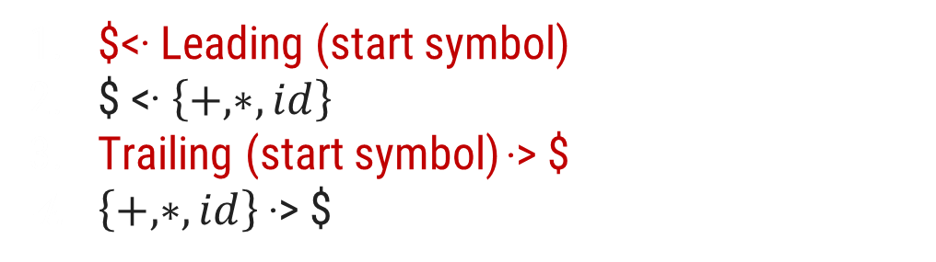
Example: Operator precedence parsing
Step 1: Find Leading & Trailing of NT
E→
E+
T| T
Nonterminal | Leading | Trailing
T→
F| F
T*
E | {+,*,id} | {+,*,id}
F→ id
T | {*,id} | {*,id}
F | {id} | {id}
Step 3: Creation of Table
Step 2: Establish Relation
 | + | * | id | $
$<. Leading (start symbol)
$ <. $\left\{+,∗,id\right\}$
Trailing (start symbol) .> $
$\left\{+,∗,id\right\} \text{.}\text{> \$}$
+ | .> | <. | <. | .>
* | .> | .> | <. | .>
id | .> | .> |  | .>
$ | <. | <. | <.

Slide 97
Example: Operator precedence parsing
Assign precedence operator between terminals
String: id+id*id
$ id+id*id $
$ <. id+id*id$
$ <. id .> +id*id$
$ <. id .> + <. id*id$
$ <. id .> + <. id .> *id$
$ <. id .> + <. id .> *<. id$
$ <. id .> + <. id .> *<. id .> $
Step 4: Parse the string using precedence table
 | + | * | id | $
+ | .> | <. | <. | .>
* | .> | .> | <. | .>
id | .> | .> |  | .>
$ | <. | <. | <.

Slide 98
Example: Operator precedence parsing
Step 4: Parse the string using precedence table
Scan the input string until first .> is encountered.
Scan backward until <. is encountered.
The handle is string between <. and .>
$ <. Id .> + <. Id .> * <. Id .> $ | Handle id is obtained between <. and .> Reduce this by F→id
$ F + <. Id .> * <. Id .> $ | Handle id is obtained between <. and .> Reduce this by F→id
$ F + F * <. Id .> $ | Handle id is obtained between <. and .> Reduce this by F→id
$ F + F * F $ | Perform appropriate reductions of all nonterminals.
$ E + T * F $ | Remove all non terminals.
$ + * $ | Place relation between operators
$ <. + <. * >$ | The * operator is surrounded by <. and .>. This indicates * becomes handle so reduce by T→T*F.
$ <. + >$ | + becomes handle. Hence reduce by E→E+T.
$ $ | Parsing Done

Slide 99
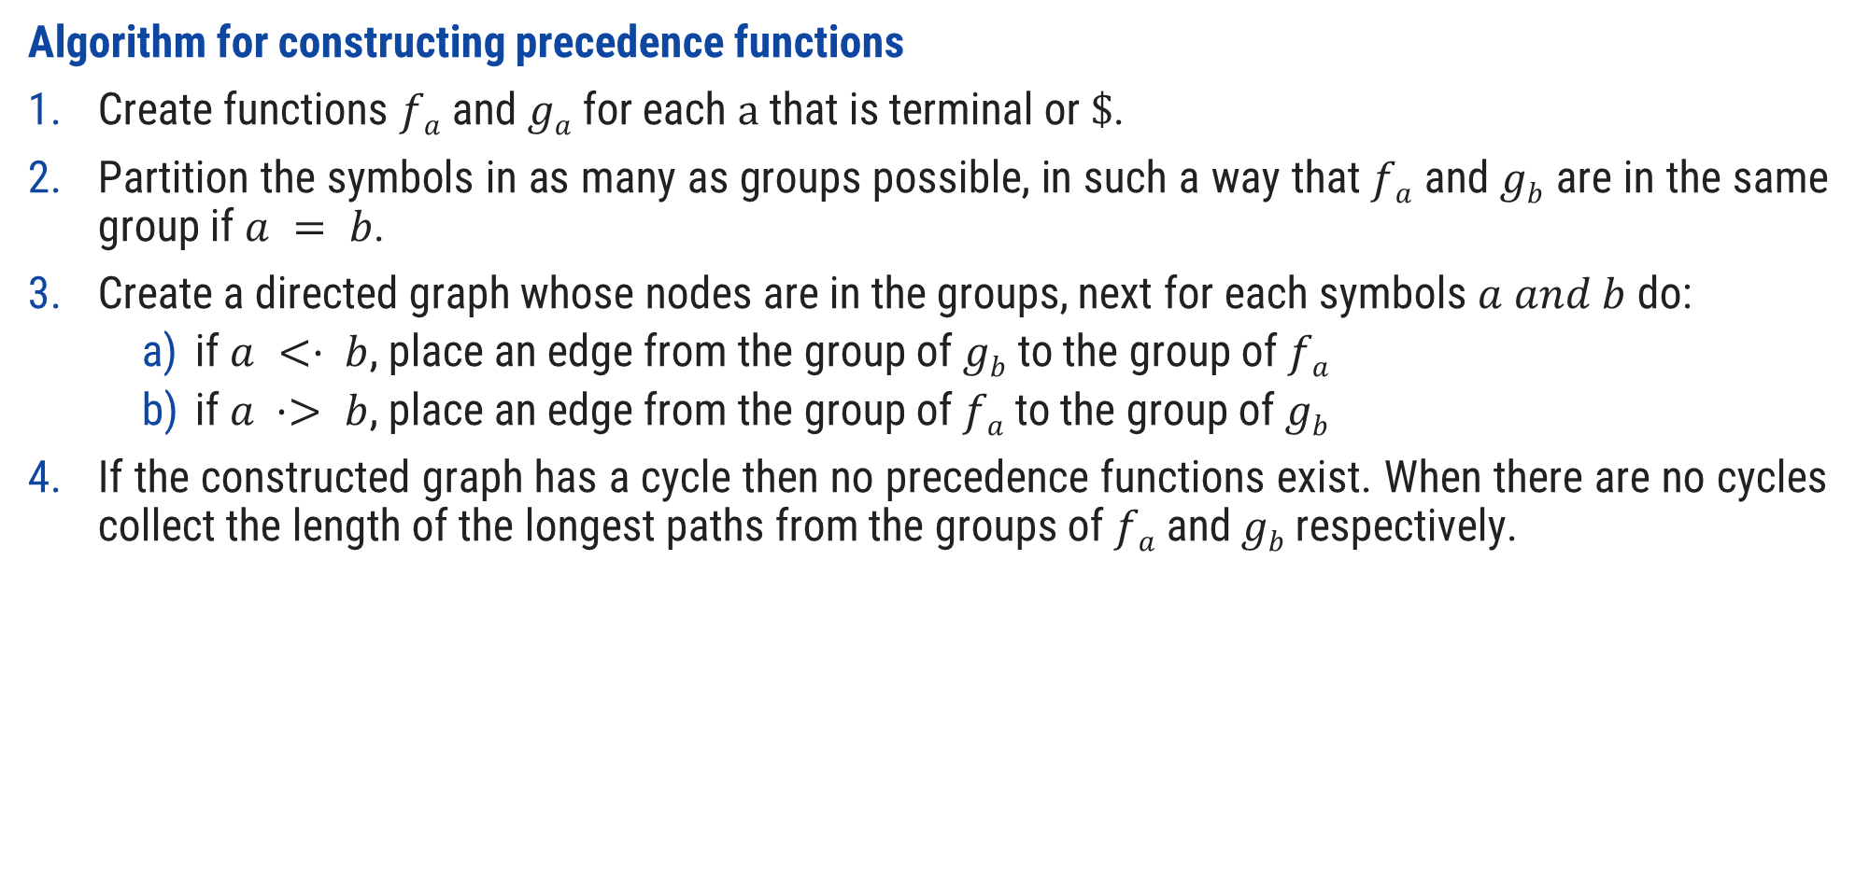
Operator precedence function
Algorithm for constructing precedence functions
Create functions $fa$ and $ga$ for each $a$ that is terminal or $\$$.
Partition the symbols in as many as groups possible, in such a way that $fa$ and $gb$ are in the same group if $a = b$.
Create a directed graph whose nodes are in the groups, next for each symbols $a and b$do:
if $a <· b$, place an edge from the group of $gb$ to the group of $fa$
if $a ·> b$, place an edge from the group of $fa$ to the group of $gb$
If the constructed graph has a cycle then no precedence functions exist. When there are no cycles collect the length of the longest paths from the groups of $fa$ and $gb$respectively.

Slide 100

Operator precedence function
Create functions f_{a} and g_{a} for each a that is terminal or $.
$a= \{+,∗,id\} or \$$
E→ E+T | T
T→ T*F | F F→ id
f₊
f*
f_{id}
f$
g₊
g*
g_{id}
g$

Slide 101
Operator precedence function
Partition the symbols in as many as groups possible, in such a way that f_{a} and g_{b} are in the same group if a = b.
.
 | + | * | id | $
g_{id}
f_{id}
+ | .> | <. | <. | .>
* | .> | .> | <. | .>
id | .> | .> |  | .>
$ | <. | <. | <.
f*
g*
g₊
f₊
f$
g$

Slide 102
Operator precedence function
if a <· b, place an edge from the group of g_{b} to the group of f_{a}
if a ·> b, place an edge from the group of f_{a} to the group of g_{b}
g
f
 | + | * | id | $
g_{id}
f_{id}
+ | .> | <. | <. | .>
* | .> | .> | <. | .>
id | .> | .> |  | .>
$ | <. | <. | <.
f*
g*
g₊
f₊
f₊ .> g₊
f₊ → g₊
f* .> g₊
f* → g₊
f_{id} .> g₊
f_{id} → g₊
f$
g$
f$ <. g₊
f$ ← g₊

Slide 103
Operator precedence function
if a <· b, place an edge from the group of g_{b} to the group of f_{a}
if a ·> b, place an edge from the group of f_{a} to the group of g_{b}
g
f
 | + | * | id | $
g_{id}
f_{id}
+ | .> | <. | <. | .>
* | .> | .> | <. | .>
id | .> | .> |  | .>
$ | <. | <. | <.
f*
g*
g₊
f₊
f₊ <. g*
f₊ ← g*
f* .> g*
f* → g*
f_{id} .> g*
f_{id} → g*
f$
g$
f$ <. g*
f$ ← g*

Slide 104
Operator precedence function
if a <· b, place an edge from the group of g_{b} to the group of f_{a}
if a ·> b, place an edge from the group of f_{a} to the group of g_{b}
g
f
 | + | * | id | $
g_{id}
f_{id}
+ | .> | <. | <. | .>
* | .> | .> | <. | .>
id | .> | .> |  | .>
$ | <. | <. | <.
f*
g*
g₊
f₊
f₊ <. g_{id}
f₊ ← g_{id}
f* <. g_{id}
f* ← g_{id}
f$ <. g_{id}
f$ ← g_{id}
f$
g$

Slide 105
Operator precedence function
if a <· b, place an edge from the group of g_{b} to the group of f_{a}
if a ·> b, place an edge from the group of f_{a} to the group of g_{b}
g
f
 | + | * | id | $
g_{id}
f_{id}
+ | .> | <. | <. | .>
* | .> | .> | <. | .>
id | .> | .> |  | .>
$ | <. | <. | <.
f*
g*
g₊
f₊
f₊ <. g$
f₊ → g$
f* <. g$
f* → g$
f_{id} <. g$
f_{id} → g$
f$
g$

Slide 106
Operator precedence function
 | + | * | id | $
f | 2
g_{id}
f_{id}
g
f*
g*
If the constructed graph has a cycle then no precedence functions exist. When there are no cycles collect the length of the longest paths from the groups of f_{a} and g_{b} respectively.
g₊
f₊
f$
g$

Slide 107
Operator precedence function
 | + | * | id | $
g_{id}
f_{id}
f | 2
g | 1
f*
g*
g₊
f₊
f$
g$

Slide 108
Operator precedence function
 | + | * | id | $
g_{id}
f_{id}
f | 2 | 4
g | 1
f*
g*
g₊
f₊
f$
g$

Slide 109
Operator precedence function
 | + | * | id | $
g_{id}
f_{id}
f | 2 | 4
g | 1 | 3
f*
g*
g₊
f₊
f$
g$

Slide 110
Operator precedence function
 | + | * | id | $
g_{id}
f_{id}
f | 2 | 4 | 4
g | 1 | 3
f*
g*
g₊
f₊
f$
g$

Slide 111
Operator precedence function
 | + | * | id | $
g_{id}
f_{id}
f | 2 | 4 | 4
g | 1 | 3 | 5
f*
g*
g₊
f₊
f$
g$

Slide 112
Operator precedence function
 | + | * | id | $
g_{id}
f_{id}
f | 2 | 4 | 4 | 0
g | 1 | 3 | 5 | 0
f*
g*
g₊
f₊
f$
g$

Slide 113
Parsing Methods
Parsing
Top down parsing
Bottom up parsing (Shift reduce)
Back tracking
Operator precedence
Parsing without backtracking (predictive Parsing)
LR parsing
SLR
LL(1)
CLR
Recursive
descent
LALR

Slide 114
LR parser
LR parsing is most efficient method of bottom up parsing which can be used to parse large class of context free grammar.
The technique is called LR(k) parsing:
The “L” is for left to right scanning of input symbol,
The “R” for constructing right most derivation in reverse,
The “k” for the number of input symbols of look ahead that are used in making parsing decision.
a | + | b | $
INPUT
X
Y
Z
$
LR parsing program
OUTPUT
Parsing Table
Action
Goto

Slide 115
Parsing Methods
Parsing
Top down parsing
Bottom up parsing (Shift reduce)
Back tracking
Operator precedence
Parsing without backtracking (predictive parsing)
LR parsing
SLR
LL(1)
CLR
Recursive
descent
LALR

Slide 116
Computation of closure & go to function
X→ Xb
Closure(I):
X→ X b
Goto(I,X)
X→ X b
.
.

Slide 117
Steps to construct SLR parser
Construct Canonical set of LR(0) items
Construct SLR parsing table
Parse the input string

Slide 118







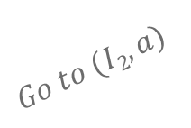


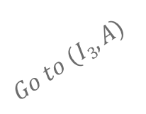



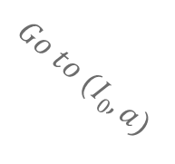




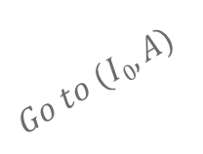
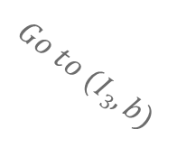
Example: SLR(1)- simple LR
S → AA
A → aA | b
S→ AA .
$I$₅
S’→ S.
$$I1$$
$$Go to (I2,A)$$
A→ a . A
$$Go to (I0,S)$$
$$I2$$
A→. aA
$I$₃
$$I0$$
S→ A . A
A→. b
S’→.S
$$Go to (I2,a)$$
$$Go to (I0,A)$$
A→. aA
S→. AA
A→. b
A→ b.
$I$₄
A→. aA
$$Go to (I2,b)$$
A→. b
$$Go to (I0,a)$$
LR(0) item set
$I$₃
A→ aA .
$I$₆
$$Go to (I3,A)$$
Augmented grammar
A→ a . A
$$Go to (I0,b)$$
A→. aA
$$Go to (I3,a)$$
A→ a . A
$I$₄
A→. b
A→. aA
$I$₃
A→ b.
$$Go to (I3,b)$$
A→. b
A→ b.
$I$₄

Slide 119
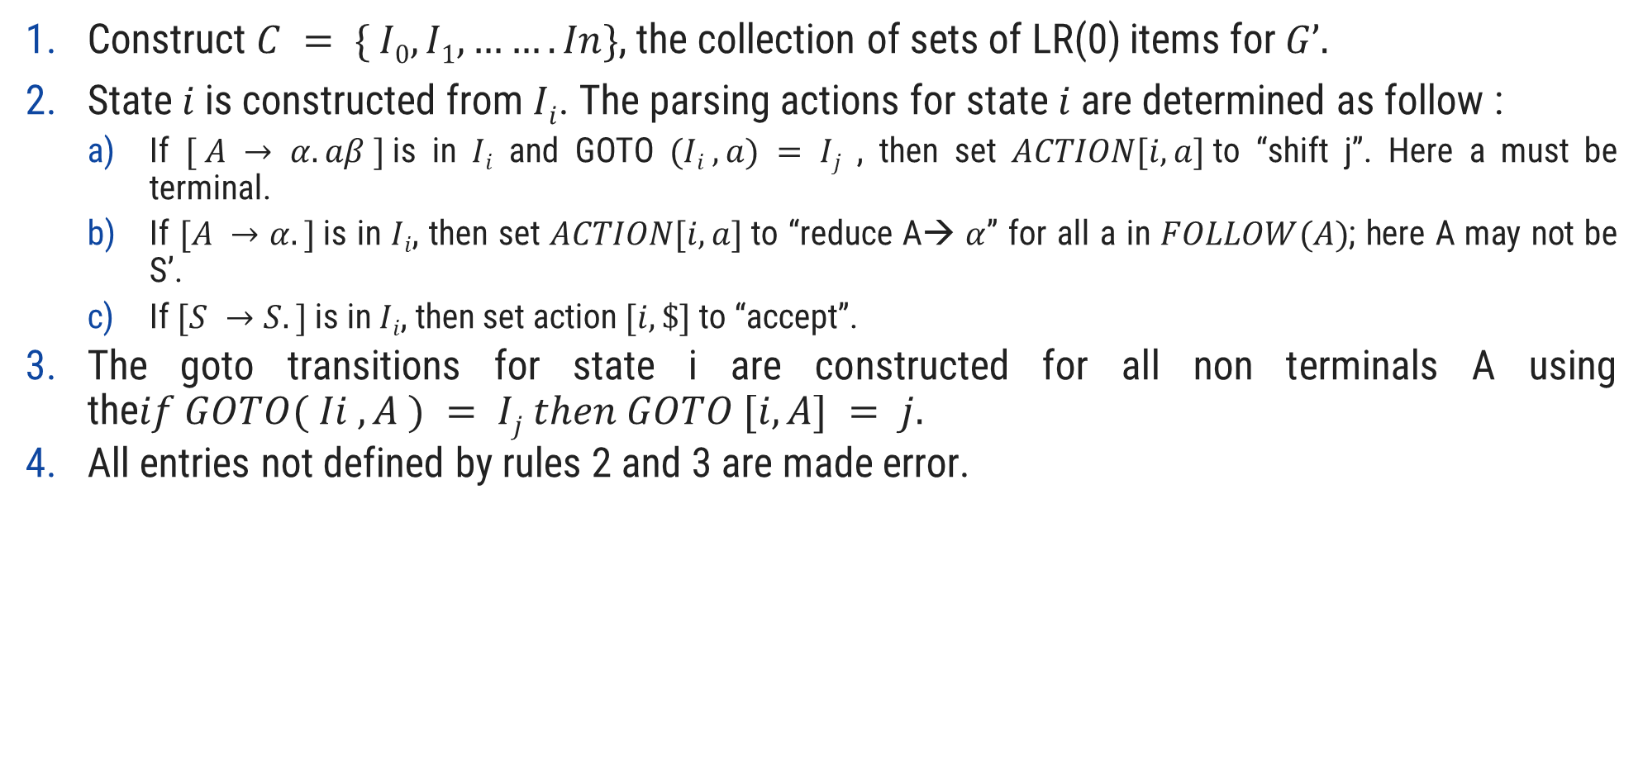
Rules to construct SLR parsing table
Construct $C = \{ I0, I1, ……. In\}$, the collection of sets of LR(0) items for $G’.$
State$i$is constructed from $Ii$. The parsing actions for state $i$ are determined as follow :
If $[ A → α.aβ ]$is in $Ii$ and GOTO $(Ii , a) = Ij$ , then set $ACTION[i, a]$to “shift j”. Here a must be terminal.
If $[A →α.]$is in $Ii$, then set $ACTION[i, a]$to “reduce A→ $α$” for all a in $FOLLOW(A)$; here A may not be S’.
If $[S →S.]$is in $Ii$, then set action $[i, \$]$to “accept”.
The goto transitions for state i are constructed for all non terminals A using the$if GOTO( Ii , A ) = Ij then GOTO [i, A] = j.$
All entries not defined by rules 2 and 3 are made error.

Slide 120















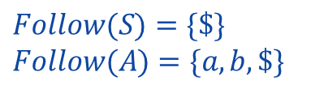





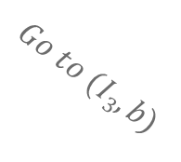
Example: SLR(1)- simple LR
S→ AA .
$I$₅
$$Follow(S)=\{\$\}$$
$$Follow(A)=\{a, b, \$\}$$
S’→ S.
$$I1$$
$$Go to (I2,A)$$
A→ a . A
$$Go to (I0,S)$$
$$I2$$
A→. aA
$I$₃
$$I0$$
S→ A . A
A→. b
 | Action |  |  | Go to
Item set | a | b | $ | S | A
0 | S3 | S4 |  | 1 | 2
1 |  |  | Accept
2 | S3 | S4 |  |  | 5
3 | S3 | S4 |  |  | 6
4 | R3 | R3 | R3
5 |  |  | R1
6 | R2 | R2 | R2
S’→. S
$$Go to (I2,a)$$
$$Go to (I0,A)$$
A→. aA
S→. AA
A→. b
A→ b.
$I$₄
A→. aA
$$Go to (I2,b)$$
A→. b
$$Go to (I0,a)$$
$I$₃
A→ aA .
$I$₆
$$Go to (I3,A)$$
A→ a . A
$$Go to (I0,b)$$
A→. aA
$$Go to (I3,a)$$
A→ a . A
$I$₄
A→. b
A→. aA
$I$₃
A→ b.
$$Go to (I3,b)$$
A→. b
S → AA
A → aA | b
A→ b.
$I$₄

Slide 121
Parsing Methods
Parsing
Top down parsing
Bottom up parsing (Shift reduce)
Back tracking
Operator precedence
Parsing without backtracking (predictive Parsing)
LR parsing
SLR
LL(1)
CLR
Recursive
descent
LALR

Slide 122

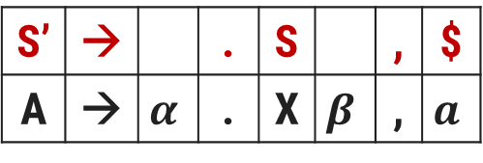

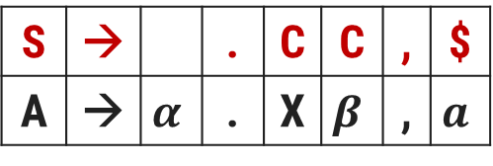
How to calculate look ahead?
How to calculate look ahead?
S→CC
C→ cC | d
Closure(I)
S’→.S,$
S→.CC,
C→.cC,
C→.d,
S’ | → |  | . | S |  | , | $
A | → | $$α$$ | . | X | $$β$$ | , | $$a$$
$$Lookahead=First\left(βa\right)$$
$$First\left(\$\right)$$
$$=\$$$
$
c|d
S | → |  | . | C | C | , | $
A | → | $$α$$ | . | X | $$β$$ | , | $$a$$
c|d
$$Lookahead=First\left(βa\right)$$
$$First\left(C\$\right)$$
$$=c,d$$

Slide 123



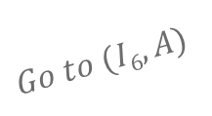




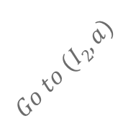



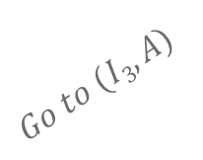











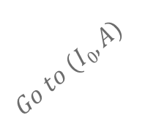
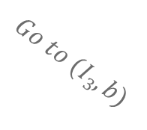

Example: CLR(1)- canonical LR
$I$₅
$I$₆
A→ aA.,$
$I$₉
S→ AA. ,$
A→ a.A,$
$I$₆
S’→ S., $
$$I1$$
$$Go to (I6,A)$$
A→ a.A,$
$$Go to (I2,A)$$
A→. aA,$
$$Go to (I0,S)$$
$$I2$$
$$Go to (I6,a)$$
$$I0$$
A→. aA,$
S→ A.A,$
$$Go to (I2,a)$$
A→. b, $
$$Go to (I6,b)$$
S’→.S,$
A→ b. ,S
A→. b, $
A→.aA, $
$I$₇
$I$₇
S→.AA,$
$$Go to (I0,A)$$
A→ b. ,$
A→. b, $
$$Go to (I2,b)$$
A→.aA, a|b
$I$₈
A→.b, a|b
LR(1) item set
$I$₃
A→ aA.,a|b
$$Go to (I3,A)$$
Augmented grammar
$$Go to (I0,a)$$
A→a.A, a|b
$I$₃
$$Go to (I0,b)$$
A→.aA ,a|b
$$Go to (I3,a)$$
A→ a.A , a|b
A→ b., a|b
A→. b, a|b
A→.aA , a|b
$I$₄
$$Go to (I3,b)$$
A→.b , a|b
S → AA
A → aA | b
$I$₄
A→ b., a|b

Slide 124
Example: CLR(1)- canonical LR
$I$₅
$I$₆
A→ aA.,$
$I$₉
S→ AA. ,$
A→ a.A,$
$I$₆
S’→ S., $
$$I1$$
$$Go to (I6,A)$$
A→ a.A,$
$$Go to (I2,A)$$
A→. aA,$
$$Go to (I0,S)$$
$$I2$$
$$Go to (I6,a)$$
$$I0$$
A→. aA,$
S→ A.A,$
$$Go to (I2,a)$$
A→. b, $
$$Go to (I6,b)$$
S’→.S,$
A→ b. ,S
A→. b, $
A→.aA, $
$I$₇
$I$₇
S→.AA,$
$$Go to (I0,A)$$
A→ b. ,S
A→. b, $
$$Go to (I2,b)$$
Item set | Action |  |  | Go to
 | a | b | $ | S | A
0 | S3 | S4 |  | 1 | 2
1 |  |  | Accept
2 | S6 | S7 |  |  | 5
3 | S3 | S4 |  |  | 8
4 | R3 | R3
5 |  |  | R1
6 | S6 | S7 |  |  | 9
7 |  |  | R3
8 | R2 | R2
9 |  |  | R2
A→.aA, a|b
$I$₈
A→.b, a|b
$I$₃
A→ aA.,a|b
$$Go to (I3,A)$$
$$Go to (I0,a)$$
A→a.A, a|b
$I$₃
$$Go to (I0,b)$$
A→.aA ,a|b
$$Go to (I3,a)$$
A→ a.A , a|b
A→ b., a|b
A→. b, a|b
A→.aA , a|b
$I$₄
$$Go to (I3,b)$$
A→.b , a|b
S → AA
A → aA | b
$I$₄
A→ b., a|b

Slide 125
Parsing Methods
Parsing
Top down parsing
Bottom up parsing (Shift reduce)
Back tracking
Operator precedence
Parsing without backtracking (predictive Parsing)
LR parsing
SLR
LL(1)
CLR
Recursive
descent
LALR

Slide 126



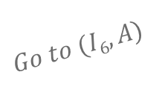




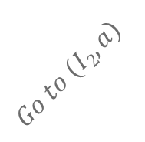



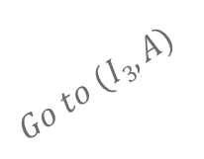












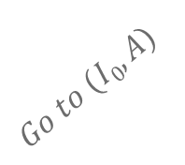
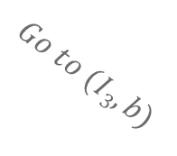


Example: LALR(1)- look ahead LR
$I$₅
$I$₆
A→ aA.,$
$I$₉
S→ AA. ,$
A→ a.A,$
$I$₆
S’→ S., $
$$I1$$
$$Go to (I6,A)$$
A→ a.A,$
$$Go to (I2,A)$$
A→. aA,$
$$Go to (I0,S)$$
$$I2$$
$$Go to (I6,a)$$
$$I0$$
A→. aA,$
S→ A.A,$
$$Go to (I2,a)$$
A→. b, $
$$Go to (I6,b)$$
S’→.S,$
A→ b. ,$
A→. b, $
A→.aA, $
$I$₇
$I$₇
S→.AA,$
$$Go to (I0,A)$$
A→ b. ,$
A→. b, $
$$Go to (I2,b)$$
A→.aA, a|b
CLR
$I$₈
$I$₃₆
A→.b, a|b
$I$₃
A→ aA.,a|b
A→a.A, a|b|$
$$Go to (I3,A)$$
$$Go to (I0,a)$$
A→.aA , a|b|$
A→a.A, a|b
$I$₃
$$Go to (I0,b)$$
A→. b, a|b|$
A→.aA ,a|b
$$Go to (I3,a)$$
A→ a.A , a|b
A→ b., a|b
A→. b, a|b
A→.aA , a|b
$I$₄₇
$I$₄
$$Go to (I3,b)$$
A→.b , a|b
A→ b., a|b|$
S → AA
A → aA | b
$I$₈₉
$I$₄
A→ b., a|b
A→ aA.,a|b|$

Slide 127
Example: LALR(1)- look ahead LR
Item set | Action |  |  | Go to
 | a | b | $ | S | A
0 | S3 | S4 |  | 1 | 2
1 |  |  | Accept
2 | S6 | S7 |  |  | 5
3 | S3 | S4 |  |  | 8
4 | R3 | R3
5 |  |  | R1
6 | S6 | S7 |  |  | 9
7 |  |  | R3
8 | R2 | R2
9 |  |  | R2
Item set | Action |  |  | Go to
 | a | b | $ | S | A
0 | S36 | S47 |  | 1 | 2
1 |  |  | Accept
2 | S36 | S47 |  |  | 5
36 | S36 | S47 |  |  | 89
47 | R3 | R3 | R3
5 |  |  | R1
89 | R2 | R2 | R2
CLR Parsing Table
LALR Parsing Table

Slide 128
Thank You

