Slide 1

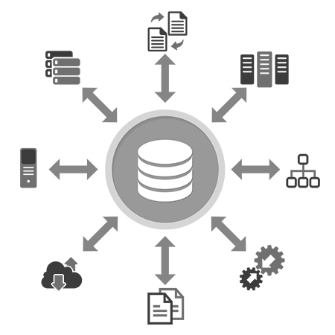

2170715 – Data Mining & Business Intelligence
Unit-2
The Architecture of
BI and DW
Prof. Naimish R. Vadodariya
8866215253
naimish.vadodariya@darshan.ac.in

Slide 2
Outline
Data Warehouse Architecture
OLTP v/s OLAP
Data Warehouse Schema Architecture
OLAP Operations
OLAP Servers

Slide 3
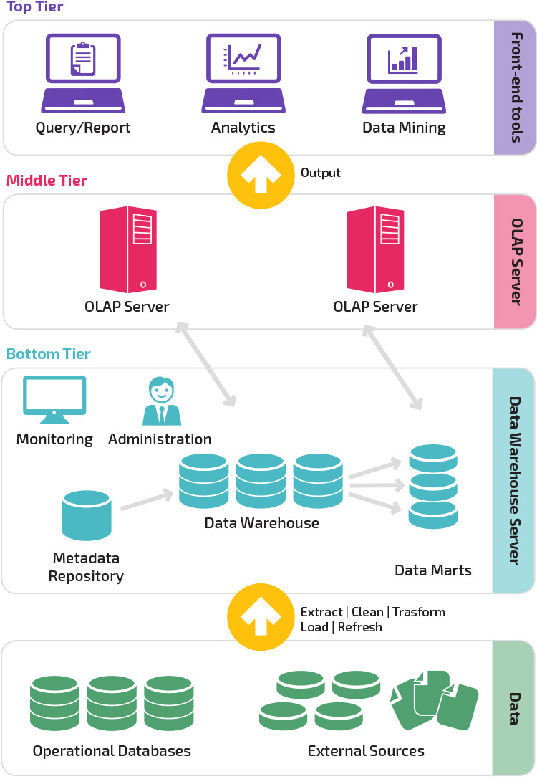
Data Warehouse Architecture
Top Tier
Middle Tier
Bottom Tier

Slide 4
Data Warehouse Architecture
Bottom tier:
The bottom tier is a warehouse database server that is almost always a relational database system.
Back-end tools and utilities are used to feed data into the bottom tier from operational databases or other external sources.
These tools and utilities perform data extraction, cleaning, and transformation, as well as load and refresh functions to update the data warehouse.
The data are extracted using application program interfaces known as gateways.
A gateway is supported by the underlying DBMS and allows client programs to generate SQL code to be executed at a server.
Examples of gateways include ODBC (Open Database Connection) and OLEDB (Open Linking and Embedding for Databases) by Microsoft and JDBC (Java Database Connection).
This tier also contains a metadata repository, which stores information about the data warehouse and its contents.

Slide 5
Data Warehouse Architecture
Middle tier:
The middle tier is an OLAP (Online Analytical Processing Server) that is typically implemented using either
A relational OLAP (ROLAP) model, that is, an extended relational DBMS that maps operations on multidimensional data to standard relational operations or,
A multidimensional OLAP (MOLAP) model, that is, a special-purpose server that directly implements multidimensional data and operations.
Top tier:
The top tier is a front-end client layer, which contains query and reporting tools, analysis tools, and/or data mining tools.

Slide 6
OLAP (On-Line Analytical Processing)
OLAP is characterized by relatively low volume of transactions.
Queries are often very complex and involve aggregations.
For OLAP systems a response time is an effectiveness measure.
OLAP applications are widely used by Data Mining techniques.
In OLAP database there is aggregated, historical data, stored in multi-dimensional schemas (usually star schema).

Slide 7
OLTP (On-Line Transaction Processing)
It is characterized by a large number of short on-line transactions (INSERT, UPDATE, DELETE).
The main emphasis for OLTP systems is put on very fast query processing, maintaining data integrity in multi-access environments and an effectiveness measured by number of transactions per second.
In OLTP database, there is detailed and current data, and schema used to store transactional databases is the entity model (usually 3NF).

Slide 8
OLTP v/s OLAP (Understanding)
OLTP | OLAP
Many Short Transactions (Queries + Updates) | Long Transactions (Complex Queries)
Examples Update account balance Enroll in course Add book to shopping cart | Examples Report total sales for each department in each month Identify top-selling books Count classes with fewer than 10 students
Queries touch small amount of data (one record or few records) | Queries touch large amount of data
Updates are frequent | Updates are infrequent

Slide 9
OLTP v/s OLAP
Functionality | OLTP | OLAP
Characteristic | Operational processing informational processing | Transaction Analysis
Orientation | Transaction | Analysis
User | Clerk, DBA, database professional | Knowledge worker (e.g., manager, executive, analyst)
Function | day-to-day operations | long-term informational requirements, decision support
DB design | ER based, application-oriented | Star/snowflake, subject-oriented
Data | Current; guaranteed up-to-date | Historical; accuracy maintained over time
Summarization | Primitive, highly detailed | Summarized, consolidated
View | Detailed, flat relational | Summarized, multidimensional
Unit of work | Short, simple transaction | Complex query
Access | Read/write | Mostly read

Slide 10
Data Warehouse Schema Architecture
Data Warehouse environment usually transforms the relational data model into some special architectures.
There are many schema models designed for data warehousing but the most commonly used are:
Star Schema
Snowflake Schema
Fact constellation(Group of star, Collection of fact tables) Schema
The determination of which schema model should be used for a data warehouse based upon the analysis of project requirements, accessible tools and project team preferences.

Slide 11
Star Schema
The star schema architecture is the simplest data warehouse schema.
It is called a star schema because the diagram resembles a star, with points radiating from a center.
The center of the star consists of fact table and the points of the star are the dimension tables.
Usually the fact tables in a star schema are in third normal form (3NF) whereas dimensional tables are de-normalized.
Despite the fact that the star schema is the simplest architecture, it is most commonly used nowadays and is recommended by Oracle.

Slide 12
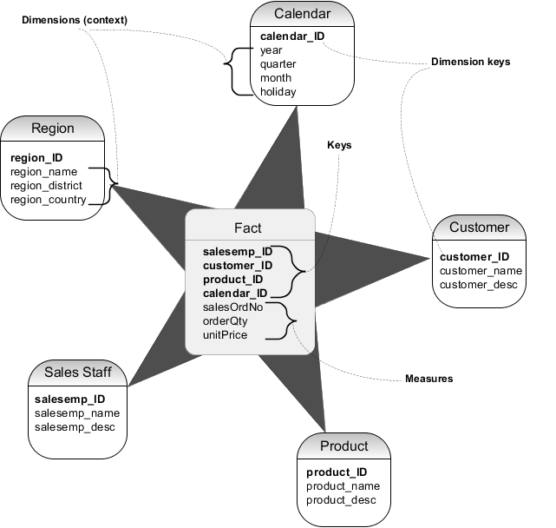
Star Schema - Example

Slide 13
Snowflake Schema
The snowflake schema architecture is a more complex variation of the star schema used in a data warehouse, because the tables which describe the dimensions are normalized.
This table is easy to maintain and saves storage space.
However, this saving of space is negligible in comparison to the typical size of the fact table.
Furthermore, the snowflake structure can reduce the effectiveness of browsing, since more joins will be needed to execute a query.
Hence, although the snowflake schema reduces redundancy, it is not as popular as the star schema in data warehouse design.

Slide 14
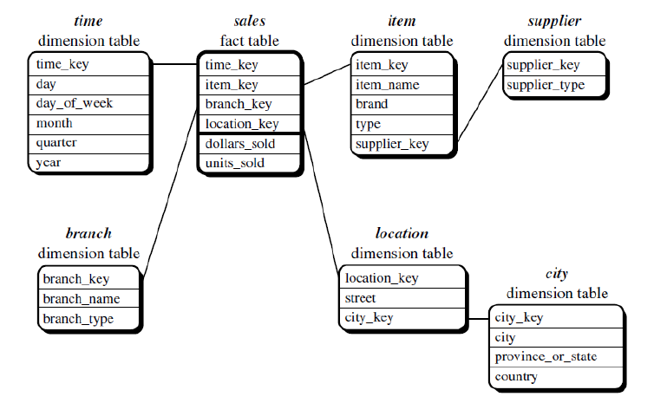
Snowflake Schema - Example

Slide 15
Snowflake Schema - Example
DMQL(Data Mining Query Language) code for Snowflake Schema can be written as follows:
Define cube sales snowflake [time, item, branch, location]:
Dollars sold = sum(sales in dollars), units sold = count(*)
Define dimension time as (time key, day, day of week, month, quarter, year)
Define dimension item as (item key, item name, brand, type, supplier (supplier key, supplier type))
Define dimension branch as (branch key, branch name, branch type)
Define dimension location as (location key, street, city (city key, city, province or state, country))

Slide 16
Fact Constellation Schema
Sophisticated applications may require multiple fact tables to share dimension tables.
This kind of schema can be viewed as a collection of stars, and hence is called a galaxy schema or a fact constellation.
A fact constellation schema allows dimension tables to be shared between fact tables.
For example, the dimensions tables for time, item, and location are shared between both the sales and shipping fact tables.
The main shortcoming of the fact constellation schema is a more complicated design because many variants for particular kinds of aggregation must be considered and selected.

Slide 17
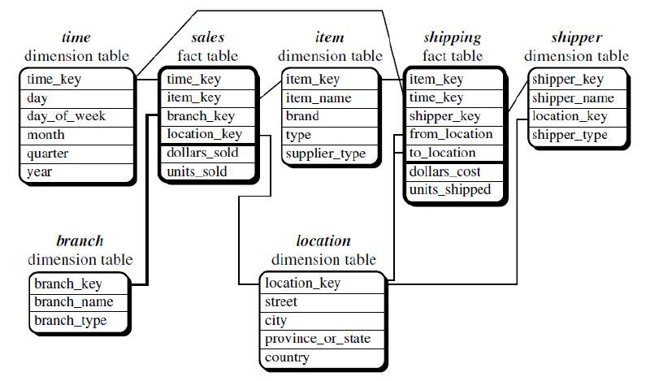
Fact Constellation Schema

Slide 18
Fact Constellation Schema
DMQL code for Fact Constellation schema can be written as follows:
Define cube sales [time, item, branch, location]:
Dollars sold = sum(sales in dollars), units sold = count(*)
Define dimension time as (time key, day, day of week, month, quarter, year)
Define dimension item as (item key, item name, brand, type, supplier type)
Define dimension branch as (branch key, branch name, branch type)
Define dimension location as (location key, street, city, province or state, country)
Define cube shipping [time, item, shipper, from location, to location]:
Dollars cost = sum(cost in dollars), units shipped = count(*)
Define dimension time as time in cube sales
Define dimension item as item in cube sales
Define dimension shipper as (shipper key, shipper name, location as location in cube sales, shipper type)
Define dimension from location as location in cube sales
Define dimension to location as location in cube sales

Slide 19
OLAP Operations
Roll up
Drill Down
Slice
Dice
Pivot (Rotate)

Slide 20
Roll up – OLAP Operation
The roll-up operation (also called drill-up or aggregation operation) performs aggregation on a data cube by following ways:
By climbing up a concept hierarchy for a dimension
By dimension reduction
Roll-up is performed by climbing up a concept hierarchy for the dimension location.
Initially the concept hierarchy was "street < city < province < country".
On rolling up, the data is aggregated by ascending the location hierarchy from the level of city to the level of country.
The data is grouped into cities rather than countries.
When roll-up is performed, one or more dimensions from the data cube are removed.

Slide 21
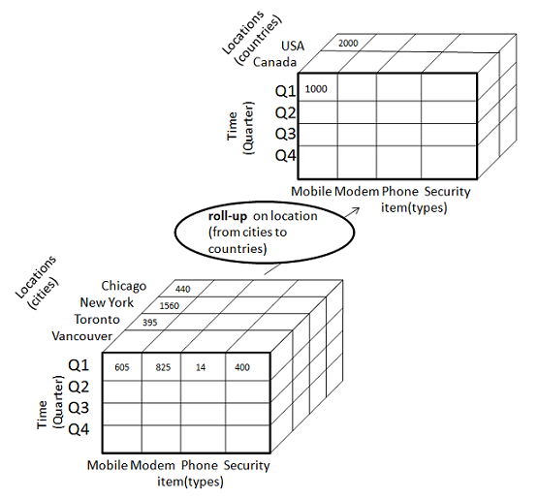
Roll up – OLAP Operation

Slide 22
Drill Down – OLAP Operation
Drill-down is the reverse operation of roll-up. It is performed by either of the following ways:
By stepping down a concept hierarchy for a dimension
By introducing a new dimension
Drill-down is performed by stepping down a concept hierarchy for the dimension time.
Initially the concept hierarchy was "day < month < quarter < year."
On drilling down, the time dimension is descended from the level of quarter to the level of month.
When drill-down is performed, one or more dimensions from the data cube are added.
It navigates the data from less detailed data to highly detailed data.

Slide 23
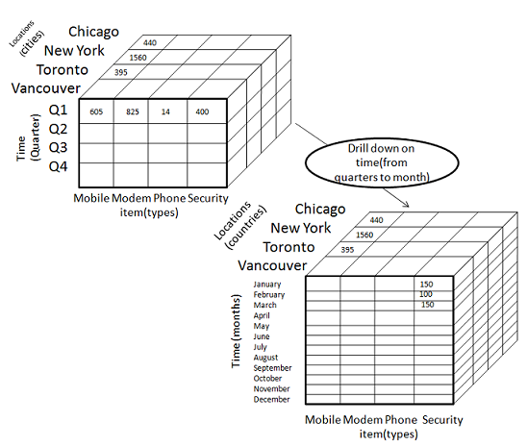
Drill Down – OLAP Operation

Slide 24
Slice – OLAP Operation
The slice operation selects one particular dimension from a given cube and provides a new sub cube.
Here Slice is performed for the dimension "time" using the criterion time = "Q1“, time = "Q2“, time = "Q3“ etc.
It will form a new sub-cube by selecting one or more dimensions.

Slide 25
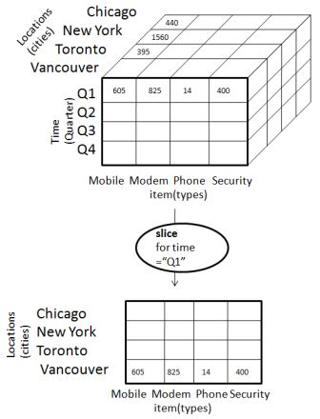
Slice – OLAP Operation

Slide 26
Dice – OLAP Operation
Dice selects two or more dimensions from a given cube and provides a new sub cube.
The dice operation on the cube based on the following selection criteria involves three dimensions.
(location = "Toronto" or "Vancouver")
(time = "Q1" or "Q2")
(item =" Mobile" or "Modem")

Slide 27
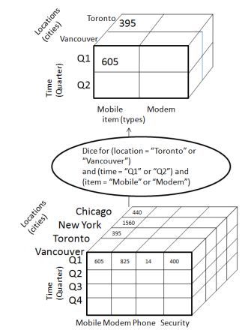
Dice – OLAP Operation

Slide 28
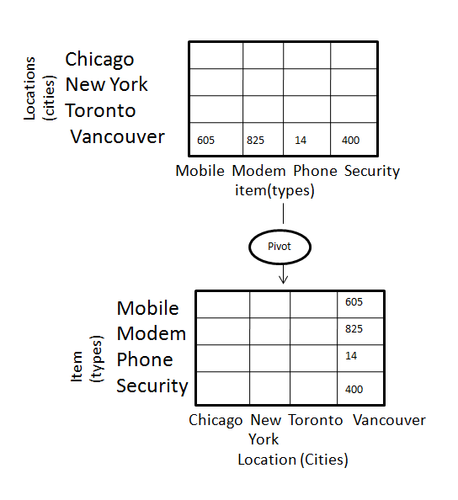
Pivot – OLAP Operation
The pivot operation is also known as rotation.
It rotates the data axes in view in order to provide an alternative presentation of data.

Slide 29
OLAP Servers
Relational OLAP (ROLAP)
Multidimensional OLAP (MOLAP)
Hybrid OLAP (HOLAP)

Slide 30
Relational OLAP (ROLAP)
Relational On-Line Analytical Processing (ROLAP) work mainly for the data that resides in a relational database, where the base data and dimension tables are stored as relational tables.
ROLAP servers are placed between the relational back-end server and client front-end tools.
ROLAP servers use RDBMS to store and manage warehouse data, and OLAP middleware to support missing pieces.
Advantages of ROLAP
ROLAP can handle large amounts of data.
Can be used with data warehouse and OLTP systems.
Disadvantages of ROLAP
Limited by SQL functionalities.
Hard to maintain aggregate tables.

Slide 31
Multidimensional OLAP (MOLAP)
Multidimensional On-Line Analytical Processing (MOLAP) support multidimensional views of data through array-based multidimensional storage engines.
With multidimensional data stores, the storage utilization may be low if the data set is sparse.
Advantages of MOLAP
Optimal for slice and dice operations.
Performs better than ROLAP when data is dense(heavy).
Can perform complex calculations.
Disadvantages of MOLAP
Difficult to change dimension without re-aggregation.
MOLAP can handle limited amount of data.

Slide 32
Hybrid OLAP (HOLAP)
Hybrid On-Line Analytical Processing (HOLAP) is a combination of ROLAP and MOLAP.
HOLAP provide greater scalability of ROLAP and the faster computation of MOLAP.
Advantages of HOLAP
HOLAP provide advantages of both MOLAP and ROLAP.
Provide fast access at all levels of aggregation.
Disadvantages of HOLAP
HOLAP architecture is very complex because it support both MOLAP and ROLAP servers.

Slide 33


