Slide 1

Introduction to Phishing Attacks
Phishing attacks are a common form of cybercrime. They involve fraudulent attempts to obtain sensitive information, such as login credentials or financial details, by masquerading as a trusted entity in electronic communications.

Slide 2

Why Are Phishing Attacks Effective ?
Phishing attacks are effective because they exploit human vulnerabilities. Attackers use psychological manipulation to make their messages appear legitimate and urgent, prompting victims to act without thinking critically.
1
Trust and Familiarity
2
Urgency and Fear
3
Curiosity and Greed

Slide 3

Examples of Phishing Attacks
Spoofed Emails
Fake Websites
Attackers send emails that mimic legitimate communications from trusted organizations. These emails may contain malicious links or attachments.
Attackers create fake websites that look identical to legitimate websites. They may use these websites to steal login credentials or other personal information.

Slide 4

Identifying Phishing Attempts
It's important to be vigilant and learn how to identify phishing attempts to protect yourself. Look for red flags and inconsistencies
Suspicious Sender
Check the email address and domain name for typos or inconsistencies
Be wary of emails that create a sense of urgency, fear, or pressure to act quickly.
Urgency and Fear
Suspicious Links
Hover over links before clicking to see the actual URL. Don't click on links from unknown senders.
Requests for Personal Information
Be cautious of emails requesting sensitive information, such as login credentials, credit card details, or personal details.

Slide 5


Slide 6
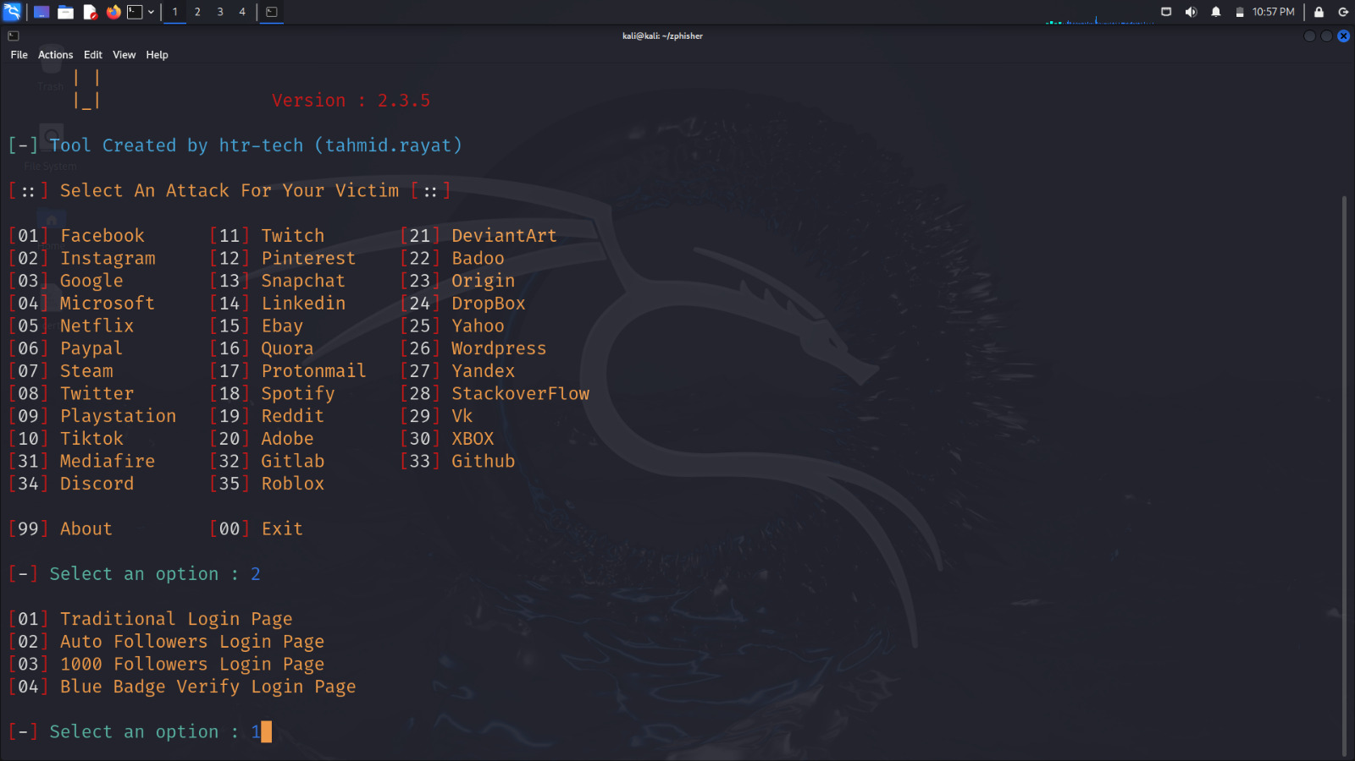

Slide 7


Slide 8


Slide 9


Slide 10
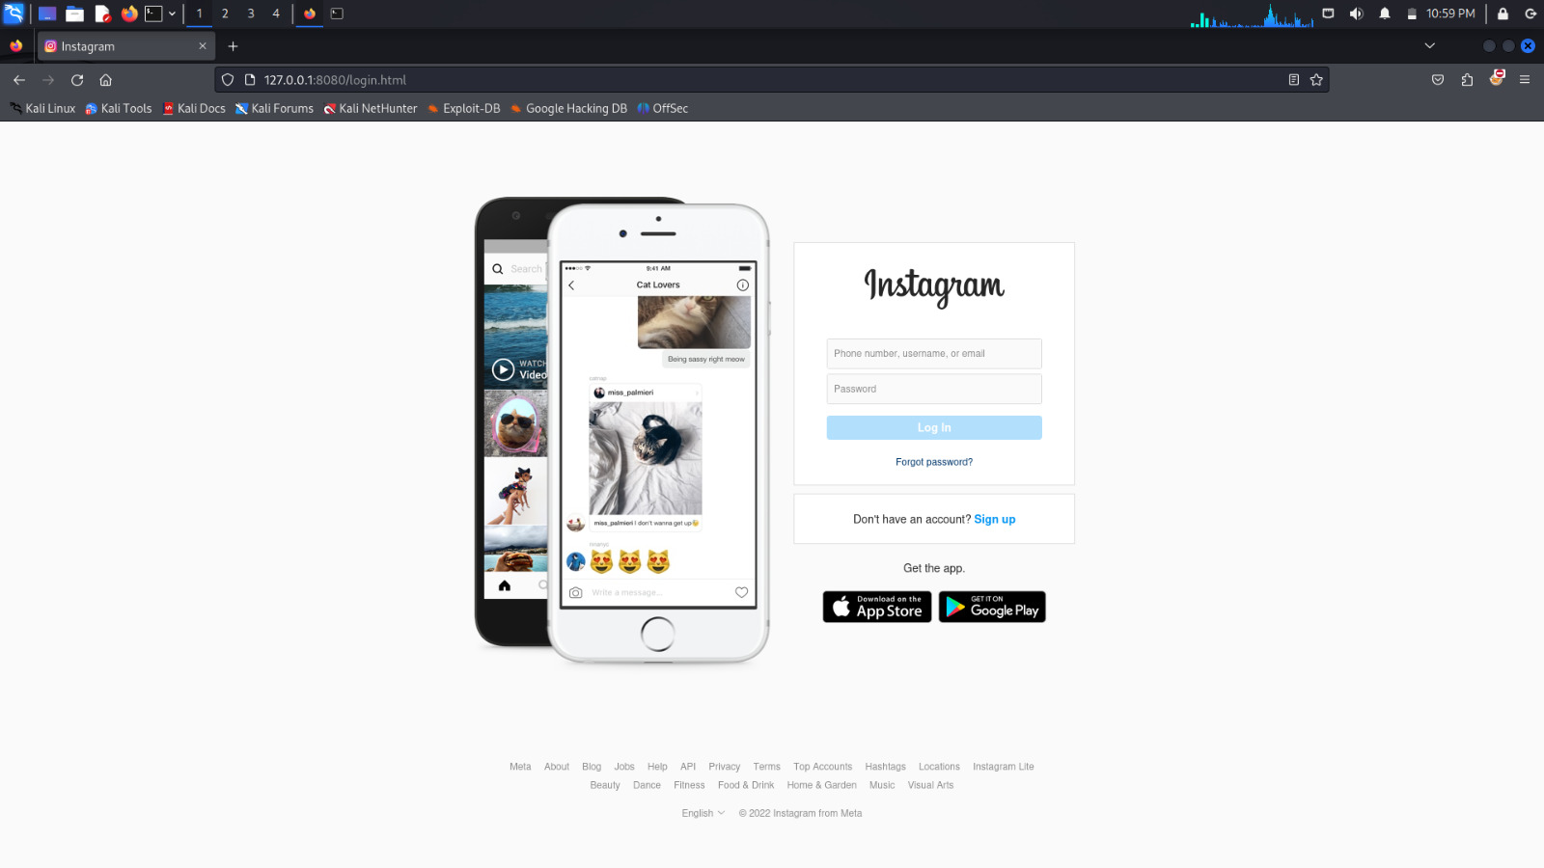

Slide 11
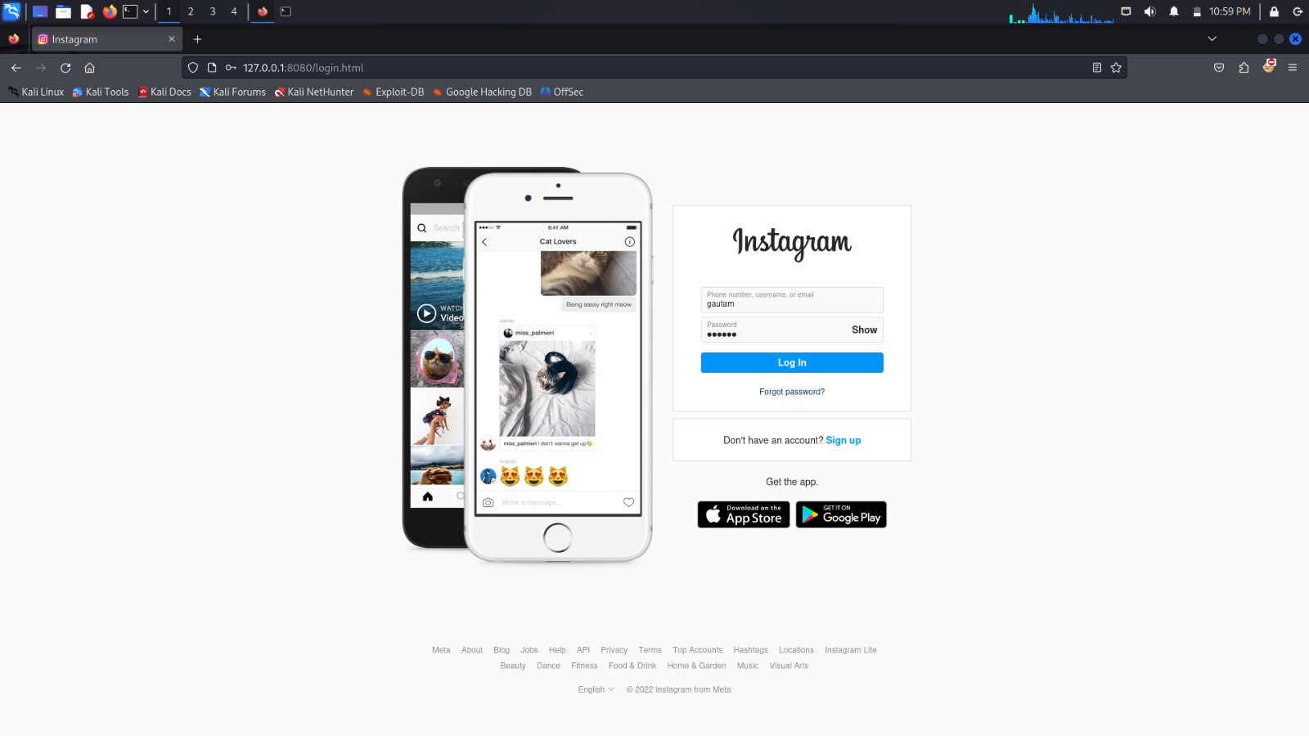

Slide 12
