Slide 1
Network Analysis
Adam Duncan Cambridge Associates

Slide 2
Complexity Reduction
Network analysis is a complexity reduction technique used to identify key elements or players in a system.
It is typically used to identify attributes of social systems. [e.g. critical employees, expertise concentrations, etc.]
Most recently it has been used by the NSA to identify potential terrorist suspects.

Slide 3
The Paul Revere Example
This example was created by Keiran Healey (http://kieranhealy.org//blog/archives/2013/06/09/using-metadata-to-find-paul-revere/) and is a good example of how to use network analysis to find critical linkages in a system, where only sparse data is available.
Imagine we have a list of memberships to different organizations. We can build a simple matrix of values where 1=membership, 0=not a member.

Slide 4
Using Meta Data to Make Magic
From this simple collection of membership information, we can derive a great deal about who might be leading the revolution against the British government.
The most amazing thing about network analysis is how much insight we can glean from what appears to be limited information.

Slide 5
Simple Network Mechanics
Let our membership matrix be called ‘A’.
The rows are the people in our set (i.e. potential suspects)
The columns are the associations or guilds that each suspect is either a member or not.
The entries are either 1=member, 0=non-member
We can then compute two useful matrices from this initial matrix

Slide 6
Some Matrix Math
First, we can multiply A*A^{T} where A^{T} is the transpose of the matrix A.
This matrix is called an adjacency matrix and is our “suspect” matrix.
Recall that A*A^{T} does not equal A^{T}*A, so let’s compute that as well.
A^{T}*A is another adjacency matrix and is our “guild” matrix.

Slide 7
Interpreting the Math
Let’s think about that math for a sec.
Suppose A has 50 rows and 5 columns.
Then A*A^{T} is a: 50x5 * 5x50 = 50x50 matrix
Each of the cells of the new matrix will be the sum of the counts of common memberships between any 2 suspects.

Slide 8
More Interpretation
Let’s look at A^{T}*A more closely:
A^{T}*A is a 5x50 * 50x5 matrix.
The result [from linear algebra] is a 5x5 matrix
This is also a square matrix, but now with the guilds along the rows and columns.
Now the cell entries are the sums of all the suspects belonging to both guilds.
With 2 simple math operations we’ve unlocked a ton of previously hidden associations.

Slide 9
Visualizing the Data
Now, all we need to do is map the data into something visual.
In R, the igraph package helps us do this. It’s a set of powerful routines for doing network analysis.
We can use the plotting routines to visualize the 2 matrices we’ve created.

Slide 10
Some Terminology
Vertices – These are the nodes of the network graph. Nodes are the ‘things’ in the graphs: people, guilds, etc.
Edges – These are the connecting lines between any two vertices.
Note that we can assign variables to any of the attributes of Vertices and Edges. For example, we might want to size the vertices proportional to some third variable of interest.

Slide 11
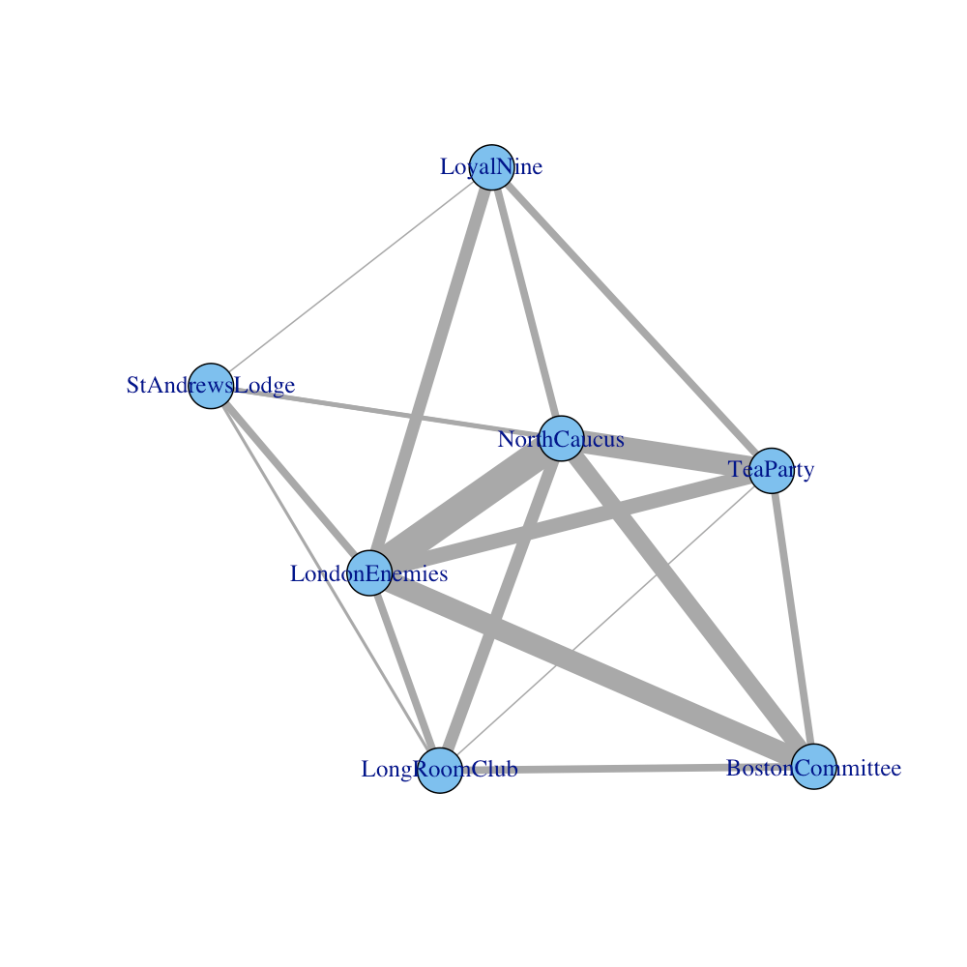
The Guilds
Source: Kieran Healy

Slide 12
The Suspect Network
Similarly we can look at the ‘inverse’ of that picture, the “suspect” network…

Slide 13
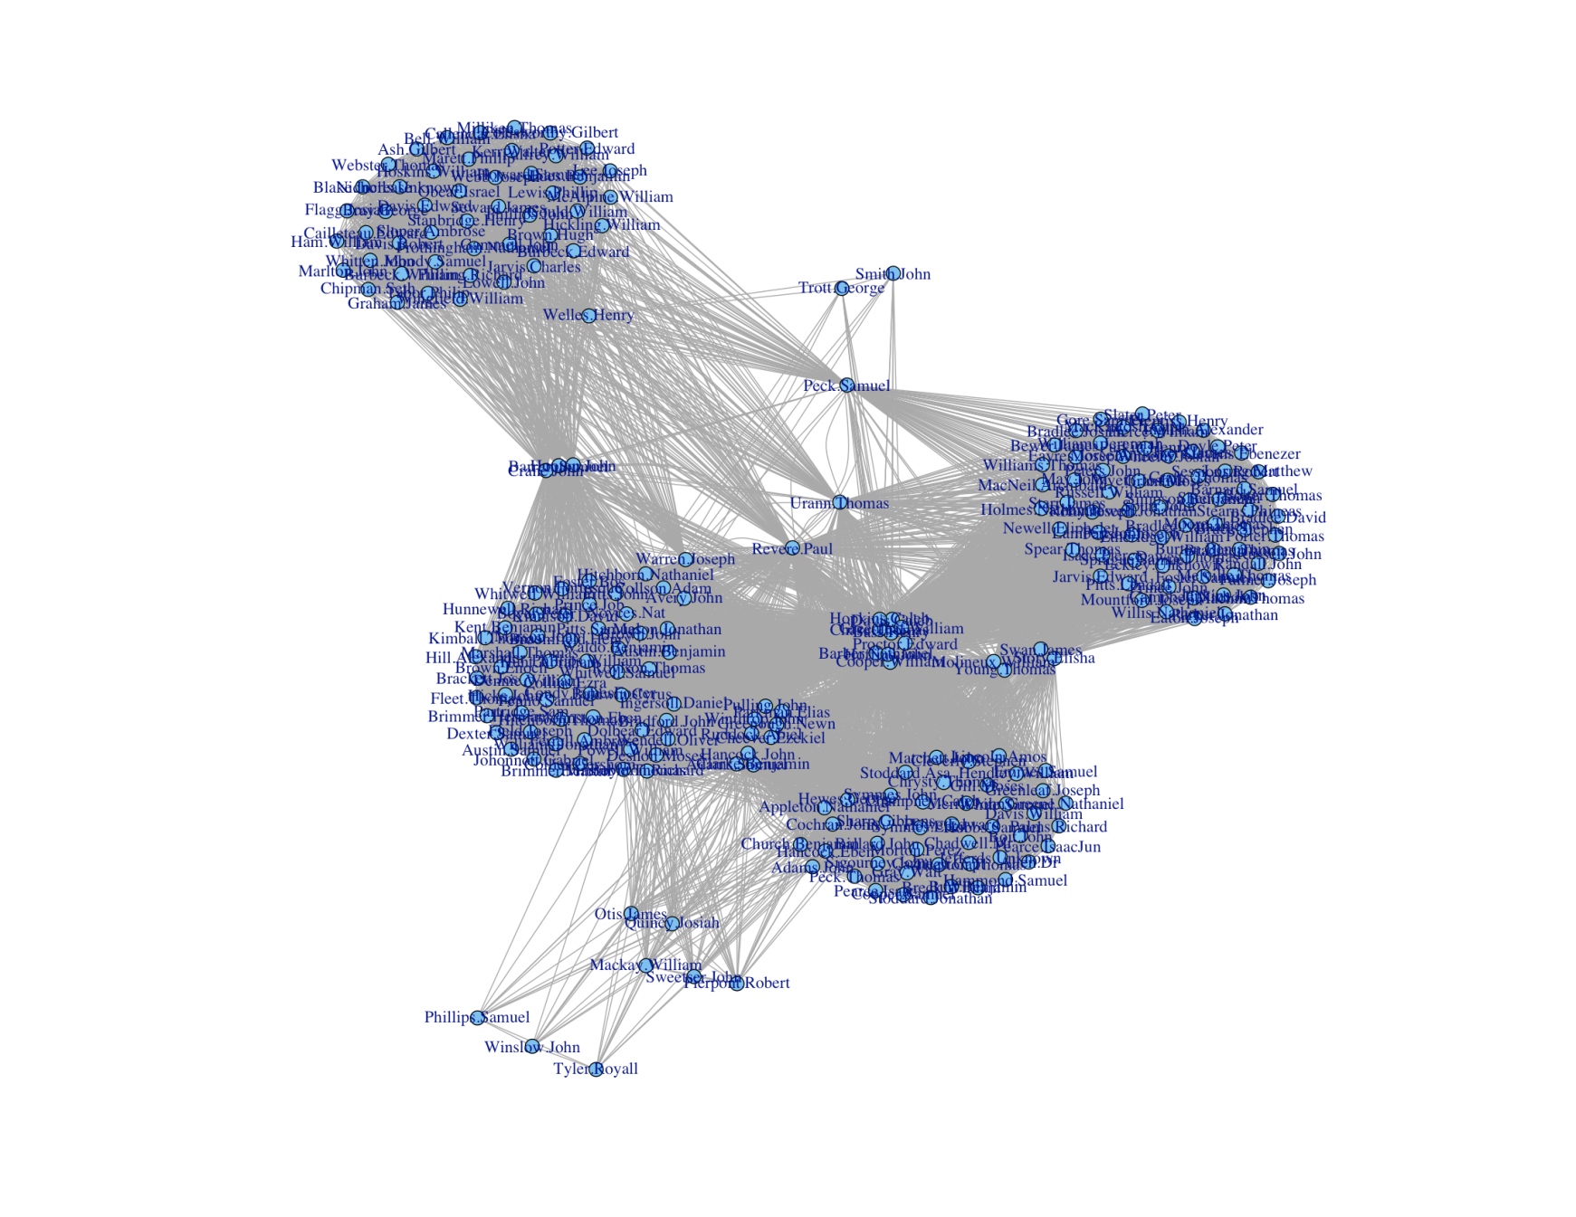
The Suspects
That’s Paul Revere, the leader of the Revolution!
Source: Kieran Healy

Slide 14
That’s Powerful Stuff
That’s a crazy amount of information to glean from such a simple start!
And, it’s not all just about pretty pictures. The math of network analysis is quite deep and equally revealing.
For example, we might want to compute statistics about each of the vertices: Betweeness, Closeness, Eigen Centrality,. Etc.

Slide 15
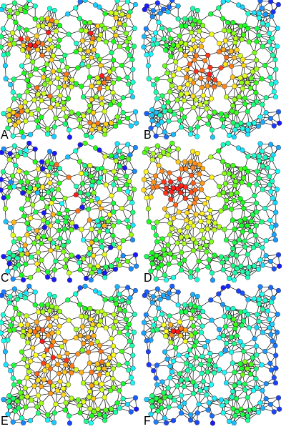
Different Centrality Measures
Examples of:
Degree centrality
Closeness centrality,
Betweenness centrality
Eigenvector centrality
Katz centrality
Alpha centrality of the same graph.
Source: Wikipedia.com

Slide 16
Investing Analogs
The analogs to the investing world are many.
One simple application is Overlap Analysis for stock holdings using public 13F filing information.
The stocks are the “suspects” and the hedge funds are the “guilds”.
In exactly the same fashion we can produce things like this…

Slide 17
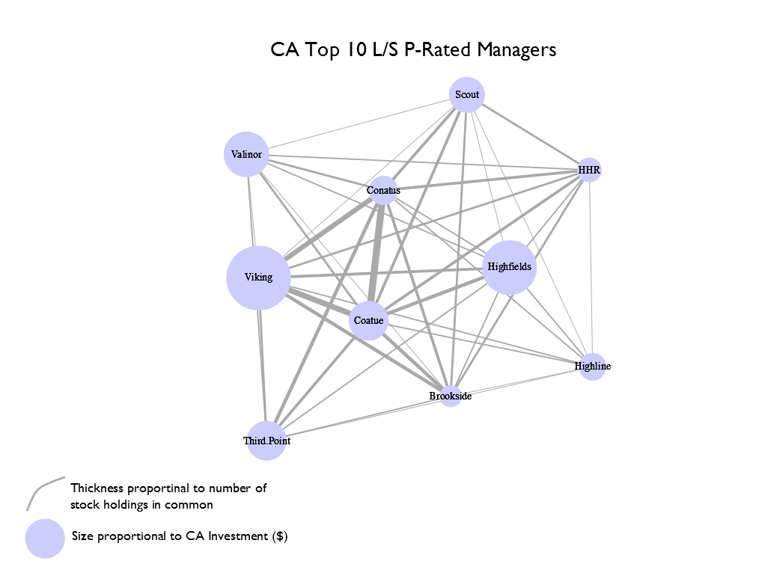

Slide 18
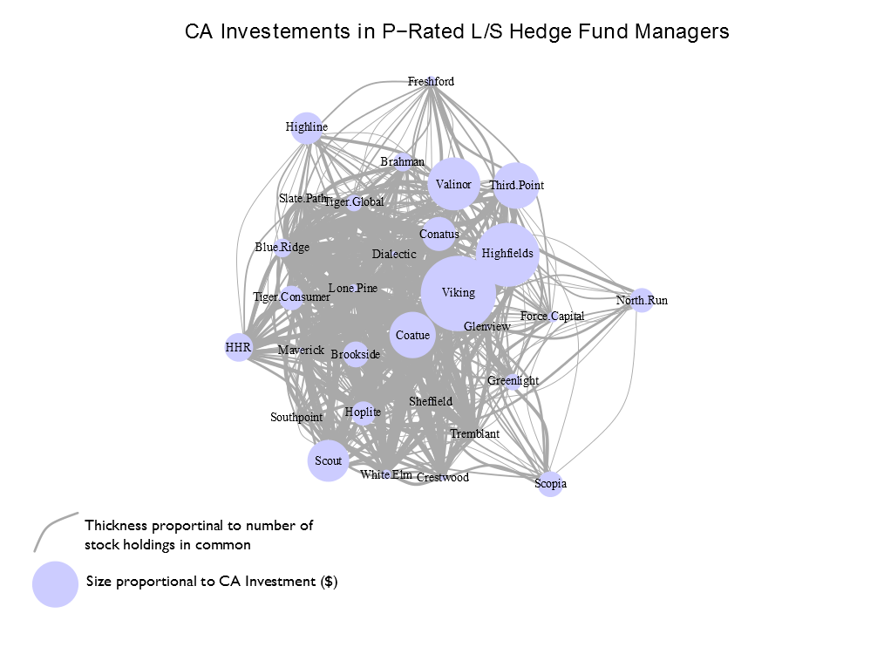

Slide 19
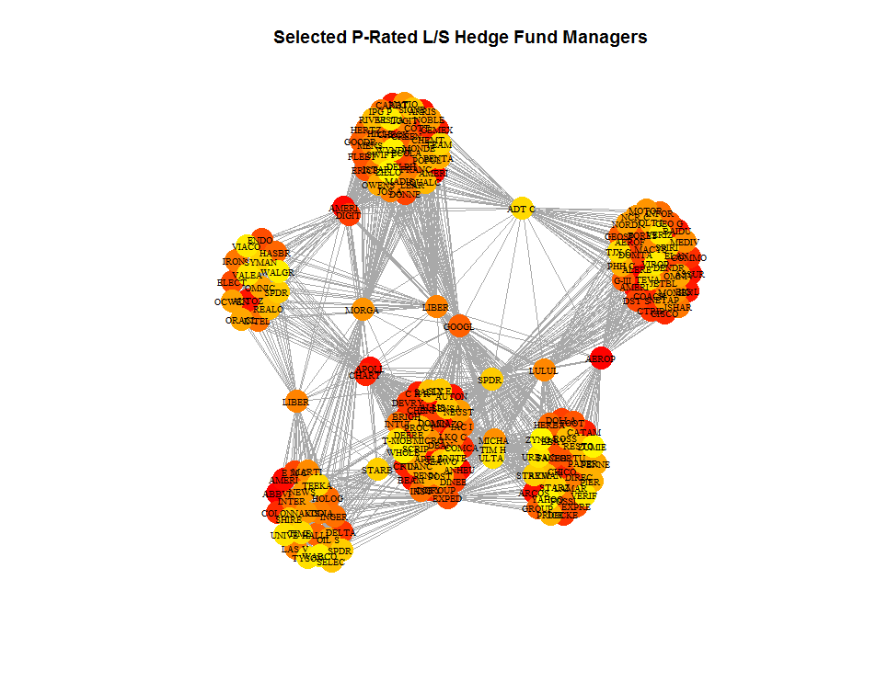

Slide 20
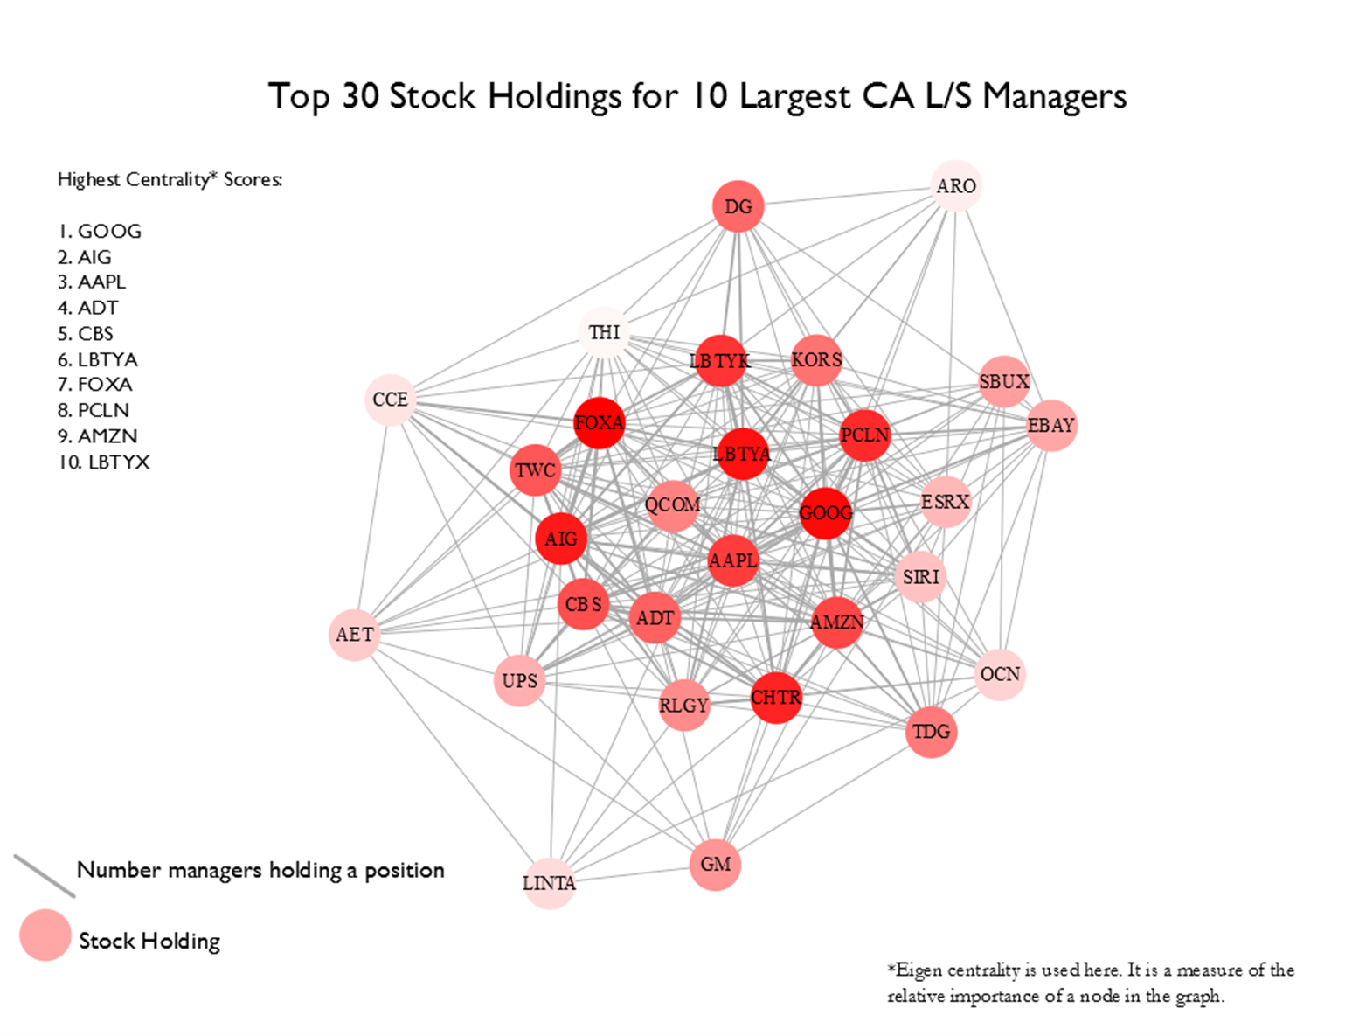

Slide 21
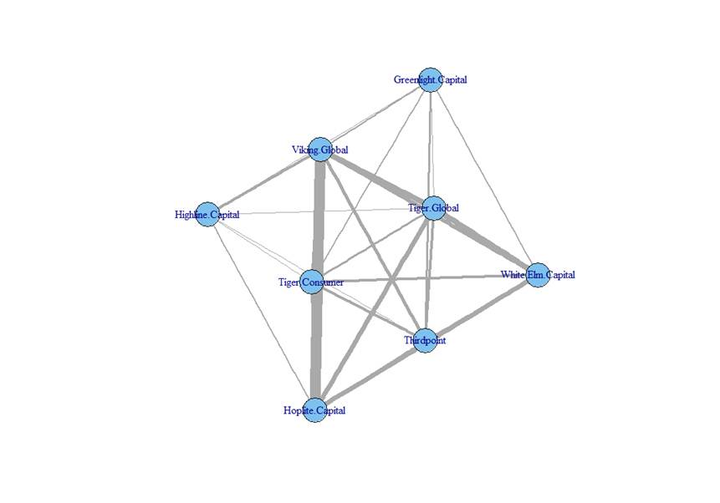
The Tiger Keretsu

Slide 22
The applications for network analysis outside of its traditional uses are many.
Good situations are when complexity is high and only meta data is available. Just because we don’t have the exact data we want doesn’t mean we can’t draw powerful conclusions about where to start.
Helpful if data can be coded as Boolean and still be meaningful.

