Slide 1
Newport Slides
Adam Duncan

Slide 2
Problem: Manager Overlap
The problem: Detecting portfolio overlap
The solution: Network Analysis

Slide 3
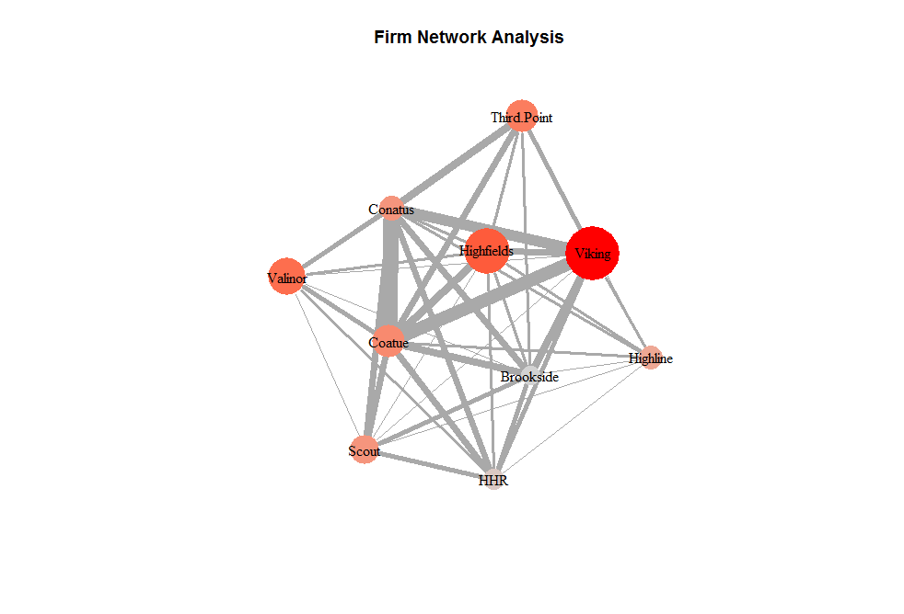
The thickness of the connections is proportional to the overlap in 13F positions. The color is a measure of centrality or importance in the network. The size is proportional to C|A investment in the manager.
If you own Viking, for example, adding Coatue or Conatus might not be as helpful as adding, say, Highline.

Slide 4
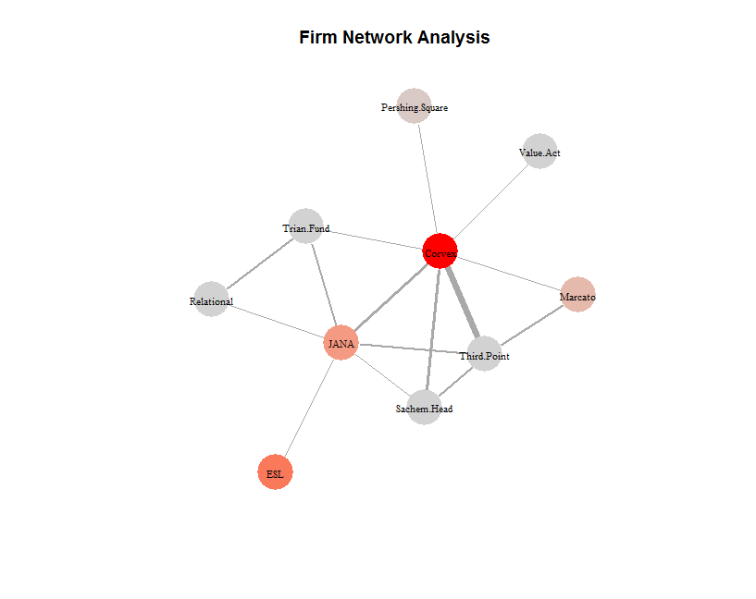
Very little overlap in the Activist space…

Slide 5
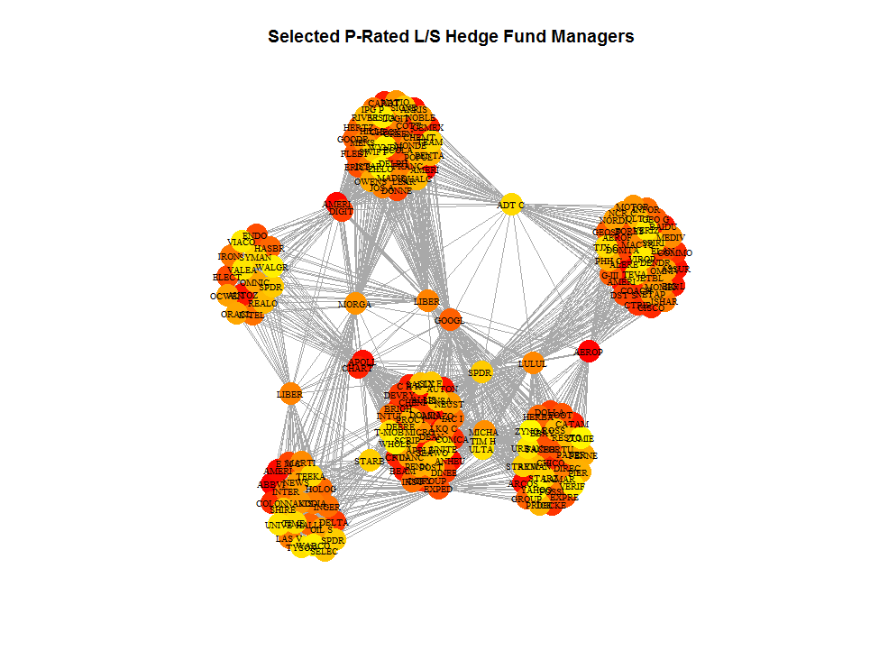
Here, the nodes are individual stocks. You can see the distinct groupings which are the unique holdings of each manager. But, some have tension and are drawn to the center. These are the positions with heavy overlap.

Slide 6
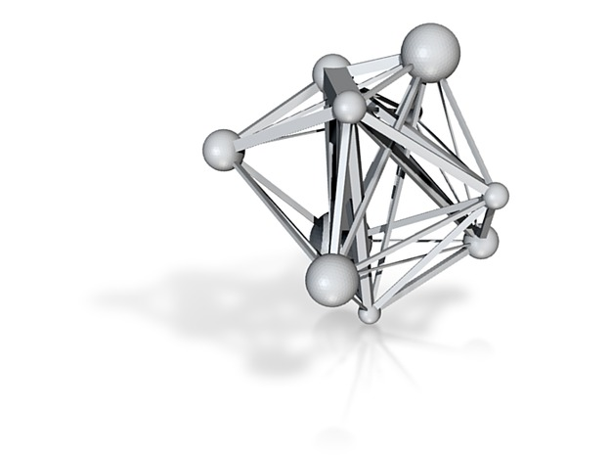
The real representation

