Slide 1
바나나파이 포팅&드라이버 사전자료
gto
2020.07.27

Slide 2
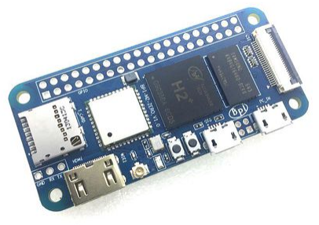
Banana Pi MPI-M2 zero
cpu : Allwinner사의 H2+ Quad-core cortex-A7
memory : DDR3 512MB SDRAM
storage : eMMC 8GB
Mini HDMI
Wi-Fi 802.11 b/g/n, Bluetooth 4.0
1 x USB2.0 (OTG)
40 Pin Raspberry Pi-compatible GPIO, including UART, SPI, I2C, etc.
Android and Linux
국내사이트 5~7만원선(해외직구대행)

Slide 3
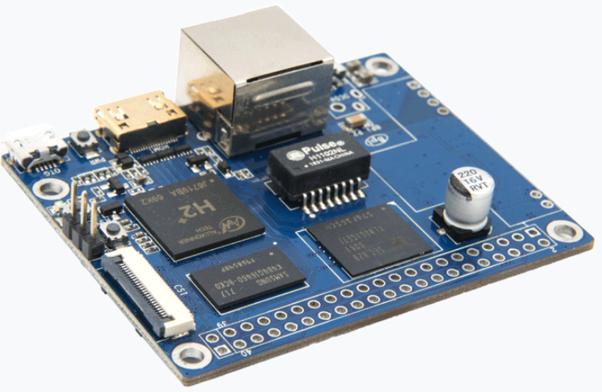
Banana Pi PI2 zero
cpu : Allwinner사의 H2+ Quad-core cortex-A7
gpu : Mali 400 MP2
memory : DDR3 512MB SDRAM
storage : eMMC 8GB
Mini HDMI
Ethernet, Wi-Fi 802.11 b/g/n, Bluetooth 4.0
1 x USB2.0 (OTG)
40 Pin Raspberry Pi-compatible GPIO, including UART, SPI, I2C, PoE Power
Android and Linux
국내사이트 6~8만원선(해외직구대행)
http://www.tmon.co.kr/deal/3820282762?opt_deal_srl=3820282770&coupon_srl=2593674&utm_source=danawa&utm_medium=affiliate&utm_term=205009_%EB%8B%A4%EB%82%98%EC%99%80DB&utm_content=&utm_campaign=%EB%8B%A4%EB%82%98%EC%99%80

Slide 4
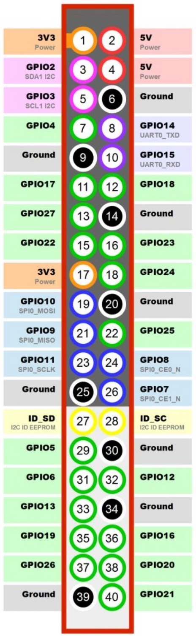
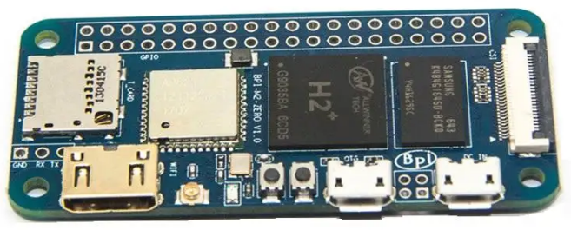

Slide 5
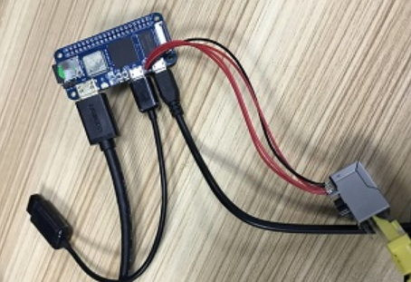
Ethernet Pin
5V 전원
HDMI
5Pin
OTG

