Slide 1
Government & Comparative Politics
Introductions
IE University
Spring 2023
Prof. Guillermo Toral

Slide 2
What we’ll cover today
Introductions: the course, the instructor, the participants
What to expect from this course
What is comparative politics?

Slide 3
A bit about the course
Introduction to comparative politics
We will examine key sources of variation across political systems, their origins, and their consequences
We will work with cases from different geographic contexts, different levels of development, and at different points in history
We will talk not just about political differences, but also their impact on economic, social, and human development
The course emphasizes empirical evidence as a common basis to make sense of complex political realities
We will be discussing not just theories and ideas, but also their relationship to empirical evidence
We will be dissecting arguments as well as empirical exercises by academics, think tanks, and government agencies
The course has a strong research skills component
We will build skills for academic research and argumentation – useful to analyze politics but also for careers in the private sector, in research, etc.

Slide 4
A bit about me
Personal background
Education
Professional experience
Research
Teaching experience
Email: gtoral@faculty.ie.edu
I typically respond within 48 hours
Office: 17.24 in the Tower
Office hours: at my office or on Zoom
Tuesdays 2-4, sign up at https://calendly.com/guillermo-toral/office-hours (link on Blackboard)
If that doesn’t work, email me for an appointment
Notes:
OK so now that we’ve had a taste of what the course is about, let me tell you a bit about me, your instructor for this class. My name is Guillermo Toral. You can just call me Guillermo (no need to say “Prof.” or “Dr.”)
Grew up in Madrid. Spent 13 years abroad and just moved back a few months ago.
Studied BA in UCM in polisci and public admin. Then Mphil at Oxford. PhD at MIT, 2020.
The last two years I was a professor at Vanderbilt, in Nashville USA.
Before doing the PhD I spent 3 years at the WB, working on education policy and programs.
My research. Research on governance, examining corruption and anti-corruption, the effectiveness of different policies for making bureaucracies more effective. Focus on education, healthcare. I combine big data, surveys, interviews, and causal inference.
At MIT and Vanderbilt I taught classes on statistics and data science, corruption, international development, bureaucracies.

Slide 5
A bit about you all
Fill in a short, ungraded “quiz” on Blackboard:
Full name and preferred given name
1 sentence about your background (e.g., where grew up, or something about your identity)
1 sentence about what you want to do after you graduate (e.g., what kind of job, where you want to live, or what you want to study next)
1 sentence about what you expect from this course
1 sentence about how confident you feel about your research & writing skills

Slide 6
What other courses are you taking this semester? What courses did you take last semester?

Slide 7
What we’ll cover today
Introductions: the course, the instructor, the participants
What to expect from this course
What is comparative politics?

Slide 8
What to expect from this course
What are the learning objectives of the course?
How is the course structured?
What will you all be required to do?
How will I grade you?
What books will we use?
Some ground rules for this course

Slide 9
Course objectives
Describe the key dimensions of variation in political systems around the world and how major countries in all continents differ along them.
Reflect critically about the origins and consequences of differences in political systems, with reference to established theories in political science.
Apply key concepts and theories of political science to debates about politics around the world.
Demonstrate social scientific literacy, including basic quantitative literacy, and apply it to the study and discussion of politics.
Use critical reading, autonomous research, and academic writing skills to build and present cogent and evidence-based arguments about politics.

Slide 10
Course structure
Comparative politics and the state:
The approach and method of CP
The nature, formation, and development of states
Political regimes:
Authoritarianism, types, and survival
Democracy, democratization, and survival
Varieties of representation:
Parliamentarism vs presidentialism
Elections and electoral systems
Review session & Midterm exam
Political actors:
Voters and political behavior
Political parties and party systems
Courts, subnational authorities, other avenues of non-electoral accountability
Interest groups, social movements, and the media
Domains of political competition:
Redistribution and social policy
Culture, identity, and ideas
Review session & Final exam

Slide 11
Session structure
Quiz
On Blackboard (using respondus)
You can consult notes, but only on paper – no other electronic devices are allowed
Each worth 1.25% of the grade
Lecture on the week’s topic
Exercise and structure discussion
Workshop on research skills
Notes:
In data labs we will be using data from real-world public policies, and use them to discuss specifics

Slide 12
Course requirements
In class:
Lectures
In-class discussions and exercises
Workshops to help you build your research paper
Midterm exam
Final exam
At home:
Readings, and preparing for quizzes
Research and writing for the research paper
Studying for midterm and final

Slide 13
Course evaluation
Quizzes (15%)
In-class, at the beginning of the first session, every session
A mix of multiple choice and short answer questions
They cover readings for the week and previous week’s lecture
Mid-term exam (15%)
Covers everything up until session 15 (including readings, lectures, in-class discussions)
Final exam (40%)
Covers everything from session 1 to 30 (including readings, lectures, in-class discussions)
Research paper (20%):
Workshops will help you get there
Class participation (10%)
Graded based on depth, quality, and frequency of contributions to in-class discussions

Slide 14
IT requirements for this course
Qwickly
We’ll be using Qwickly to record attendance
Make sure you have the latest version of the app
Respondus
Quizzes and exams will be done on Blackboard, with Respondus
Make sure you install and have a working version of Respondus on your laptop – IT can help if necessary

Slide 15

Register your attendance with Qwickly
To register your attendance in each session, you need to use the Qwickly app on your phone and scan the QR code shown at the beginning of lecture
IE Qwickly Guide here
Notes:
Ultimately what’s at stake for us, in this course, in the kind of issues we’ll be dealing with – is making the world a better place, thinking systematically through all the hard choices to get there.
Rigor and creativity can and must go hand in hand.
We have a lot to cover this semester but I’m confident that you’ll be up to the challenge. I think this course will be high-effort, high reward – will help you build skills useful throughout the rest of your degree and into your professional lives.

Slide 16
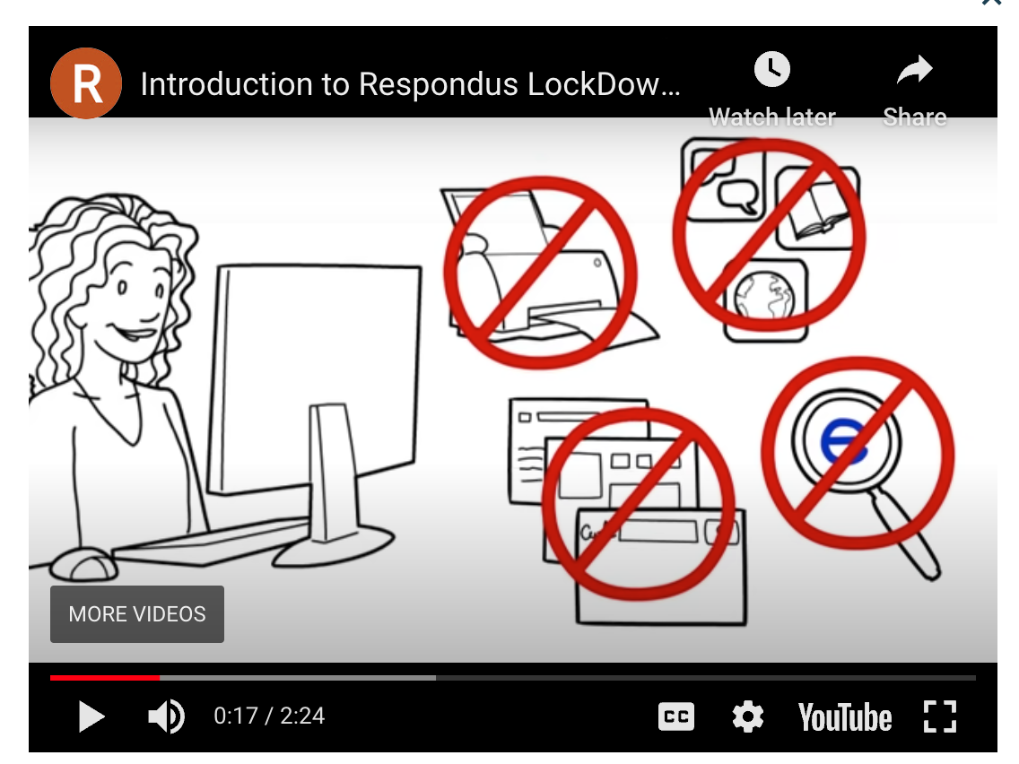
Take quizzes and exams with Respondus Lockdown Browser
To take the midterm you need to use Respondus, a browser that prevents app switching and internet browsing
IE Respondus Guide here
Installation link here

Slide 17


Required books
Caramani, Comparative politics (2020)
Clark, Golder, and Golder Foundations of comparative politics (2019)

Slide 18
Key dates
We typically meet on Thursdays
But not always – make sure you check the Blackboard calendar
Midterm exam is on March 9
Research paper is due on May 15
Final exam is on May 25 (Madrid) / May 22 (Segovia)
Notes:
As you know the hybrid policy at IE has changed – in-person attendance is expected for all sessions, you can have up to 30% absences.
No flexibility as far as I can tell with those key dates, so mark them on your calendars. You must be in class.

Slide 19
Some basic rules in this course
Punctuality
Attendance – Qwickly
Phone policy
Laptop policy
Academic integrity
Readings
Participation
Diversity and inclusion
Notes:
PUNCTUALITY
I won’t wait more than a couple of minutes to start
Qwickly expires in a few minutes
Respect for others’ time: there’s 50 of us, 5 minutes of idle / waiting time totals about 4h that could be spent working, socializing, talking with family.
ATTENDANCE
Qwickly – download the app
QR code on the screen
Do a test run
I’ll do it each time per session
Problems with attendance, you deal with the program, not with me. I simply record whether you’re present or not.
No need to email me if you’re going to have to miss a session, you’re all adults.
Do email me if you want me to help with the material covered, readings, etc.
READINGS
Readings are compulsory.
There’ll be quizzes.
Required books are to be obtained –downloaded from IE library
Why those books
Additional materials I’ll recommend
INCLUSIVE CLASSROOM
Discussion is at the heart of PPA
Disagreement shouldn’t be personal or disrespectful.
I’m commited to making this class a safe environment for all, regardless of gender, race, political views, etc. I see diverse backgrounds as an asset. In this class we’re going to be dealing with complex problems and disagreement is only natural, but it shouldn’t be personal or disrespectful.

Slide 20
What we’ll cover today
Introductions: the course, the instructor, the participants
What to expect from this course
What is comparative politics?

Slide 21
What is NOT comparative politics?
International relations
Political philosophy
Exclusively dedicated to:
National-level politics
Macro-level phenomena
Formal institutions
Interested in individual cases in and of themselves
Political commentary

Slide 22
Next steps
Next week we will be discussing the approach and method of comparative politics
What IS comparative politics?
Is the scientific study of politics possible?
How do we go about systematically studying politics?
How is comparative politics useful to citizens, to professionals, and to societies?
Read Comparative politics – Chapters 1-3 (and Intro if you did not read it for today)

