Slide 1
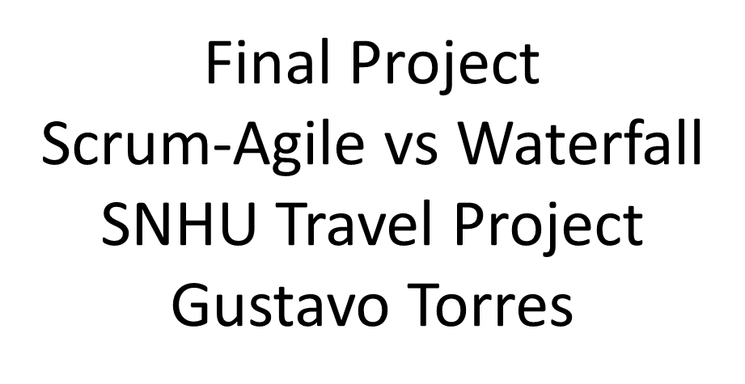
CS 250

Slide 2
Scrum Roles
Scrum Master – Facilitates team, removes blockers
Product Owner – Manages backlog and priorities
Developer – Builds and implements features
Tester – Validates functionality and quality

Slide 3
Agile SDLC Phases
Planning – Backlog and Sprint Planning
Development – Iterative sprints
Testing – Continuous testing during development
Review – Sprint Review for feedback
Improvement – Retrospective for process improvement

Slide 4
Waterfall vs Agile
Waterfall – Fixed plan, late testing, difficult to change
Agile – Flexible, continuous feedback, ongoing testing
Agile allows faster adaptation to change
Agile improves collaboration and visibility

Slide 5
Agile in SNHU Travel Project
Used user stories to define requirements
Adapted to changes (wellness travel focus)
Continuous communication between roles
Delivered value in smaller increments

Slide 6
Why Agile is Better
Faster response to change
Better communication and teamwork
Continuous improvement through retrospectives
Reduced risk of building the wrong product

Slide 7
References
Atlassian. (2026). Agile ceremonies guide.
Microsoft. (2025). Azure Boards overview.
Scrum Guide (2020).
Project Management Institute (2024).

