Slide 1
Melodica Media Corp.
Now Playing
1:23
2:36

Slide 2
Table of contents
01
02
SQL Scripts and Schema
SSIS SSAS
03
04
PowerBI
Conclusion
Album list

Slide 3

About Melodica
Best hits
Melodica Media Corp. is a multinational company headquartered in California, US that operates the namesake Melodica online music store.
The store is comprised of downloadable
MP4 files of songs that customers can download a piece.

Slide 4
Project Overview and Objectives
Discover
Data Warehouse Setup: Established through SQL Server Management Studio for secure and efficient data storage.
ETL Processes via SSMS: Utilized SQL Server Management Studio for ETL processes, ensuring accurate data transfer and transformation.
SCD Type 2 in 'DimCustomer': Implemented to track and maintain historical customer data changes.
Power BI Integration: Facilitated in-depth analysis of sales and customer behavior, significantly enhancing decision-making.
OLTP
Staging
DW
SSIS
SSAS
PowerBI

Slide 5
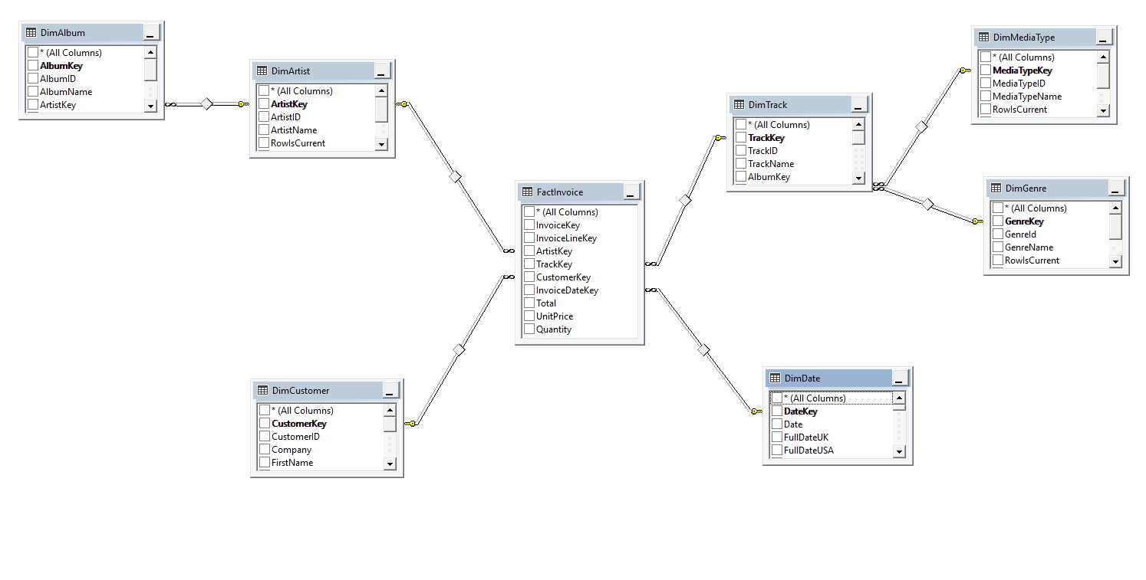
Best hits
Data Warehouse
Starting from the OLTP Database using SSMS (SQL Server Management Studio) the Staging Database and the Data Warehouse were created.
The Data Warehouse includes the dimension tables: Album, Artist, Customer, Track, Media Type, Genre and Date as well as the fact table Invoice
The entity relationship diagram is in a Snowflake Schema.

Slide 6
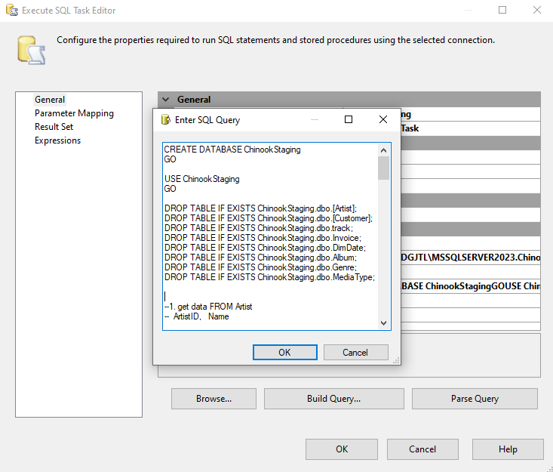
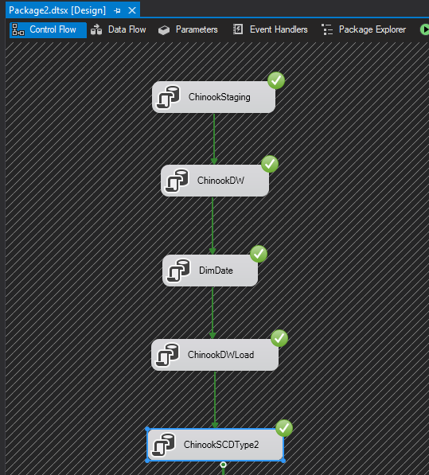
SSIS
Best podcast
Using the Visual Studio’ s SSIS (SQL Server Integration Services)
•SQL Query integration
•Control flow diagram
•Package creation

Slide 7
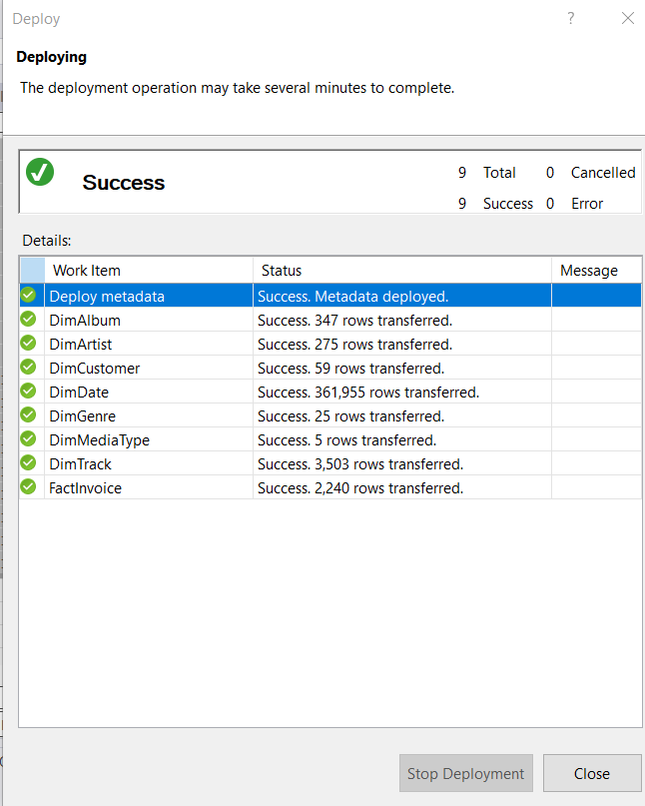
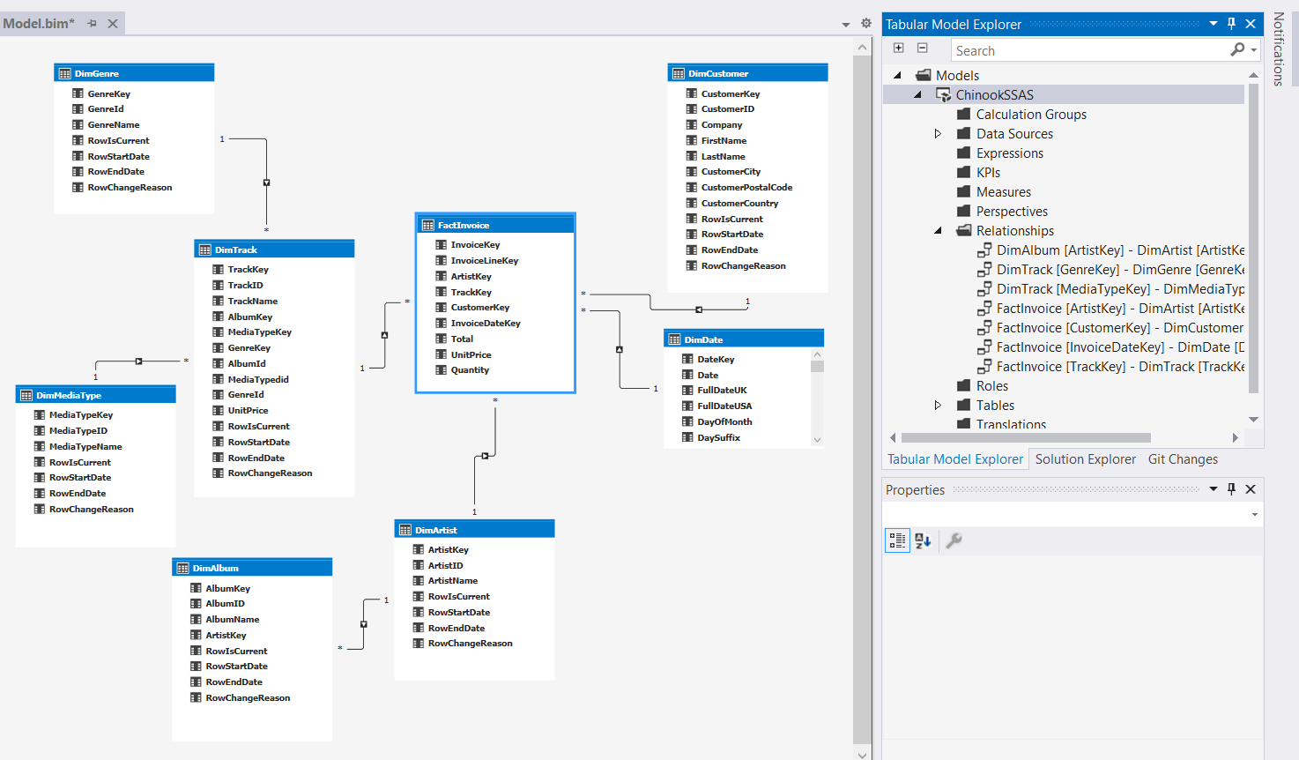
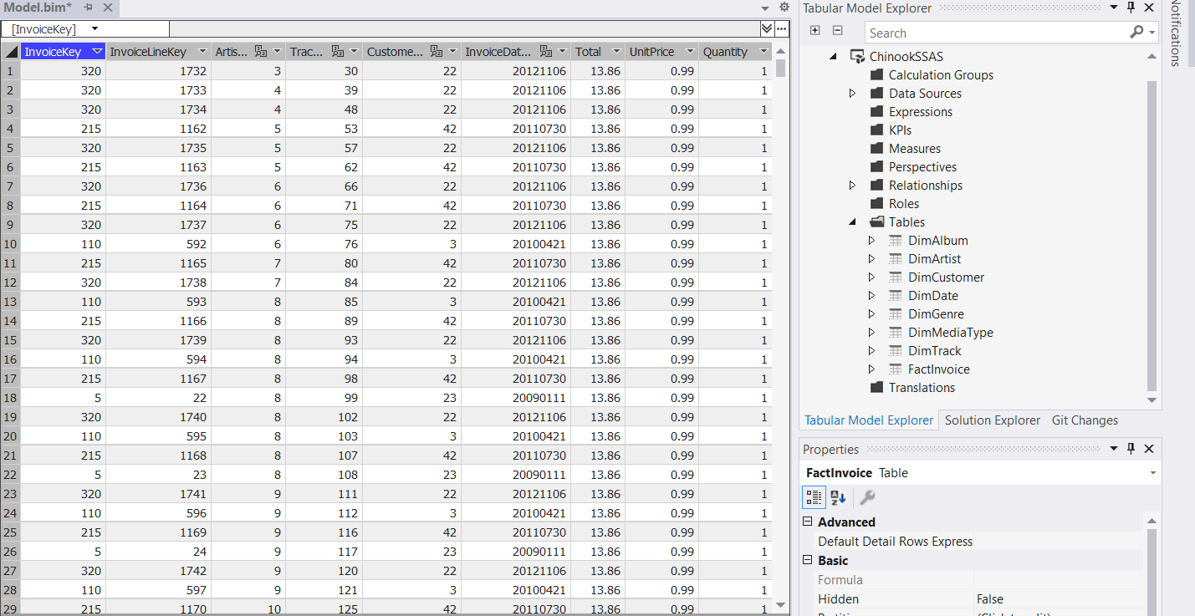
SSAS
Now playing
Using the Visual Studio’ s SSAS (SQL Server Analysis Services)
•Transfer of the data into SSAS
•Creation of the relationships between the dimension and the fact tables
•Adding measures or new columns
•Project deployment

Slide 8
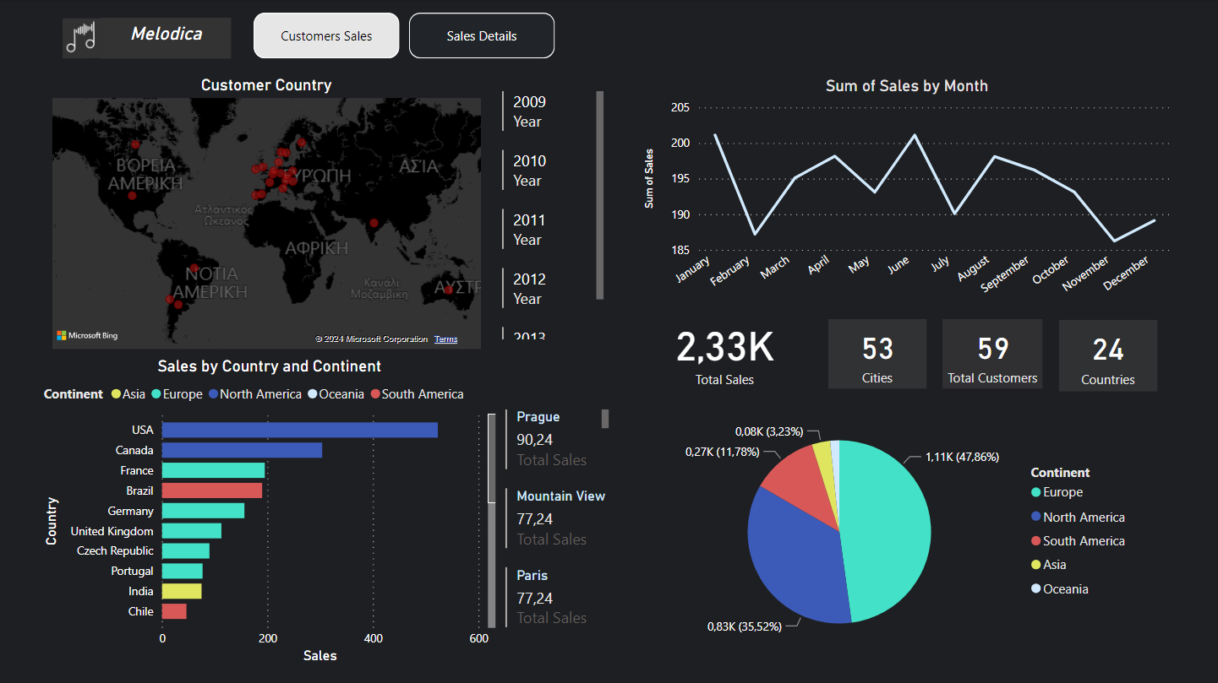
Now playing
PowerBI
Following that, the data was transferred to PowerBI with the aim of optimizing and better interpreting both the data and the results.
In the initial dashboard, the sales of Melodica from 2009 to 2013 were examined.
Α detailed analysis of sales was conducted,
focusing on consumers and their geographical
details. Additionally, a line chart depicting monthly
sales was included to identify peak sales months
each year.
In summary, the total sales amounted to 2,330, involving 59 customers from 24 countries and 53
cities.

Slide 9
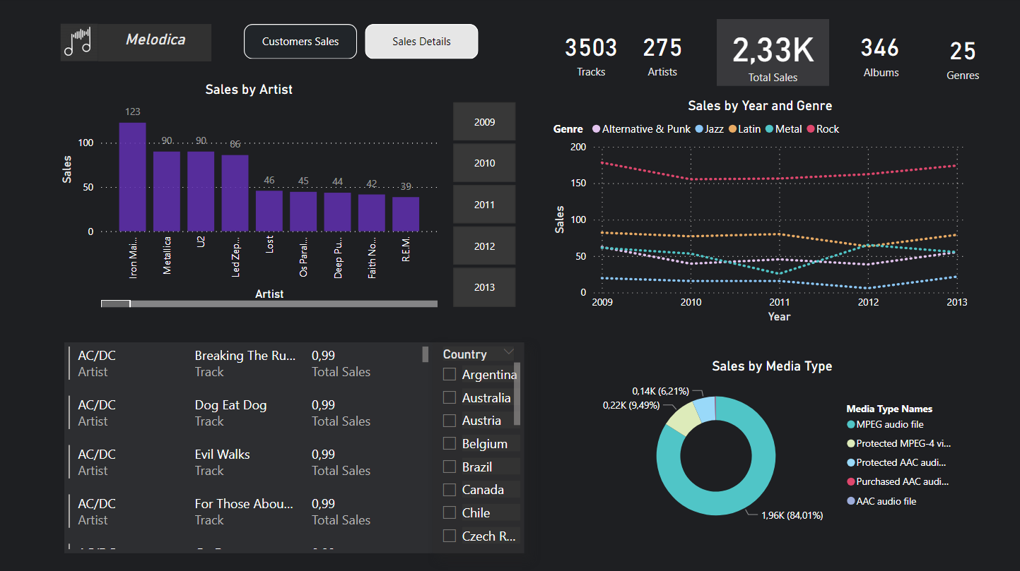
PowerBI
Best hits
The second Dashboard shows the sales related to the songs, the artists, the category of music and media type.
In the period 2009 to 2013 were sold 3503 songs, 275 artists, 346 albums and 25 genres.
Specifically, the top five music categories and the top 10 artists were analyzed in more detail.
In addition, charts were created to better analyze the cities and sales in each one as well as the preference of the media type.

Slide 10
Conclusion
Best hits
Given the low percentage of total sales both Asia and Oceania have, a market research is advised for both these continents. This will be very crucial in uncovering the music preference of these populations, and thus, in unlocking the full potential of these markets.
Use of machine learning methods is proposed, combined with our analysis as well as raw data, to predict future metrics (such as sales, costs) etc. This will allow reduction of operation costs and increase preparedness.
Investing in lowering the cost of production for the most sold media type, the MPEG audio file, will allow the business to reduce production costs down the road and increase profit margins.

Slide 11
Album list
Thank you! ☺

