Slide 1

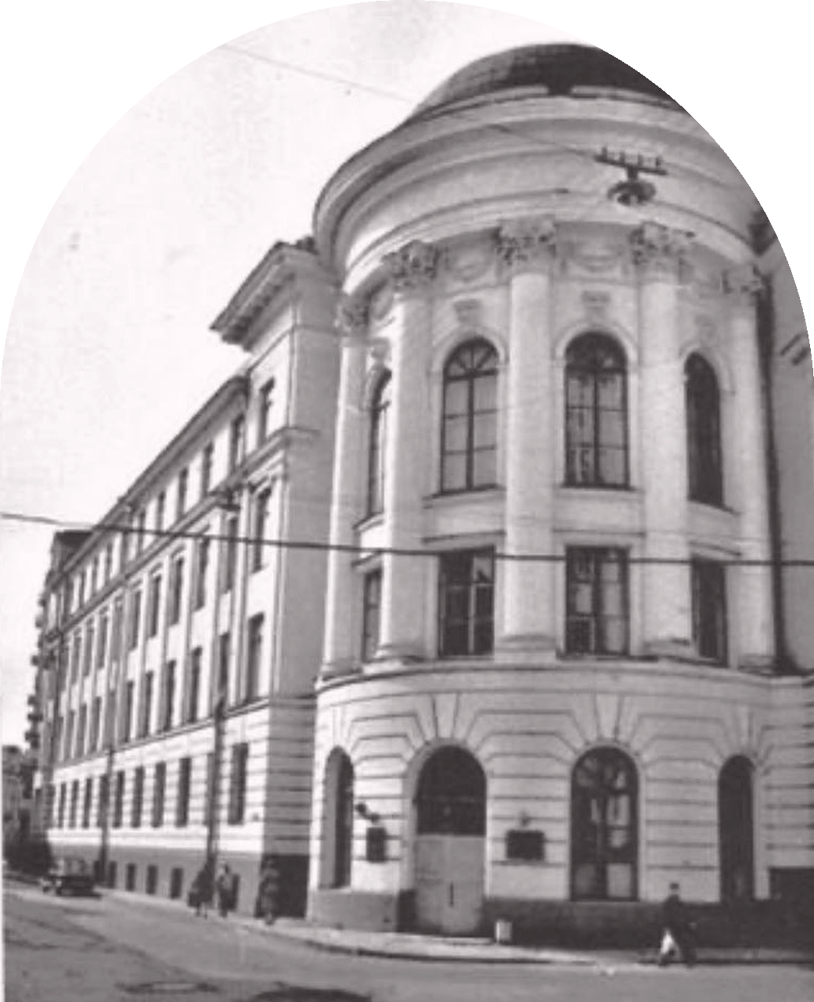
HISTORY OF
MY UNIVERSITY
MOSCOW REGIONAL PEDAGOGICAL INSTITUTE
1931 – 1940
PRESENTED BY
Margarita Kondakova
Elizaveta Vashchina
Alexandra Abdulmanova

Slide 2
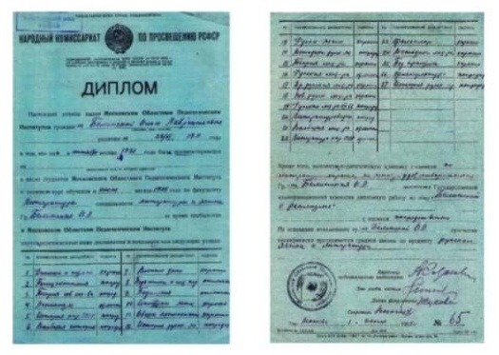
How It All Began
1931
THE BEGINNING
On June 1, 1931 our university was founded. At first it was called the Moscow Regional Industrial-Pedagogical Institute. Later it got a simpler name — the Moscow Regional Pedagogical Institute (MOPI).
WHY IT WAS NEEDED
The new institute appeared because the country badly needed teachers. In 1932, the Moscow region introduced universal seven-year education, so schools needed many qualified teachers. The government also wanted MOPI to become a model pedagogical university for other regions.
MOPI diploma, 1931

Slide 3
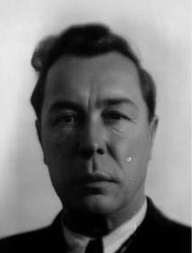
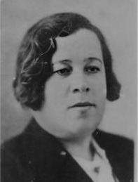
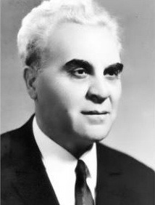
Directors of MOPI
MO
PI
The leadership changed quite often, which reflected the difficult political times.
1931
Afanasy Vasilyevich Shulgin
first director
1935–1936
A. A. Savrasova
1938–1941
D. A. Allakhverdyan
LEADERSHIP · 1931–1941

Slide 4
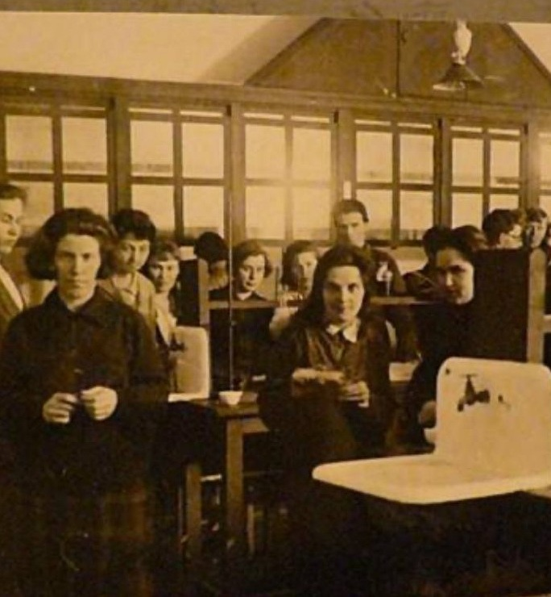
First Faculties
At the start, the institute had three faculties:
01
Social and Literary
with a history department
02
Physics and Mathematics
03
Chemistry and Technology
12
1
departments
methodical office
Chemistry students of the first MOPI intake, 1931

Slide 5
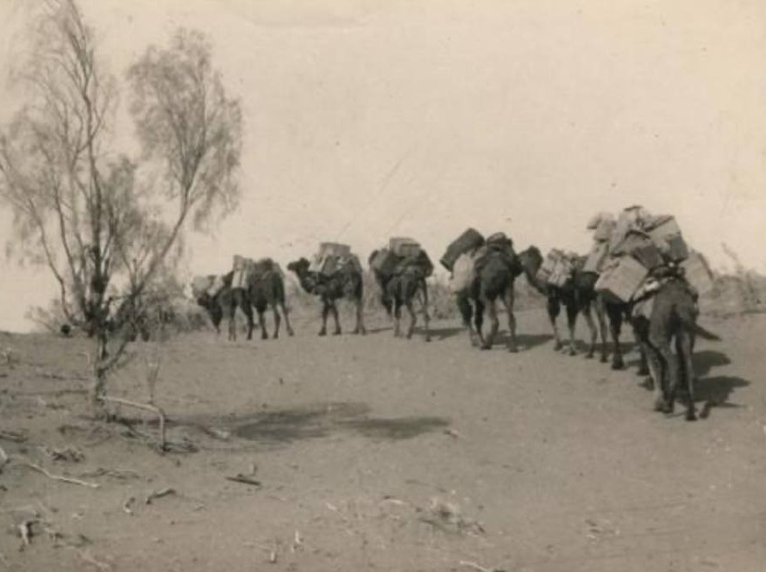
Growth in 1932–1935
The institute grew quickly.
BY 1933 — SIX FULL-TIME FACULTIES
01
Literature
02
Geography
03
Physics
04
Chemistry
05
Economics
06
History
1932
Correspondence department opened
22
First graduates, 1934/35
Geographical expedition of MOPI to the Uzboy river (Turkmenistan), early 1930s
People could become teachers without leaving their jobs.
All from the History faculty — the number was small because the university was still very young.

Slide 6
Famous Professors
Despite political pressure, MOPI had a strong teaching staff. Famous historians worked here:
01
N. L. Rubinstein
head of the History of the USSR department
02
B. A. Rybakov
future academician, worked at MOPI from 1934 to 1952
03
V. M. Khvostov
head of the Modern History department
04
B. F. Porshnev
head of Ancient and Medieval History
05
A. V. Shestakov
author of a school textbook on USSR history
Students remembered these professors as brilliant teachers.

Slide 7
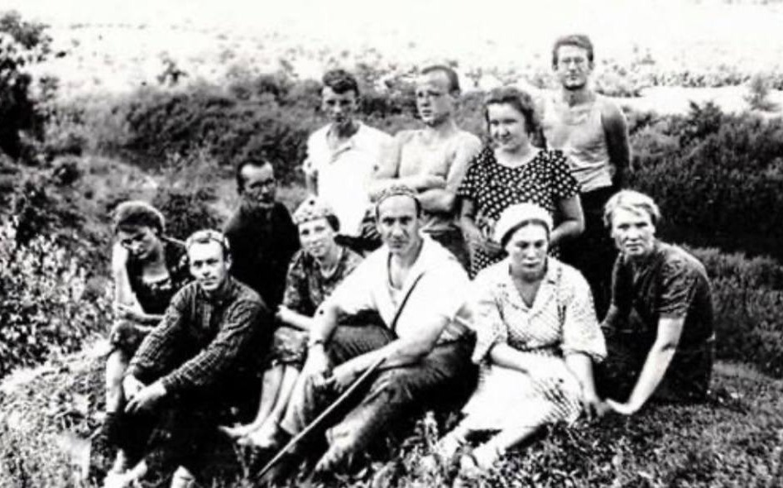
1937–1939: New Steps
FIRST ACADEMIC JOURNAL
POSTGRADUATE STUDIES
1937
1939
Uchyonye Zapiski
Aspirantura
The institute started publishing its own academic journal, “Uchyonye Zapiski.”
Postgraduate studies opened. This was an important step for training young scientists.
B. A. Rybakov with MOPI students at archaeological excavations

Slide 8
Results of the First Decade
945
2,582
1931
teachers graduated
students
library founded
from the History faculty alone, 1931–1941
studied at MOPI by June 1941
it grew together with the institute
Together with other faculties the number was much bigger. MOPI became one of the leading centres for teacher training in the country.

Slide 9
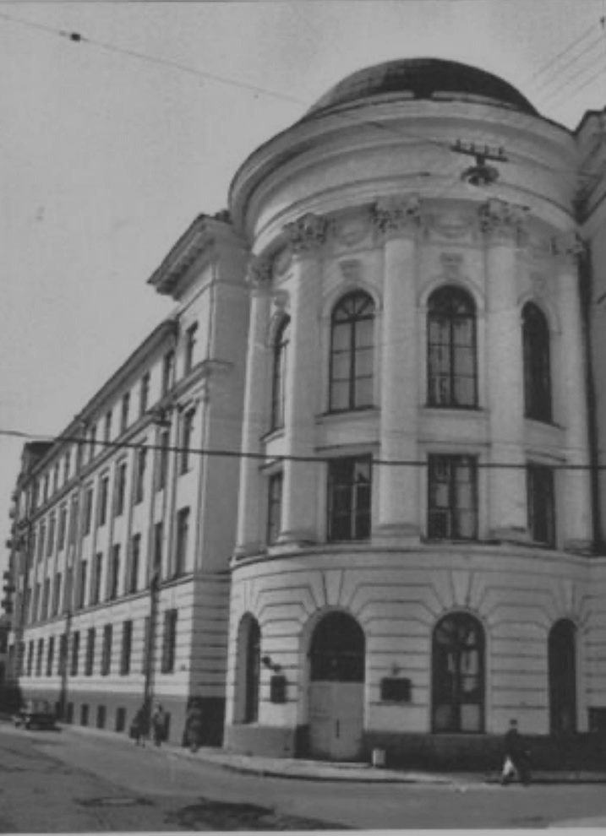
1941: The War Begins
October 15, 1941
Classes stopped. The institute was evacuated. Students marched to Murom, and later professors and teachers were moved to the town of Malmyzh in the Kirov region.
Moscow
Murom
Malmyzh
classes stop
students march here
Kirov region
264
273
26
full-time students remained by the start of 1941/42
students arrived in Malmyzh
teachers arrived in Malmyzh
MOPI's main pre-war building, Podsosensky Lane, 20

Slide 10
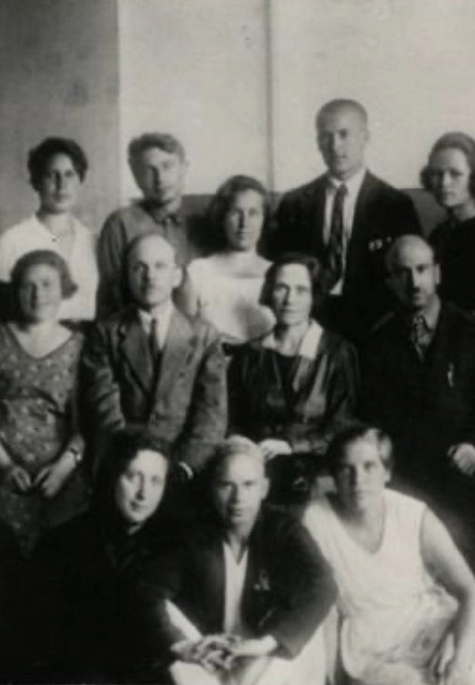
TO BE CONTINUED
But that is already a different page of our history —
the war years.
Margarita Kondakova · Elizaveta Vashchina · Alexandra Abdulmanova
Literature faculty students, 1933

