Slide 1
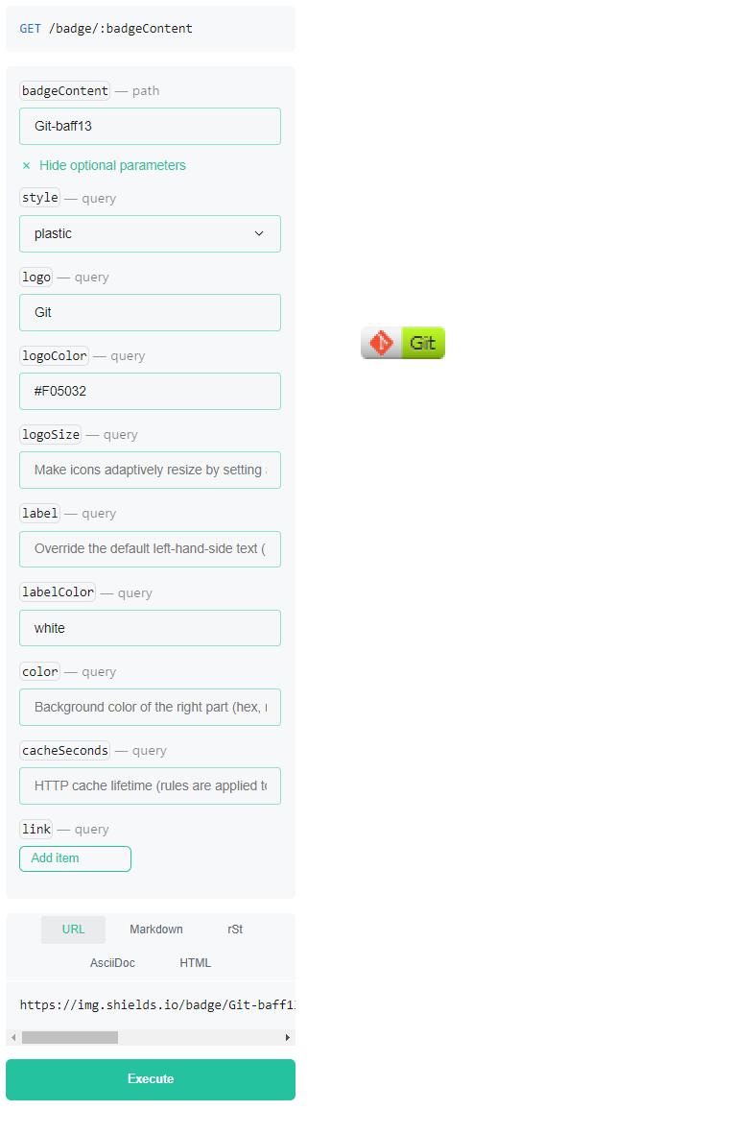
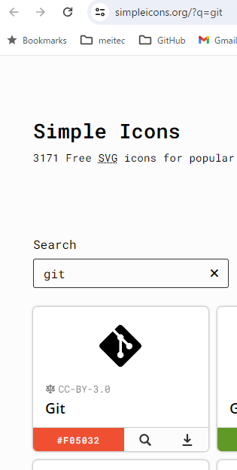
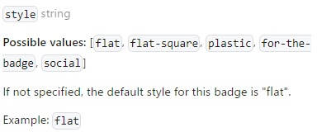
https://shields.io/badges
https://simpleicons.org
Git-Color
Color of Logo
Background Color of Logo
Markdown
[![Git](https://img.shields.io/badge/Git-baf213?style=plastic
&logo=Git&labelColor=white)](https://git-scm.com/)

