Slide 1
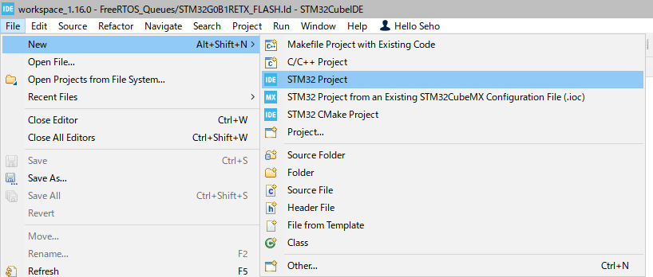
Hello Cube #01

Slide 2
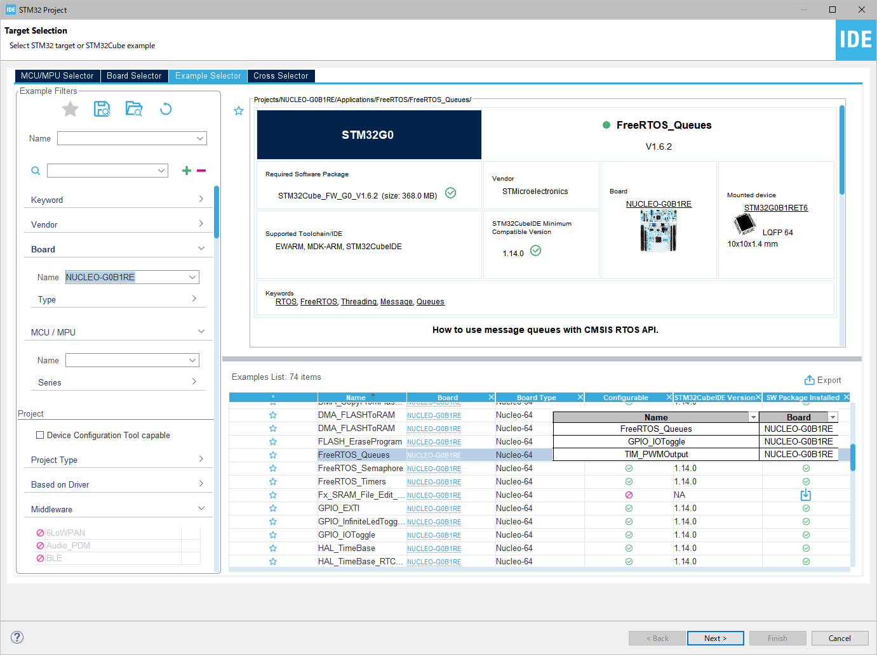
Hello Cube #02

Slide 3
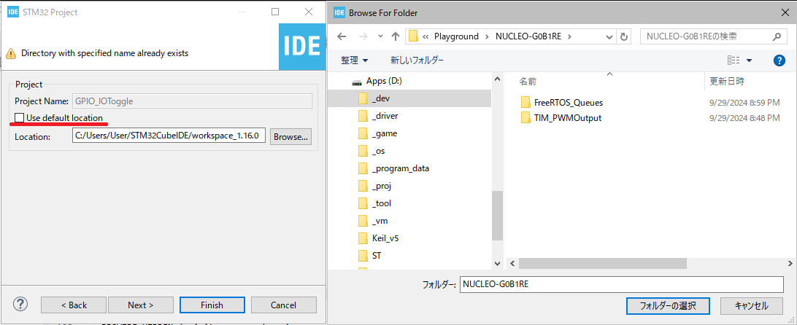
Hello Cube #03

