Slide 1
Evaluation Board (NUCLEO-G0B1RE)
LED
MCU(STM32G0B1RE)
UART
GPIO
Flash
Middleware
Driver
ST-Link
Button
Application
Timer
ADC
DAC
Application (Task)
FreeRTOS
Timer
GPIO
HAL
UART
Hardware Block Diagram
Software Block Diagram

Slide 2
Manager
Pending
Developer
Planned
InWork
Done
InReview
Closed
Canceled
Task (Issue, Artifact) Work Flow

Slide 3
PM
- Project mgmt.
- Risk mgmt.
- Resource mgmt.
TPM
- SwRS
- Task mgmt.
- Software release
DEV
- SwDD
- Implementation(Coding)
- Smoke Test
- Bug Fix
DEV
- SwDD
- Implementation(Coding)
- Smoke Test
- Bug Fix
DEV
- SwDD
- Implementation(Coding)
- Smoke Test
- Bug Fix
Project Manager
Technical Project Manager
Developer
Software Development Division Organization

Slide 4
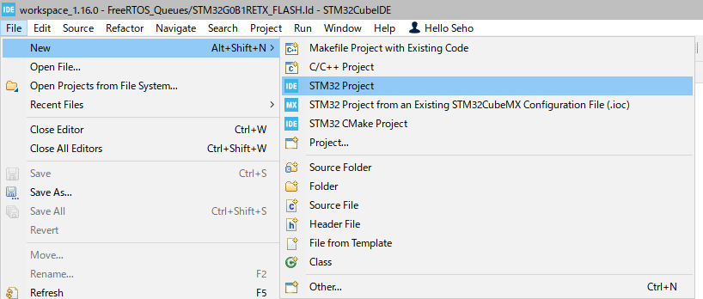
Hello Cube #01

Slide 5
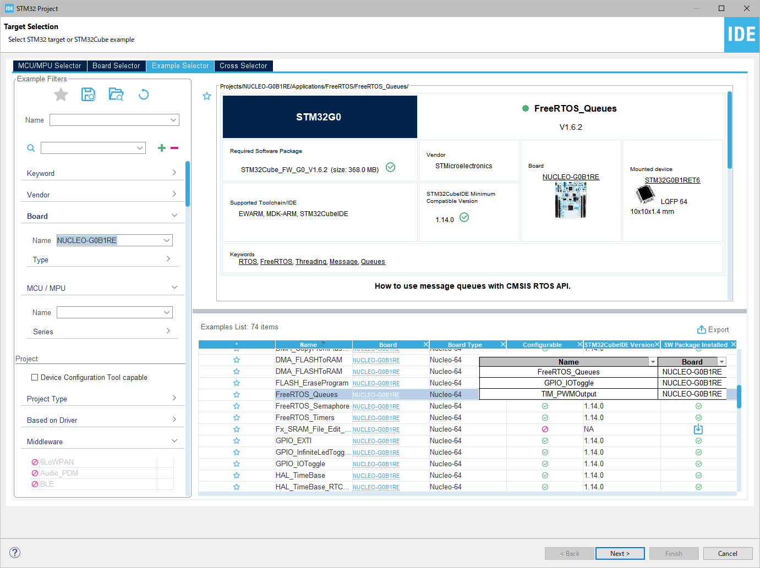
Hello Cube #01

Slide 6
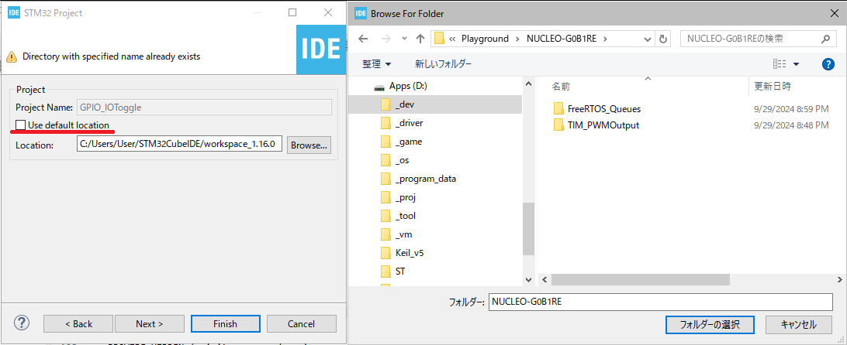
Hello Cube #03

Slide 7
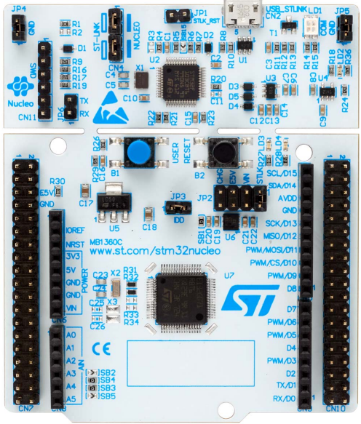
X1, 8Mhz
X2, 32.768kHz
X3, 未実装

Slide 8
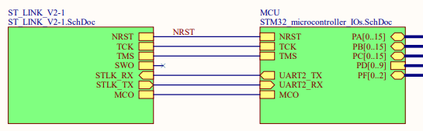
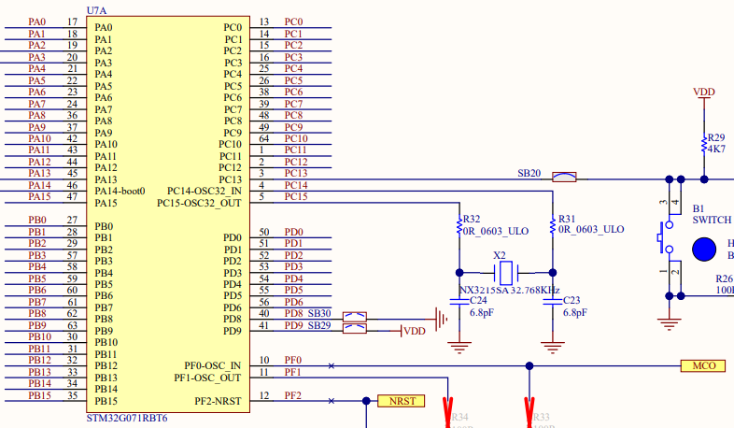
2,3 Page

Slide 9
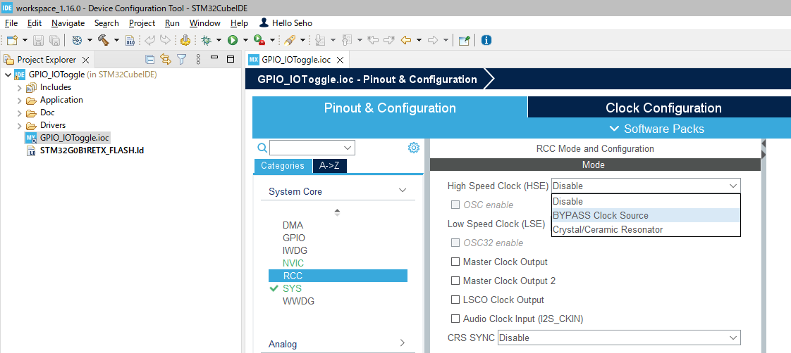

Slide 10
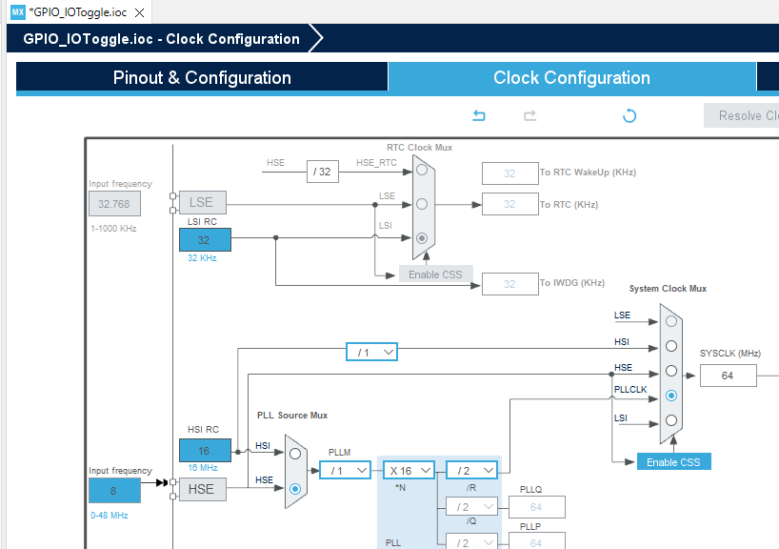

Slide 11
LD4

Slide 12
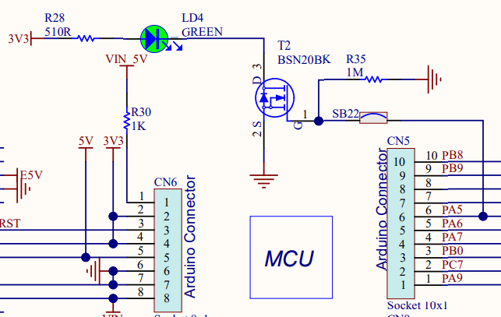
5 Page

Slide 13
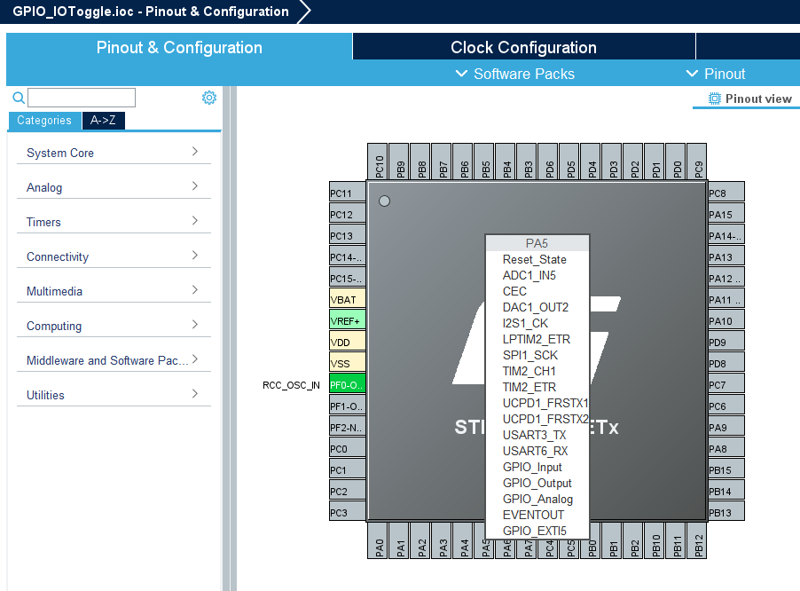

Slide 14
