Slide 1

CS 777 1. CDC Survey – Predict form of arthritis, rheumatoid arthritis, gout, lupus, or fibromyalgia 2. Trends in World Health and Economics - Clustering
Oct 2021
Gaurav Tungare

Slide 2
Topics
Background for Dataset
Classifiers Used
Logistic Regression
Decision Tree
Random Forest
Naïve Bayes
Dimension Selection/Reduction
Best Model selection
Justification of Best Model
Lessons Learnt
Clustering
Classification
Background for Dataset
Analysis of data
Clustering using – Kmean Silhouette Score
Clustering using – Gaussian Mixture
Lessons Learnt

Slide 3
Background for Dataset- Classification
The project-2018-BRFSS-arthritis.csv file has the dataset for the project and it has 11933 tuples and 108 attributes. Each tuple is a person who participated in the survey and each. attribute is an answer to a survey question. The class attribute is havarth3 and its value is either 1 or 2. The value of 1 means that the person was ever told to have some form of arthritis, rheumatoid arthritis, gout, lupus, or fibromyalgia.
Total Record Count – 11933 tuples w/ 108 attributes
After Train and Test split between dataset
Total “Train” Record Count - 7997
Total “Test” Record Count – 3936

Slide 4
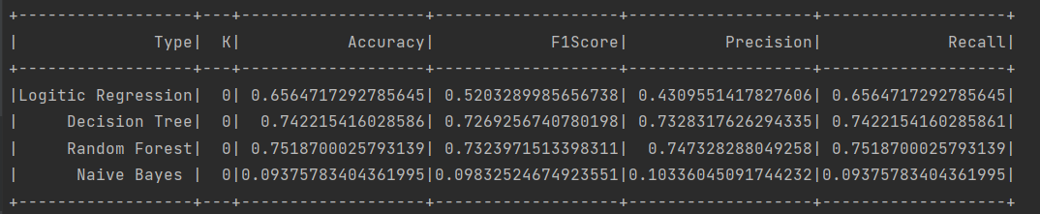
Classifiers Used & Result
The Logistic Regression
Decision Tree
RandomForest
Naive Bayes

Slide 5
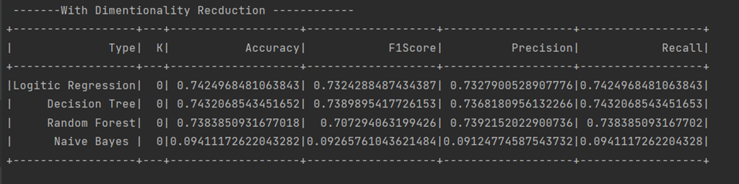
Dimensionality Reduction/Selection & Result

Slide 6
Best Model Classification
The best model after 100 iteration is RandomForest classification gave the best performance across
Justification
The above model has Accuracy of 0.7518 which indicate that the model is able to correctly predict the value of some form of arthritis, rheumatoid arthritis, gout, lupus, or fibromyalgia, TP rate ~0.80 indicate a good performing model
The F-measure of 0.732 indicate good sensitivity and recall for over all model, the close the F-measure to 1 the prediction across test data set improves, again this measure gives us confidence that the class attribute which the model is predicting is good
 | Accuracy | F1Score | Precision | Recall
 | 0.75187 | 0.73239 | 0.747328 | 0.7518700

Slide 7
Classification – Lessons Learnt
Learnt various aspect of classification on various classification algorithms
Naïve Bayes, Logistic, Decision Tree & Randomforest. On the test dataset the model performance is not varying a lot , the deviation across each model is +/- 3% which indicate that you need to be very careful with attribute selection method
I learnt about general prediction ability of a model all models were analyzed ,various accuracy, sensitivity, specificity, precision, F measure (or F-score). These different measures represent different aspects of the performance of a model which was used to predict some form of arthritis, rheumatoid arthritis, gout, lupus, or fibromyalgia.

Slide 8
Clustering - Background for Dataset
Gather insight into major trends and patterns for World Health and Economics, also identify the specific global statistical trends that have not reached a broad public audience
A selection of world health and economics statistics from the Gapminder project can be found in the dslabs package as data(gapminder) as well in python
“The Best Stats You've Ever Seen “ :-The original Gapminder TED talk
https://www.ted.com/talks/hans_rosling_the_best_stats_you_ve_ever_seen?language=en
https://www.gapminder.org/
Pip install gapminder

Slide 9
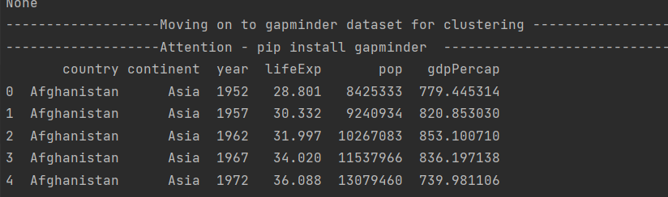
Background for Dataset
Year Range- 1960 to 2016
Country.
Year. Life_expectancy. Life expectancy in years.
Population. Country population.
GDP. GDP according to World Bank.
Continent.
Region.
Total Record Count
1704 tuples

Slide 10
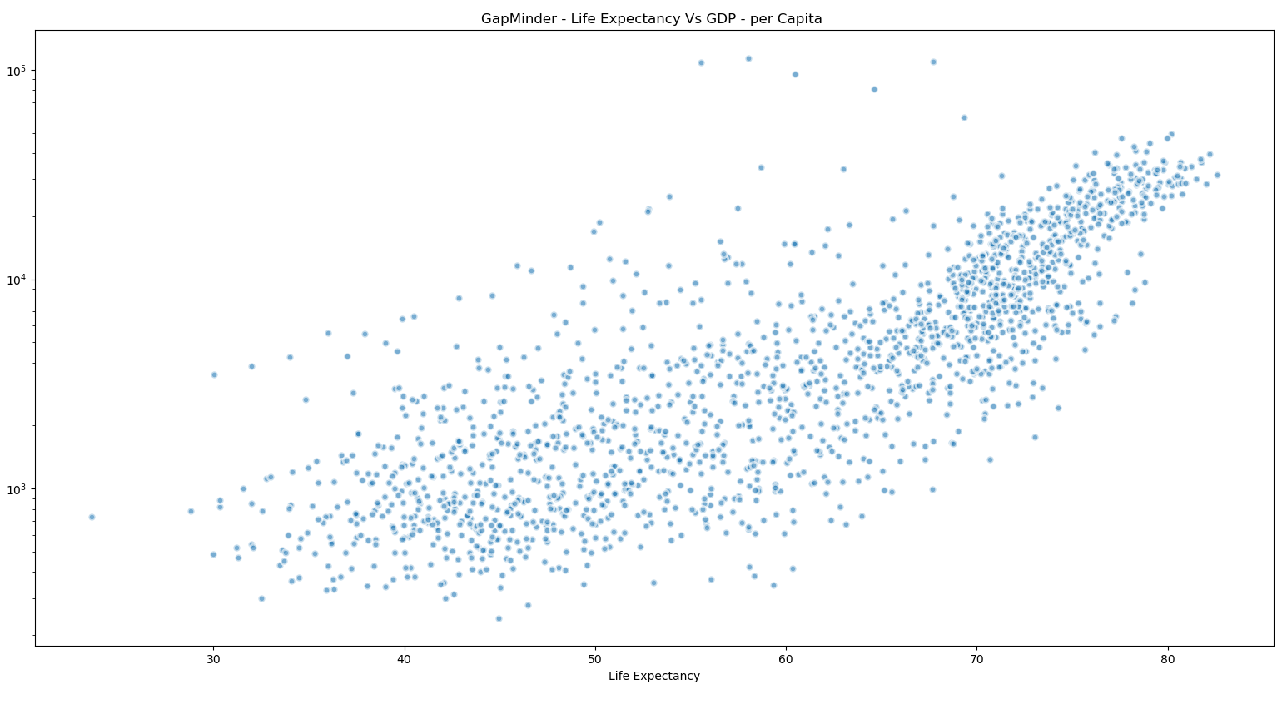
Analysis of data - Life Expectancy Vs GDP
We will start by looking at data from with life expectancies around 70 years
We see a lot of clustering around 70 years and around 40 year mark which in line with the GDP of high income and low income countries
Clustering around life expectancy around 40 year mark denote that there is a correlation between the gdp of the country and

Slide 11
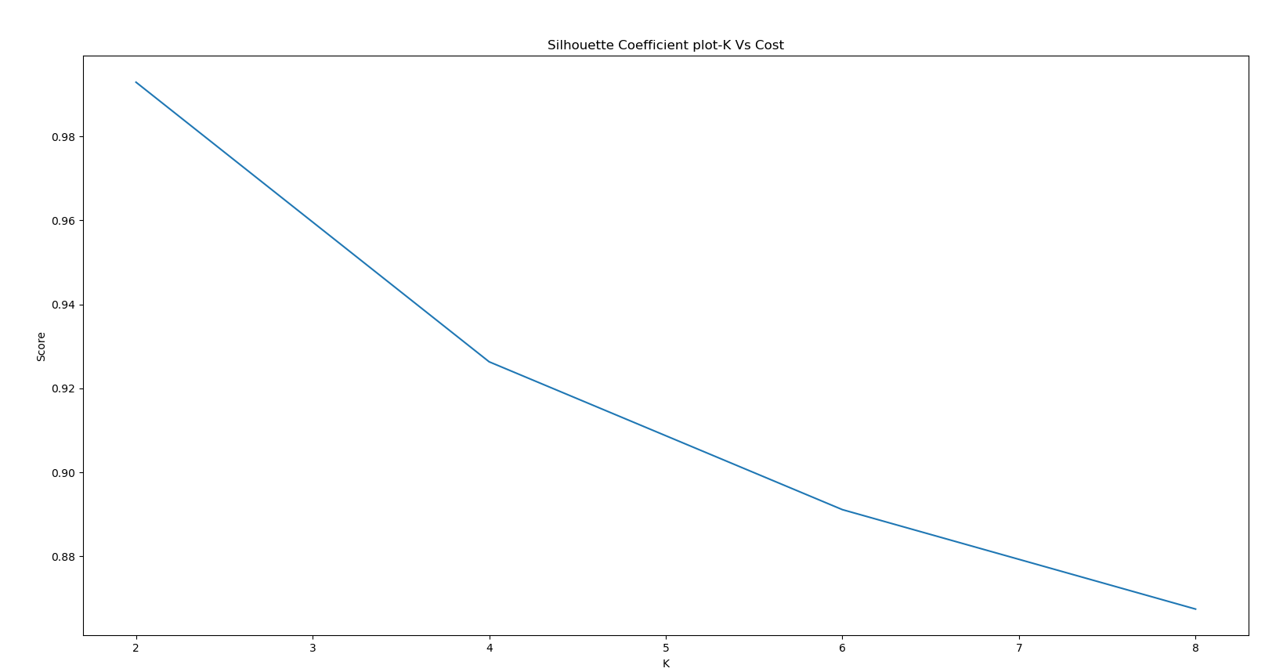
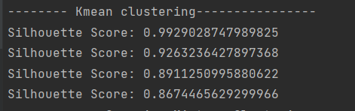
Clustering- Kmean
I am using Silhouette Score for measuring the goodness of the clusters

Slide 12
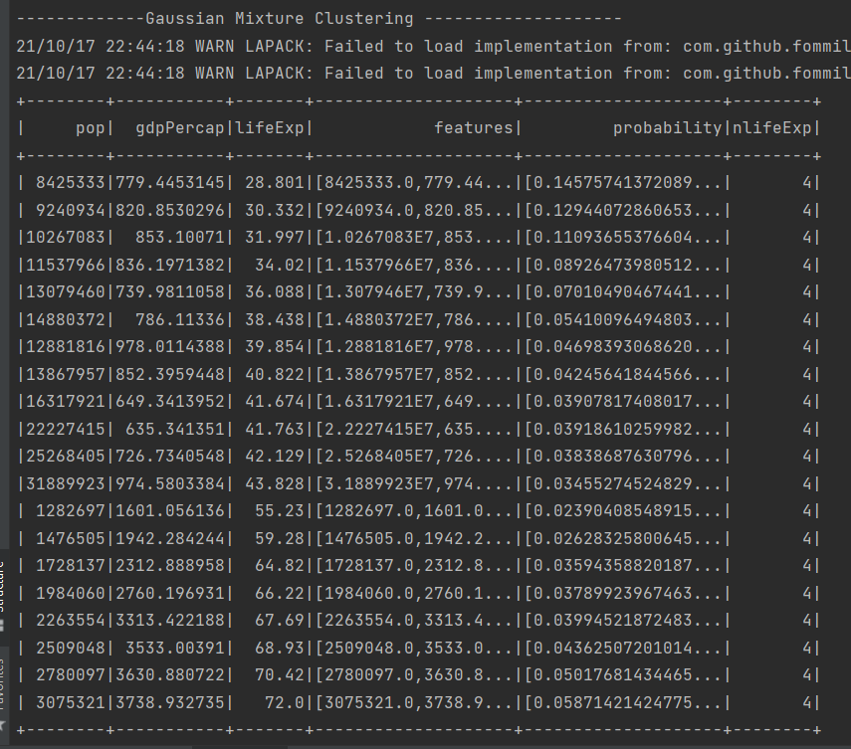
Clustering- Gaussian Mixture
I am using Gaussian Mixture to demonstrate the clustering technique learned in the class, The gaussian mixture using EM algo does give the required clusters

Slide 13
Clustering- Lesson Learnt
In general, k-means and EM may perform better or worse, depending on the nature of the data we want to cluster, and our criteria for what defines a good clustering result.
Thanks

