Slide 1

CS 688 – Twitter stock market sentiment analysis
Apr 2021
Gaurav Tungare

Slide 2
Topics
Objective
Background -Identification of Gainer and Loser stock
Snapshot of choices
Gainer Stock – Tesla, Coinbase & Moderna
Loser Stock – AMC Entertainment, Johnson&Johnson & Peloton
Preprocessing
Most Frequent Term – Gainer Stock & Loser Stock
Top word pair (bigrams) for gainer and loser stock
Word Network for gainer and loser stock
Sentiment Score Analysis
With Type1 and Type 2 classification
With Type 2 classification only
Data visualization that shows the single-day change

Slide 3
Background -Identification of Gainer and Loser stock
Gainer Stock
Loser Stock
Tesla
Market Darling
Expoential growth
Coinbase
Just launched IPO
Potential 1000X returns
Moderna
Leader with mRNA technology
Potential replication of technology to other areas
Techonogy Spread
New technology with blockchain
AMC
Affected by covid situation
Less footfall
Johson & Johnson
Implication with negative review
Cascading effect in other areas
Peloton
Potential regulator issues with the design question
Negative reviews with infant death
Talks of bankruptcy
Getting acquired by Amazon

Slide 4
PreProcessing
The following are the pre-preprocessing step performed to achieve a clean text tweet
Remove twitters #tags
Remove emojis AND a lot of other stuff (other languages, etc.)
Remove http elements manually
Remove special characters “[\\()*&^%$#@.?<>=+;'!,_/~|:-]” manually
Convert to lower case
Remove non alpha numeric elements manually
Remove all the numeric characters

Slide 5
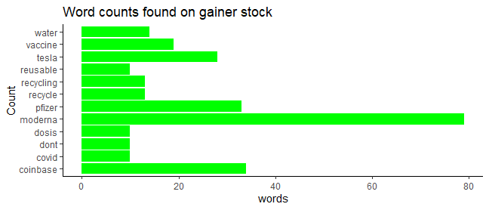
Most Frequent Term
Gainer Stock

Slide 6
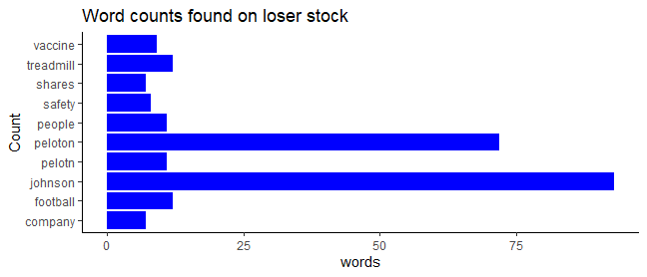
Most Frequent Term
Loser Stock

Slide 7
Most Word Pair (bigrams)
Gainer Stock
Loser Stock
 | Word1 | Word2 | n
1 | dosis | de | 9
2 | de | pfizer | 8
3 | de | las | 7
4 | moderna | vaccine | 7
5 | de | la | 6
6 | elon | musk | 6
7 | fatal | tesla | 6
8 | la | segunda | 6
9 | las | vacunas | 6
10 | lost | billion | 6
 | Word1 | Word2 | n
1 | boris | johnson | 28
2 | amp | johnson | 14
3 | johnson | amp | 13
4 | gme | amc | 9
5 | amc | gme | 7
6 | de | la | 7
7 | de | los | 4
8 | johnson | vaccine | 4
9 | le | peloton | 4
10 | peloton | tread | 4

Slide 8
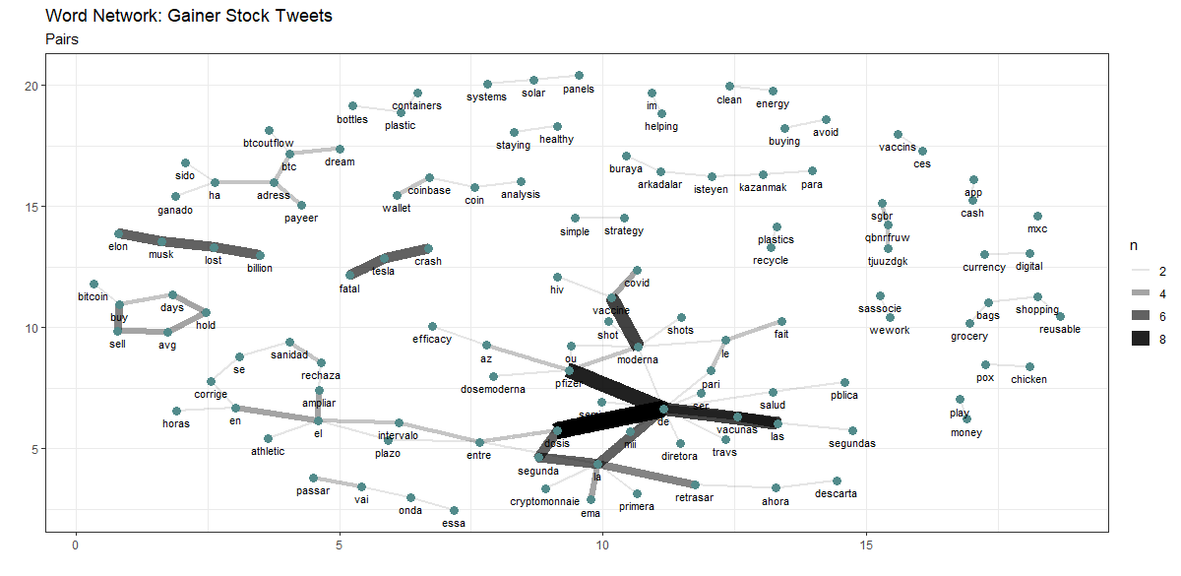
Most Word Pair (bigrams)
Gainer Stock
Observations
Bicoin-buy-sell-hold-avg is appearing which is interesting
Fatal-tesla is appearing
Coinbase-wallet are appearing
Bottle-groceries-plastic are appearing

Slide 9
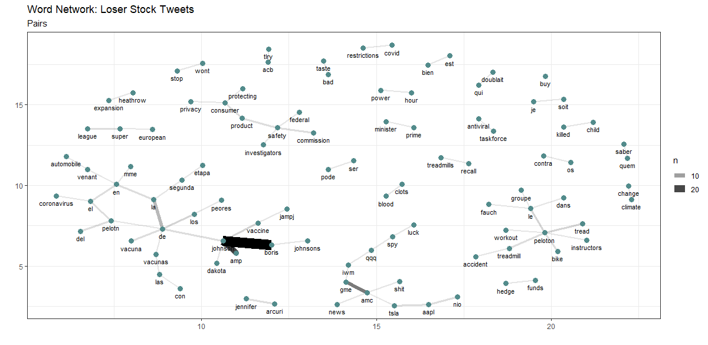
Most Word Pair (bigrams)
Loser Stock
Observations
Peloton-workout-recall are appearing
Consumer-protection-product safety is appearing
Johnson vaccines appears frquently

Slide 10
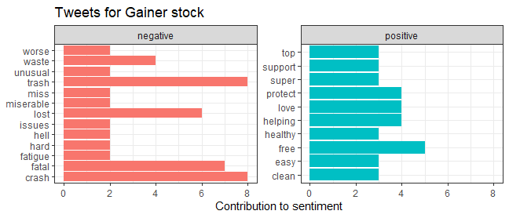
Sentiment Analysis
Gainer Stock
Observations
On positive side words coming out are support, protect and help
We have words like crash, miserable ad fatigues which are common in the covid times

Slide 11
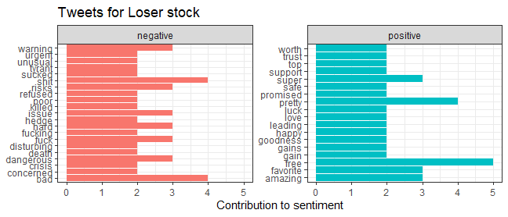
Sentiment Analysis
Loser Stock
Observations
On positive side words coming out are trust, support and free
We have words like risks, warning, dangerous and urgent

Slide 12
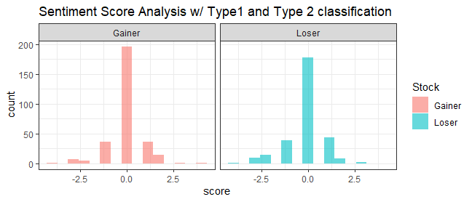
Sentiment Sore Analysis
With Type 1 and Type 2
Observations
As expected, negative and positive sentiments are cancelling each other to create a high score for 0
There is higher density of score above zero which indicate that there are positive sentiments for the stock. There are several factor affecting which reflects in the tweet with words like “free”, “clean” appearing often resulting the more density of score above zero
There are negative sentiments expressed with words containing “fatal”, ”hard” and “issues” being expressed often as well

Slide 13
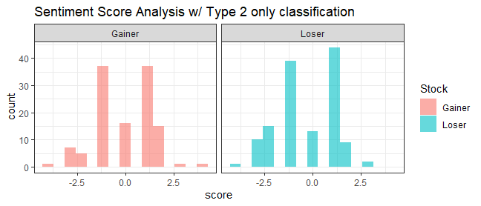
Sentiment Sore Analysis
With Type 2 only
Observations
There is higher density of score above zero which indicate that there are positive sentiments for the stock. There are several factor affecting which reflects in the tweet with words like “free”, “clean” appearing often resulting the more density of score above zero
There are negative sentiments expressed with words containing “fatal”, ”hard” and “issues” being expressed often as well

Slide 14
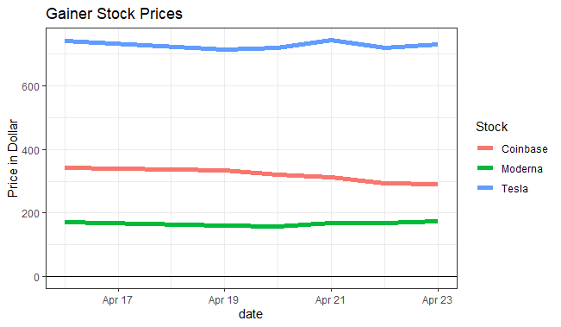
Data Visualization
Gainer Stock
Observations
Tesla as a higher price point of the overall stock which reflect in the plot as the price point it around $720
For Coinbase closing price of $ 291.60
For Moerna closing price of $173.63

Slide 15
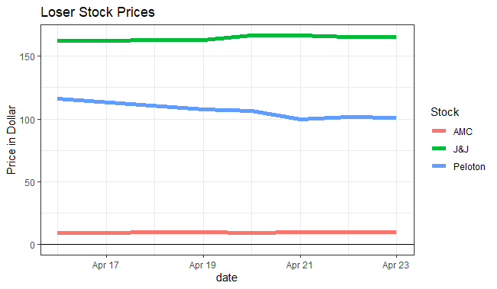
Data Visualization
Loser Stock
Observations
J&J stock gone through lot of swing ,also AMC stock has seen price fluctuation
For AMC closing price of $10.16
For J&J closing price of $165.52
For Peleton closing price of $101.07

Slide 16
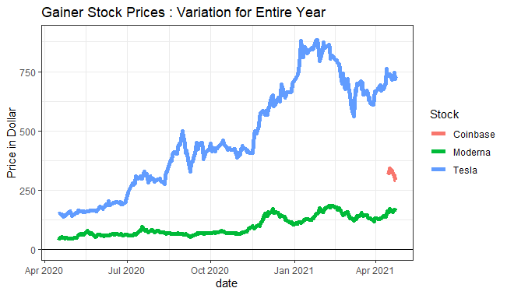
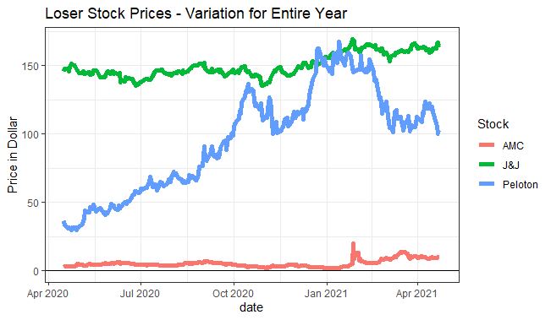
Data Visualization
Gainer Stock
Loser Stock

Slide 17
Thank You

