Slide 2
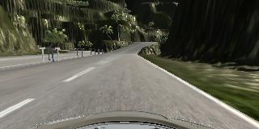
Conv2D (Conv1)
# filt: 12
# kernel: 5x5
#stride: 2x2
MaxPool (MaxPool1)
# pool: 2x2
# stride: 2x2
Conv2D (Conv2)
# filt: 48
# kernel: 4x4
#stride: 2x2
Spatial DropOut
Spatial DropOut
Image Preprocess
Conv2D (Conv3)
# filt: 48
# kernel: 4x4
#stride: 2x2
Conv2D (Conv4)
# filt: 64
# kernel: 3x3
#stride: 2x2
Spatial DropOut
Spatial DropOut
GlobalAveragePool
DropOut
Dense(128)
Dense(1)

Slide 3
Latitudinal Controller
(GTRegression)
angle ([-1, 1])
PI Controller
Throttle
Const_Speed x (1 – α x|angle|)

Slide 4
Latitudinal Controller
(GTRegression)
angle ([-1, 1])
Set-Speed
(mph)
Longitudinal Controller
(GTRegression)
Throttle
Clip[5, 20]
PI Controller

