Slide 1
Good commit messages
Gwyn Jones, Lead Front End Developer

Slide 2
Why they matter

Slide 3
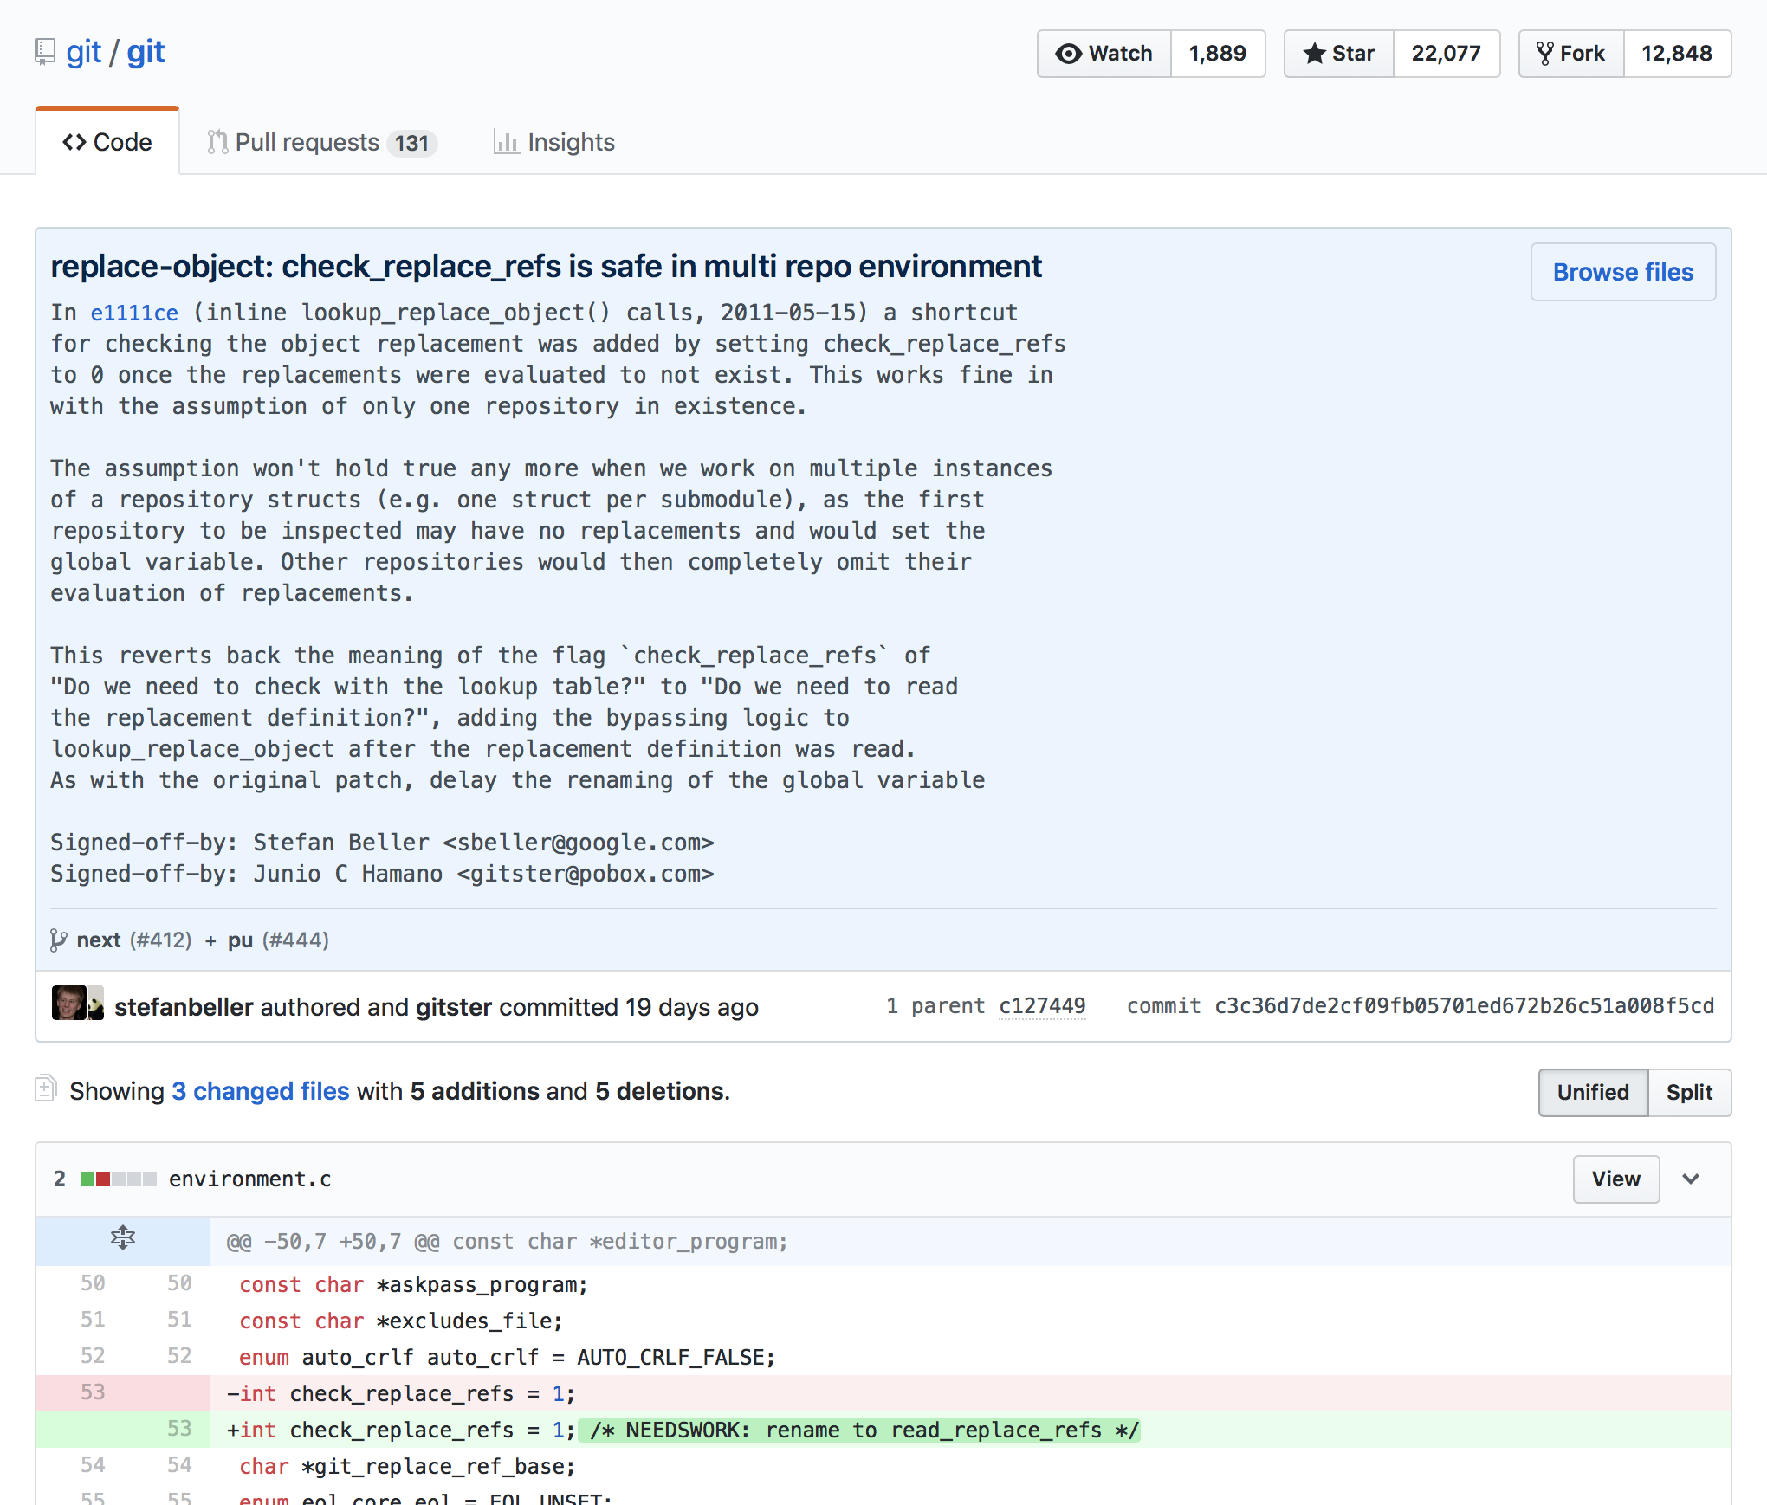
They communicate the context of a change
“The contributors to these repositories know that a well-crafted Git commit message is the best way to communicate context about a change to fellow developers (and indeed to their future selves). A diff will tell you what changed, but only the commit message can properly tell you why.”
Chris Beams. “How to Write a Git Commit Message”

Slide 4
Re-establishing the context of a piece of code is wasteful. We can’t avoid it completely, so our efforts should go to reducing it [as much] as possible. Commit messages can do exactly that and as a result, a commit message shows whether a developer is a good collaborator.
Peter Hutterer

Slide 5
What’s the point: a vicious cycle
“A project’s long-term success rests (among other things) on its maintainability, and a maintainer has few tools more powerful than his project’s log. It’s worth taking the time to learn how to care for one properly. What may be a hassle at first soon becomes habit, and eventually a source of pride and productivity for all involved.”
Chris Beams. “How to Write a Git Commit Message”
We don’t get value from our commit history because it’s unstructured and inconsistent,
We don’t put effort into our commits because we don’t get value from them
But this can easily be flipped into a virtuous cycle

Slide 6
Git has many really useful tools that rely upon a well maintained log
Blame* - show what revision and author last modified each line of a file
Revert - given one or more existing commits, revert the changes that the related patches introduce, and record some new commits that record them
Rebase - re-apply commits on top of another base commit
Log (incl. --oneline --graph --decorate)
Shortlog - summarises the log in a format suitable for release announcements
*like the name ‘git’, I believe the intention here is to be humorous. When accompanied by meaningful commit messages Git Blame becomes incredibly useful for understanding the context of a particular change.

Slide 7
What they are
Good commits are part of a well maintained project log
A well maintained project log
Good commits

Slide 8
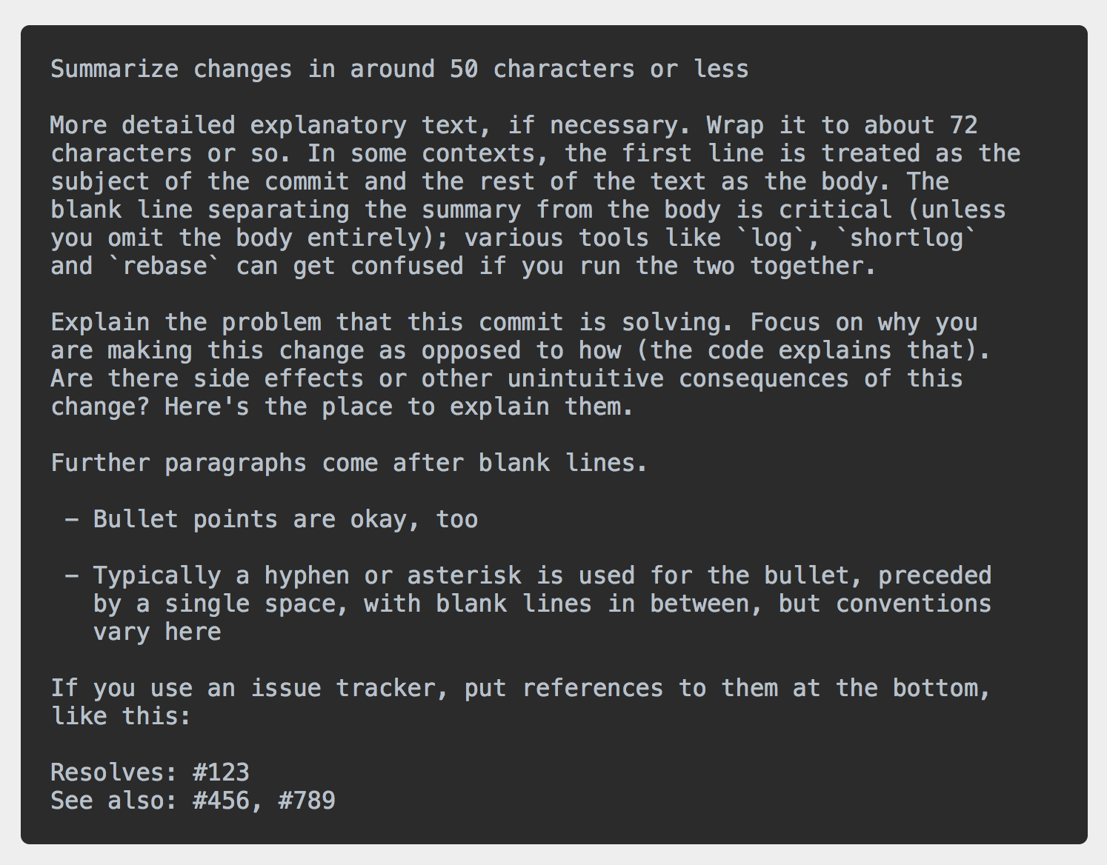
The 7 rules of a good commit message
Separate subject from body with a blank line
Limit the subject line to 50 characters
Capitalize the subject line
Do not end the subject line with a period
Use the imperative mood in the subject line
Wrap the body at 72 characters
Use the body to explain what and why rather than how

Slide 9
My personal hierarchy of commit ‘goodness’ needs
Subject: capitalize and no full stop
1
Wrap the subject and body
Restricting line length to 50 and 72 respectively makes for easier reading of the project log
2
Use the imperative mood in the subject line
This standard helps in two ways: it encourages ‘atomic’ commits and it helps humans parse the story of the project when it consists of commits from multiple developers
3
Separate subject from body with a blank line
Where the commit warrants a bit more explanation, ensuring there is a blank line between subject and the detail will help the formatting of several Git tools
4
5
Explain what and why rather than how
This is the most important thing because it communicates the context of the change.

