Slide 1
Progressive Web Apps
Part 2. The Service Worker

Slide 2
Part 2: The Service Worker

Slide 3
“At the heart of every progressive web app is the service worker.”
Building Progressive Web Apps, Tal Ater (O’Reilly)
A web app
A Service Worker
App distribution model
Your HTML, CSS, JavaScript, images etc.
A magical thing we’ll look at in more detail later
Allows for the app to be installed. The thing which is used here is a Web app manifest
If you’ve got all three, you’ve got a PWA
The need for all three to be a PWA explain why “You can have web apps that use some PWA capabilities but aren’t PWAs and PWAs that use only some PWA capabilities”
The Service worker

Slide 4
The service worker is...
“At its simplest, a service worker is a script that runs in the web browser and manages caching for an application.
Service workers function as a network proxy. They intercept all outgoing HTTP requests made by the application and can choose how to respond to them. For example, they can query a local cache and deliver a cached response if one is available. Proxying isn't limited to requests made through programmatic APIs, such as fetch; it also includes resources referenced in HTML and even the initial request to index.html.
Service worker-based caching is thus completely programmable and doesn't rely on server-specified caching headers. Unlike the other scripts that make up an application, such as the Angular app bundle, the service worker is preserved after the user closes the tab. The next time that browser loads the application, the service worker loads first, and can intercept every request for resources to load the application. If the service worker is designed to do so, it can completely satisfy the loading of the application, without the need for the network.”
Angular documentation
“JavaScript running in its own thread that will act as a locally installed web server or web proxy for your PWA...”
Progressive Web Apps: The Big Picture by Maximiliano Firtman

Slide 5
Service Workers are a bit different to the JavaScript we’re used to
Runs on a single thread (event loop etc.). Attached to a single HTML page and its lifecycle. Global object is window
JS
JS
JS
JS
Navigation
Close tab. Open new tab
Navigation
JS
Service worker registration
Runs on a separate thread (having its own event loop etc.). Global object is self. Lifecycle persists beyond tab closure - and in some cases - browser closure (!)

Slide 6
What Service Workers can do
Network independence - can completely satisfy loading the application
Instant loading of the application from their cache
Background data synchronisation with the server
Background fetching of files
Respond to the context in which the application is running
Passively receive messages via the Push API
The big capabilities they can provide (if you chose for them to do so)

Slide 7
Not all features are available on all platforms, so use progressive enhancement.

Slide 8
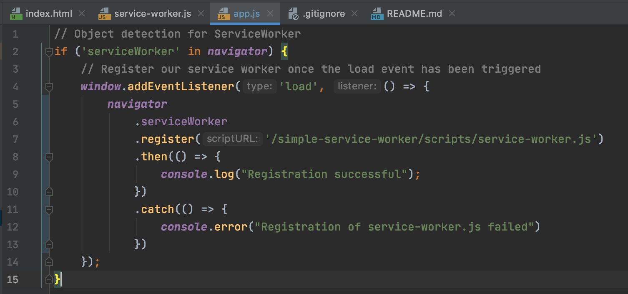
Example 1: Registering a Service Worker
A few things to note here:
Object detection is used (for progressive enhancement)
The ‘load’ event is used to improve performance
The register() method returns a promise
We can see that our Service Worker has been registered by looking at
the message printed to the console
Either finding it in the ‘Applications -> Service Workers’ menu item in Developer Tools (if using Chrome) or putting about:debugging#/runtime/this-firefox in the address bar (if using Firefox)
To run this code locally visit https://github.com/gtvj/exploring-pwas and follow the instructions in the README.md file.
This first example can be reached by clicking the ‘Simple Service Worker’ link (and the code is in the /simple-service-worker/ directory)

Slide 9
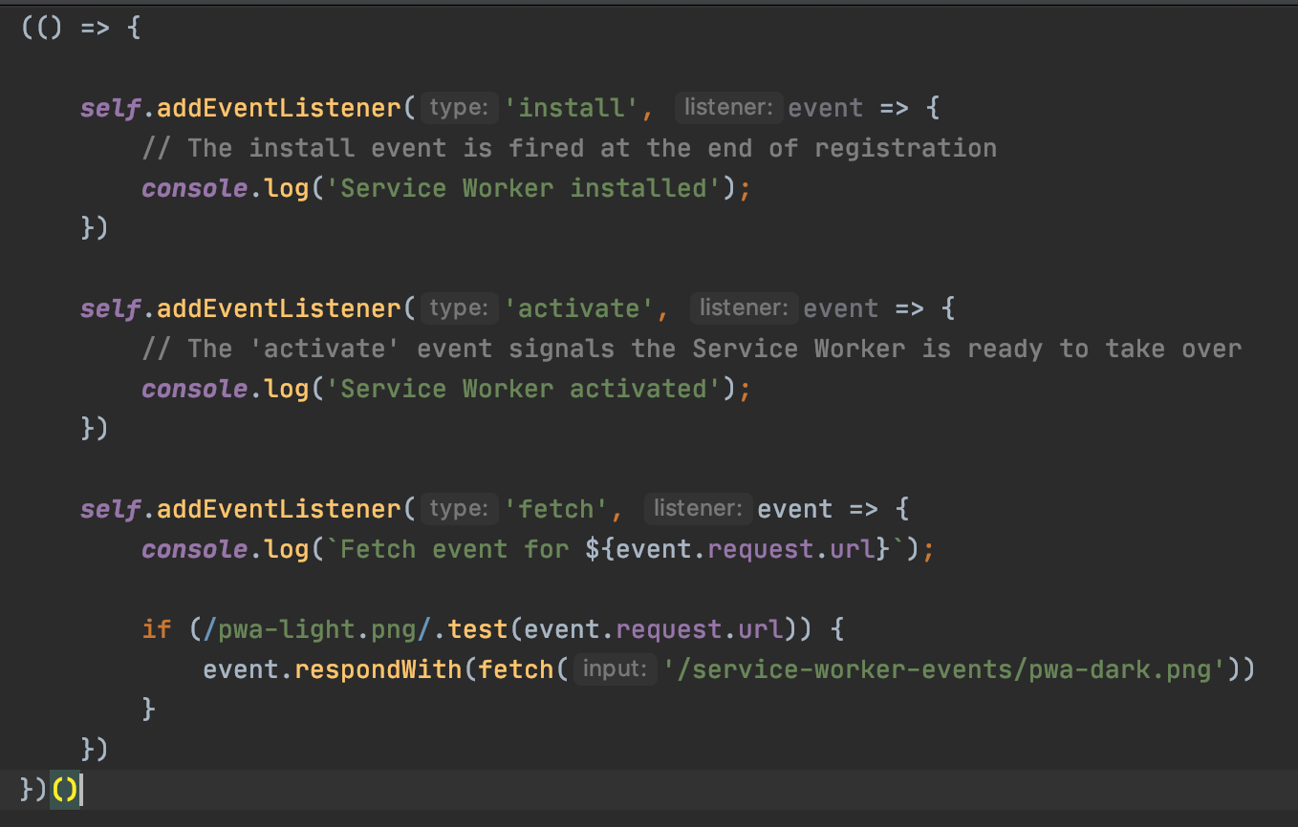
Example 2. Service Worker events
“A service worker is an event-driven worker registered against an origin and a path. It takes the form of a JavaScript file that can control the web-page/site that it is associated with, intercepting and modifying navigation and resource requests”
MDN https://developer.mozilla.org/en-US/docs/Web/API/Service_Worker_API
Let’s take a closer look at the ‘fetch’ event

Slide 10
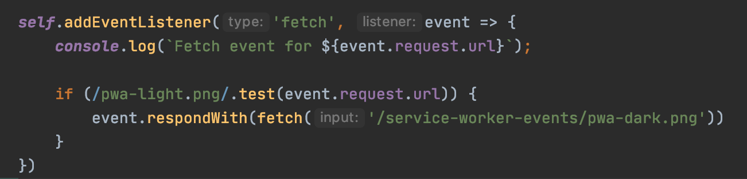
A closer look at the Service Worker ‘fetch’ event
Not to be confused with the Fetch API
To demo:
Clear site data, from the Application panel
Click the ‘Service worker events’ link
Note the colour of the logo - and that this logo is loaded via an <img> tag in the HTML
Reload the page and look at the logo
Close the browser and past the image URL into a new window
The service worker receives a fetch event for every request within its scope.
This includes requests that are made within CSS files, HTML tags and by JavaScript. It even includes the initial request for the HTML file.
Within the handlers we can use respondWith() to deliver a different resource - either from a cache, by making an alternative network request, or building a response on the fly
An interesting exercise would be to update the Service Worker so that an alternative HTML file is served.

Slide 11
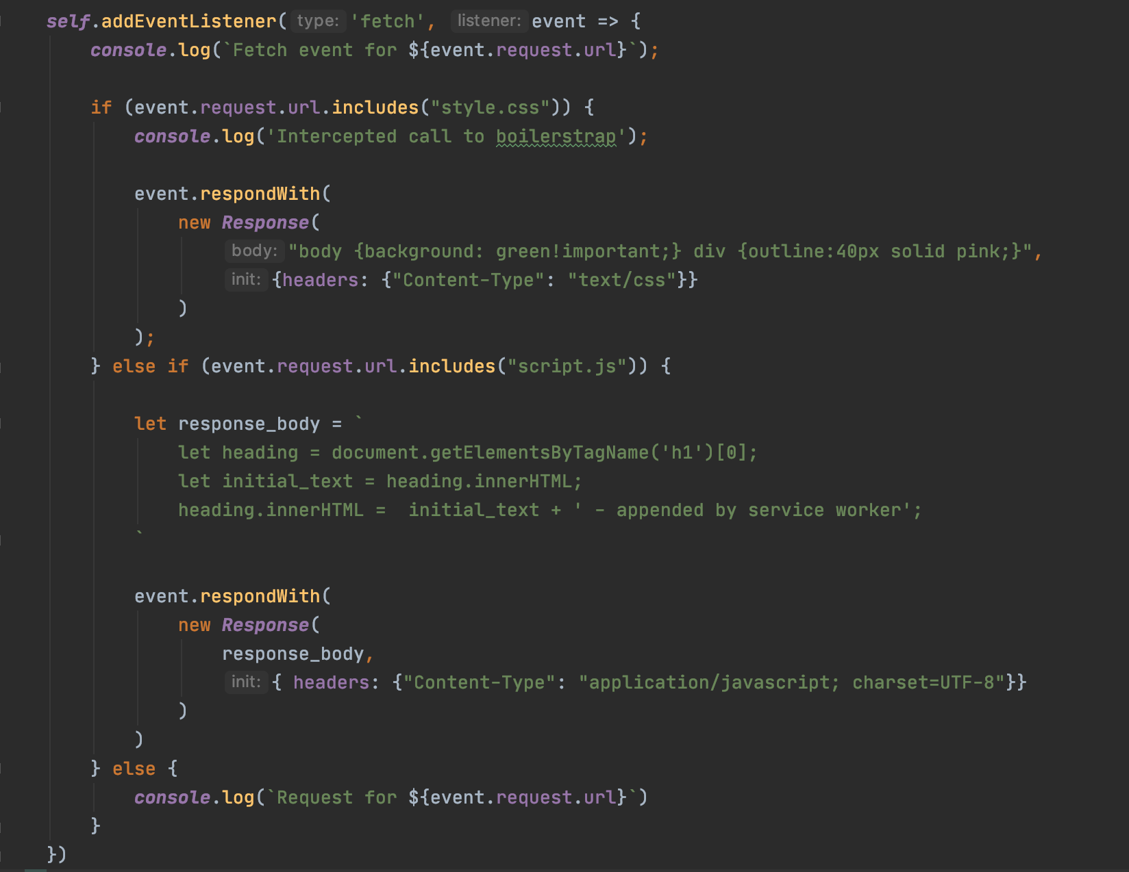
Example 3. Creating responses ‘on the fly’
In addition to fetching ‘different’ files, we can use the Response() constructure to create a response ‘on the fly’.
An example of this can be found in the service-worker-response-on-the-fly directory

Slide 12
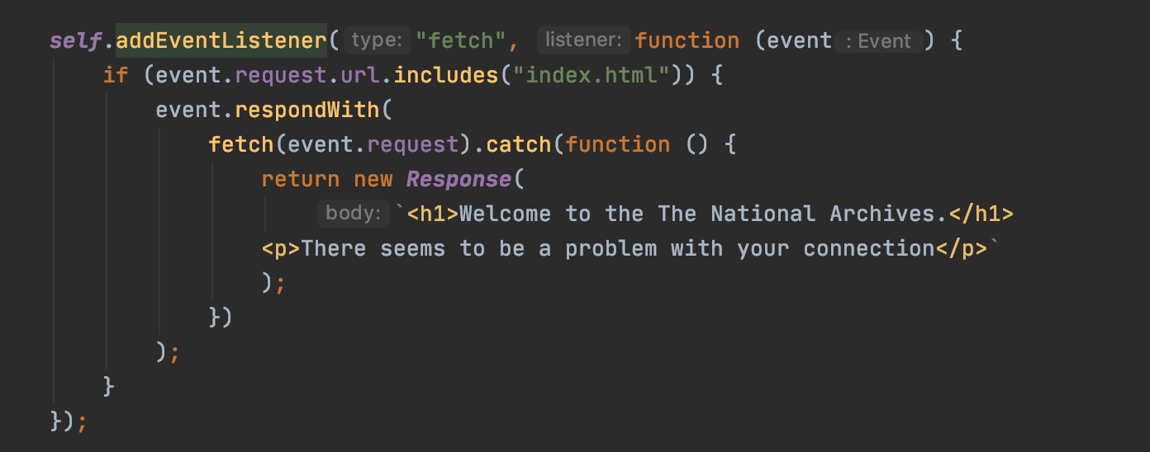
Example 4. ‘Catching’ failed fetches
By intercepting a browser’s default response to a Fetch event and interjecting Fetch API call we can detect a user being offline and provide a custom experience.
Note:
Test event.request.url
event.respondWith
Use of catch() on the promise returned by Fetch

Slide 13
Example 3. Broad brush caching
A slightly more involved example can be seen by clicking the ‘Service Worker cache everything’ on the home page when running https://github.com/gtvj/exploring-pwas. Then:
Disable the cache (in the Network panel) and set it to ‘Slow 3G’ connection
Click the ‘Service Worker cache everything’ link
Check the
browser console to see the service registration message and confirmation that cache_list has been added to cache
Application tab to see the registered Service Worker
Stop your web server
Reload the page
Something to note:
Despite being on a ‘Slow 3G’ connection the page loads instantly

Slide 14
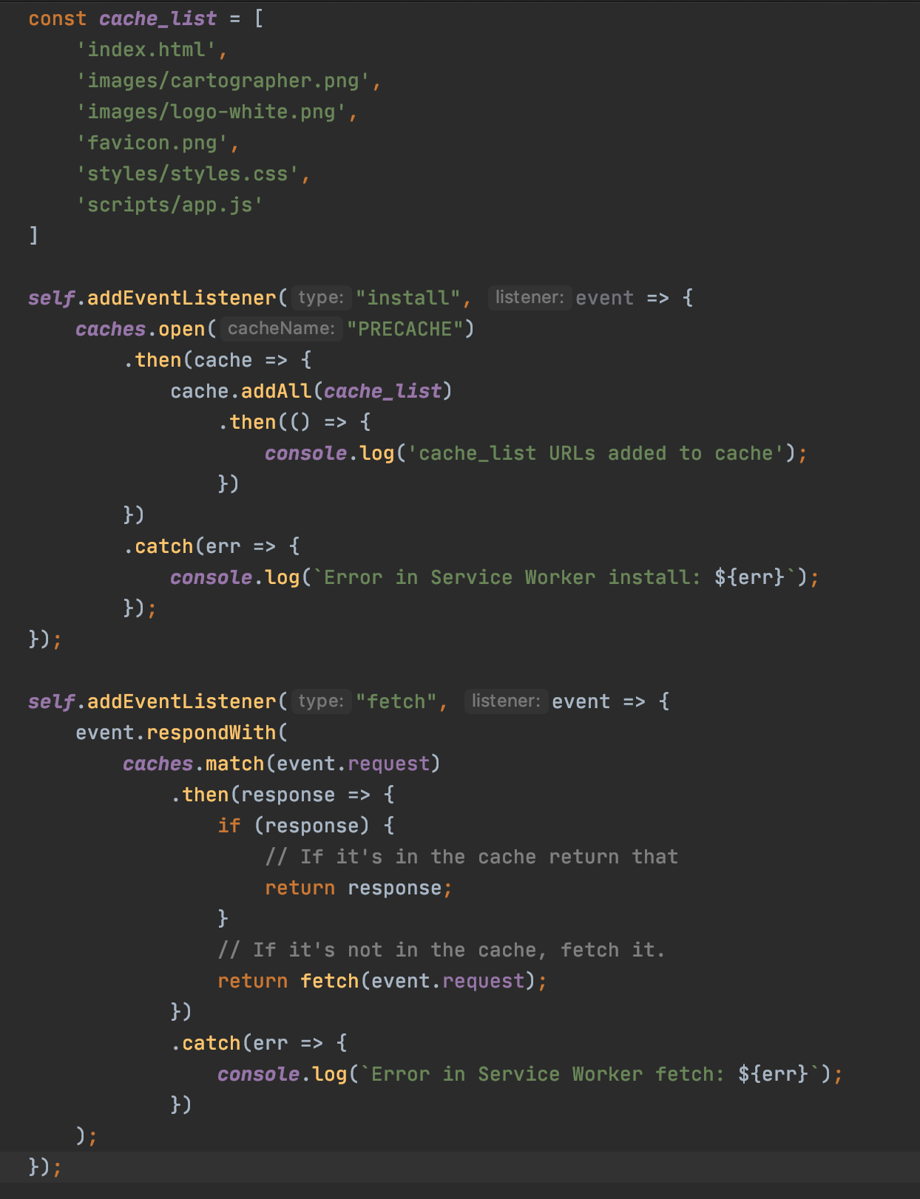
The files we want to cache
While this isn’t a mountain of code, it’s quite a lot considering it’s simply saying:
Cache a bunch of files when the Service Worker is registered
From then on, respond to fetch requests with the cached version - if one exists. Otherwise make a network request
The point here is that Service Worker APIs are low-level requiring developers to do a lot of ‘reinventing the wheel’ for common use cases.
self is the worker global scope - like window in normal browser JS or global in Node
Opening the cache we want to use and add our items
Attaching an event listener to all fetch events - including those raised by HTML or CSS
Preventing the default fetch handling and providing our own Response promise
A closer look at this example

Slide 15
In summary
“Service workers essentially act as proxy servers that sit between web applications, the browser, and the network (when available). They are intended, among other things, to enable the creation of effective offline experiences, intercept network requests and take appropriate action based on whether the network is available, and update assets residing on the server. They will also allow access to push notifications and background sync APIs.”
MDN documentation

