Slide 1
Flask 101
An introduction for developers

Slide 2
What is Flask
A web application micro-framework written in Python. Simple.

Slide 3
Follow-along repo:
github.com/
nationalarchives/
flask-101

Slide 4
Micro-frameworks provide a solid core...
… you then select extensions to provide the rest
Three dependencies:
Werkzeug provides routing, debugging and Web Server Gateway Interface (WSGI)
Jinja2 provides template support
Click provides command-line integration
These are all authored by Armin Ronacher, the author of Flask

Slide 5
...but remember, Flask does not provide a lot of the things you might expect if coming from, say, Laravel

Slide 6
A quick look at WSGI

Slide 7
Web Server Gateway Interface (WSGI*)
A calling convention for web servers to forward requests to applications written in Python
Specified (and standardised) in PEP 3333
Has two sides:
A server/gateway side (often a full web server such as Apache)
The application/framework side (a Python callable)
* Pronounced whiskey or ‘Whiz Ghee’, apparently.

Slide 8
OK. So, what do I actually need to know about WSGI?
Initially, all you need to know is:
a WSGI container is a separate process that runs on a different port to your web server
Your web server is configured to pass requests (some, not all) to the WSGI container which runs your web application, then passes the response back to the requester
Browser
Web
Server
WSGI
server
WSGI application
Callable object

Slide 9
Routing, request and redirects

Slide 10
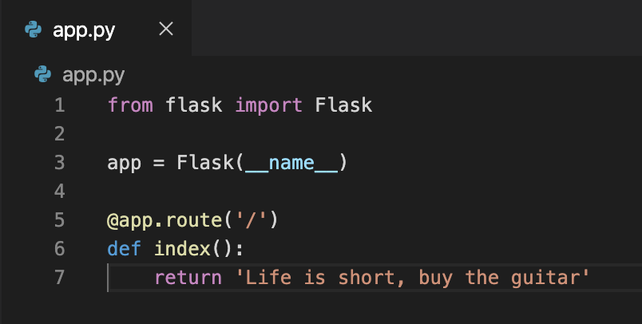
A tiny but complete Flask application
Imports Flask
Creates an application instance
Decorates our index(): method with the @app.route decorator. In doing so we create our first route function (with index() being run when ‘/’ receives a HTTP request)

Slide 11
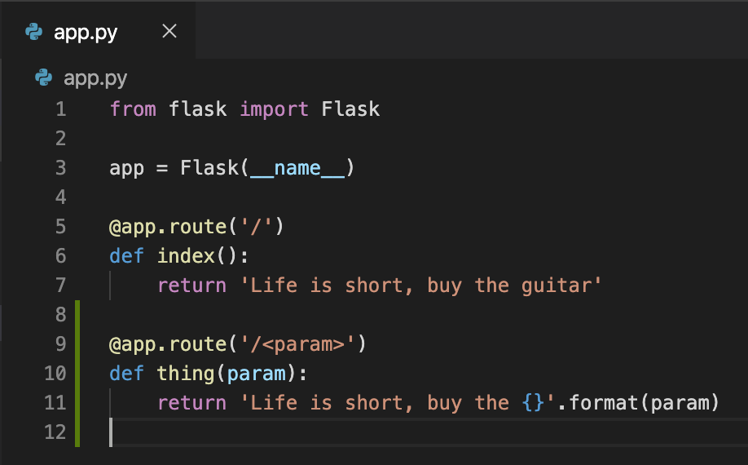
Dynamic routes
Here we add a dynamic route.
Flask supports string, int, float, and path* for routes.
* a special type of string that can include forward slashes.
Play with this using: git checkout dynamic-routes

Slide 12
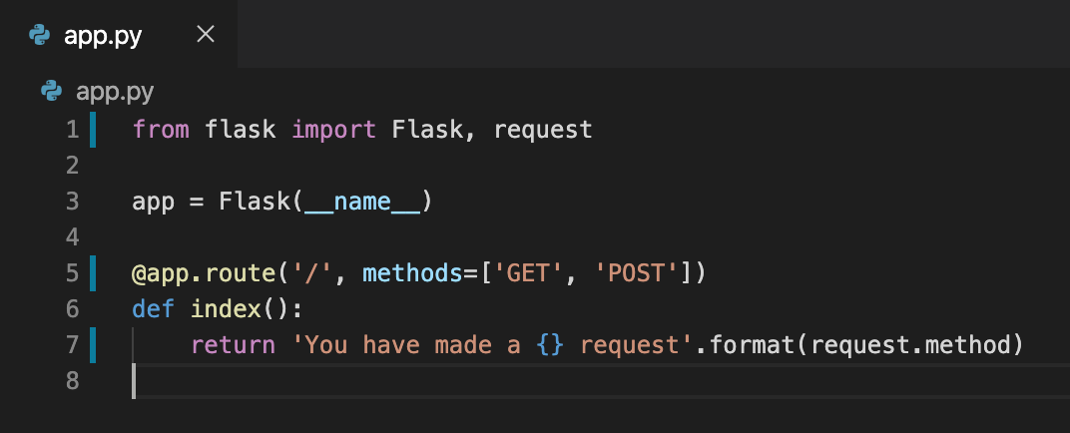
Specifying accepted methods
By default, the route decorator allows any HTTP methods but you also have the ability to whitelist only those you want to permit.
Note also the import of request and how this allows us to get information about the request
Play with this using: git checkout specify-http-methods

Slide 13
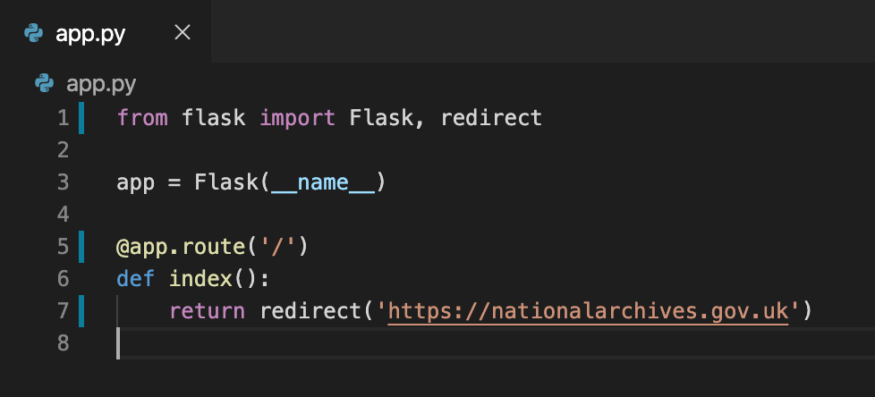
Redirects
To perform redirects we import redirect from flask
Play with this using: git checkout redirects

Slide 14
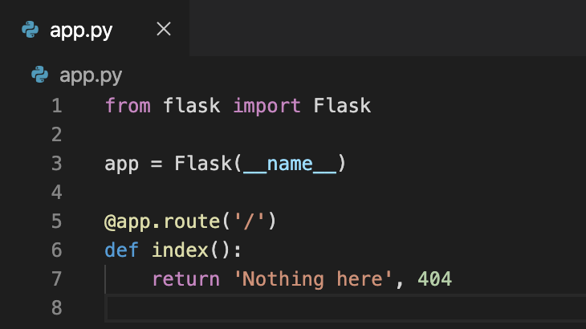
Specifying status codes
By returning a tuple from our view functions we can specify the response HTTP status code.
Play with this using: git checkout specify-http-methods

Slide 15
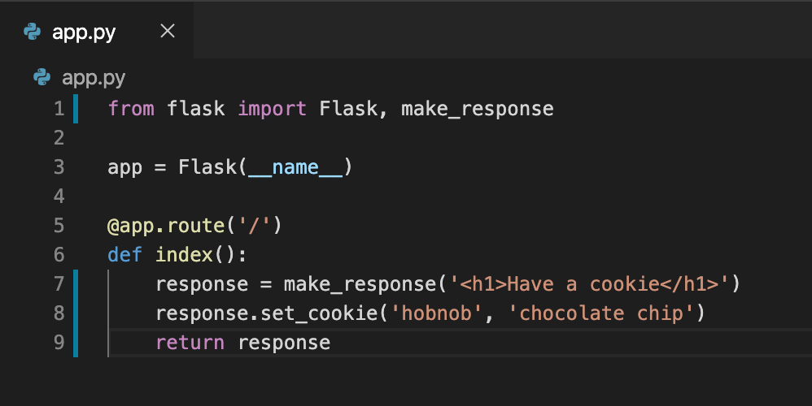
Returning a response object
Returning tuples obviously doesn’t scale too well, so Flask provides make_response() to prepare a response object
Play with this using: git checkout response-object

Slide 16
Templates

Slide 17
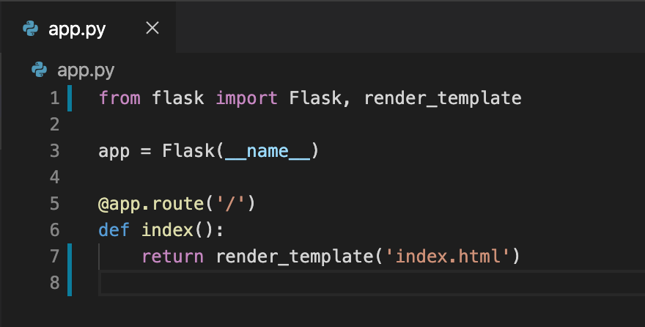
A simple template
Flask uses the Jinja2 Template engine

Slide 18
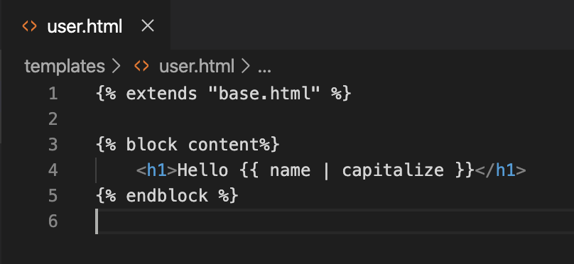
Jinja2 template engine
We won’t dwell on the capabilities of Jinja2. It provides everything you’d expect, including:
Template inheritance
Includes
Variables
Control structures: conditionals, loops
It also provides:
Macros (Python functions you define and import into the templates that need them)
Predefined filters, including: trim, upper, lower, striptags and safe
The repository has an implementation of templates using several of these features. To explore use: git checkout add-templates

Slide 19
Command-line basics

Slide 20
Command-line options
Some useful command line options include:
flask run to start a development server
flask shell opens a Python shell in the context of the application
flask [command] --help to see available options for the command
Note: you can also create your own command-line methods by importing Click and using it to decorate your methods

Slide 21
Other cool stuff...

Slide 22
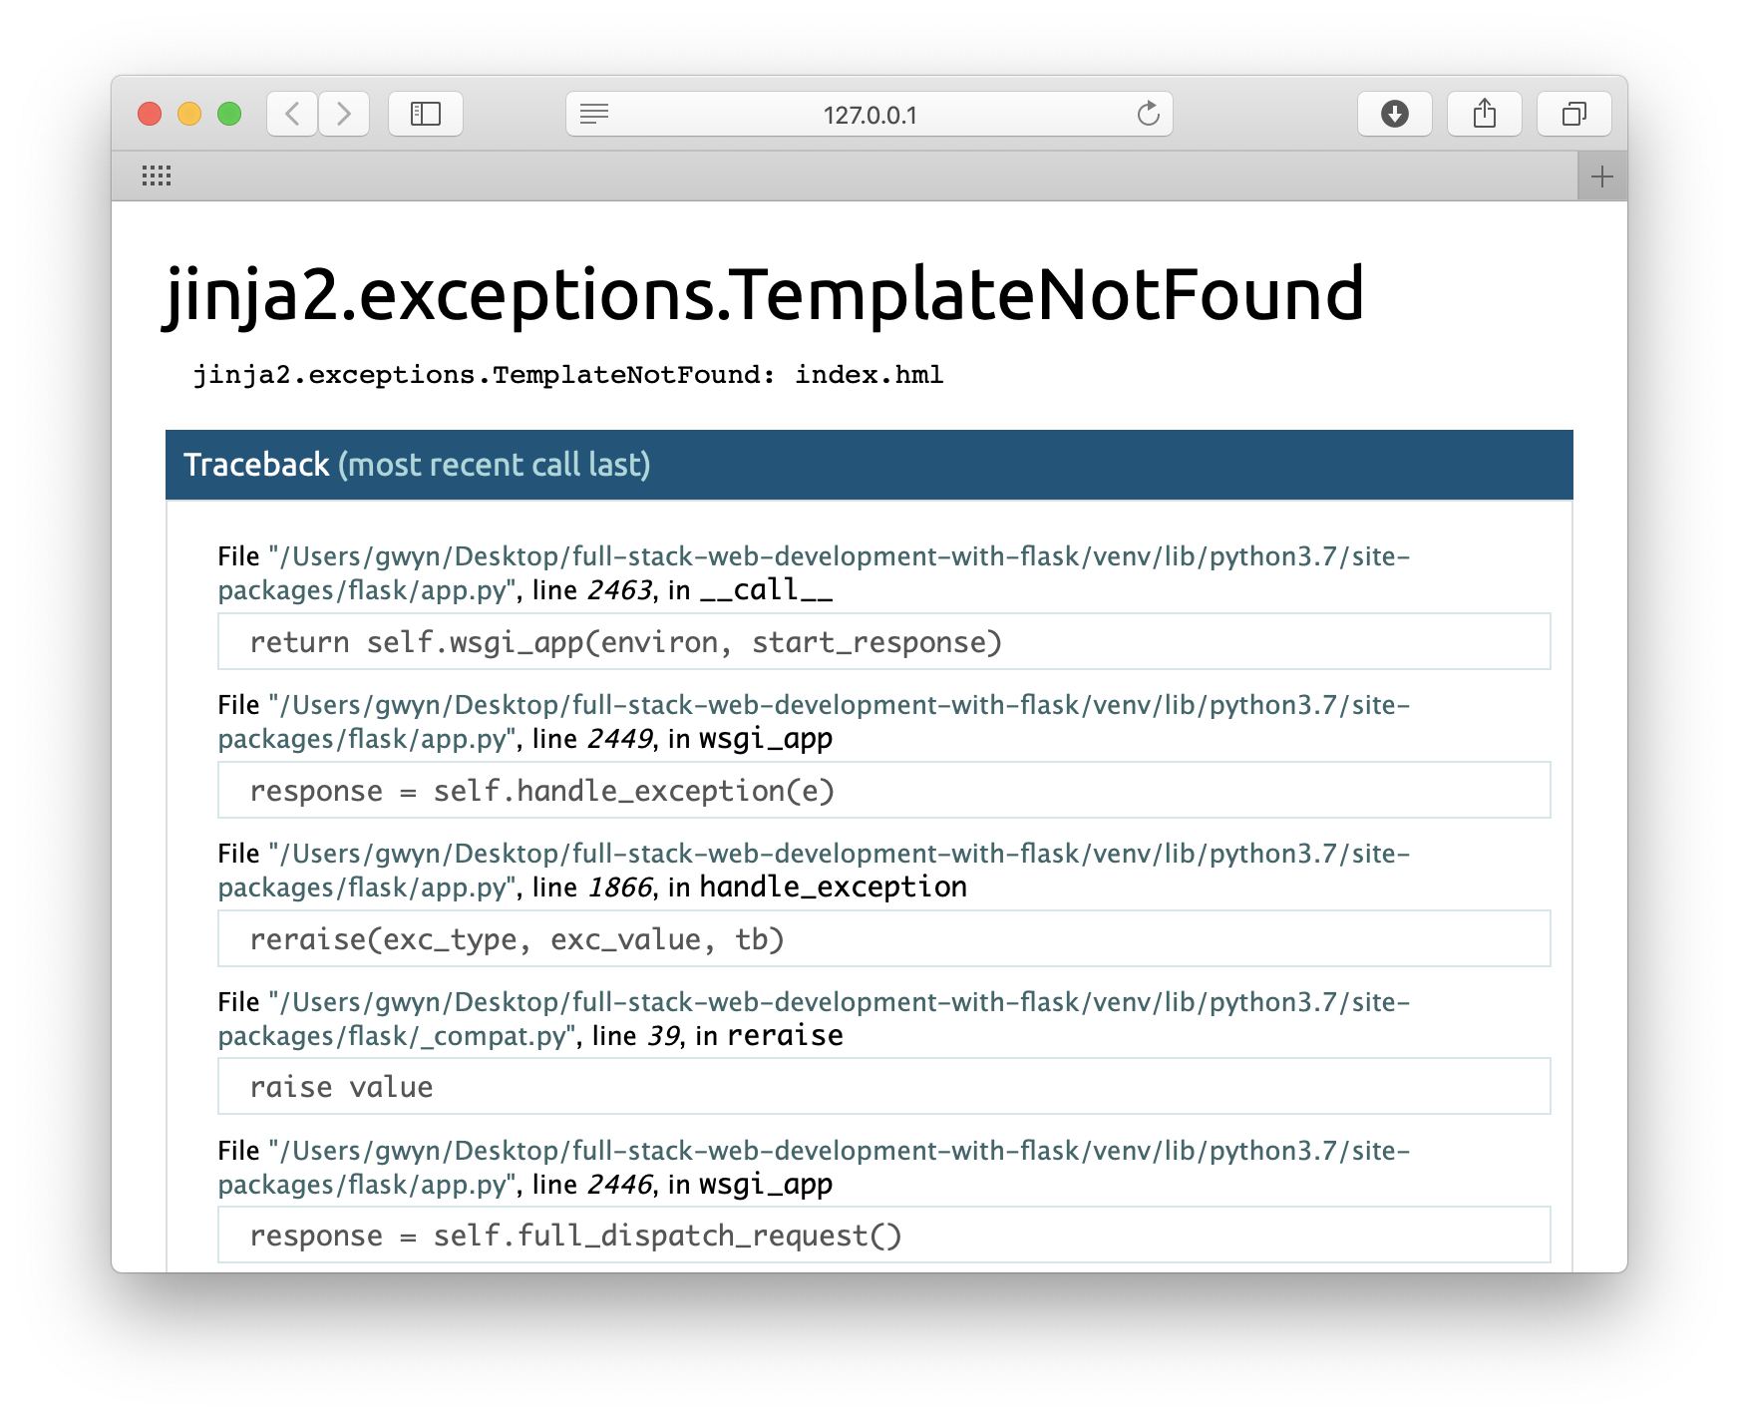
Debug mode
Flask applications can optionally be executed in debug mode. This enables two modules:
Reloader: watches the source code and restarts the server when a change takes place (it doesn’t refresh the browser)
Debugger: transforms the web browser into an interactive stack trace that allows you to:
Inspect source code
Evaluate expressions in any place in the call stack 👏
By default, debug mode is disabled. To enable it, set a FLASK_DEBUG=1 environment variable before invoking flask run:

Slide 23
Let’s add an extension!
🏋🏻‍♀️

Slide 24
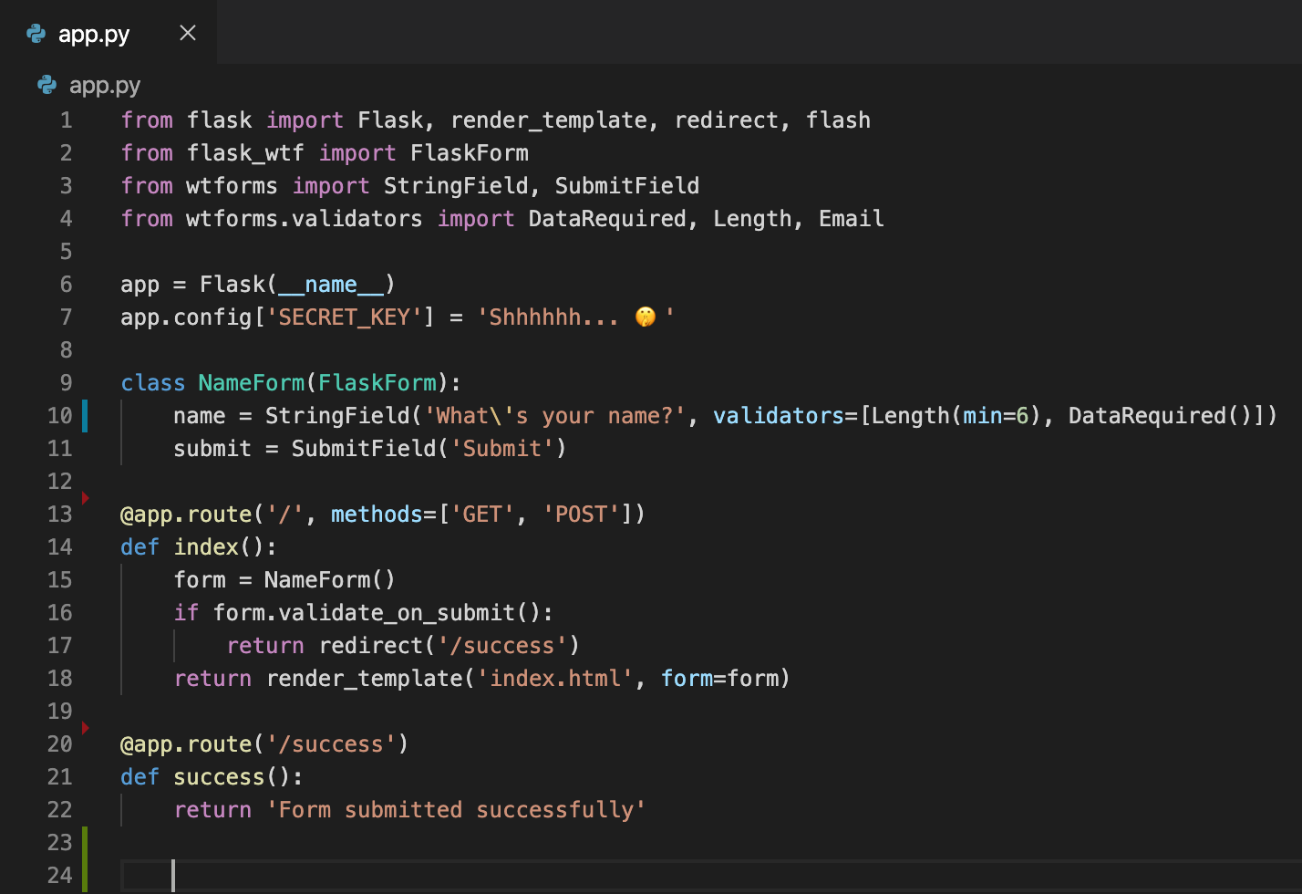
Flask-WTF
The request object in Flask is capable of handling forms, but there are extensions that could make things easier. One such extension is Flask-WTF
If you’d like to follow along, do this:
install it with pip install flask-wtf
Play with this using: git checkout flask-wtf

Slide 25
Flask extensions can provide...
...but, as always, be judicious when using other people’s code.
Creating RESTful APIs, analytics generation, session management, security (many aspects of), authentication (including using OAuth and OpenID), working with databases (both SQL and document-based), database migrations, caching, data validation, email, internationalization, full-text search, route rate limiting, queueing, exception tracking, SDK integrations (Google maps, Gravatar, Pusher), CORS, debugging, documentation, testing
There is a curated ‘awesome list’: https://github.com/humiaozuzu/awesome-flask

