Slide 1
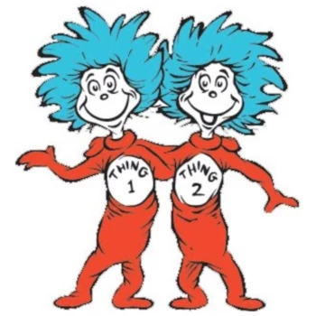
Introduction to Regular Expressions
Workshop

Slide 2
A high-level look at Regular Expressions

Slide 3
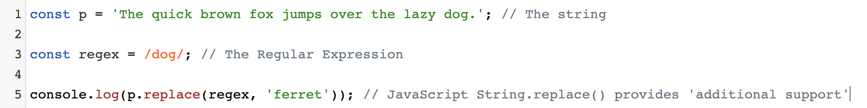
What can we do with RegEx?
“Regular expressions are the key to powerful, flexible, and efficient text processing. Regular expressions themselves... allow you to describe and parse text. With additional support provided by the particular tool being used, regular expressions can add, remove, isolate, and generally fold, spindle, and mutilate all kinds of text and data.”
Mastering Regular Expressions, 3rd Edition
The tool we’re using
Regular Expression
The too being used
Regular expressions

Slide 4
Where do we use them?
There are many places we can use Regular Expressions including:
A host programming language - support is either included in the Standard Library (Python etc.) or built into the syntax (Perl, JavaScript etc.) of modern languages
IDEs and text editors (very handy for ‘find’ and ‘find and replace’ operations)
At the command line (using Unix tools like grep)
...and lots of other places where there’s a need to search text.

Slide 5
What do they look like?
Regular expressions are sequences of characters that define a search pattern. The characters in a regular expression may be:
literal (actual text), or
metacharacters (special characters with special meanings)
Here’s a simple example RegEx that makes use of the the ‘d’ and ‘g’ literal characters and the ‘.’ metacharacter:
/d.g/
This matches ‘dig’, ‘dog’, ‘dzg’, etc...

Slide 6
There are different ‘flavours’ of RegEx
The ways regular expressions are implemented is not always ‘regular’.
We’ve got BRE (Basic Regular Expressions), ERE (Extended Regular Expressions), PCRE (Perl Compatible Regular Expressions)
Different tools will use different ‘flavours’ (some, like PHP, support multiple).
If something’s not working, it might be that the particular tool you’re using doesn’t support the RegEx feature you’re trying to use. JavaScript, for example, doesn’t support ‘lookbehinds’ - as I learned when first trying to use them!
Regular expression

Slide 7
Let’s start using them

Slide 8
Matching single characters
Here’s an example to explore:
Matching single literal characters
Regex ‘flags’
Using a ‘.’ metacharacter
Escaping characters

Slide 9
Using alternation
The ‘pipe’ character provides alternation in Regular Expressions.
Here’s a very simple example:
https://regexr.com/4cu8v
Use alternation to match either A or B

Slide 10
Using character sets
In regular expressions a set of characters is defined using the metacharacters [ and ]
Everything between them is part of the set and any one of the set members must match
Here’s an example to explore this https://regexr.com/4bv1d

Slide 11
Using character set ranges
In addition to literal character set ranges, we can use the ‘-’ metacharacter to define character set ranges.
Here’s an example: https://regexr.com/4c0mr

Slide 12
“Anything but” matching
The ^ metacharacter negates all characters in a set or range.
Here’s an example:
http://regexr.com/4c3o5
Negating a character set using the
^ metacharacter

Slide 13
A closer look at metacharacters

Slide 14
Simple metacharacters and their usage
Metacharacter | Purpose | Usage | Meaning
[ ] | Define a set | [cm]at | Match ‘cat’ or ‘mat’
. | Match any character | . | Match any single character
- | Specify a range | [0-5] | Match 0, 1, 2, 3, 4 or 5
\ | ‘Escape’ the next character | file\.txt | Match file.txt
^ | Negate a character set* | [^cd] | Match anything but ‘c’ or ‘d’
* we won’t go into this now, but ^ has a different meaning when used outside a character set

Slide 15
Other metacharacters and their usage
Metacharacter | Purpose | Notes
\s | Match any whitespace | Includes tabs, spaces and carriage returns
\S | Match any non-whitespace | Equivalent to [^\f\n\r\t\v]
\d | Match any digit | Equivalent to [0-9]
\D | Match any non-digit | Equivalent to [^0-9]
\w | Match any alphanumeric and _ | Equivalent to [a-zA-Z0-9_]
\W | Match any non alphanumeric | Equivalent to [^a-zA-Z0-9_]

Slide 16
Repeating matches

Slide 17
Using quantifiers
Often we will not know how many characters are in the patterns. We can handle this uncertainty with quantifiers.
Here’s are some examples to experiment with:
https://regexr.com/4cfm9
 | Match the previous character...
+ | one or more times
? | Zero or one time
* | Zero or more times
{2,4} | Two to four times
{,5} | Up to five times

Slide 18
Quantifiers, greed and lazyness
By default, quantifiers are ‘greedy’ meaning that they will continue matching characters until they’re unable to consume any more. We can change this by appending a ? to the quantifier
Here’s an example: http://regexr.com/4cfoh
It’s important to understand how quantifiers behave in certain circumstances

Slide 19
Position matching

Slide 20
Use word boundaries
\b will match a word boundary
\B will match ‘not’ a word boundary
Here’s an example:
http://regexr.com/4cu4l
Note: the boundary metacharacters match a position, not a character
Allows us to specify that the match should be at the beginning or end of a word.

Slide 21
Use string boundaries
^ for start of string*
$ for end of string
Here are some examples:
https://regexr.com/4cu6n - using ^
https://regexr.com/4cu79 - adding $ and multi-line mode
Note: we’ve seen the ^ metacharacter before. It’s one of several characters that can have a different meaning depending on context.
Match based on position within the string

Slide 22
Sub-expressions and backreferences

Slide 23
Grouping with sub-expressions
Sub-expressions allow us to group parts of an expression so that they are treated as a single entity (for quantification purposes or to be clear about alternation)
Here’s a simple example: https://regexr.com/4cu7u
And here’s a common alternation ‘gotcha’: https://regexr.com/4cu8m
Creating our own ‘parts’ of a match

Slide 24
Using back-references
Back references - as the name suggests - allows us to capture a match and refer back to what was matched. This is incredibly powerful:
Here’s an example:
https://regexr.com/4cub1

Slide 25
That’s all… for now.
This session was intended to be an introduction to Regular Expressions. While we’ve covered quite a bit of ground, there are some areas we’ve not covered but I hope this has at least provided a starting point.
I love Regular Expressions, so would be absolutely delighted to help you solve any pattern matching problems you come across.
Here are some useful and fun resources to play with:
Regex Golf https://alf.nu/RegexGolf
Regex Crossword https://regexcrossword.com/

Slide 26
Thank you

