Slide 1
Visualisation with JavaScript
See the companion code running at: https://pure-hamlet-59256.herokuapp.com/
An introduction for designer/developers
Note: this slide deck is organised by week (with each week having a blue title page), and arranged in reverse chronological order (so the most recent week will be first). Hope that makes sense 😀

Slide 2
Week 9. Changes and transitions
The code is now running at: https://pure-hamlet-59256.herokuapp.com/

Slide 3
Week 8.
The General Update Pattern
The code is now running at: https://pure-hamlet-59256.herokuapp.com/

Slide 4
Week 7.
Introducing Axes
The code is now running at: https://pure-hamlet-59256.herokuapp.com/

Slide 5
Week 6. Continuing with scales, including scaleTime()

Slide 6
Week 5. Completing our chart and looking at D3 scales

Slide 7
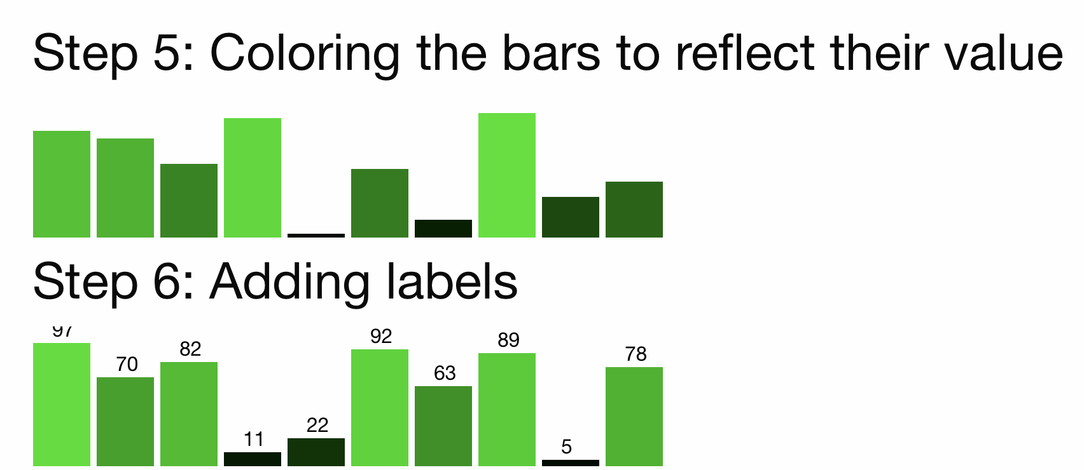
Adding dynamic colour and labels to the chart
👩🏾‍💻 See building-a-real-chart-in-d3.html

Slide 8
Scales in D3
“D3 scales are functions that map from an input domain to an output range”
👩🏾‍💻 a close look at D3 scales is provided in d3-scales.html

Slide 9
Week 4. Step-by-step to a data-driven, chart in D3
👩🏾‍💻 See building-a-real-chart-in-d3.html for the full process, beginning to end

Slide 10
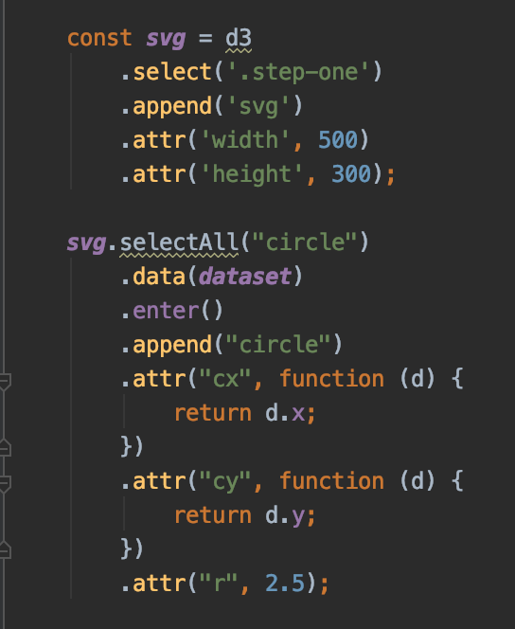
The data join: selecting things that don’t exist
Don’t be put off - This is conceptually strange
Thinking with joins
“This code does exactly what you need: it creates a circle element for each data point, using the x and y data properties for positioning. But what’s with the selectAll("circle")? Why do you have to select elements that you know don’t exist in order to create new ones? WAT.
Here’s the deal. Instead of telling D3 how to do something, tell D3 what you want. You want the circle elements to correspond to data. You want one circle per datum. Instead of instructing D3 to create circles, then, tell D3 that the selection "circle" should correspond to data. This concept is called the data join”
https://bost.ocks.org/mike/join/

Slide 11
Week 3
The data join - and a mixed bag

Slide 12
But first…
🤯😱🎓
🏃🏻‍♀️😩

Slide 13
The steps
for all visualisations
Prepare your data
Clean it (strings to ints etc.)
Shape it (rollup etc.)
Bind data to DOM elements
Draw the visualisation
Add interaction
Add animations
This is the sequence you need to follow

Slide 14
How might React fit into this picture? Do we really need it?
Let’s look at the repository and discuss this. We might not need it. Is there an easier/better way to link our range slider to the data? Could we have all the code in a vanilla event listener?
👩🏾‍💻 See:
our-first-react-component.html
our-first-react-component-with-d3.html

Slide 15
Let’s look at an example Treemap with updating data
There’s an example in the repository.
👩🏾‍💻 See:
Using-someone-elses-visualisation.html
updating-visualisation-data.html

Slide 16
Week 2:
D3 Modules and methods; Data cleaning and prep;
Code ‘borrowing’

Slide 17
But first…
let’s begin with a review of solutions to Week 1 challenge
👩🏾‍💻 there’s one in week-one-challenge-a-solution.html

Slide 18
D3 provides a lot, but it’s all very well documented
D3 has 30 modules (d3-shape, d3-scale etc.) that together provide around 900 functions
Because D3 is modular, you need only load those modules you need.
All modules are documented, along with their dependencies at https://github.com/d3
For example, here’s the documentation for d3-fetch https://github.com/d3/d3-fetch

Slide 19
Fetching data with d3-fetch
👩🏾‍💻 follow along using-rollup-to-shape-data.html
Let’s look at the d3-fetch module and some of its methods. Here we see:
Loading only the required D3 modules (d3-fetch and d3-dsv, which is a dependency)
Using d3-csv and d3-json to fetch and parse data from the filesystem or API
There are other methods that can fetch all sorts of other things like image or binary data.
As an example of using a d3 module
http://localhost:8080/loading-csv-with-d3.html

Slide 20
D3 data conversion - Part 1 ‘cleaning’ our data
👩🏾‍💻 follow along using loading-data-with-d3.html
Use the type function as the second argument to d3.json to ‘pipe’ your data through it. Think of this as being similar to JavaScript Array.prototype.map()

Slide 21
Data conversion - Part 2
Shaping the data for visualisation
👩🏾‍💻 follow along using-rollup-to-shape-data.html
D3 visualisations will typically need data that’s in a particular shape.
Let’s see how we can use d3-rollup() to transform some clean data into a usable shape
Remember: d3-rollup() returns a Map, but - for binding data to the DOM - d3 tends to prefer Arrays of Objects (which is why we’re doing the transform)

Slide 22
A quick aside, let’s look at using someone else’s D3 visualisations

Slide 23
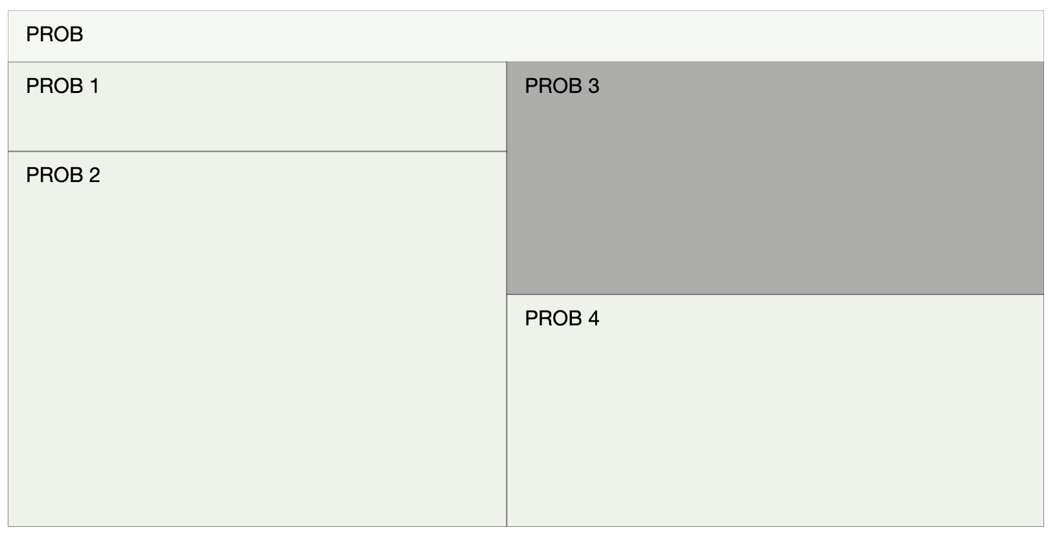
This is jumping ahead a bit….
...but, given what we’ve got ahead of us this sprint, I thought it might be useful.
Here’s something I’ve ‘hacked’ together by manipulating someone else’s visualisation.
Here’s the original: https://bl.ocks.org/d3indepth/a6ca05860b7249ebe163a212a4abd9cf
Here’s what I came up with: http://localhost:8080/using-someone-elses-visualisation.html
Let’s go through the code together to work out what it’s doing...

Slide 24
Week 1: Introducing D3 and some basics of SVG

Slide 25
What D3 is not
It is not a charting library (though many JavaScript charting libraries use D3 ‘under the hood’)
It has nothing to do with ‘3D’ - use three.js for that
It does not draw shapes itself. Instead it leaves that to a ‘render technology’ (typically SVG, but can be Canvas or even HTML)
Think of D3 as the artist and SVG as the medium
A strange place to start, I know - but there are a lot of misconceptions

Slide 26
What D3 is
Started in 2011 at the Stanford Visualisation Group (See the paper here: http://vis.stanford.edu/papers/d3)
D3 is Data Driven Documents (D3):
Binds data to a DOM
Enables transitions in the DOM to represent changes in the data
A modular system (since version 4)
In a nutshell, it’s Data Driven Documents

Slide 27
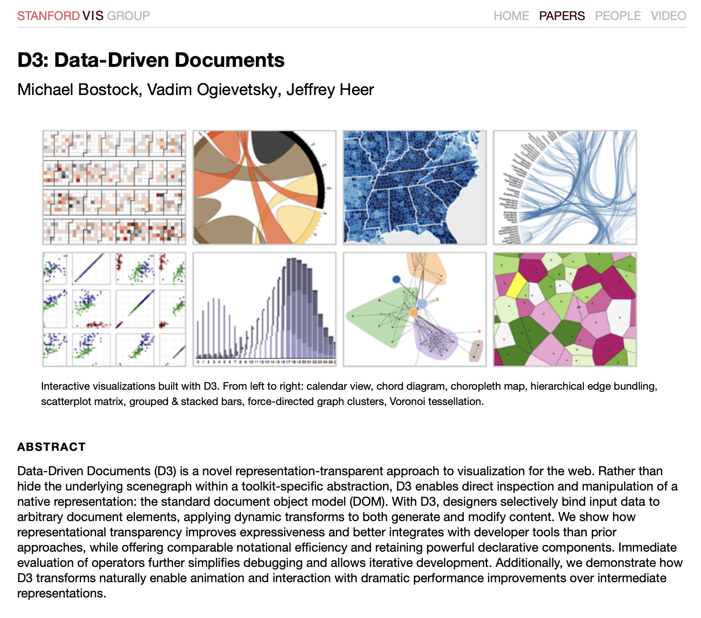
The Stanford paper
“...selectively bind input data to arbitrary document elements, applying dynamic transforms to both generate and modify content”

Slide 28
Technologies involved
JavaScript
You select an HTML element where you will place your D3 visualisation
You can use CSS to style elements of your visualisation (you can also control some of this by amending the properties of the SVG shapes)
JavaScript does two things:
‘assembles’ the visualisation from the data
Allows you to control what happens in response to user actions
SVG (or Canvas - or even HTML) draws the elements of your visualisation
Note: you don’t tend to write much SVG by hand when working with D3
Assemble the visualisation
Respond to events and changes
Controlling the visual appearance
SVG (or another render technology)
CSS

Slide 29
But why are you recommending D3 and not just a charting library?

Slide 30
Some benefits of D3
Some of our ideation outputs are highly bespoke and complex. With D3 we’ll be able to control these (without relying on hobbling together 3rd party ‘pre-packaged’ visualisations that are unlikely to meet development standards (esp. a11y)
D3 is the leader (and behind many charting libraries)

Slide 31
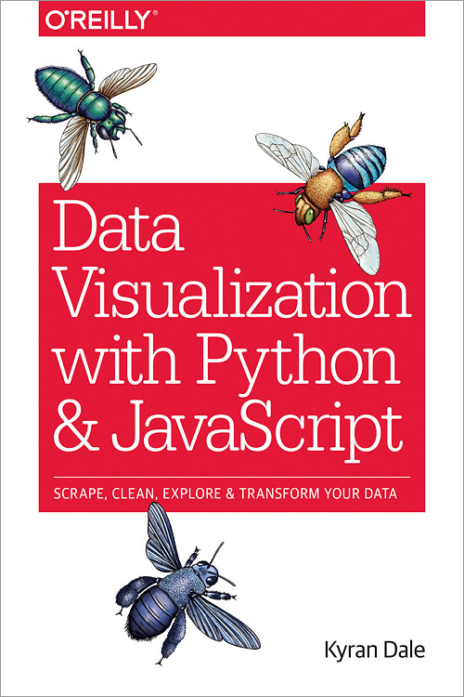
“Dataviz on the Web is an exciting place to be right now with innovations in interactive visualizations coming thick and fast, and many (if not most) of them being developed with D3”
Kyran Dale

Slide 32
A quick SVG refresher

Slide 33
What SVG is
XML based language for describing two-dimensional graphics - what HTML is to text, SVG is to graphics
A web standard 😍
Can be used in HTML and CSS (either inline or referencing a file)*
Easy to get to grips with but can be quite a deep topic when you look at advanced topics
The helicopter view
* As always, check browser support

Slide 34
Some common SVG elements
<g> - the group element
<line>
<circle>
<text>
<path>
<rect>
<a>
<ellipse>
<path>
<polygon>
...there are many more - see https://developer.mozilla.org/en-US/docs/Web/SVG/Element

Slide 35
Some common SVG attributes
fill
stroke
tabindex
cy, cx, r - for circle
x, y, width, height - for rect
x1, x2, y1, y2, stroke - for line
...there are many more - see https://developer.mozilla.org/en-US/docs/Web/SVG/Attribute

Slide 36
Week 1: Code demo/challenge

Slide 37
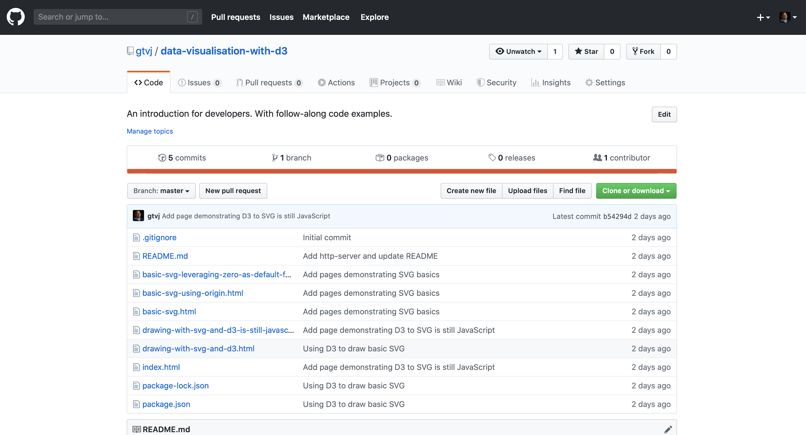
Repository
https://github.com/gtvj/data-visualisation-javascript
Let’s look at the repository:
A basic SVG
A basic SVG leveraging zero as default for attributes
A basic SVG using ‘transform’ to set origin on a group
Drawing an SVG with D3
D3 is still JavaScript

Slide 38
Challenge
Using the code we’ve looked at (especially the last example) use JavaScript and D3 to create a visualisation that shows 50 circles, of random size, color and position on the SVG.

