Slide 1
Diversion Detection in Cyclus
TwoFCS Workshop 2019
Greg Westphal, Kathryn D. Huff
University of Illinois at Urbana-Champaign
June 26, 2019

Slide 2
Outline
Motivation
Safeguards by Design
Inter-facility diversion
PyRe
Diverter
Demonstrations
Transition Scenario
Conclusions

Slide 3
Motivation/Goals
Motivation:
Safeguard by design
Transition from LWR to SFR
Model diversion inside facilities
Goals:
Detect diversion using signatures and observables
Optimum detector and inspection locations in pyroprocessing
Expand to the rest of Cyclus
Characterize detection sensitivities and false positive rates.
Notes:
Bold some words or split into motivation slide

Slide 4
PyRe – Design
PyRe
Facility containing multiple sub-processes:
Separately handled
Independent transactions, possibility of diversion
Operation settings impact efficiency
Generic facility:
Multiple types of pyro plants
LWR vs SFR

Slide 5
PyRe – Diversion Options
PyRe
Material diversion occurs in two different modes: nefarious or operator.
Nefarious Diversion imagines diversion by a single bad actor with facility access.
Operator Diversion imagines undeclared production.
Trade
Material
Normal
Shipment
Reprocess
Inside
Operator
Increase
Operation
Divert
Excess

Slide 6
Diverter Class
Demonstrations
Inputs:
Location
Sub-process
Operation Setting
Quantity
Frequency
Number of Diversions
The purpose:
Cyclus toolkit
Currently only implemented into PyRe
Notes:
Cut down on wordiness – Purpose:ajsdfkljasdkf

Slide 7
Diversion Detection
Demonstrations
Nefarious:
Transactions
Operator:
Material transactions are no longer reliable
Signatures and Observables
CUSUM Method:
Startup time
Generic
3 σ sets alarm
Notes:
Describe CUSUM – make a slide for it

Slide 8
Transition Scenario
Demonstrations
A main attraction of pyroprocessing is the ability to handle LWR and SFR waste.
To verify this capability in PyRe, we ran an EG01 – EG24 transition scenario.
We want to observe the following:
Appropriate deploying of PyRe
Ability to meet demand of new SFRs
Diversion capabilities
Accurate transition from UOX to SFR fuels

Slide 9
Transition Scenario - Setup
Demonstrations
Legacy:
200 LWRs
50% 60yr lifetime
50% 80yr lifetime
LWR PyRe
Transition:
~200 LWRs starting in 2015
80yr lifetime
SFR starts in 2050
80yr lifetime
SFR PyRe

Slide 10
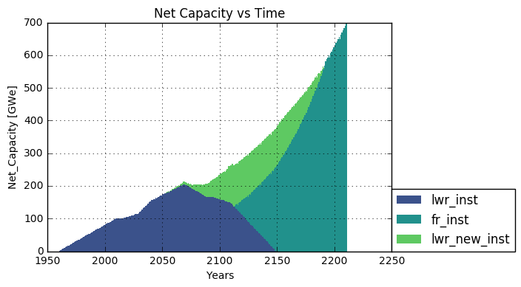
Transition Scenario - Results
Demonstrations

Slide 11
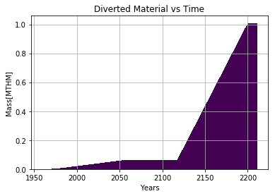
Diversion Settings
Demonstrations
Two PyRe prototypes:
LWR vs SFR
LWR:
Fewer diversions
More material per instance
Less frequent
SFR:
Frequent diversion
Small quantities
LWR
Divert
SFR
Divert

Slide 12
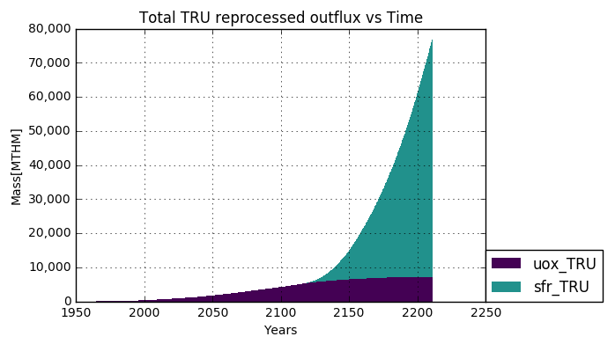
Transition Scenario - Utilization

Slide 13
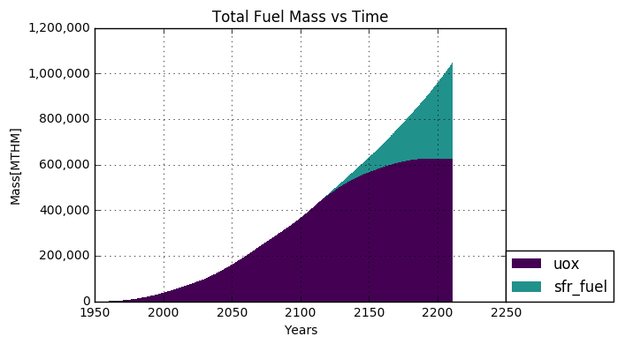
Transition Scenario - Utilization

Slide 14
Conclusions
Conclusions
We have developed a customizable method of diverting material from inside Cyclus facilities.
Preliminary work has been done on the detection of two different types of diversion: Nefarious and Operator
PyRe was demonstrated to function as both LWR and SFR reprocessing method
Capable of handling nefarious and operator diversion
Generic facility capable of modeling multiple facility layouts

Slide 15
Future Work
Conclusions
Following this work, the following needs to be addressed:
Finish CUSUM method for multiple parameters
Perform sensitivity analysis on key parameters
Adapt the Diverter class into a Cyclus toolkit so other archetypes can make use of it.
Initially designed for PyRe to test its functionality
Run further test cases for PyRe, including different types of SFRs

Slide 16
Acknowledgements
This material is based upon work supported by the Department of Energy National Nuclear Security Administration under Award Number(s) DE-NA0002576 through the Consortium for Nonproliferation Enabling Capabilities.

Slide 17
References
[1]: K. D. HUFF, M. J. GIDDEN, R. W. CARLSEN, R. R. FLANAGAN, M. B.
MCGARRY, A. C. OPOTOWSKY, E. A. SCHNEIDER, A. M. SCOPATZ, and
P. P. H. WILSON, “Fundamental concepts in the Cyclus nuclear fuel cycle
simulation framework,” Advances in Engineering Software, 94, 46–59 (Apr.
2016).
[2]: R. W. CARLSEN, M. GIDDEN, K. HUFF, A. C. OPO- TOWSKY, O.
RAKHIMOV, A. M. SCOPATZ, Z. WELCH, and P. WILSON, “Cyclus v1.5.3,”
Figshare (Jun. 2014), http://dx.doi.org/10.6084/m9.figshare.1041745.

Slide 18
Thank You Any Questions?

