Slide 1
Diversion Detection in Cyclus
TwoFCS Workshop 2019
Greg Westphal, Kathryn D. Huff
University of Illinois at Urbana-Champaign
June 26, 2019

Slide 2
Outline
Motivation
Safeguards by Design
Inter-facility Diversion
PyRe
Demonstrations
Diversion
Transition Scenarios
Conclusions

Slide 3
Motivation/Goals
Motivation:
Safeguard by design
Transition from LWR to SFR
Model Diversion inside facilities
Goals:
Timely detection of diversion relies on the identification of signatures and observables for unique facilities.
Determine optimum detector and inspection locations in pyroprocessing facilities using the Cyclus framework.
Adapt this work to be applicable to a wide range of nuclear fuel cycle facilities in Cyclus
Characterize required detection sensitivities and corresponding false positive rates.
Notes:
Bold some words or split into motivation slide

Slide 4
PyRe – Design
PyRe
Facility containing multiple sub-facilities resembling the sub-processes.
Allows subprocesses to be handled separately.
Independent transactions, possibility of diversion
Parameters act as Capacity Factor to the ideal separation efficiency input
Generic facility allows for multiple types of pyro plants

Slide 5
PyRe – Diversion Options
PyRe
Material diversion occurs in two different modes: nefarious or operator.
Nefarious Diversion imagines diversion by a single bad actor with facility access.
Operator Diversion imagines undeclared production.
Either can be achieved by increasing plant throughput and siphoning off material excess for unsanctioned weapons production.
Notes:
This is the input parameters for d3ploy. Go through each input option.
I will give an example scenario and the resulting plots are on the next slide.

Slide 6
Diverter
Demonstrations
This class handles all diversion:
Which parameter to change
What sub-process is compromised
How much excess material needs to be produced for successful diversion
The purpose:
Enable with future Cyclus facilities.
Currently only implemented into PyRe
Notes:
Cut down on wordiness – Purpose:ajsdfkljasdkf

Slide 7
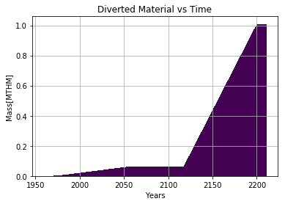
Diversion Settings
Demonstrations
Each facility prototype can have unique diversion:
Quantities
Locations
Sub-process
Parameter
Type
Number of Diversions
Frequency

Slide 8
Diversion Detection
Demonstrations
Nefarious:
Can be detected by observing material transactions
Operator:
Material transactions are no longer reliable
Instead we use one or more of the parameters
CUSUM Method:
Startup time
Generic
3 std. sets alarm
Notes:
Describe CUSUM – make a slide for it

Slide 9
Transition Scenario
Demonstrations
A main attraction of pyroprocessing is the ability to handle LWR and SFR waste.
To verify this capability, we ran a transition scenario from the current ~400 LWRs to approx. 2000 SFRs starting in 2050.
We want to observe the following:
Appropriate deploying of PyRe
Ability to meet demand of new SFRs
Diversion capabilities (which was shown earlier)
Accurate transition from UOX to SFR fuels

Slide 10
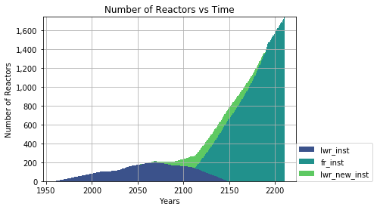
Transition Scenario - Results
Demonstrations

Slide 11
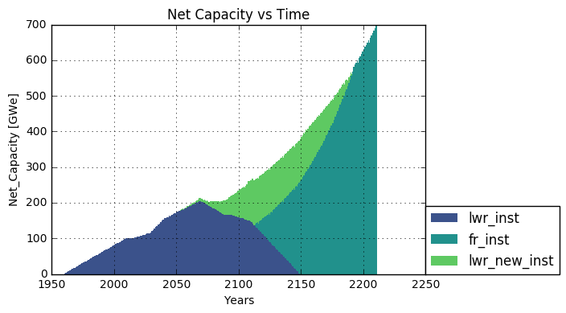
Transition Scenario - Results
Demonstrations

Slide 12
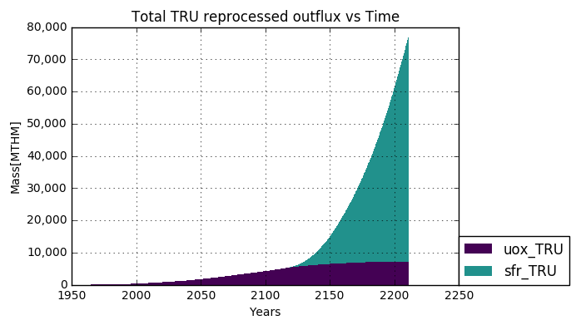
Transition Scenario - Utilization

Slide 13
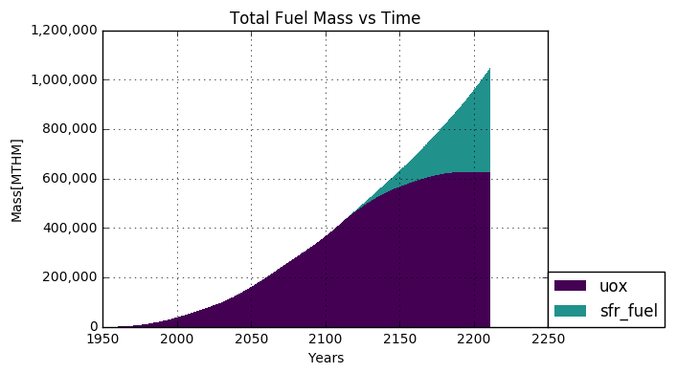
Transition Scenario - Utilization

Slide 14
Conclusions
Conclusions
We have developed a customizable method of diverting material from inside Cyclus facilities.
Preliminary work has been done on the detection of two different types of diversion: Nefarious and Operator
Initial results were demonstrated using the experimental PyRe archetype
PyRe was demonstrated to function as both LWR and SFR reprocessing method
Capable of handling nefarious and operator diversion
Ability to handle independent waste streams for analysis/diversion
Generic facility capable of modeling multiple facility layouts

Slide 15
Future Work
Conclusions
Following this work, the following needs to be addressed:
Finish CUSUM method for multiple parameters
Run a verification scenario
Perform sensitivity analysis on key parameters
Adapt the Diverter class into a Cyclus toolkit so other archetypes can make use of it.
Initially designed for PyRe to test its functionality
Run further test cases for PyRe, including different types of SFRs

Slide 16
References
[1]: K. D. HUFF, M. J. GIDDEN, R. W. CARLSEN, R. R. FLANAGAN, M. B.
MCGARRY, A. C. OPOTOWSKY, E. A. SCHNEIDER, A. M. SCOPATZ, and
P. P. H. WILSON, “Fundamental concepts in the Cyclus nuclear fuel cycle
simulation framework,” Advances in Engineering Software, 94, 46–59 (Apr.
2016).
[2]: R. W. CARLSEN, M. GIDDEN, K. HUFF, A. C. OPO- TOWSKY, O.
RAKHIMOV, A. M. SCOPATZ, Z. WELCH, and P. WILSON, “Cyclus v1.5.3,”
Figshare (Jun. 2014), http://dx.doi.org/10.6084/m9.figshare.1041745.

Slide 17
Thank You Any Questions?

