Slide 1
SYDE 522: Machine Intelligence
Content-based Retrieval of Histopathology Images
Using Autoencoders
George Tzoganakis

Slide 2
Background
Content-based image retrieval (CBIR) research growing steadily
  More multimedia data = more specialized retrieval methods
  Bridging semantic gap
Medicine produces vast amounts of image data
  Radiology department UHG produced 12,000+ images/day in 2002
CBIR systems are an effective diagnostic aid
  Allows for easy query of relevant collective wisdom
Notes:
Semantic gap: information is lost from image to representation of features - pixels->semantics
Diagnostics: The goals of medical information systems have often been defined to deliver the needed information at the right time, the right place to the right persons in order to improve the quality and efficiency of care processes. Such a goal will most likely need more than a query by patient name, series ID or study ID for images. For the clinical decision-making process it can be beneficial or even important to find other images of the same modality, the same anatomic region of the same disease.

Slide 3
Existing solutions
CBIR solutions began to appear in early 1980s
Development seems to have progressed by comparison of increasingly abstract features
  Primitive features: Netra, Candid
  More abstract: PicHunter
Deep learning?

Slide 4
Why autoencoders?
Deep learning has shown great promise in computer vision applications
  This is being extended to structural and functional medical imaging
Resulting dimensionality reduction offers potential for far more efficient search through various algorithms
Not very thoroughly explored solution thus far

Slide 5
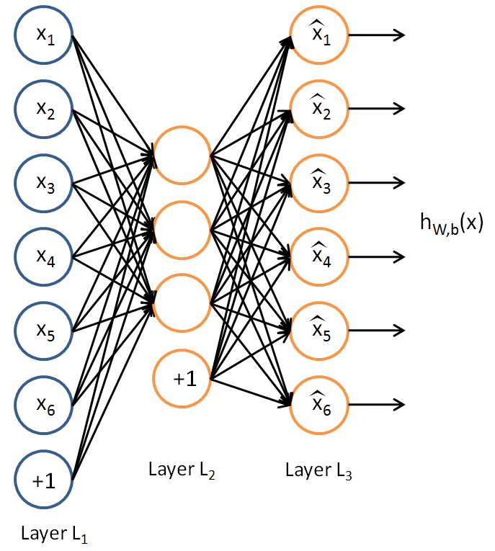
Autoencoder theory
Notes:
We are forcing a neural network to learn a mapping that looks like an identity function, but is not quite as we will see in a moment.
We can divide this into an encoding stage, where the network produces the deterministic mapping
And a decoding stage, where the code or latent representation is used to reconstruct the input in its original dimensionality
Corruption step
This is forcing the network to learn a distributed representation of robust underlying features in the input, essentially capturing the joint distribution linking variables

Slide 6
Autoencoder theory
Neural network learns mapping F: S → S
  Encoding stage, deterministic mapping
  y = s(Wx + b)
  Decoding stage, reconstruction of latent representation y as z = s(W'y + b')
In a denoising autoencoder, a stochastic corruption is applied
Given hidden layer sizes p < n, distributed representation of features is learned
Python implementation
Notes:
We are forcing a neural network to learn a mapping that looks like an identity function, but is not quite as we will see in a moment.
We can divide this into an encoding stage, where the network produces the deterministic mapping
And a decoding stage, where the code or latent representation is used to reconstruct the input in its original dimensionality
Corruption step
This is forcing the network to learn a distributed representation of robust underlying features in the input, essentially capturing the joint distribution linking variables

Slide 7
Considerations
Results (speed, accuracy)? If so, advantages for this method over others, e.g. other dimensionality reduction techniques?
Effects of different stochastic corruption processes?
Varying architectures?
How to avoid dimensionality problems in training
  Dimensionality of data rivals the availability of samples
Notes:
Advantage, computational efficiency or performance
Layer sizes, configurations

Slide 8
Questions?

