Slide 1
ToolGrad
Efficient Tool-use Dataset Generation
with Textual “Gradients”
The problem: costly, failure-prone training data
Presented by Jing Tan
DSAN 6725 / Findings of ACL 2026
Notes:
Hi everyone. I’m Jing Tan. Today I’ll introduce ToolGrad, a framework for generating training data for AI tool use.
A language model may need to read a file or call a calculator. To learn this, it needs examples that connect a user request with the correct tool calls and a final response.
Creating those examples is the problem. Earlier methods often write a question first, then search for a working solution. This search can take many attempts and may still fail.
ToolGrad asks: what if we change the order and build the solution first? That is the idea I’ll explain today.
中文提示：训练数据包含 request、tool calls、response。问题：先编问题再搜解法。最后一句抛出 solution first。

Slide 2
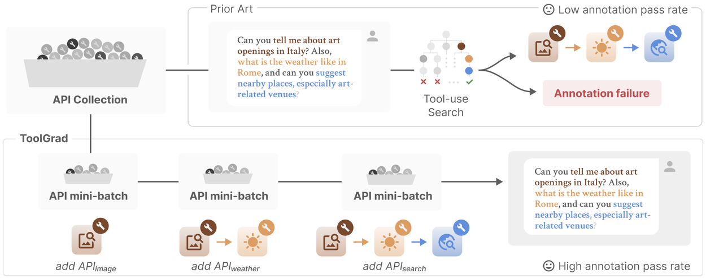
Answer-first: the order matters
Working tool calls first. Matching user request second.
Official overview diagram: Google Research ToolGrad blog [2].
2
Notes:
Target 50 seconds. Pause briefly between paragraphs.
This is the answer-first approach.
Look at the top row. The query-first approach starts with a user question and searches for tool calls that solve it. Here, DFS means depth-first search, a method for exploring possible solutions.
Now look at the bottom row. ToolGrad first builds a workflow from successful tool calls. It then generates a user request and a response that match that workflow. So, the answer here means the tool-use solution, not just a sentence.
This changes the difficult task of finding a solution into the easier task of describing what a verified workflow does. But how does ToolGrad build that workflow?
中文提示：先指上半图 query-first，并解释 DFS；再指下半图 answer-first。结尾问：How does ToolGrad build that workflow? 自然引到模块页。

Slide 3
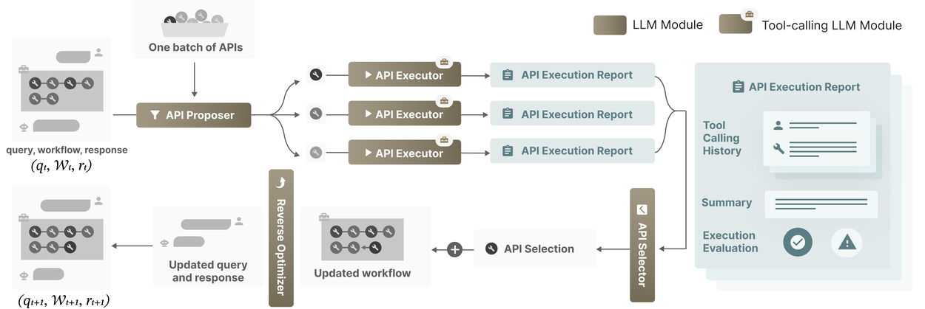
Inside the ToolGrad workflow
Propose
Test
Select
Update
Textual “gradient” = guidance for a tool choice, not a derivative
Official workflow diagram: [2]. Method: [1], §3–4.2.
3
Notes:
Target 75 seconds. Pause briefly between paragraphs.
The framework repeats four modules. Follow the arrows in this diagram.
First, the API Proposer suggests possible tool calls. API means Application Programming Interface. It is how a model accesses a tool.
Second, the API Executors test the proposals in parallel and produce execution reports. These reports describe the calls and their results.
Third, the API Selector reads the reports, selects one useful call, and decides where it belongs in the workflow.
Fourth, the Workflow Updater adds that call. An LLM then updates the user query and final response to match. The diagram labels this last part Reverse Optimizer.
The selection signal acts as a textual gradient: language-based guidance for the next tool choice. This is an analogy, not a mathematical derivative. The generation loop builds data without updating model weights.
The resulting dataset is called ToolGrad-500. The completed data is used later for supervised fine-tuning, or SFT, where the model learns from these examples. So, does this process actually help?
中文提示：依箭头讲 Proposer、Executors、Selector、Updater。解释图中 Reverse Optimizer。textual gradient 不是数学导数；生成数据和之后的 SFT 是两件事。结尾：Does this process actually help?

Slide 4
Does ToolGrad improve data and models?
1. Data generation
2. Model tool calling
Generation pass rate (%)
BFCL single-turn score (higher is better)
Model | Score
Gemma-3-12B | 76.8
ToolGrad-12B | 83.1
Gemini 2.5 Pro | 83.2
ToolGrad-12B = Gemma-3-12B
fine-tuned on ToolGrad-500
DFS = depth-first search
12B = 12 billion model parameters
[1], Table 2 and Figure 3. BFCL v1/v2 only. The two measures answer different questions.
4
Notes:
Target 75 seconds. Pause briefly between paragraphs.
The experiments check two things: the data generation process and the model trained on that data.
On the left, the generation pass rate rises from sixty-three point eight percent with DFS to ninety-nine point eight with ToolGrad. This measures successful data generation, not the model’s answer accuracy. The paper also reports more ground-truth tool uses per sample and fewer tool calls during generation.
On the right, BFCL stands for Berkeley Function Calling Leaderboard. It tests how well models call tools. The score rises from seventy-six point eight for Gemma-three-12B to eighty-three point one for ToolGrad-12B.
These are the same model family before and after SFT on ToolGrad-500. Twelve B means twelve billion model parameters.
For comparison, Gemini two point five Pro scores eighty-three point two. ToolGrad’s score is close, but this result is limited to the paper’s single-turn BFCL tests. That brings us to the practical value and the limits.
中文提示：先左后右。左：生成通过率。右：BFCL 工具调用评分。先解释 BFCL，再解释 Gemma 微调前后与 12B。最后 Gemini 是比较对象，不能泛化到所有任务。

Slide 5
Practical impact and limits
Verified workflows become
training examples for tool use
ToolGrad-500 supplies data for supervised fine-tuning (SFT).
What the results support
What still needs testing
Single-turn tool calling
on BFCL v1/v2
Longer conversations
and realistic user requests
The key idea: verify the solution, then write the question.
Data and SFT: [1], §4.4. Limits: [1], §7. Open releases: [3].
5
Notes:
Target 50 seconds. Pause briefly between paragraphs.
For model developers, the practical value is a more reliable way to create tool-use examples for training. ToolGrad-500 shows how verified workflows can become data for SFT. The project also releases code, data, and trained models.
However, single-turn tool calling is only part of an agent’s job. These results do not establish performance in a long conversation. Also, AI-generated requests may differ from how real people ask for help. Those are important next steps.
My takeaway is simple: verify the solution first, then write the question. ToolGrad shows how changing the order can improve the way we build training data. Thank you.
中文提示：先价值：给开发者生成 SFT 数据。再限制：单轮、合成问题。最后重复 verify solution first，再 Thank you，停留本页结束。

Slide 6
References
[1] Zhou, Z., Uehara, K., Zhang, H., et al. (2026)
ToolGrad: Efficient Tool-use Dataset Generation
with Textual “Gradients”
Findings of ACL 2026, pp. 19040–19056. DOI: 10.18653/v1/2026.findings-acl.950
aclanthology.org/2026.findings-acl.950/
[2] Google Research (September 10, 2026)
ToolGrad official research blog
research.google / ToolGrad research blog
[3] Official code, dataset, and model releases
github.com/zhongyi-zhou/toolgrad
6

