Slide 1
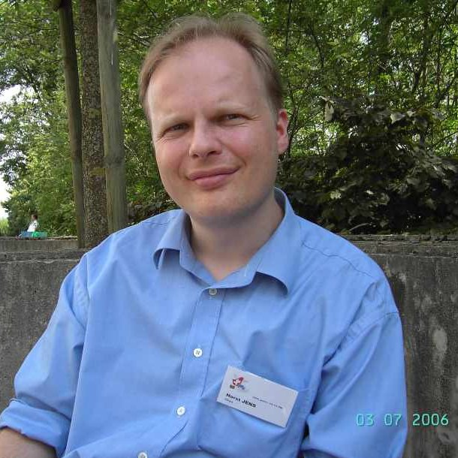
from .py to .deb : Preparation
2006/12 by Horst JENS pagamebook@gmail.com
technical Advisor: Alexander Hungenberg
Prepare applications to make a .deb package out of a python program:
  Terminal
  File-Manager
  Text Editor
Install programs:
  dpkg-dev
  dh-make
Learn how to use commands:
  cd ..
  cp
  mv
  rm
Note: in all commands on the next pages, replace rockpaperscissor, rockpaperscissors16, sandbox etc. with your own python program or folder names.
$ sudo apt-get install dpkg-dev
$ sudo apt-get install dh-make
$ man cd
$ man cp
$ man mkdir
$ man rm

Slide 2
Setting up an environment
create a „sandbox“ folder. Select it.
create a folder for your python program
(pythonprogramname-versionnumber)
copy the archive (tar.gz, zip, ...) of your working python program into this folder. (e.g. „rockpaperscissors16.tar.gz“)
extract the archive file in this folder (creating files and sub-folders)
do not delete this archive file !
test if python-program still works
read the man-file of dh_make (yes, you install dh-make and type dh_make) and fill out the options as needed:
    -e for your email address
    -c for your license
    -f for your archive filename
Answer "s" for "single" and hit "Enter"
$ mkdir sandbox
$ cd sandbox
$ mkdir rockpaperscissors-0.16
$ cd rockpaperscissors-0.16
$ man dh_make
$ dh_make -e pygamebook@gmail.com -c GPL -f rockpaperscissors16.tar.gz
Type of package: single binary, multiple binary, library, kernel module or cdbs?
[s/m/l/k/b] s
Maintainer name : Horst JENS
Email-Address : pygamebook@gmail.com
Date : Sun, 26 Nov 2006 20:13:51 +0100
Package Name : rockpaperscissors
Version : 0.16
License : gpl
Type of Package : Single
Hit <enter> to confirm:

Slide 3
working with config-files: control
Now two things happened:
  1.) a sub folder called "debian" was created
  2.) the archived file was copied into the sandbox folder (parent folder) and renamed from .tar.gz to .orig.tar.gz
Delete this .orig.tar.gz file in the parent folder (sandbox) !
Now change into the new created debian sub folder:
Now edit the file control :
  section: The section to organize your program into (game, office, ..)
  depends: packages needed in the format "package (version)" version can further specified with <= or >=
  description: A one-line description (60 chars max) of your program followed by a multi-line description.
save and close the file control
$ rm ../rockpaperscissors_0.16.orig.tar.gz
$ cd debian
$ ls
changelog compat control copyright dirs docs README.Debian rules
$ gedit control
Source: rockpaperscissors
Section: games
Priority: optional
Maintainer: Horst JENS <pygamebook@gmail.com>
Build-Depends: debhelper (>= 5)
Standards-Version: 3.7.2
Package: rockpaperscissors
Architecture: any
Depends: python (>=2.4.3-11ubuntu3)
Description: A game to let you play "Rock, Paper, Scissors" against the computer
The game is written in python using the tkinter GUI.

Slide 4
working with config-files: rules
edit the file rules:
  find the section build-stamp
  and replace it with this text:
  find the section clean
  and replace it with this text:
  before editing the section install (see next page) please note:
$ gedit rules
build-stamp: configure-stamp
dh_testdir
touch build-stamp
clean:
dh_testdir
dh_testroot
rm -f build-stamp configure-stamp
dh_clean
  The commands in the install section of the file rules will copy the file rockpaperscissors16.py into /usr/games/rockpaperscissors.py .
  The string $(CURDIR) refers to ~/sandbox/rockpaperscissors-0.16
  The folder $(CURDIR)/debian exist.
  The folder $(CURDIR)/debian/rockpaperscissors does NOT exist YET,
  but will be created by by the commands in this section and refers to root (/).
imagine a game called “rock”:
it will be installed from .deb into:
/home/rock/rock.py
/home/rock/readme.txt
/home/rock/rock.desktop
/home/rock/data/rock1.jpg
/home/rock/data/rock2.jpg
/usr/games/rock.py
/usr/share/doc/rock/readme.txt
/usr/share/applications/rock.desktop
/usr/share/games/rock/data/rock1.jpg
/usr/share/games/rock/data/rock2.jpg

Slide 5
working with config-files: rules
  find the section install and replace it with this text:
  (take your python project name instead of rockpaperscissors and make other changes as needed).
install: build
dh_testdir
dh_testroot
dh_clean -k
dh_installdirs
# Add here commands to install the package into debian/rockpaperscissors.
#$(MAKE) install DESTDIR=$(CURDIR)/debian/rockpaperscissors
mkdir -p $(CURDIR)/debian/rockpaperscissors
### insert your commands here
cp rockpaperscissors16.py $(CURDIR)/debian/rockpaperscissors/usr/games/rockpaperscissors.py
### Installing the data files
# the subfolder "data" should be copied to /usr/share/games/rockpaperscissors
mkdir -p $(CURDIR)/debian/rockpaperscissors/usr/share/games/rockpaperscissors
cp -r data/ $(CURDIR)/debian/rockpaperscissors/usr/share/games/rockpaperscissors
### Installing menufile
# Now copy the file with the menu entry into /usr/share/applications.
cp rockpaperscissors.desktop $(CURDIR)/debian/rockpaperscissors/usr/share/applications/
### copy readme and documentation files into /usr/share/yourfoldername if needed
# mkdir -p $(CURDIR)/debian/rockpaperscissors/usr/share/doc/rockpaperscissors
# cp readme.txt $(CURDIR)/debian/usr/share/doc/rockpaperscissors/readme.txt

Slide 6
dirs, copyright, README.Debian
edit the file dirs
Here should be listed all necessary folders (in case those folders do not exist on the target computer)
Now edit the file copyright
Fill in: author, email, license. You can refer to /usr/share/common-licenses/.
Fill in all the licenses/sources for used sounds, images etc.
Now delete all the not-used example files:
Now edit README.Debian
and describe all the changes to pathnames etc- that you will have to make in your python program.
leave the "debian" sub folder and go to the parent folder
now edit your python program file(s) so that all the paths connect to the correct folders (/usr/share/games/...) like described in the "README.Debian" file.
$ gedit dirs
usr/games
usr/share/games/rockpaperscissors
usr/share/applications
$ gedit copyright
$ rm *.ex
$ rm *.EX
$ gedit README.Debian
$ cd ..
$ gedit rockpaperscissors16.py

Slide 7
creating the .desktop file
create a desktop file: This file will make Icon and menu entry's for your program. Look at some other entry's in the folder /usr/share/applications for ideas.
Note that nautilus does not display the extension .desktop but instead the name entry of the desktop file.
Use the ls command to display the .desktop file correctly.
Now it is time to build the package. With the option -k you can add a GPG-Key to sign your package.
Now your .deb package should be in your parent folder. (sandbox)
Install the .deb file to your system by double-clicking on it or by typing:
now kill the gnome-panel to see the new menu entry
if you want, you can also create a .rpm package:
$ gedit rockpaperscissors.desktop
[Desktop Entry]
Encoding=UTF-8
Icon=/usr/share/games/rockpaperscissors/data/computerklein.gif
Name=Rock, Paper, Scissors
Comment= A little game to play Rock, Paper, Scissors against the computer.
Exec=python /usr/games/rockpaperscissors.py
Terminal=false
Type=Application
Categories=GNOME;GTK;Game;
StartupNotify=false
$ sudo dpkg-buildpackage
$ cd ..
$ ls
$ sudo dpkg -i rockpaperscissors_0.16-1_i386.deb
$ killall gnome-panel
$ sudo apt-get install alien
$ sudo alien --to-rpm rockpaperscissors_0.16-1_i386.deb

