Slide 1
Gendered Language on the Economics Job Market Rumors Forum
Alice H. Wu

Slide 2
Fact
Women underrepresented in Economics.
Hypothesis
Some authors proposed that it may be caused by an unwelcoming culture that reinforces stereotypical beliefs of men as an in-group in the field and women as an out-group (e.g., Tajfel and Turner 1986; Tonso 1996).

Slide 3
Question
Does exist an unwelcoming or stereotypical?
Hypothesis
My hypothesis is that an unwelcoming or stereotypical culture will lead EJMR participants to use terms to describe men that emphasize their fit and position within the field and terms to describe women that deemphasize their professional accomplishments.
Data
There is a page EconJobRumors where (most likely) economists post anonymously about different things.
Using this data I can answer how women and men are portrayed in anonymous discussions.

Slide 4
Methodology
Get all the posts since 2013 to 2017 using web scrapping of all data.
Inspect the most frequent 10 000 words.
I generate a subset that have at least on the most frequent words.
Identification if the post is about man or woman. I use gender classifiers (e.g., “she”/“woman”)

Slide 5
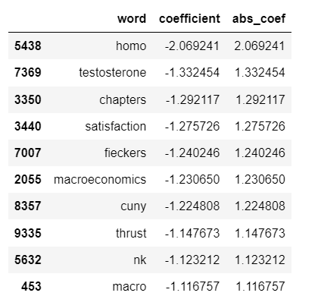
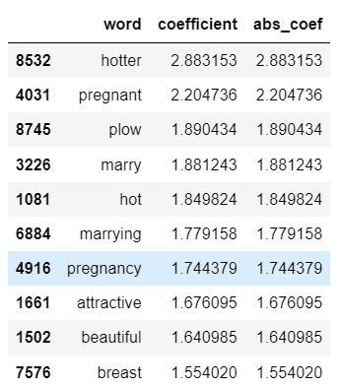
Results

