Slide 1

Computer Security DD2395
Buffer Overflow
Roberto Guanciale

Slide 2
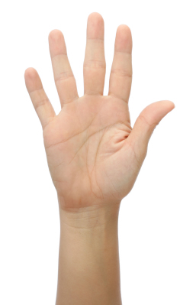

Questions
Raise your hand
Twitter
  roberto_kth
www.quizsocket.com
  QP2S56

Slide 3
Quizsocket vulnerability
Countermeasures
  Check IP address
  Cookie
  Chacpa

Slide 4
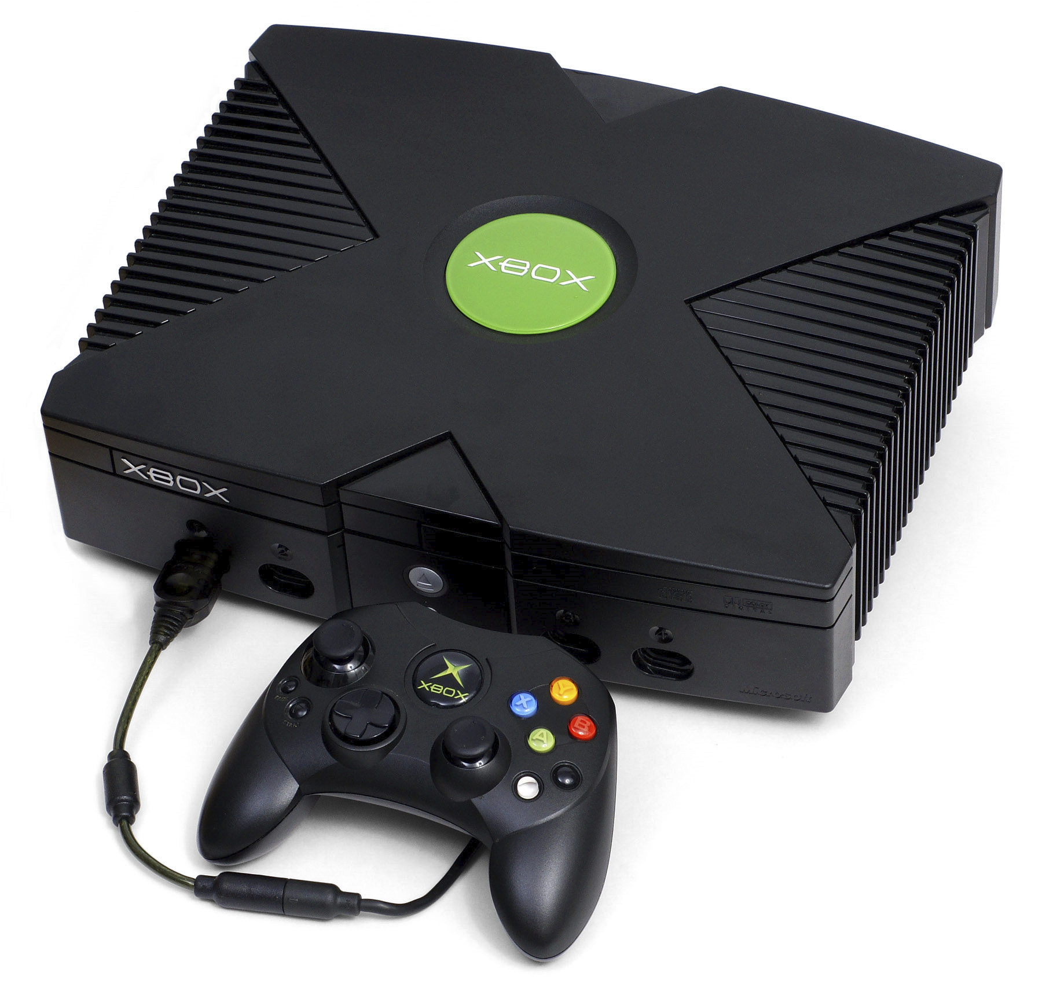


Buffer Overflow
A very common attack mechanism
One of the most dangerous security threat
Major concern due to
  legacy code
  careless programming
Present in well-designed systems
  XBox
  Hearthbleed (OpenSSL)
  Stagefright (Android media-stack)

Slide 5
Buffer Overflow - basics
Caused by programming error
  Allows more data to be stored than capacity
  Reads more data than the capacity
Overwriting adjacent memory locations
  corruption of program data
  unexpected transfer of control
  memory access violation
  execution of code chosen by attacker

Slide 6
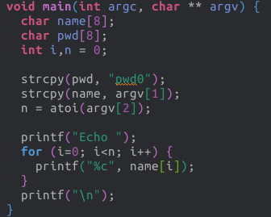
Buffer Overflow - Example

Slide 7
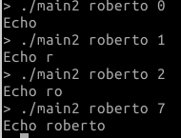
Buffer Overflow - Example

Slide 8
Buffer Overflow - Example

Slide 9
Buffer Overflow - Example
Question 2: 16?
A) IndexOutOfBoundsException
B) Program terminates
C) Other

Slide 10
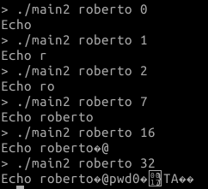
Buffer Overflow - Example

Slide 11
Buffer Overflow - Example
https://gist.github.com/simonwagner/10271224

Slide 12
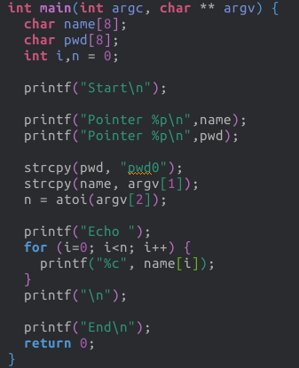
Memory Layout

Slide 13
Memory Layout
Address | Content | Var
0x7fffffffdd10 | roberto\0 | name
0x7fffffffdd20 | pwd0\0 | pwd

Slide 14
Memory Layout
Address | Content | Var
0x7fffffffdd10 | roberto\0 | name
0x7fffffffdd20 | pwd0\0 | pwd
Question 3: The variable name
(i.e. address 0x7fffffffdd10) is
A) in the stack
B) in the heap
C) in the data memory

Slide 15
Memory Layout
Address | Content | Var
0x7fffffffdd10 | roberto\0 | name
0x7fffffffdd20 | pwd0\0 | pwd
Question 3: The variable name
(i.e. address 0x7fffffffdd10) is
A) in the stack
B) in the heap
C) in the data memory

Slide 16
How can we fix the program?

Slide 17
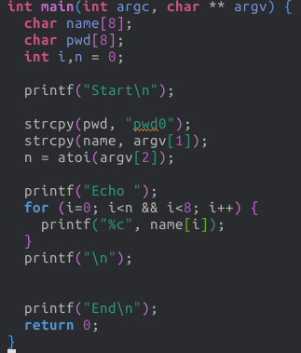
How can we fix the program?

Slide 18
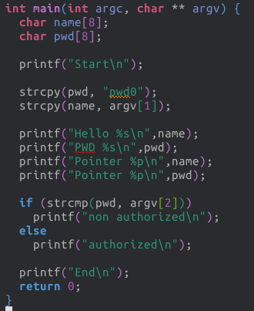
Buffer Overflow - Example

Slide 19
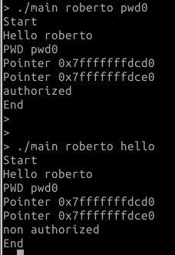
Buffer Overflow - Example

Slide 20
Buffer Overflow - Example
Address | Content | Var
0x7ffffffffcd0 | roberto\0 | name
0x7ffffffffce0 | pwd0\0 | pwd

Slide 21
Buffer Overflow - Example
Address | Content | Var
0x7ffffffffcd0 | roberto\0 | name
0x7ffffffffce0 | pwd0\0 | pwd
16

Slide 22
Buffer Overflow - Example
Address | Content | Var
0x7ffffffffcd0 | roberto\0 | name
0x7ffffffffce0 | pwd0\0 | pwd
16
Question 4: Can you spot a bug?
A) Yes
B) No

Slide 23
Buffer Overflow - Example
Address | Content | Var
0x7ffffffffcd0 | roberto\0 | name
0x7ffffffffce0 | pwd0\0 | pwd
16

Slide 24
Buffer Overflow - Example
Address | Content | Var
0x7ffffffffcd0 | roberto\0 | name
0x7ffffffffce0 | pwd0\0 | pwd
16
Address | Content | Var
0x7ffffffffcd0 | roberto1234567812345678 | name
0x7ffffffffce0 | hello\0 | pwd

Slide 25
How can we fix the program?

Slide 26
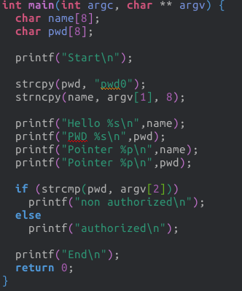
How can we fix the program?

Slide 27
Buffer Overflow Attacks
to exploit a buffer overflow an attacker
  must identify a buffer overflow vulnerability in some program
    Source code inspection (e.g. on GitHub log)
    https://github.com/search?utf8=%E2%9C%93&q=buffer+overflow&type=Issues&ref=searchresults
    Binary code inspection
    Tracing execution
    Fuzzing tools (random inputs)
understand how buffer is stored in memory and
determine effects of corruption

Slide 28
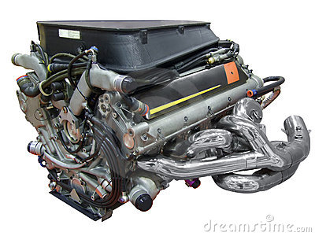
Programming language vulnerabilities
Assembler:
  is a bare engine;
  you have to build the car yourself and manually supply it with gas while it's running, but if you're careful it can go like a bat out of hell
  at machine level all data is an array of bytes
  interpretation depends on instructions used
  manual stack management

Slide 29
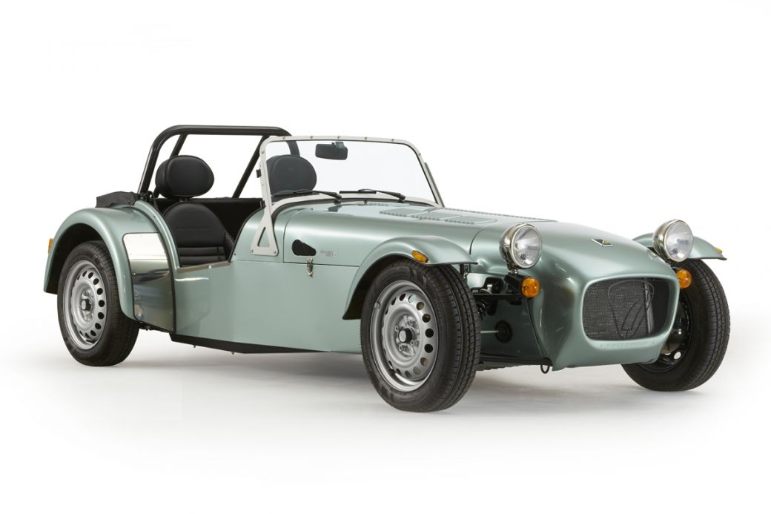
Programming language vulnerabilities
Assembler
C
  is a racing car that goes incredibly fast but breaks down every fifty kilometers
  data-structure abstraction
  manual heap deallocation
  you can still do *((int *)666)=0;

Slide 30
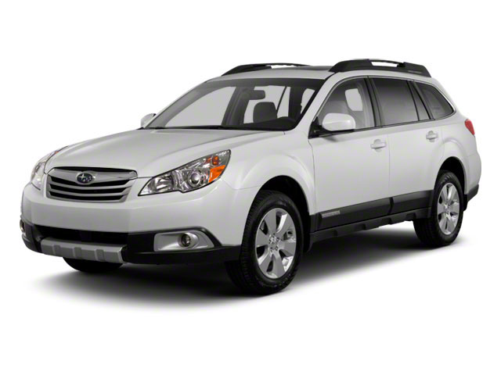
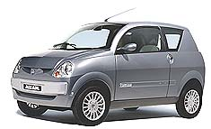
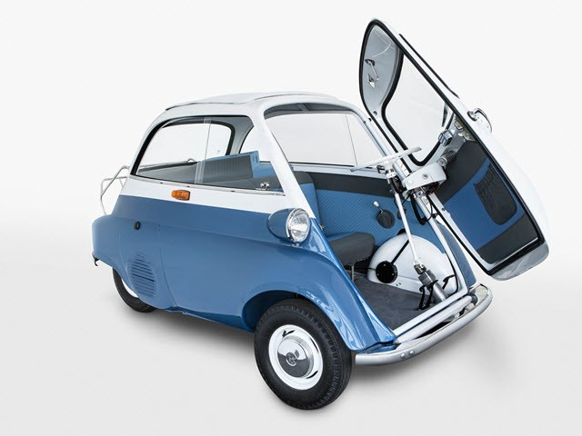
Programming language vulnerabilities
Assembler
C
Java / Python / ML / modern high-level languages
  station wagons / cars you can drive it without a license / cars
  with controls not in the usual places
  have a strong notion of
    type and valid operations
  not vulnerable to buffer overflows
  garbage collectors
  overhead, some limits on use
  bugs in the VM/run-time

Slide 31
C/C++
have high-level control structures
but allow direct access to memory
  hence are vulnerable to buffer overflow
  legacy code
    widely used
    unsafe and
    vulnerable code

Slide 32
Memory layout of a process
Stack
Heap
Global Data
Linked Libraries
Code
&
Program Code

Slide 33
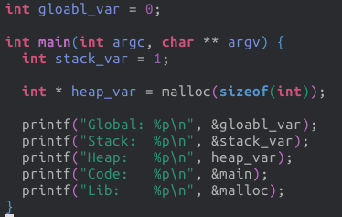
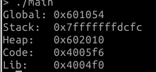
Memory layout of a process

Slide 34
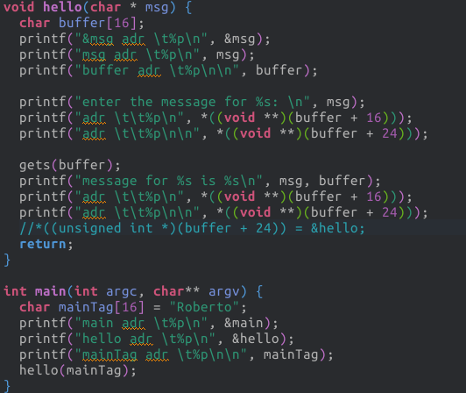
Stack

Slide 35
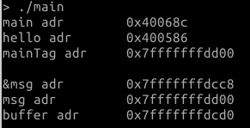
Stack

Slide 36
Stack
0x7...d00: mainTag: Roberto

Slide 37
Stack
0x7...d00: mainTag: Roberto
0x7...cd0: buffer: ???????

Slide 38
Stack
0x7...d00: mainTag: Roberto
0x7...cd0: buffer: ???????
0x7...cc8: msg: ??????

Slide 39
Stack
0x7...d00: mainTag: Roberto
0x7...cd0: buffer: ???????
0x7...cc8: msg: ???????

Slide 40
Stack
0x7...d00: mainTag: Roberto
0x7...cd0: buffer: ???????
0x7...cc8: msg: 0x7...d00

Slide 41
Stack
0x7...d00: mainTag: Roberto
?
0x7...cd0: buffer: ???????
0x7...cc8: msg: 0x7...d00

Slide 42
Stack
0x7...d00: mainTag: Roberto
0x7...cd0: buffer: ???????
0x7...cc8: msg: 0x7...d00

Slide 43
Stack
0x7...d00: mainTag: Roberto
0x7...ce8: returnPtr: ????
0x7...cd0: buffer: ???????
0x7...cc8: msg: 0x7...d00

Slide 44
Stack
0x7...d00: mainTag: Roberto
0x7...ce8: returnPtr: ????
0x7...cd0: buffer: ???????
0x7...cc8: msg: 0x7...d00

Slide 45
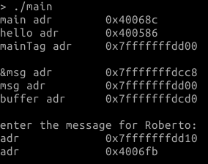
Stack
0x7...d00: mainTag: Roberto
0x7...ce8: returnPtr: ????
0x7...cd0: buffer: ???????
0x7...cc8: msg: 0x7...d00

Slide 46
Stack
0x7...d00: mainTag: Roberto
0x7...ce8: returnPtr: 0x4006fb
0x7...cd0: buffer: ???????
0x7...cc8: msg: 0x7...d00

Slide 47
Stack
0x7...d00: mainTag: Roberto
0x7...ce8: returnPtr: 0x4006fb
0x7...cd0: buffer: ???????
0x7...cc8: msg: 0x7...d00

Slide 48
Stack
0x7...d00: mainTag: Roberto
0x7...ce8: returnPtr: 0x4006fb
0x7...ce0: framePtr: 0x7...d10
0x7...cd0: buffer: ???????
0x7...cc8: msg: 0x7...d00

Slide 49
Stack
0x7...d00: mainTag: Roberto
0x7...ce8: returnPtr: 0x4006fb
0x7...ce0: framePtr: 0x7...d10
0x7...cd0: buffer: ???????
0x7...cc8: msg: 0x7...d00

Slide 50
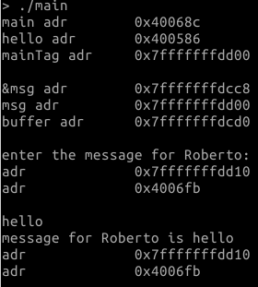
Stack

Slide 51
Stack
Question 4: What happen if I
enter more than 16 characters?
A) nothing
B) the framePointer is overwritten
C) the returnPtr is overritten
D) msg is overritten
0x7...d00: mainTag: Roberto
0x7...ce8: returnPtr: 0x4006fb
0x7...ce0: framePtr: 0x7...d10
0x7...cd0: buffer: ???????
0x7...cc8: msg: 0x7...d00

Slide 52
Stack
Question 4: What happen if I
enter more than 16 characters?
A) nothing
B) the framePointer is overwritten
C) the returnPtr is overritten
D) msg is overritten
0x7...d00: mainTag: Roberto
0x7...ce8: returnPtr: 0x4006fb
0x7...ce0: framePtr: 0x7...d10
0x7...cd0: buffer: ???????
0x7...cc8: msg: 0x7...d00

Slide 53
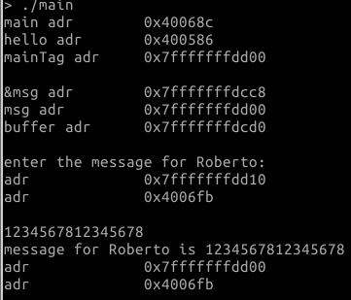
Stack

Slide 54
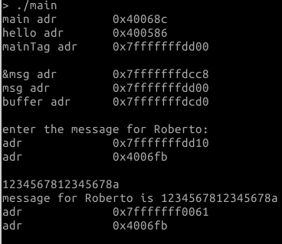
Stack

Slide 55
Stack Buffer Overflow
occurs when buffer is located on stack
  used by Morris Worm
local variables below saved frame pointer and return address
hence overflow of a local buffer can potentially overwrite these key control elements

Slide 56
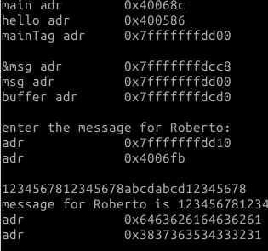
Return Attack

Slide 57
Return Attack

Slide 58
Return Attack

Slide 59
Return Attack

Slide 60
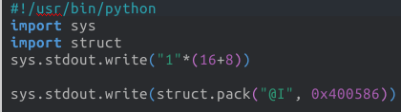
Return Attack

Slide 61
Return attack
Attacker needs
  Know where the function is loaded
    (the address is used to override the return pointer)
    use debugger
  Know space below the frame pointer
    inspection
  Know valid value for overwriting frame pointer
  Take into account little-Endian vs big-Endian

Slide 62
Effects of buffer overflow
Victim secret exposed
Victim data changed
Victim control flow changed
Victim program changed
DoS (victim crashes)

Slide 63
Shellcode
code supplied by attacker
  often saved in buffer that is overflowed
  traditionally transfer control to a shell
machine code
  specific to processor and operating system
  traditionally needed good assembly language skills
  more recently automated sites/tool

Slide 64
Example Shellcode
http://shell-storm.org/shellcode

Slide 65
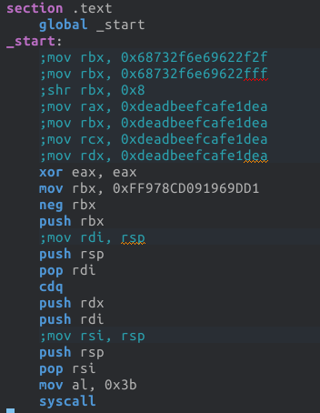


Example Shellcode

Slide 66
Example Shellcode
classic Intel Linux shellcode to run Bourne shell
shellcode must
  marshall argument for execve() (e.g. /bin/sh)
  include all code to invoke system function
  be position-independent
  not contain NULLs (C string terminator)

Slide 67
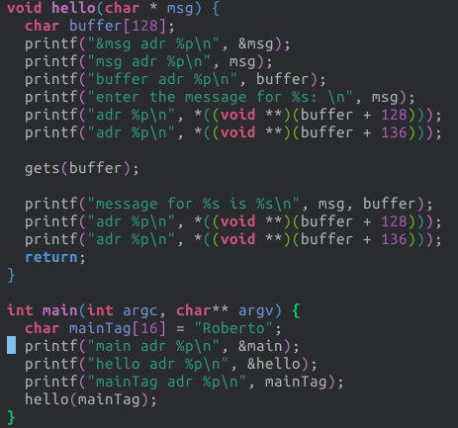
Example Shellcode

Slide 68
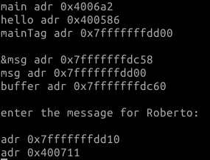
Example Shellcode

Slide 69
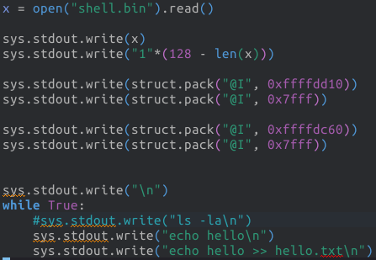
Example Shellcode

Slide 70
Example Shellcode

Slide 71
Example Shellcode

Slide 72
Example Shellcode

Slide 73
Xbox softmod
Xbox dashboard uses code signing to prevent execution of non-licit code
exploits in savegame
  MechAssault, Splinter Cell, and 007 Agent Under Fire
execution of arbitrary code: FTP server to copy a font
font-hack exploits a buffer overflow in the Xbox font loader which is part of the dashboard
  execution of arbitrary unsigned code

Slide 74
More Stack Overflow Variants
victim program can be:
  a trusted system utility
  network service daemon
  commonly used library code, e.g. image processing
shellcode functions
  spawn shell
  create listener to launch shell on connect
  create reverse connection to attacker
  change firewall rules

Slide 75
Return to System Call
Attacker gains control of the system-call stack
System-call control flow (OS) hijacked to execute arbitrary program
Non-privileged SW executed as privileged
Rootkit/auto-rooter

Slide 76
Return oriented programming
attacker gains control of the call stack
hijacks program control flow
to executes chosen machine instruction sequences
  called "gadgets"
each gadget ends in a return instruction
gadgets are located within the existing program
chained together, gadgets allow to perform arbitrary operations

Slide 77
Return oriented programming
X:= X+1
Y:= X*5
X:= Y-3
Z:=Z+X

Slide 78
Return oriented programming
X:= X+1
Y:= X*5
X:= Y-3
Z:=Z+X
void F1() {
void F2() {
void F3() {
???
???
???
X:= X+1
return;
}
Y:= X*5
X:=Y-3
return;
}
Z:= Z+X
return;
}

Slide 79
Return oriented programming
X:= X+1
Y:= X*5
X:= Y-3
Z:=Z+X
void F1() {
void F2() {
void F3() {
???
???
???
X:= X+1
return;
}
Y:= X*5
X:=Y-3
return;
}
Z:= Z+X
return;
}
STACK
retPtr
???
retPtr
???
retPtr

Slide 80
Return oriented programming
X:= X+1
Y:= X*5
X:= Y-3
Z:=Z+X
void F1() {
void F2() {
void F3() {
???
???
???
X:= X+1
return;
}
Y:= X*5
X:=Y-3
return;
}
Z:= Z+X
return;
}
STACK
retPtr
???
retPtr
???
retPtr

Slide 81
Return oriented programming
X:= X+1
Y:= X*5
X:= Y-3
Z:=Z+X
void F1() {
void F2() {
void F3() {
???
???
???
X:= X+1
return;
}
Y:= X*5
X:=Y-3
return;
}
Z:= Z+X
return;
}
STACK
retPtr
???
retPtr

Slide 82
Return oriented programming
X:= X+1
Y:= X*5
X:= Y-3
Z:=Z+X
void F1() {
void F2() {
void F3() {
???
???
???
X:= X+1
return;
}
Y:= X*5
X:=Y-3
return;
}
Z:= Z+X
return;
}
STACK
retPtr
???
retPtr

Slide 83
Return oriented programming
X:= X+1
Y:= X*5
X:= Y-3
Z:=Z+X
void F1() {
void F2() {
void F3() {
???
???
???
X:= X+1
return;
}
Y:= X*5
X:=Y-3
return;
}
Z:= Z+X
return;
}
STACK
retPtr

Slide 84
Return oriented programming
X:= X+1
Y:= X*5
X:= Y-3
Z:=Z+X
void F1() {
void F2() {
void F3() {
???
???
???
X:= X+1
return;
}
Y:= X*5
X:=Y-3
return;
}
Z:= Z+X
return;
}
STACK
retPtr

Slide 85
Return oriented programming
X:= X+1
Y:= X*5
X:= Y-3
Z:=Z+X
void F1() {
void F2() {
void F3() {
???
???
???
X:= X+1
return;
}
Y:= X*5
X:=Y-3
return;
}
Z:= Z+X
return;
}
STACK

Slide 86
Global Data Overflow
can attack buffer located in global data
  may be located above program code
no return address
  hence no easy transfer of control
may have function pointers (e.g. C++ virtual tables)
or manipulate management data structures

Slide 87
Heap Overflow
attack buffer located in heap
  typically located above program code
  memory requested by programs to use in dynamic data structures (e.g. linked lists, malloc)
also possible due to dangling pointers
no return address
may have function pointers (e.g. C++ virtual tables)
or manipulate management data structures

Slide 88
Arithmetic Overflow
An integer, which has not been properly checked, is incremented past the maximum possible value
It may wrap to become a very small, or negative number
Can lead to buffer overflows, if the integer is used to computer memory offsets, array indexes etc.

Slide 89
Arithmetic Overflow
An integer, which has not been properly checked, is incremented past the maximum possible value
It may wrap to become a very small, or negative number
Can lead to buffer overflows, if the integer is used to computer memory offsets, array indexes etc.
Can lead to violation of security policy
  X = number of pointers to the data structure D
  Reuse the memory of D only when X is 0
  Can we have a new pointer to D if X is 4294967295?

Slide 90
Arithmetic Overflow
An integer, which has not been properly checked, is incremented past the maximum possible value
It may wrap to become a very small, or negative number
Can lead to buffer overflows, if the integer is used to computer memory offsets, array indexes etc.
Can lead to violation of security policy
Can lead to failures

Slide 91
Arithmetic Overflow
An integer, which has not been properly checked, is incremented past the maximum possible value
It may wrap to become a very small, or negative number
Can lead to buffer overflows, if the integer is used to computer memory offsets, array indexes etc.
Can lead to violation of security policy
Can lead to failures
Can lead to data corruption
  my balance = -2147483648 SEK ~ -2 billion SEK
  ask to borrow 1 SEK
  my balance = +2147483647 SEK~ +2 billion SEK

Slide 92
Buffer overflow defenses
buffer overflows are widely exploited
  large amount of vulnerable code in use
  despite cause and countermeasures known
two broad defense approaches
  compile-time - harden new programs
  run-time - handle attacks on existing programs

Slide 93
Compile time Defenses: Language
use a modern high-level languages with strong typing
  you can not access to untyped memory
  not vulnerable to buffer overflow
compiler enforces range checks and allowed operations on variables
do have cost in resource
and restrictions on access to hardware
so still need some code in C like languages
there can be a buffer overflow if there is a bug
  in the language interpreter or JIT compiler

Slide 94
Compile time Defenses: safe coding
if using potentially unsafe languages e.g. C
programmer must explicitly write safe code
code review
allow for graceful failure
check pointers yield by allocators
check to have sufficient space in all buffers

Slide 95
Compile time Defenses:
Language Extension, Safe Libraries
proposals for safety extensions to C
  performance penalties
  must compile programs with special compiler
have several safer standard library variants
  new functions, e.g. strncpy()
  safer re-implementation of standard functions as a library, e.g. Libsafe

Slide 96
Compile time Defenses:
Stack protection
add entry and exit code to check stack for signs of corruption
use random (different for every execution) canary
  e.g. Stackguard, Win /GS
check for overwrite between local variables and saved frame pointer and return address
  abort program if change found
  issues: recompilation, debugger support

Slide 97
Compile time Defenses:
Stack protection
add entry and exit code to check stack for signs of corruption
use random (different for every execution) canary
  e.g. Stackguard, Win /GS
check for overwrite between local variables and saved frame pointer and return address
  abort program if change found
  issues: recompilation, debugger support
ReturnPtr
FramePtr
Var 1
Var 2
Par 1

Slide 98
Compile time Defenses:
Stack protection
add entry and exit code to check stack for signs of corruption
use random (different for every execution) canary
  e.g. Stackguard, Win /GS
check for overwrite between local variables and saved frame pointer and return address
  abort program if change found
  issues: recompilation, debugger support
ReturnPtr
FramePtr
Canary: 12354
Var 1
Var 2
Par 1

Slide 99
Compile time Defenses:
Stack protection
add entry and exit code to check stack for signs of corruption
use random (different for every execution) canary
  e.g. Stackguard, Win /GS
check for overwrite between local variables and saved frame pointer and return address
  abort program if change found
  issues: recompilation, debugger support
ReturnPtr
FramePtr
Canary: df3werw3
Var 1
Var 2
Par 1

Slide 100
Compile time Defenses:
Stack protection
save/check safe copy of return address
shadow stack
  e.g. Stackshield, RAD
  -fstack-protector
Shadow Stack
Stack
Heap
Global Data
Linked Libraries
Code
&
Program Code

Slide 101
Run-time Defenses:
Executable Address Space Protection
use virtual memory support to make some regions of memory non-executable
  e.g. stack, heap, global data
  need h/w support in MMU
  long existed on SPARC / Solaris systems
  recent on x86/ARM Linux/Unix/Windows systems
issues: support for executable stack/heap code
  needed for JIT (e.g. Java) or nested functions
  need special provisions
-z execstack

Slide 102
Run-time Defenses:
Address Space Randomization
randomize location of key data structures
  stack, heap, global data
  using random shift for each process
large address range on modern systems means negligible impact
also randomize location of standard library functions
- echo 0 | sudo tee /proc/sys/kernel/randomize_va_space

Slide 103
Run-time Defenses:
Guard Pages
place guard memory pages between critical regions of memory
  configured in MMU as illegal addresses
  any access aborts process
  can even place between stack frames and heap buffers

Slide 104
Run-time Defenses:
Use polymorphic technique of malware
every instance of the application is different
  different number of local variables
  different alignment of datastructures
  different number of instruction
a buffer overflow in one instance can not be used in another one

Slide 105
Other Defenses:
Verification
Code verification
  Using mathematical model
  Proving absence of bugs
Expensive: ~2000$ per line of code
Verified execution platforms
  isolation kernels
  software fault isolation

Slide 106
THANKS!
Any questions?
You can find me at robertog@kth.se

