Slide 1

Computer Security DD2395
Buffer Overflow
And System Security
Roberto Guanciale

Slide 2
Buffer Overflow - effects
[S] Access to Secret data
[D] Corruption of program Data
[C] Unexpected transfer of Control
[V] Memory access Violation
[X] EXecution of code chosen by attacker
S
D
C
V
X

Slide 3
Stack Buffer Overflow
occurs when buffer is located on stack
  used by Morris Worm
local variables below saved frame pointer and return address
overflow of a local buffer can potentially overwrite these key control elements

Slide 4
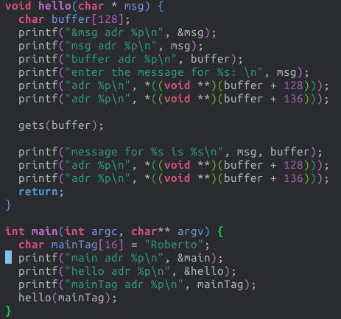
Example Shellcode

Slide 5
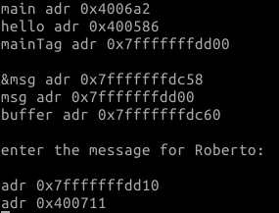
Example Shellcode

Slide 6
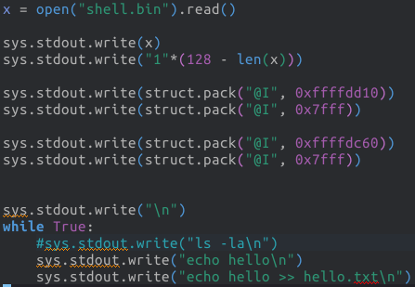
Example Shellcode

Slide 7
Example Shellcode

Slide 8
Example Shellcode

Slide 9
Example Shellcode

Slide 10
Global Data Overflow
can attack buffer located in global data
  may be located above program code
no return address
  hence no easy transfer of control
can target function pointers (e.g. C++ virtual tables)
or manipulate critical data structures

Slide 11
Heap Overflow
attack buffer located in heap
  typically located above program code
  memory requested by programs to use in dynamic data structures (e.g. linked lists, malloc)
also possible due to dangling pointers
no return address
can target function pointers (e.g. C++ virtual tables)
or manipulate critical data structures

Slide 12
Arithmetic Overflow
An integer, which has not been properly checked, is incremented past the maximum possible value
It may wrap to become a very small, or negative number
Can lead to buffer overflows, if the integer is used to compute memory offsets, array indexes etc.

Slide 13
Arithmetic Overflow
An integer, which has not been properly checked, is incremented past the maximum possible value
It may wrap to become a very small, or negative number
Can lead to buffer overflows, if the integer is used to computer memory offsets, array indexes etc.
Can lead to violation of security policies
  X = number of pointers (references) to the data structure D
  Reuse the memory of D only when X is 0
  Can we have a new pointer to D if X is 4294967295 = 2^32-1?

Slide 14
Arithmetic Overflow
An integer, which has not been properly checked, is incremented past the maximum possible value
It may wrap to become a very small, or negative number
Can lead to buffer overflows, if the integer is used to computer memory offsets, array indexes etc.
Can lead to violation of security policy
Can lead to failures

Slide 15
Arithmetic Overflow
An integer, which has not been properly checked, is incremented past the maximum possible value
It may wrap to become a very small, or negative number
Can lead to buffer overflows, if the integer is used to computer memory offsets, array indexes etc.
Can lead to violation of security policy
Can lead to failures
Can lead to data corruption
  my balance = -2147483648 SEK ~ -2 billion SEK
  ask to borrow 1 SEK
  my balance = +2147483647 SEK~ +2 billion SEK

Slide 16
Buffer overflow defenses
buffer overflows are widely exploited
  large amount of vulnerable code in use
  despite cause and countermeasures known
two defense approaches
  compile-time - harden new programs
  run-time - handle attacks on existing programs

Slide 17
Suggestions?
Discuss 5 minutes

Slide 18
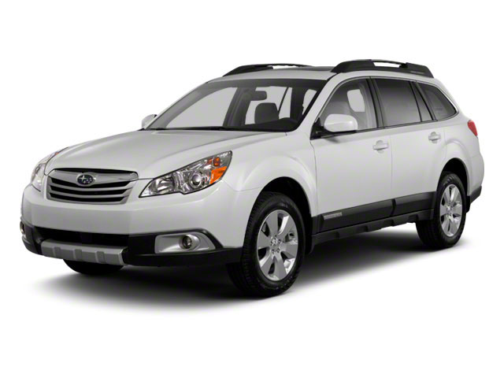
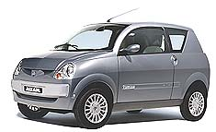
Compile time Defenses: Language
use a modern high-level languages with strong typing
  you can not access to untyped memory
  not vulnerable to buffer overflow
compiler enforces range checks and allowed operations on variables
do have cost in resource

Slide 19
Compile time Defenses: Language
use a modern high-level languages with strong typing
  you can not access to untyped memory
  not vulnerable to buffer overflow
compiler enforces range checks and allowed operations on variables
do have cost in resource
and restrictions on access to hardware
so still need some code in C like languages

Slide 20
Compile time Defenses: Language
use a modern high-level languages with strong typing
  you can not access to untyped memory
  not vulnerable to buffer overflow
compiler enforces range checks and allowed operations on variables
do have cost in resource
and restrictions on access to hardware
so still need some code in C like languages
there can be a buffer overflow if there is a bug
in the language interpreter or JIT compiler

Slide 21
Compile time Defenses: Language
use a modern high-level languages with strong typing
  you can not access to untyped memory
  not vulnerable to buffer overflow
compiler enforces range checks and allowed operations on variables
do have cost in resource
and restrictions on access to hardware
so still need some code in C like languages
there can be a buffer overflow if there is a bug
  in the language interpreter or JIT compiler
S
D
C
V
X

Slide 22
Compile time Defenses: safe coding
if using potentially unsafe languages e.g. C
programmer must explicitly write safe code
  e.g. justify why a buffer can receive n bytes
code review
check pointers yield by allocators
  e.g. when allocation fails
check to have sufficient space in all buffers
S
D
C
V
X

Slide 23
Compile time Defenses:
Language Extension, Safe Libraries
proposals for safety extensions to C
  performance penalties
  must compile programs with special compiler
use safer standard library variants
  new functions, e.g. strncpy()
  safer re-implementation of standard functions as a library,
  e.g. Libsafe
S
D
C
V
X

Slide 24
Compile time Defenses:
Stack protection
add entry and exit code to check stack for signs of corruption
use random (different for every execution) canary
  e.g. Stackguard, Win /GS

Slide 25
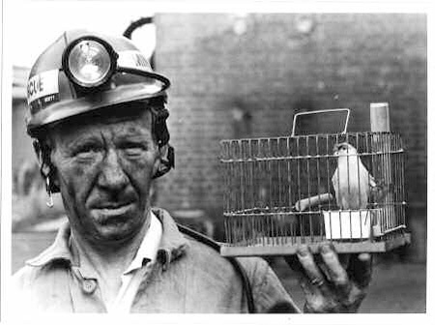
Compile time Defenses:
Stack protection
add entry and exit code to check stack for signs of corruption
use random (different for every execution) canary
  e.g. Stackguard, Win /GS
Canaries were used in coal mines
to detect the presence of
carbon monoxide

Slide 26
Compile time Defenses:
Stack protection
add entry and exit code to check stack for signs of corruption
use random (different for every execution) canary
  e.g. Stackguard, Win /GS
check for overwrite between local variables and saved frame pointer and return address
  abort program if change found
  issues: recompilation, debugger support

Slide 27
Compile time Defenses:
Stack protection
add entry and exit code to check stack for signs of corruption
use random (different for every execution) canary
  e.g. Stackguard, Win /GS
check for overwrite between local variables and saved frame pointer and return address
  abort program if change found
  issues: recompilation, debugger support
ReturnPtr
FramePtr
Var 1
Var 2
Par 1

Slide 28
Compile time Defenses:
Stack protection
add entry and exit code to check stack for signs of corruption
use random (different for every execution) canary
  e.g. Stackguard, Win /GS
check for overwrite between local variables and saved frame pointer and return address
  abort program if change found
  issues: recompilation, debugger support
ReturnPtr
FramePtr
Canary: 12354
Var 1
Var 2
Par 1

Slide 29
Compile time Defenses:
Stack protection
add entry and exit code to check stack for signs of corruption
use random (different for every execution) canary
  e.g. Stackguard, Win /GS
check for overwrite between local variables and saved frame pointer and return address
  abort program if change found
  issues: recompilation, debugger support
ReturnPtr
FramePtr
Canary: df3werw3
Var 1
Var 2
Par 1

Slide 30
Compile time Defenses:
Stack protection
add entry and exit code to check stack for signs of corruption
use random (different for every execution) canary
  e.g. Stackguard, Win /GS
check for overwrite between local variables and saved frame pointer and return address
  abort program if change found
  issues: recompilation, debugger support
ReturnPtr
FramePtr
Canary: df3werw3
Var 1
S
D
C
V
X
Var 2
Par 1

Slide 31
Compile time Defenses:
Stack protection
save/check safe copy of return address
shadow stack
  e.g. Stackshield, RAD
  -fstack-protector
Shadow Stack
Stack
Heap
Global Data
Linked Libraries
Code
&
Program Code
S
D
C
V
X

Slide 32
Run-time Defenses:
Executable Address Space Protection
use virtual memory support to make some regions of memory
non-executable
  e.g. stack, heap, global data
  need HW support in MMU
  long existed on SPARC / Solaris systems
  recent on x86/ARM Linux/Unix/Windows systems
S
D
C
V
X

Slide 33
Run-time Defenses:
Executable Address Space Protection
use virtual memory support to make some regions of memory non-executable
  e.g. stack, heap, global data
  need h/w support in MMU
  long existed on SPARC / Solaris systems
  recent on x86/ARM Linux/Unix/Windows systems
issues: support for executable stack/heap code
  needed for JIT (e.g. Java) or nested functions
  need special provisions
-z execstack

Slide 34
Run-time Defenses:
Address Space Randomization
randomize location of key data structures
  stack, heap, global data
  using random shift for each process
large address range on modern systems means negligible impact
also randomize location of standard library functions

Slide 35
Run-time Defenses:
Address Space Randomization
randomize location of key data structures
  stack, heap, global data
  using random shift for each process
large address range on modern systems means negligible impact
also randomize location of standard library functions
echo 0 | sudo tee /proc/sys/kernel/randomize_va_space
S
D
C
V
X

Slide 36
Run-time Defenses:
Guard Pages
place guard memory pages between critical regions of memory
  configured in MMU as illegal addresses
  any access aborts process
  can be placed between stack frames and heap buffers
S
D
C
V
X

Slide 37
Run-time Defenses:
Use polymorphic technique of malware
every instance of the application is different
  different number of local variables
  different alignment of data-structures
  different number of instructions
a buffer overflow in one instance can not be used in another one
S
D
C
V
X

Slide 38
Other approaches?
Prevent?
Detect?
Mitigate?
Discuss 5 minutes

Slide 39
Other Defenses:
Verification
Code verification
  Using mathematical model
  Proving absence of bugs
Expensive: ~2000$ per line of code
Verified execution platforms
  isolation kernels
  software fault isolation
S
D
C
V
X

Slide 40
System security
Low level SW (e.g. operating system) can not be written with safe languages
It is difficult to write bug free code
Reduce as much as possible the critical code base
  1 line of code = 1 liability (1 or more bugs)
Isolate critical components from failures of the non-critical ones

Slide 41
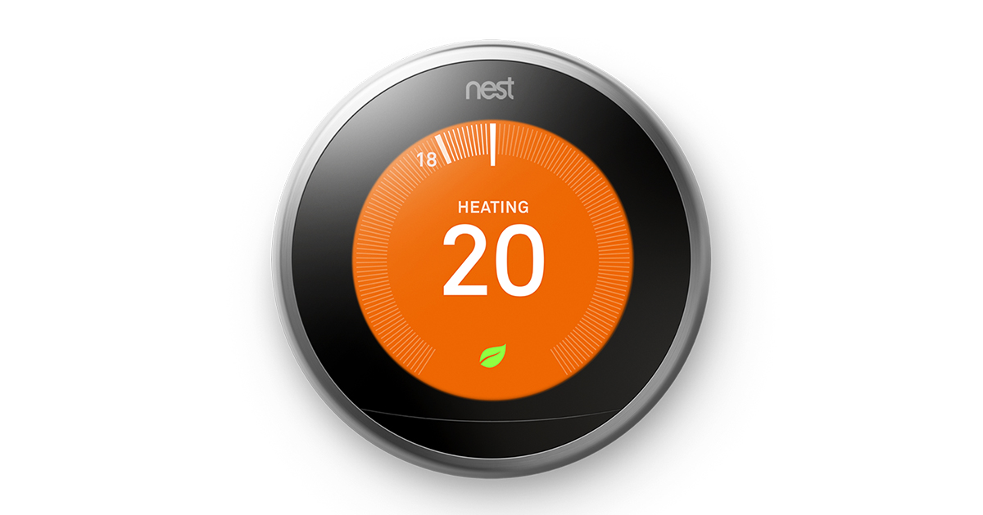
System security
Smart thermostat
  Control heating unit
  Keep safe limits (e.g. 15 C min)
  Programmable
  Wi-Fi

Slide 42
System security
Smart thermostat
  Control heating unit
  Keep safe limits (e.g. 15 C min)
  Programmable
  Wi-Fi
  Machine learning algorithms

Slide 43
System security
Smart thermostat
  Control heating unit
  Keep safe limits (e.g. 15 C min)
  Programmable
  Wi-Fi
  Machine learning algorithms

Slide 44
System security
Smart thermostat
  Control heating unit
  Keep safe limits (e.g. 15 C min)
  Programmable
  Wi-Fi
  Machine learning algorithms
Linux 2.6.37
  ~10 million lines of code
  98 vulnerabilities

Slide 45
System security
  Integer signedness error in the CIFSFindNext function in fs/cifs/cifssmb.c in the Linux kernel before 3.1 allows remote CIFS servers to cause a denial of service (memory corruption) or possibly have unspecified other impact via a large length value in a response to a read request for a directory.
Smart thermostat
  Control heating unit
  Keep safe limits (e.g. 15 C min)
  Programmable
  Wi-Fi
  Machine learning algorithms
Linux 2.6.37
  ~10 million lines of code
  98 vulnerabilities

Slide 46
Microkernels
L4 is the most famous
“A concept is tolerated inside the microkernel only if moving it outside the kernel, i.e., permitting competing implementations, would prevent the implementation of the system's required functionality”
  address spaces
  threads
  scheduling
  inter-thread communication
Everything else is outside the kernel (e.g. drivers)
15 thousands lines of code

Slide 47

Microkernels

Slide 48
Software Fault Isolation
Sandbox non-critical code
Google Chrome Native Client
Modify binary to ensure that overflows can not access critical resources
Critical
Resources
0x01000000
0x00FFFFFF
Non-critical
Resources

Slide 49
Software Fault Isolation
Sandbox non-critical code
Google Chrome Native Client
Modify binary to ensure that overflows can not access critical resources
…
Store (X, Y)
...
Critical
Resources
0x01000000
0x00FFFFFF
Non-critical
Resources

Slide 50
Software Fault Isolation
Sandbox non-critical code
Google Chrome Native Client
Modify binary to ensure that overflows can not access critical resources
…
Store (X, Y)
...
…
X = X & 0x00FFFFFF
Store (X, Y)
...
Critical
Resources
0x01000000
0x00FFFFFF
Non-critical
Resources

Slide 51
Software Fault Isolation
Sandbox non-critical code
Google Chrome Native Client
Modify binary to ensure that overflows can not access critical resources
…
Store (X, Y)
X = X+1
Store(X+1,Y)
...
…
X = X & 0x00FFFFFF
Store (X, Y)
X = X+1
X = X & 0x00FFFFFF
Store (X, Y)
...
Critical
Resources
0x01000000
0x00FFFFFF
Non-critical
Resources

Slide 52
Software Fault Isolation
Sandbox non-critical code
Google Chrome Native Client
Modify binary to ensure that overflows can not access critical resources
…
Store (X, Y)
X = X+1
Store(X+1,Y)
...
…
X = X & 0x00FFFFF0
Store (X, Y)
X = X+1
Store (X, Y)
...
Critical
Resources
0x01000000
0x00FFFFFF
Non-critical
Resources

Slide 53
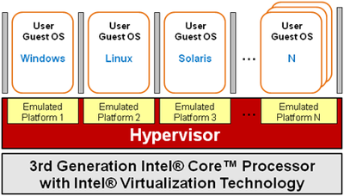
Hypervisors
Execute below OS
Isolate complete OSes from each other
Can inspect the behavior of a (possibly) buggy OS

Slide 54
Run-time monitor
Enforce Write XOR Execute policy
  A page can be either writable or executable, but not both
  It is not possible to inject malware into executable code

Slide 55
Run-time monitor
Enforce Write XOR Execute policy
  A page can be either writable or executable, but not both
  It is not possible to inject malware into executable code
  Still possible to
    Write malware
    Ask the OS to make the page non-writable
    Ask the OS to make the page executable
    Jump to the malicious code

Slide 56
Run-time monitor
Enforce Write XOR Execute policy
  A page can be either writable or executable, but not both
  It is not possible to inject malware into executable code
  Still possible to
    Write malware
    Ask the OS to make the page non-writable
    Ask the OS to make the page executable
    Jump to the malicious code
Check signature of binary code at (3)

Slide 57
THANKS!
Any questions?
You can find me at robertog@kth.se

