Slide 1

Computer Security DD2395
Buffer Overflow
Roberto Guanciale

Slide 2
Lab O
Deadline extended to Friday 01/12
Office meeting today 13:15

Slide 3
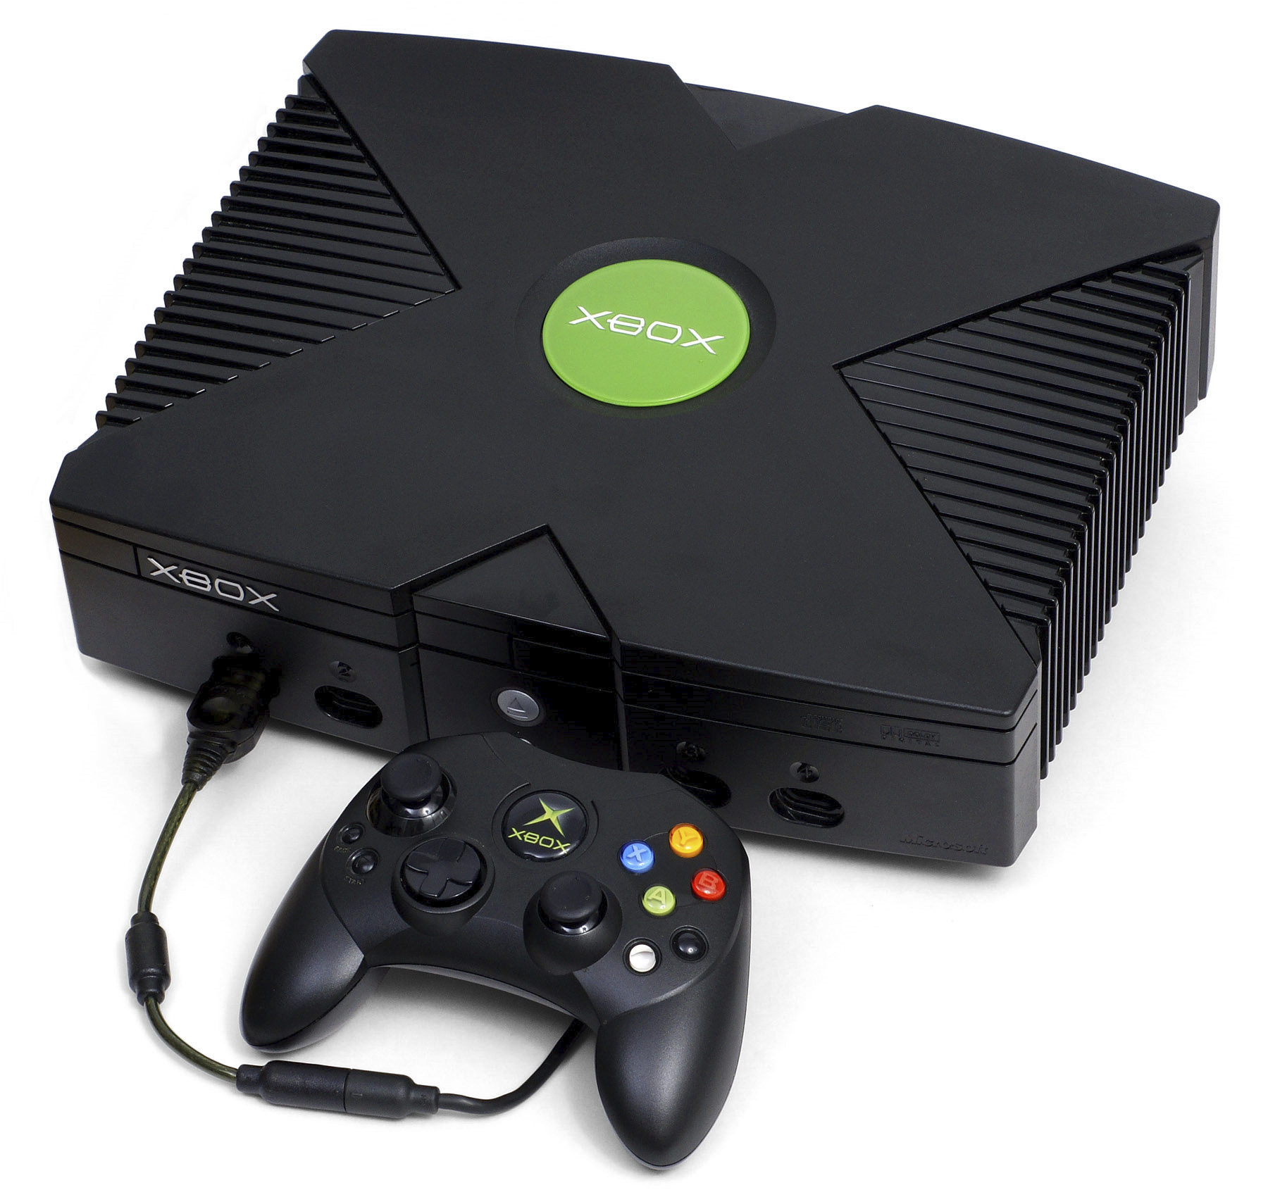


Buffer Overflow
A very common attack mechanism
One of the most dangerous security threat
Major concern due to
  legacy code
  careless programming
Present in well-designed systems
  XBox
  Hearthbleed (OpenSSL)
  Stagefright (Android media-stack)

Slide 4
Buffer Overflow - basics
Caused by programming error
  Allows more data to be stored than capacity
  Reads more data than the capacity
Overwriting adjacent memory locations
  corruption of program data
  unexpected transfer of control
  memory access violation
  execution of code chosen by attacker

Slide 5
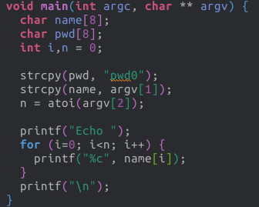
Buffer Over-read - Example

Slide 6
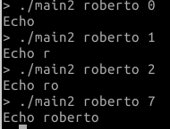
Buffer Over-read - Example

Slide 7
Buffer Over-read - Example

Slide 8
Buffer Over-read - Example
Question 2: 16?
A) IndexOutOfBoundsException
B) Program terminates
C) Other

Slide 9
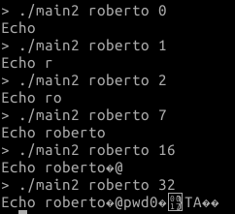
Buffer Over-read - Example

Slide 10
Buffer Over-read - Example
https://gist.github.com/simonwagner/10271224

Slide 11
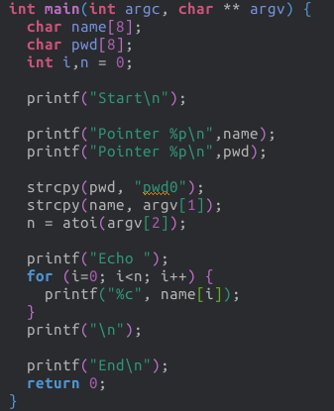
Memory Layout

Slide 12
Memory Layout
Address | Content | Var
0x7fffffffdd10 | roberto\0 | name
0x7fffffffdd20 | pwd0\0 | pwd

Slide 13
Memory Layout
Address | Content | Var
0x7fffffffdd10 | roberto\0 | name
0x7fffffffdd20 | pwd0\0 | pwd
Question 3: The variable name
(i.e. address 0x7fffffffdd10) is
A) in the stack
B) in the heap
C) in the data memory

Slide 14
Memory Layout
Address | Content | Var
0x7fffffffdd10 | roberto\0 | name
0x7fffffffdd20 | pwd0\0 | pwd
Question 3: The variable name
(i.e. address 0x7fffffffdd10) is
A) in the stack
B) in the heap
C) in the data memory

Slide 15
How can we fix the program?

Slide 16
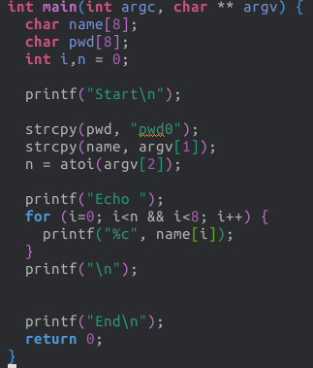
How can we fix the program?

Slide 17
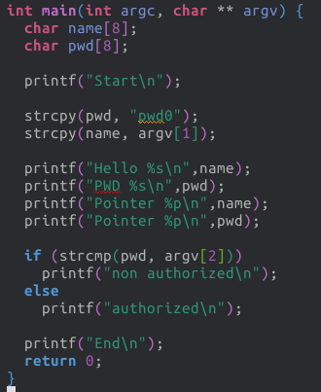
Buffer Overflow - Example

Slide 18
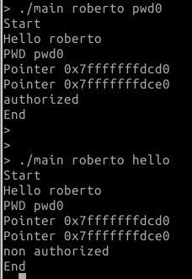
Buffer Overflow - Example

Slide 19
Buffer Overflow - Example
Address | Content | Var
0x7ffffffffcd0 | roberto\0 | name
0x7ffffffffce0 | pwd0\0 | pwd

Slide 20
Buffer Overflow - Example
Address | Content | Var
0x7ffffffffcd0 | roberto\0 | name
0x7ffffffffce0 | pwd0\0 | pwd
16

Slide 21
Buffer Overflow - Example
Address | Content | Var
0x7ffffffffcd0 | roberto\0 | name
0x7ffffffffce0 | pwd0\0 | pwd
16
Question 4: Can you spot a bug?
A) Yes
B) No

Slide 22
Buffer Overflow - Example
Address | Content | Var
0x7ffffffffcd0 | roberto\0 | name
0x7ffffffffce0 | pwd0\0 | pwd
16

Slide 23
Buffer Overflow - Example
Address | Content | Var
0x7ffffffffcd0 | roberto\0 | name
0x7ffffffffce0 | pwd0\0 | pwd
16
Address | Content | Var
0x7ffffffffcd0 | roberto1234567812345678 | name
0x7ffffffffce0 | hello\0 | pwd

Slide 24
How can we fix the program?

Slide 25
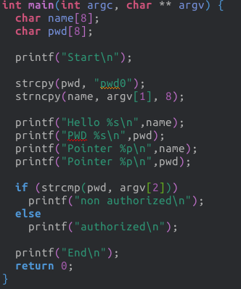
How can we fix the program?

Slide 26
Buffer Overflow Attacks
to exploit a buffer overflow an attacker
  must identify a buffer overflow vulnerability in some program
    Source code inspection (e.g. on GitHub log)
    https://github.com/search?utf8=%E2%9C%93&q=buffer+overflow&type=Issues&ref=searchresults
    Binary code inspection
    Tracing execution
    Fuzzing tools (random inputs)
understand how buffer is stored in memory and
determine effects of corruption

Slide 27
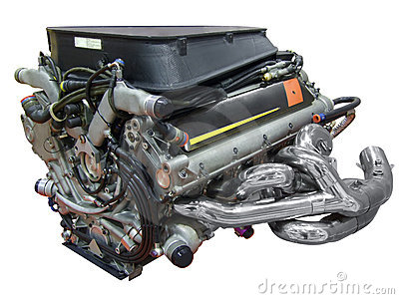
Programming language vulnerabilities
Assembler:
  is a bare engine;
  you have to build the car yourself and manually supply it with gas while it's running, but if you're careful it can go like a bat out of hell
  at machine level all data is an array of bytes
  interpretation depends on instructions used
  manual stack management

Slide 28
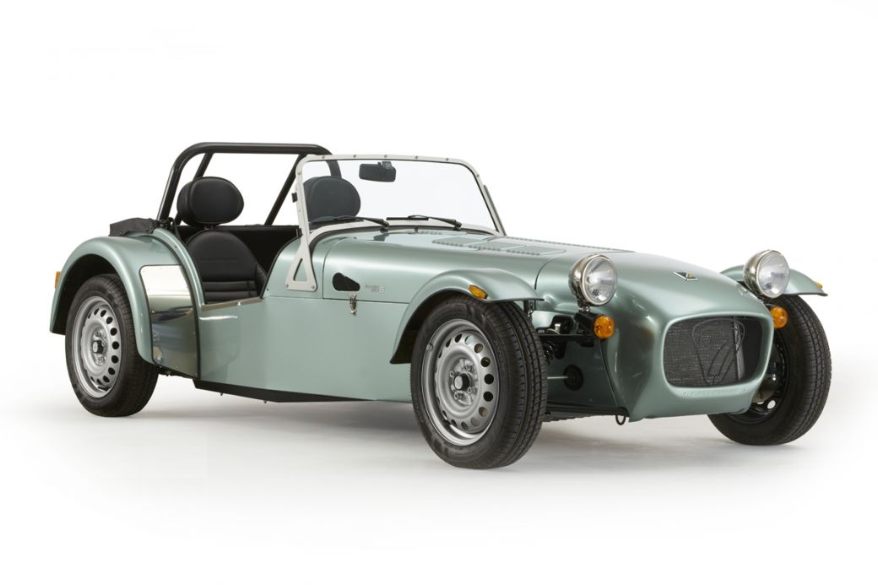
Programming language vulnerabilities
Assembler
C
  is a racing car that goes incredibly fast but breaks down every fifty kilometers
  data-structure abstraction
  manual heap deallocation
  you can still do *((int *)666)=0;

Slide 29
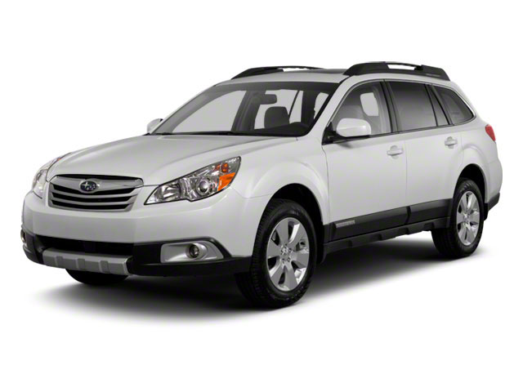
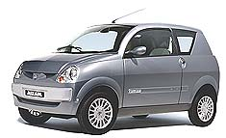
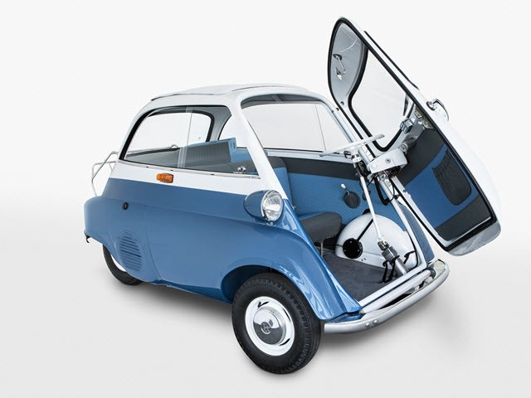
Programming language vulnerabilities
Assembler
C
Java / Python / ML / modern high-level languages
  station wagons / cars you can drive it without a license / cars
  with controls not in the usual places
  have a strong notion of
    type and valid operations
  not vulnerable to buffer overflows
  garbage collectors
  overhead, some limits on use
  bugs in the VM/run-time

Slide 30
C/C++
have high-level control structures
but allow direct access to memory
  hence are vulnerable to buffer overflow
  legacy code
    widely used
    unsafe and
    vulnerable code

Slide 31
Memory layout of a process
Stack
Heap
Global Data
Linked Libraries
Code
&
Program Code

Slide 32
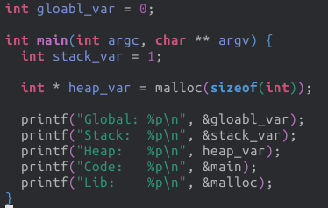
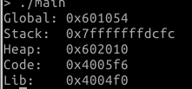
Memory layout of a process

Slide 33
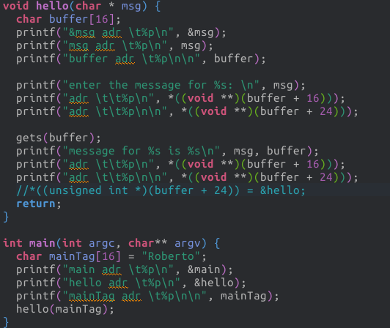
Stack

Slide 34
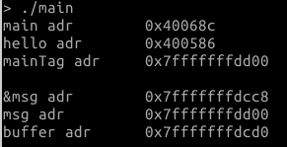
Stack

Slide 35
Stack
0x7...d00: mainTag: Roberto

Slide 36
Stack
0x7...d00: mainTag: Roberto
0x7...cd0: buffer: ???????

Slide 37
Stack
0x7...d00: mainTag: Roberto
0x7...cd0: buffer: ???????
0x7...cc8: msg: ??????

Slide 38
Stack
0x7...d00: mainTag: Roberto
0x7...cd0: buffer: ???????
0x7...cc8: msg: ???????

Slide 39
Stack
0x7...d00: mainTag: Roberto
0x7...cd0: buffer: ???????
0x7...cc8: msg: 0x7...d00

Slide 40
Stack
0x7...d00: mainTag: Roberto
?
0x7...cd0: buffer: ???????
0x7...cc8: msg: 0x7...d00

Slide 41
Stack
0x7...d00: mainTag: Roberto
0x7...cd0: buffer: ???????
0x7...cc8: msg: 0x7...d00

Slide 42
Stack
0x7...d00: mainTag: Roberto
0x7...ce8: returnPtr: ????
0x7...cd0: buffer: ???????
0x7...cc8: msg: 0x7...d00

Slide 43
Stack
0x7...d00: mainTag: Roberto
0x7...ce8: returnPtr: ????
0x7...cd0: buffer: ???????
0x7...cc8: msg: 0x7...d00

Slide 44
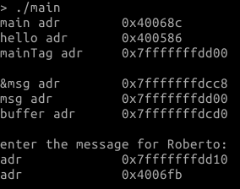
Stack
0x7...d00: mainTag: Roberto
0x7...ce8: returnPtr: ????
0x7...cd0: buffer: ???????
0x7...cc8: msg: 0x7...d00

Slide 45
Stack
0x7...d00: mainTag: Roberto
0x7...ce8: returnPtr: 0x4006fb
0x7...cd0: buffer: ???????
0x7...cc8: msg: 0x7...d00

Slide 46
Stack
0x7...d00: mainTag: Roberto
0x7...ce8: returnPtr: 0x4006fb
0x7...cd0: buffer: ???????
0x7...cc8: msg: 0x7...d00

Slide 47
Stack
0x7...d00: mainTag: Roberto
0x7...ce8: returnPtr: 0x4006fb
0x7...ce0: framePtr: 0x7...d10
0x7...cd0: buffer: ???????
0x7...cc8: msg: 0x7...d00

Slide 48
Stack
0x7...d00: mainTag: Roberto
0x7...ce8: returnPtr: 0x4006fb
0x7...ce0: framePtr: 0x7...d10
0x7...cd0: buffer: ???????
0x7...cc8: msg: 0x7...d00

Slide 49
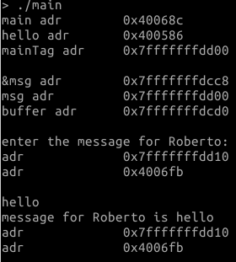
Stack

Slide 50
Stack
Question 4: What happen if I
enter more than 16 characters?
A) nothing
B) the framePointer is overwritten
C) the returnPtr is overritten
D) msg is overritten
0x7...d00: mainTag: Roberto
0x7...ce8: returnPtr: 0x4006fb
0x7...ce0: framePtr: 0x7...d10
0x7...cd0: buffer: ???????
0x7...cc8: msg: 0x7...d00

Slide 51
Stack
Question 4: What happen if I
enter more than 16 characters?
A) nothing
B) the framePointer is overwritten
C) the returnPtr is overritten
D) msg is overritten
0x7...d00: mainTag: Roberto
0x7...ce8: returnPtr: 0x4006fb
0x7...ce0: framePtr: 0x7...d10
0x7...cd0: buffer: ???????
0x7...cc8: msg: 0x7...d00

Slide 52
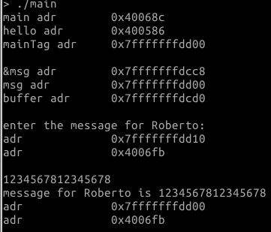
Stack

Slide 53
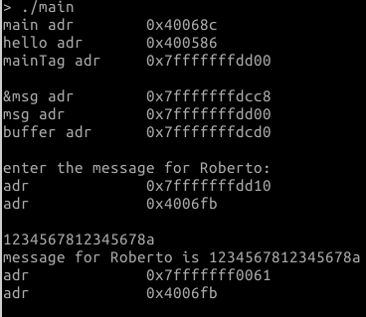
Stack

Slide 54
Stack Buffer Overflow
occurs when buffer is located on stack
  used by Morris Worm
local variables below saved frame pointer and return address
hence overflow of a local buffer can potentially overwrite these key control elements

Slide 55
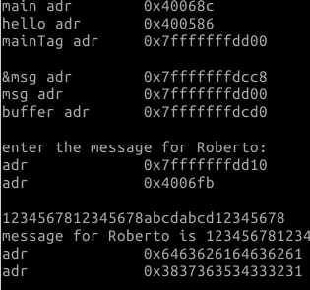
Return Attack

Slide 56
Return Attack

Slide 57
Return Attack

Slide 58
Return Attack

Slide 59
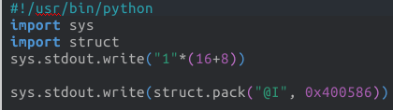
Return Attack

Slide 60
Return attack
Attacker needs
  Know where the function is loaded
    (the address is used to override the return pointer)
    use debugger
  Know space below the frame pointer
    inspection
  Know valid value for overwriting frame pointer
  Take into account little-Endian vs big-Endian

Slide 61
Effects of buffer overflow
Victim secret exposed
Victim data changed
Victim control flow changed
Victim program changed
DoS (victim crashes)

Slide 62
Shellcode
code supplied by attacker
  often saved in buffer that is overflowed
  traditionally transfer control to a shell
machine code
  specific to processor and operating system
  traditionally needed good assembly language skills
  more recently automated sites/tool

Slide 63
Example Shellcode
http://shell-storm.org/shellcode

Slide 64
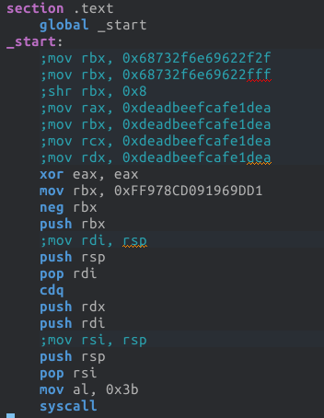


Example Shellcode

Slide 65
Example Shellcode
classic Intel Linux shellcode to run Bourne shell
shellcode must
  marshall argument for execve() (e.g. /bin/sh)
  include all code to invoke system function
  be position-independent
  not contain NULLs (C string terminator)

Slide 66
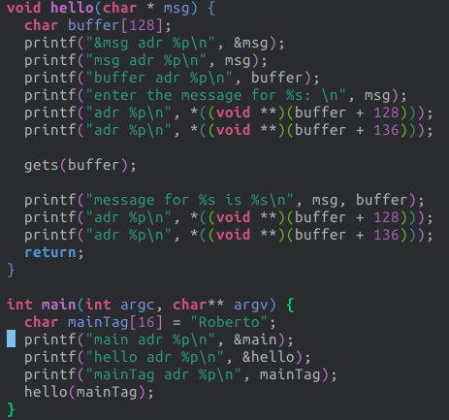
Example Shellcode

Slide 67
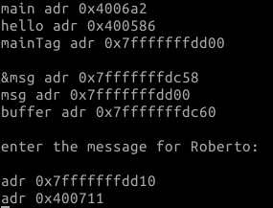
Example Shellcode

Slide 68
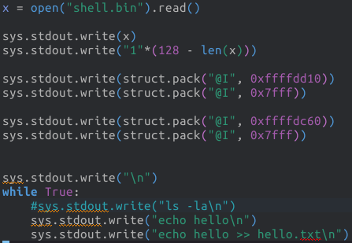
Example Shellcode

Slide 69
Example Shellcode

Slide 70
Example Shellcode

Slide 71
Example Shellcode

Slide 72
Xbox softmod
Xbox dashboard uses code signing to prevent execution of non-licit code
exploits in savegame
  MechAssault, Splinter Cell, and 007 Agent Under Fire
execution of arbitrary code: FTP server to copy a font
font-hack exploits a buffer overflow in the Xbox font loader which is part of the dashboard
  execution of arbitrary unsigned code

Slide 73
More Stack Overflow Variants
victim program can be:
  a trusted system utility
  network service daemon
  commonly used library code, e.g. image processing
shellcode functions
  spawn shell
  create listener to launch shell on connect
  create reverse connection to attacker
  change firewall rules

Slide 74
Global Data Overflow
can attack buffer located in global data
  may be located above program code
no return address
  hence no easy transfer of control
may have function pointers (e.g. C++ virtual tables)
or manipulate management data structures

Slide 75
Heap Overflow
attack buffer located in heap
  typically located above program code
  memory requested by programs to use in dynamic data structures (e.g. linked lists, malloc)
also possible due to dangling pointers
no return address
may have function pointers (e.g. C++ virtual tables)
or manipulate management data structures

Slide 76
Return to System Call
Attacker gains control of the system-call stack
System-call control flow (OS) hijacked to execute arbitrary program
Non-privileged SW executed as privileged
Rootkit/auto-rooter

Slide 77
Return oriented programming
attacker gains control of the call stack
hijacks program control flow
to executes chosen machine instruction sequences
  called "gadgets"
each gadget ends in a return instruction
gadgets are located within the existing program
chained together, gadgets allow to perform arbitrary operations

Slide 78
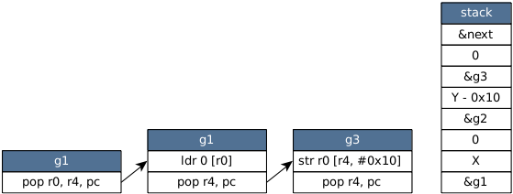
Code-reuse attacks
ROP and JOP attacks are usually not defeated by ISR
Use of memory errors to subvert victim's control flow
Chain together gadgets to execute arbitrary computations
*Y = *X
F1
F2
F3

Slide 79
Code-reuse attacks
ROP and JOP attacks are usually not defeated by ISR
Use of memory errors to subvert victim's control flow
Chain together gadgets to execute arbitrary computations
*Y = *X
F1
F2
F3

Slide 80
Code-reuse attacks
ROP and JOP attacks are usually not defeated by ISR
Use of memory errors to subvert victim's control flow
Chain together gadgets to execute arbitrary computations
*Y = *X
F1
F2
F3

Slide 81
Code-reuse attacks
ROP and JOP attacks are usually not defeated by ISR
Use of memory errors to subvert victim's control flow
Chain together gadgets to execute arbitrary computations
*Y = *X
F1
F2
F3

Slide 82
Code-reuse attacks
ROP and JOP attacks are usually not defeated by ISR
Use of memory errors to subvert victim's control flow
Chain together gadgets to execute arbitrary computations
*Y = *X
F1
F2
F3

Slide 83
Code-reuse attacks
ROP and JOP attacks are usually not defeated by ISR
Use of memory errors to subvert victim's control flow
Chain together gadgets to execute arbitrary computations
*Y = *X
F1
F2
F3

Slide 84
Code-reuse attacks
ROP and JOP attacks are usually not defeated by ISR
Use of memory errors to subvert victim's control flow
Chain together gadgets to execute arbitrary computations
*Y = *X
F1
F2
F3

Slide 85
Other memory safety problems
Dangling pointers: do not point to a valid object of the appropriate type
  wrong dynamic cast of pointers
  missing update of pointers when memory is released (explicitly with free, implicitly by destroying the stack frame)
  missing initialization of pointers
Usage of non-initialized memory
Memory leaks

Slide 86
Other memory safety problems
Dangling pointers: do not point to a valid object of the appropriate type
  wrong dynamic cast of pointers
  missing update of pointers when memory is released (explicitly with free, implicitly by destroying the stack frame)
  missing initialization of pointers
Usage of non-initialized memory
Memory leaks
Dog * x = malloc(sizeof(Dog));
add(list, x);
…
void * y = get(list,0);
miaow((Cat *) y);

Slide 87
Other memory safety problems
Dangling pointers: do not point to a valid object of the appropriate type
  wrong dynamic cast of pointers
  missing update of pointers when memory is released (explicitly with free, implicitly by destroying the stack frame)
  missing initialization of pointers
Usage of non-initialized memory
Memory leaks
Dog * x = malloc(sizeof(Dog));
free(x);
… // location of x is reused for allocating a Cat
woof(x);

Slide 88
Other memory safety problems
Dangling pointers: do not point to a valid object of the appropriate type
  wrong dynamic cast of pointers
  missing update of pointers when memory is released (explicitly with free, implicitly by destroying the stack frame)
  missing initialization of pointers
Usage of non-initialized memory
Memory leaks
void f() {
int x = 42
…
}
void g() {
Dog * x; // Uninitialized
woof(x);
}
void main() {
f();g();

Slide 89
Other memory safety problems
Dangling pointers: do not point to a valid object of the appropriate type
  wrong dynamic cast of pointers
  missing update of pointers when memory is released (explicitly with free, implicitly by destroying the stack frame)
  missing initialization of pointers
Usage of non-initialized memory
Memory leaks
void f() {
int pwd = 123456;
…
}
int g() {
int public_var; // Uninitialized
return public_var;
}
void main() {
f();printf(“%d”, g());

Slide 90
Other memory safety problems
Dangling pointers: do not point to a valid object of the appropriate type
  wrong dynamic cast of pointers
  missing update of pointers when memory is released (explicitly with free, implicitly by destroying the stack frame)
  missing initialization of pointers
Usage of non-initialized memory
Memory leaks
void f() {
char * pwd = malloc(64);
...
return
}
void main() {
for (i=0; …; i++ ){
f();
}
}

Slide 91
Lab O
Deadline extended to Friday 01/12
Four exercises
  Buffer over-read
  Buffer overflow
  Modification of control flow
  Code injection
Use GDB to find memory addresses
Report in Canvas using one single ZIP file

Slide 92
THANKS!
Any questions?
You can find me at robertog@kth.se

