Slide 1
News
Office meeting moved to Thursday 13.15 for this week
No questions on World Cup qualification

Slide 2

Computer Security DD2395
Denial of Service
Roberto Guanciale

Slide 3
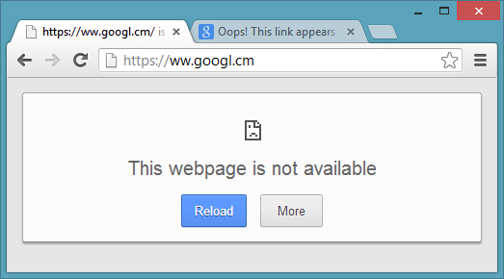

Slide 4
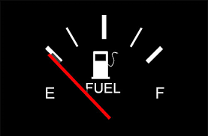

Denial Of Service
prevents or impairs the authorized use of
networks
systems
applications
By exhausting or damaging resources

Slide 5
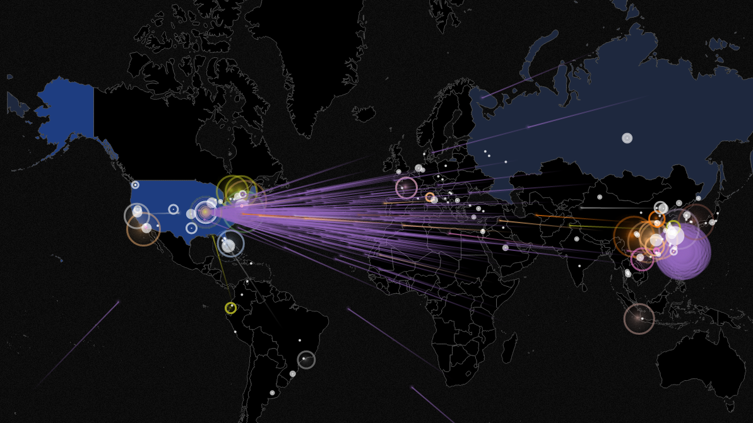
Denial Of Service
Networked
Based on SW vulnerabilities
Physical

Slide 6

Denial Of Service
Networked
Based on SW vulnerabilities
Physical

Slide 7
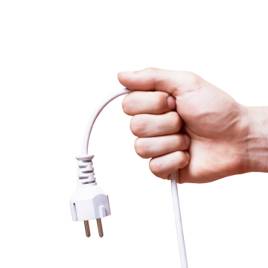
Denial Of Service
Networked
Based on SW vulnerabilities
Physical

Slide 8

Denial Of Service
Networked
Based on SW vulnerabilities
Physical

Slide 9
Denial Of Service
Networked
Based on SW vulnerabilities
Physical

Slide 10
ICMP (ping) flood
Router
1 KB/ms
A
1 KB/ms
1 KB/ms
B
1

Slide 11
ICMP (ping) flood
Router
1 KB/ms
A
1 KB/ms
1 KB/ms
B
1

Slide 12
ICMP (ping) flood
Router
1 KB/ms
A
1 KB/ms
1 KB/ms
B
1
2

Slide 13
ICMP (ping) flood
Router
1 KB/ms
A
1 KB/ms
1 KB/ms
B
1
2
2

Slide 14
ICMP (ping) flood
Router
1 KB/ms
A
1 KB/ms
1 KB/ms
B
1
2
2
3

Slide 15
ICMP (ping) flood
Router
1 KB/ms
A
1 KB/ms
1 KB/ms
B
2
2
3
4

Slide 16
ICMP (ping) flood
Router
A
0.5 KB/ms
1 KB/ms
B
1

Slide 17
ICMP (ping) flood
Router
A
0.5 KB/ms
1 KB/ms
B
1
2

Slide 18
ICMP (ping) flood
Router
A
0.5 KB/ms
1 KB/ms
B
1
2
3

Slide 19
ICMP (ping) flood
Router
A
0.5 KB/ms
1 KB/ms
B
1
2
3
4

Slide 20
ICMP (ping) flood
Router
A
0.5 KB/ms
1 KB/ms
B
2
3
4
5

Slide 21
ICMP (ping) flood
Router
A
0.5 KB/ms
1 KB/ms
B
2
3
4
5
6

Slide 22
ICMP (ping) flood
Router
A
0.5 KB/ms
1 KB/ms
B
3
4
5
6
7

Slide 23
ICMP (ping) flood
Router
A
0.5 KB/ms
1 KB/ms
B
3
4
5
6
8
7

Slide 24

ICMP (ping) flood
B
Router
0.5 KB/ms
A
0.5 KB/ms
1
1
2
2
4
4
3
3
0.5 KB/ms

Slide 25
ICMP (ping) flood
B
Router
0.5 KB/ms
A
0.5 KB/ms
1
1
2
3
5
6
2
3
1 KB/ms
4
4
7
8

Slide 26
ICMP (ping) flood
B
Router
0.5 KB/ms
A
0.5 KB/ms
1
1
2
3
5
6
2
2 KB/ms
3
4

Slide 27
ICMP (ping) flood
B
Router
0.5 KB/ms
A
0.5 KB/ms
1
1
2
3
5
6
Question 1: Who can handle this issue?
A) A
B) B
C) The router
2
2 KB/ms
3
4

Slide 28

ICMP (ping) flood
B
Router
0.5 KB/ms
A
0.5 KB/ms
1
1
2
3
5
6
2
2 KB/ms
3
4

Slide 29
ICMP (ping) flood
B
Router
0.5 KB/ms
A
0.5 KB/ms
1
5
6
7
8
9
2
2 KB/ms
3
4

Slide 30

ICMP (ping) flood
B
0.5 KB/ms
0.5 KB/ms
10 KB/ms
10 KB/ms
A
D
E
F
C
2 KB/ms

Slide 31
ICMP (ping) flood
B
0.5 KB/ms
0.5 KB/ms
10 KB/ms
10 KB/ms
A
D
E
F
C
Question 2: Who can identify the DOS?
A) D
B) E
C) F
2 KB/ms

Slide 32
ICMP (ping) flood
B
0.5 KB/ms
0.5 KB/ms
10 KB/ms
10 KB/ms
A
D
E
F
C
Question 2: Who can identify the DOS?
A) D
B) E
C) F
2 KB/ms

Slide 33
ICMP (ping) flood
B
0.5 KB/ms
0.5 KB/ms
10 KB/ms
10 KB/ms
A
D
E
F
C
Question 3: Who can stop the DOS?
A) D
B) E
C) F
2 KB/ms

Slide 34
ICMP (ping) flood
B
0.5 KB/ms
0.5 KB/ms
10 KB/ms
10 KB/ms
A
D
E
F
C
Question 3: Who can stop the DOS?
A) D
B) E
C) F
2 KB/ms

Slide 35
ICMP (ping) flood
B
0.5 KB/ms
0.5 KB/ms
10 KB/ms
10 KB/ms
A
D
E
F
C
2 KB/ms
Srcip=B,…
Srcip=C,…
Srcip=C,…
Srcip=B,…
Srcip=C,…

Slide 36
ICMP (ping) flood
B
0.5 KB/ms
0.5 KB/ms
10 KB/ms
10 KB/ms
A
D
E
F
C
2 KB/ms
Srcip=B,…
Srcip=C,…
Srcip=C,…
Srcip=B,…
Srcip=C,…

Slide 37
ICMP (ping) flood
B
0.5 KB/ms
0.5 KB/ms
10 KB/ms
10 KB/ms
A
D
E
F
C
2 KB/ms
Srcip=B,…
Srcip=C,…
Srcip=C,…
Srcip=B,…
Srcip=C,…

Slide 38
ICMP (ping) flood
B
Source address spoofing
0.5 KB/ms
0.5 KB/ms
10 KB/ms
10 KB/ms
A
D
E
F
C
2 KB/ms
Srcip=B,…
Srcip=R,…
Srcip=S,…
Srcip=B,…
Srcip=T,…

Slide 39
ICMP (ping) flood
B
Source address spoofing
Ingress filtering
0.5 KB/ms
0.5 KB/ms
10 KB/ms
10 KB/ms
A
D
E
F
C
2 KB/ms
Srcip=B,…
Srcip=R,…
Srcip=S,…
Srcip=B,…
Srcip=T,…

Slide 40
ICMP (ping) flood
Source address spoofing
Hide attacker identity

Slide 41
ICMP (ping) flood
A
X
Source address spoofing
Hide attacker identity
Avoid back traffic
Y

Slide 42
ICMP (ping) flood
A
X
Source address spoofing
Hide attacker identity
Avoid back traffic
Y

Slide 43
ICMP (ping) flood
A
X
Source address spoofing
Hide attacker identity
Avoid back traffic
Y

Slide 44
ICMP (ping) flood
A
X
Source address spoofing
Hide attacker identity
Avoid back traffic
IMCP Answers increase the victim’s congestion
Network congestion
Y

Slide 45

ICMP (ping) flood
A
X
Source address spoofing
Hide attacker identity
Avoid back traffic
IMCP Answers increase the victim’s congestion
IMCP Answers can be used to identify attacks

Slide 46
Flooding attacks
Require more bandwidth than the victim
ICMP flood
  Use ICMP packets: e.g. echo requests
  typically allowed through, some required
UPD flood
  DNS, PTP, VoIP
TCP SYN flood
  use TCP SYN (connection request) packets

Slide 47
TCP SYN Spoofing
attacks ability of a server to respond to future connection
requests
overflowing tables used to manage them
possible even if the attacker has small bandwidth

Slide 48
TCP SYN Spoofing
A
SYN,
SRC=A, DST=B
PORT=X, PORT2=Y
B
SYN-ACK,
SRC=B, DST=A
PORT=Y, PORT2=X
ACK,
SRC=A, DST=B
PORT=X, PORT2=Y

Slide 49
TCP SYN Spoofing
A
SYN,
SRC=A, DST=B
PORT=X, PORT2=Y
B
Connections
….
….
SYN-ACK,
SRC=B, DST=A
PORT=Y, PORT2=X
ACK,
SRC=A, DST=B
PORT=X, PORT2=Y

Slide 50
TCP SYN Spoofing
A
SYN,
SRC=A, DST=B
PORT=X, PORT2=Y
B
Connections
….
….
SYN-ACK,
SRC=B, DST=A
PORT=Y, PORT2=X
A,X,Y,seq,pending
ACK,
SRC=A, DST=B
PORT=X, PORT2=Y

Slide 51
TCP SYN Spoofing
A
SYN,
SRC=A, DST=B
PORT=X, PORT2=Y
B
Connections
….
….
SYN-ACK,
SRC=B, DST=A
PORT=Y, PORT2=X
A,X,Y,seq',on
ACK,
SRC=A, DST=B
PORT=X, PORT2=Y

Slide 52
TCP SYN Spoofing
A
SYN,
SRC=A, DST=B
PORT=X, PORT2=Y
B
Connections
….
SYN,
SRC=A, DST=B
PORT=Z, PORT2=Y
….
A,Y,X,…,pending
A,Y,Z,…,pending
SYN,
SRC=A, DST=B
PORT=V, PORT2=Y
A,Y,V,…,pending
A,Y,W,…,pending
SYN,
SRC=A, DST=B
PORT=Z, PORT2=Y
Memory
Full

Slide 53
TCP SYN Spoofing
Time-out connections
Limit number of established and pending connections per host

Slide 54
TCP SYN Spoofing
A
SYN,
SRC=C, DST=B
PORT=X, PORT2=Y
B
C
SYN-ACK,
SRC=C, DST=B
PORT=X, PORT2=Y

Slide 55
TCP SYN Spoofing
A
SYN,
SRC=C1, DST=B
PORT=X, PORT2=Y
B
Connections
….
SYN,
SRC=C2, DST=B
PORT=X, PORT2=Z
….
C1,X,Y,…,pending
C2,X,Z,…,pending
SYN,
SRC=C3, DST=B
PORT=X, PORT2=V
C3,X,V,…,pending
C4,X,W,…,pending
SYN,
SRC=C4, DST=B
PORT=X, PORT2=W
Memory
Full

Slide 56
TCP SYN Spoofing
A
SYN,
SRC=C, DST=B
PORT=X, PORT2=Y
B
C
SYN-ACK,
SRC=C, DST=B
PORT=X, PORT2=Y
FIN,
SRC=C, DST=B
PORT=X, PORT2=Y

Slide 57
TCP SYN Spoofing
A
SYN,
SRC=C, DST=B
PORT=X, PORT2=Y
B
C
SYN-ACK,
SRC=C, DST=B
PORT=X, PORT2=Y
Host C does not exist
C is behind a dropping FW
Overload C
FIN,
SRC=C, DST=B
PORT=X, PORT2=Y

Slide 58
Distributed DOS
have limited volume if single source used
multiple systems allow much higher traffic volumes
  Distributed Denial of Service (DDoS) Attack
often compromised PCs / workstations
  Zombies/bots with backdoor programs installed
  forming a botnet

Slide 59
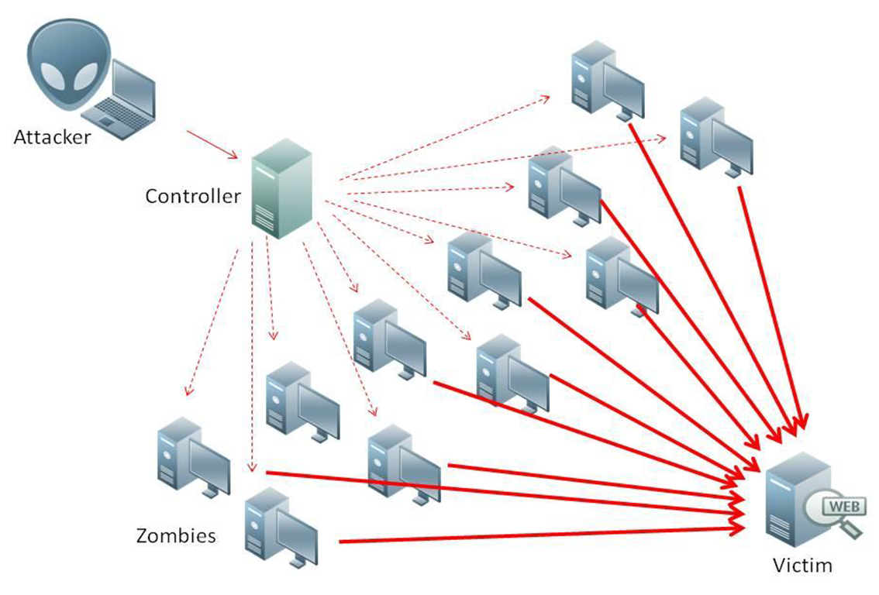
Distributed DOS

Slide 60
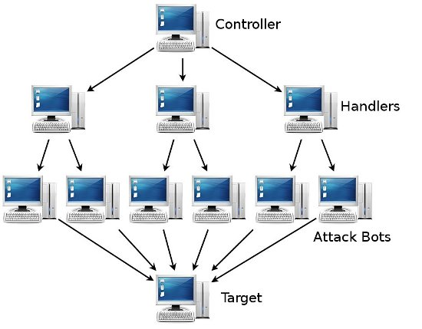
Distributed DOS

Slide 61
Distributed DOS
MIRAI (21 October 2016)
Internet-of-Things’ (IoT) botnet
  Vulnerable DVRs, surveillance cameras, …
  500,000 compromised IoT devices, 665 Gbps
Multiple DOS attacks
  SYN-flooding, UDP flooding, …
Target Internet services firm Dyn (DNS servers)
  Affected Twitter, Reddit, Spotify, SoundCloud, WhatsApp

Slide 62
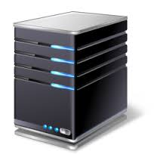
Reflection Attacks
various protocols e.g. ICMP, UDP or TCP/SYN
with spoofed source address
V
SRC=V,...
Response

Slide 63
Reflection Attacks
various protocols e.g. ICMP, UDP or TCP/SYN
loops
V
SRC=V,Echo Hello
SRC=V,Echo Hello
SRC=S,Echo Hello

Slide 64
Amplification Attacks
DNS (60 byte request to 512 - 4000 byte response)
V
SRC=V,...
Response

Slide 65
Amplification Attacks
DNS (60 byte request to 512 - 4000 byte response)
Broadcast/Multicast
I
SRC=V,...
I
V
I

Slide 66
Denial Of Service
Networked
Based on SW vulnerabilities
Physical

Slide 67
DoS on Phones
See SMS-o-Death by Collin Mulliner
http://www.mulliner.org/security/sms

Slide 68



DoS on e-mail
A
Set vacation message
B
Set vacation message

Slide 69
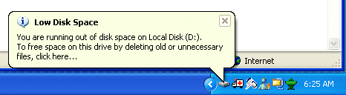
DoS on e-mail
A
To: alice@A
From: bob@B
Subj: Re-Hello
I'm in Thailand
From: bob@B
To: alice@A
Subj: Hello
...
B
From: bob@B
To: alice@A
Subj: Re-Hello
I'm in Mexico

Slide 70
DoS on e-mail
User not allowed e.g. SMTP fax proxy
Non existing user
A
From: bob@B
To: alice@A
Subj: Hello
...
B
Keep track of auto-generated mails
Use Auto-Submitted tag

Slide 71
DoS on e-mail filters
Check For Viruses
A
B

Slide 72

DoS on e-mail filters
Check For Viruses
A
B

Slide 73
DoS on e-mail filters
Infinite recursive zip
Bombs (e.g. non recursive files)
  gzip: 100 GB, 97 MB compressed, 1000:1 ration
  bzip2: 100 GB, 69 KB, 1.6 ∗ 10 6 :1
  PNG image: 19000 x 19000, 1-bit (45 MB) expand in 24-bit color to 1 GB, 44 KB compressed, 1000:1

Slide 74
XML bomb
main
<?xml version="1.0"?>
<main>
<a><b>hello</b></a>
<a><b>hello</b></a>
</main>
a
a
b
b
Question 4: You knowledge about XML
A) I do not know what XML is
B) I know what XML is
C) I know how a XML DOM parser works
D) I know how a XML DOM parser works and
what a DTD is
hello
hello

Slide 75
XML bomb
main
<?xml version="1.0"?>
<main>
<a><b>hello</b></a>
<a><b>hello</b></a>
</main>
a
a
b
b
hello
hello

Slide 76
XML bomb
main
<?xml version="1.0"?>
<!DOCTYPE main [
<!ELEMENT main (a+)>
<!ELEMENT a (b+)>
<!ELEMENT b (#PCDATA)>
]>
<main>
<a><b>hello</b></a>
<a><b>hello</b></a>
</main>
a
a
b
b
hello
hello

Slide 77
XML bomb
main
<?xml version="1.0"?>
<!DOCTYPE main [
<!ELEMENT main (a+)>
<!ELEMENT a (b+)>
<!ELEMENT b (#PCDATA)>
<!ENTITY H "hello">
]>
<main>
<a><b>&H;</b></a>
<a><b>&H;</b></a>
</main>
a
a
b
b
hello
hello

Slide 78
<?xml version="1.0"?>
<!DOCTYPE lolz [
<!ENTITY lol "lol">
<!ELEMENT lolz (#PCDATA)>
<!ENTITY lol1 "&lol;&lol;&lol;&lol;&lol;&lol;&lol;&lol;&lol;&lol;">
<!ENTITY lol2 "&lol1;&lol1;&lol1;&lol1;&lol1;&lol1;&lol1;&lol1;&lol1;
<!ENTITY lol3 "&lol2;&lol2;&lol2;&lol2;&lol2;&lol2;&lol2;&lol2;&lol2;
<!ENTITY lol4 "&lol3;&lol3;&lol3;&lol3;&lol3;&lol3;&lol3;&lol3;&lol3;
<!ENTITY lol5 "&lol4;&lol4;&lol4;&lol4;&lol4;&lol4;&lol4;&lol4;&lol4;
<!ENTITY lol6 "&lol5;&lol5;&lol5;&lol5;&lol5;&lol5;&lol5;&lol5;&lol5;
<!ENTITY lol7 "&lol6;&lol6;&lol6;&lol6;&lol6;&lol6;&lol6;&lol6;&lol6;
<!ENTITY lol8 "&lol7;&lol7;&lol7;&lol7;&lol7;&lol7;&lol7;&lol7;&lol7;
<!ENTITY lol9 "&lol8;&lol8;&lol8;&lol8;&lol8;&lol8;&lol8;&lol8;&lol8;
]>
<lolz>&lol9;</lolz>
1 KB file
3GB XML (DOM worst)

Slide 79
Fork bomb
PostgreSQL 7.2
Uses elapsed milliseconds to compute number of thread to
spawn
No limit check
What happen if you advance the date to next year?
Network Time Protocol attack

Slide 80
WEB DOS
Involuntary
  Slashdotted
  Distributed flood (spiders)
Voluntary
  Target supporting services e.g. DNS

Slide 81
WEB DOS
Slowloris
  HTTP server
    one thread/one connection
    one connection/one request
  Open TCP connection
  Infinitely (and slowly) send HTTP headers
  Consume the thread pool and connections

Slide 82


WEB DOS
J2EE
Server
HTTP
JDBC

Slide 83
J2EE/JDBC
To communicate with DB you need a transaction
1 DB connection can handle 1 transaction at a time
Work in a transaction can be committed or undone
Transactions are isolated
Common pattern
  One transaction per HTTP request

Slide 84
WEB DOS
public class ConnectionFilter implements Filter {
public void doFilter(ServletRequest request,
ServletResponse response,
FilterChain chain) {
Connection connection;
connection = connectionPool.getConnection();
//tie it to a request attribute so other servlets can grab it
request.setAttribute(CONNECTION_ATTR, connection);
//let other servlets do their work
chain.doFilter(request, response);
connection.close();
}
}

Slide 85
WEB DOS
public class ConnectionFilter implements Filter {
public void doFilter(ServletRequest request,
ServletResponse response,
FilterChain chain) {
Connection connection;
connection = connectionPool.getConnection();
//tie it to a request attribute so other servlets can grab it
request.setAttribute(CONNECTION_ATTR, connection);
//let other servlets do their work
chain.doFilter(request, response);
connection.close();
}
}

Slide 86
WEB DOS
Connection connection;
connection = connectionPool.getConnection();
Try {
//tie it to a request attribute so other servlets can grab it
request.setAttribute(CONNECTION_ATTR, connection);
//let other servlets do their work
chain.doFilter(request, response);
}
catch (Exception e) {
connection.rollback();
throw e;
//mandatory: insure the connection is closed
} finally {
if (connection != null) {
connection.close();
}
}

Slide 87
DOS Defenses
high traffic volumes may be legitimate
  result of high publicity, e.g. slash-dotted
  or to a very popular site, e.g. Olympics etc
or legitimate traffic created by an attacker
three lines of defense against (D)DoS:
  attack prevention and preemption
  attack detection and filtering
  attack source traceback and identification

Slide 88
DOS Prevention
block spoofed source addresses
  on routers as close to source as possible
    (ingress filtering)
  still far too rarely implemented
  alternatively enforce “unicast severse path”
R1
C
R1
R3
R2

Slide 89
DOS Prevention
Flood: rate controls in upstream
  on specific packets types
  e.g. some ICMP, some UDP, TCP/SYN
TCP/syn-spoof: use modified TCP connection handling
  use SYN cookies when table full (consumes computational resources)
  or selective or random drop when table full

Slide 90
DOS Prevention
block external request to broadcasts
block suspicious services (e.g. echo)
block suspicious combinations (DNS to echo port)
manage application attacks with puzzles to distinguish legitimate human requests
good general system security practices
use mirrored and replicated servers when high-performance
and reliability required

Slide 91
DOS Response
need good incident response plan
  with contacts for ISP
  needed to impose traffic filtering upstream
  details of response process
have standard filters
ideally have network monitors and IDS
  to detect and notify abnormal traffic patterns

Slide 92
DOS Response
identify type of attack
  capture and analyze packets
  design filters to block attack traffic upstream
  or identify and correct system/application bug
have ISP trace packet flow back to source
  may be difficult and time consuming
  necessary if legal action desired

Slide 93
THANKS!
Any questions?
You can find me at robertog@kth.se

