Slide 1

Computer Security DD2395
System Security
Roberto Guanciale

Slide 2
Arithmetic Overflow
An integer, which has not been properly checked, is incremented past the maximum possible value
It may wrap to become a very small, or negative number
Can lead to buffer overflows, if the integer is used to computer memory offsets, array indexes etc.

Slide 3
Arithmetic Overflow
An integer, which has not been properly checked, is incremented past the maximum possible value
It may wrap to become a very small, or negative number
Can lead to buffer overflows, if the integer is used to computer memory offsets, array indexes etc.
Can lead to violation of security policies
  X = number of pointers (references) to the data structure D
  Reuse the memory of D only when X is 0
  Can we have a new pointer to D if X is 4294967295 = 2^32-1?

Slide 4
Arithmetic Overflow
An integer, which has not been properly checked, is incremented past the maximum possible value
It may wrap to become a very small, or negative number
Can lead to buffer overflows, if the integer is used to computer memory offsets, array indexes etc.
Can lead to violation of security policies
Can lead to failures

Slide 5
Arithmetic Overflow
An integer, which has not been properly checked, is incremented past the maximum possible value
It may wrap to become a very small, or negative number
Can lead to buffer overflows, if the integer is used to computer memory offsets, array indexes etc.
Can lead to violation of security policy
Can lead to failures
Can lead to data corruption
  my balance = -2147483648 SEK ~ -2 billion SEK
  ask to borrow 1 SEK
  my balance = +2147483647 SEK~ +2 billion SEK

Slide 6
Arithmetic Overflow/countermeasures
Static analysis (e.g. symbolic execution)
Use of special values (e.g. NaN in Java)
Exceptions (e.g. Math.addExact(x,y) and ArithmeticException in Java)
Numbers with arbitrary precision (e.g. Python)

Slide 7
Buffer Overflow - effects
[S] Access to Secret data
[D] Corruption of program Data
[C] Unexpected transfer of Control
[V] Memory access Violation
[X] EXecution of code chosen by attacker
S
D
C
V
X

Slide 8
Stack Buffer Overflow
occurs when buffer is located on stack
  used by Morris Worm
local variables below saved frame pointer and return address
overflow of a local buffer can potentially overwrite these key control elements

Slide 9
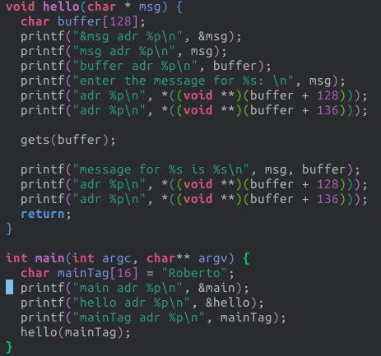
Example Shellcode

Slide 10
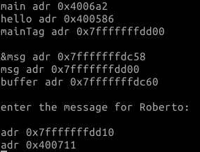
Example Shellcode

Slide 11
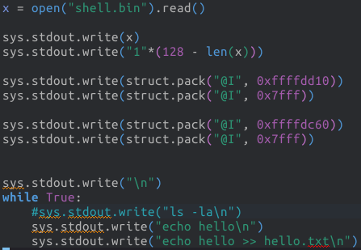
Example Shellcode

Slide 12
Example Shellcode

Slide 13
Example Shellcode

Slide 14
Example Shellcode

Slide 15
Global Data Overflow
can attack buffer located in global data
  may be located above program code
no return address
  hence no easy transfer of control
can target function pointers (e.g. C++ virtual tables)
or manipulate critical data structures

Slide 16
Heap Overflow
attack buffer located in heap
  typically located above program code
  memory requested by programs to use in dynamic data structures (e.g. linked lists, malloc)
also possible due to dangling pointers
no return address
can target function pointers (e.g. C++ virtual tables)
or manipulate critical data structures

Slide 17
Buffer overflow defenses
buffer overflows are widely exploited
  large amount of vulnerable code in use
  despite cause and countermeasures known
two defense approaches
  compile-time - harden new programs
  run-time - handle attacks on existing programs

Slide 18
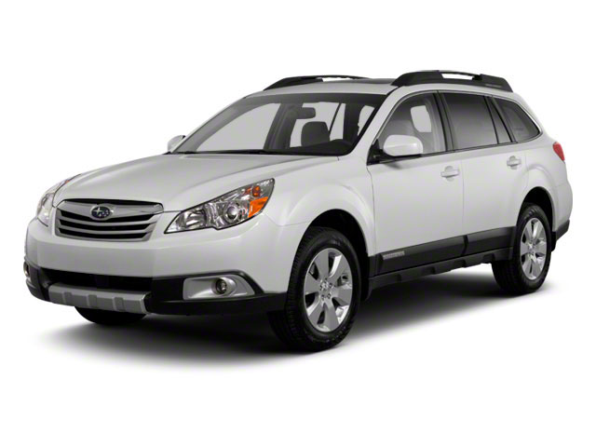
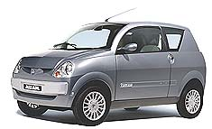
Compile time Defenses: Language
use a modern high-level languages with strong typing
  you can not access to untyped memory
  not vulnerable to buffer overflow
compiler enforces range checks and allowed operations on variables
do have cost in resource

Slide 19
Compile time Defenses: Language
use a modern high-level languages with strong typing
  you can not access to untyped memory
  not vulnerable to buffer overflow
compiler enforces range checks and allowed operations on variables
do have cost in resource
and restrictions on access to hardware
so still need some code in C like languages

Slide 20
Compile time Defenses: Language
use a modern high-level languages with strong typing
  you can not access to untyped memory
  not vulnerable to buffer overflow
compiler enforces range checks and allowed operations on variables
do have cost in resource
and restrictions on access to hardware
so still need some code in C like languages
there can be a buffer overflow if there is a bug
in the language interpreter or JIT compiler

Slide 21
Compile time Defenses: Language
use a modern high-level languages with strong typing
  you can not access to untyped memory
  not vulnerable to buffer overflow
compiler enforces range checks and allowed operations on variables
do have cost in resource
and restrictions on access to hardware
so still need some code in C like languages
there can be a buffer overflow if there is a bug
  in the language interpreter or JIT compiler
S
D
C
V
X

Slide 22
Compile time Defenses: safe coding
if using potentially unsafe languages e.g. C
programmer must explicitly write safe code
  e.g. justify why a buffer can receive n bytes
code review
check pointers yield by allocators
  e.g. when allocation fails
check to have sufficient space in all buffers
S
D
C
V
X

Slide 23
Compile time Defenses:
Language Extension, Safe Libraries
proposals for safety extensions to C
  performance penalties
  must compile programs with special compilers
use safer standard library variants
  new functions, e.g. strncpy()
  safer re-implementation of standard functions as a library,
  e.g. Libsafe
S
D
C
V
X

Slide 24
Verification
Code verification
  Using mathematical model
  Proving absence of bugs
Expensive: ~2000$ per line of code
Verified execution platforms
  isolation kernels
  software fault isolation
S
D
C
V
X

Slide 25
Run-time Defenses:
Guard Pages
place guard memory pages
  configured in MMU as illegal addresses
  any access aborts process
  can be placed between
    stack frames and heap buffers
    between critical regions of memory
Stack
GUARD
Heap
Global Data
Program Code
S
D
C
V
X

Slide 26
Run-time Defenses:
Guard Pages
Stack
place guard memory pages
  configured in MMU as illegal addresses
  any access aborts process
  can be placed between
    stack frames and heap buffers
    between critical regions of memory
GUARD
Heap
SSL
certificates
GUARD
Network
Packets
Global Data
Program Code
S
D
C
V
X

Slide 27
Control Flow Integrity
Prevent or detect alteration of the control flow due to
  ?

Slide 28
Control Flow Integrity
Prevent or detect alteration of the control flow due to
  Modification of return pointer
  Modification of a function pointer
Suggestions?

Slide 29
Compile time Defenses:
Stack protection
add entry and exit code to check stack for signs of corruption
use random (different for every execution) canary
  e.g. Stackguard, Win /GS

Slide 30
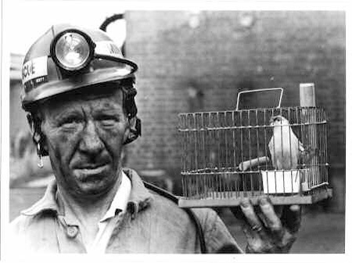
Compile time Defenses:
Stack protection
add entry and exit code to check stack for signs of corruption
use random (different for every execution) canary
  e.g. Stackguard, Win /GS
Canaries were used in coal mines
to detect the presence of
carbon monoxide

Slide 31
Compile time Defenses:
Stack protection
add entry and exit code to check stack for signs of corruption
use random (different for every execution) canary
  e.g. Stackguard, Win /GS
check for overwrite between local variables and saved frame pointer and return address
  abort program if change found
  issues: recompilation, debugger support

Slide 32
Compile time Defenses:
Stack protection
add entry and exit code to check stack for signs of corruption
use random (different for every execution) canary
  e.g. Stackguard, Win /GS
check for overwrite between local variables and saved frame pointer and return address
  abort program if change found
  issues: recompilation, debugger support
ReturnPtr
FramePtr
Var 1
Var 2
Par 1

Slide 33
Compile time Defenses:
Stack protection
add entry and exit code to check stack for signs of corruption
use random (different for every execution) canary
  e.g. Stackguard, Win /GS
check for overwrite between local variables and saved frame pointer and return address
  abort program if change found
  issues: recompilation, debugger support
ReturnPtr
FramePtr
Canary: 12354
Var 1
Var 2
Par 1

Slide 34
Compile time Defenses:
Stack protection
add entry and exit code to check stack for signs of corruption
use random (different for every execution) canary
  e.g. Stackguard, Win /GS
check for overwrite between local variables and saved frame pointer and return address
  abort program if change found
  issues: recompilation, debugger support
ReturnPtr
FramePtr
Canary: df3werw3
Var 1
Var 2
Par 1

Slide 35
Compile time Defenses:
Stack protection
add entry and exit code to check stack for signs of corruption
use random (different for every execution) canary
  e.g. Stackguard, Win /GS
check for overwrite between local variables and saved frame pointer and return address
  abort program if change found
  issues: recompilation, debugger support
ReturnPtr
FramePtr
Canary: df3werw3
Var 1
S
D
C
V
X
Var 2
Par 1

Slide 36
Compile time Defenses:
Stack protection
save/check safe copy of return address
shadow stack
  e.g. Stackshield, RAD
  -fstack-protector
Shadow Stack
Stack
Heap
Global Data
Linked Libraries
Code
&
Program Code
S
D
C
V
X

Slide 37
Target address encryption
Indirect jumps (e.g. jumps to non-constants) are necessary to implement
  Function return
  Callbacks, Virtual methods, Exception handling
int (*func1)(int) = double; => int (*func1)(int) = double ^ key;
… …
func1(15) int (*local_var)(int) = func1 ^ key;
local_var(15);

Slide 38
Code integrity
Prevention, detection, mitigation of code injection
  Due to a buffer controlled by the attacker (e.g. where a network packet is stored) being executed
  Due to existing code being overwritten
Suggestions?

Slide 39
Run-time Defenses:
Executable Address Space Protection
use virtual memory support to make some regions of memory non-executable
  e.g. stack, heap, global data
  need HW support in MMU
long existed on SPARC / Solaris systems
recent on x86/ARM Linux/Unix/Windows systems
S
D
C
V
X

Slide 40
Run-time Defenses:
Executable Address Space Protection
RD / WT
Stack
RD / WT
Heap
RD / WT
Global Data
Linked Libraries
Code
&
Program Code
RD / EX
S
D
C
V
X

Slide 41
Run-time Defenses:
Executable Address Space Protection
issues: support for executable stack/heap code
  needed for JIT (e.g. Java) or nested functions
  need special provisions
    mprotect(ptr, size, (PROT_READ | PROT_EXEC);
-z execstack
Attacker can
  Inject payload
  Corrupt control flow to invoke mprotect
  Execute the payload

Slide 42


Run-time monitor
Enforce Write XOR Execute policy
Check signature whenever a page became executable (i.e. mprotect)
W
X
W

Slide 43
Run-time monitor
Enforce Write XOR Execute policy
Check signature whenever a page became executable (i.e. mprotect)
W
X
W
W
X

Slide 44
Run-time monitor
Enforce Write XOR Execute policy
Check signature whenever a page became executable (i.e. mprotect)
  Keep database of valid signatures, check that SHA(page) in DB
  Use program with certificate
    Page = Program | Certificate
    Certificate = Enc(SHA(Page), PR_k)
    Check Dec(Certificate, PU_k) = SHA(Page)
  Keep a database of binary fragments of well known malwares, check that Intersect(page, db) = empty

Slide 45
Instruction Set Randomization
Make every Process's CPU unique
If the attacker does not know the target ISA, it is impossible to produce injectable code

Slide 46
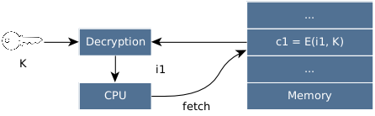
Instruction Set Randomization

Slide 47

Instruction Set Randomization

Slide 48
Decryption requirements
Cheap
  Symmetric block cyphers
Preserve instruction length
No MAC
Support random accesses
  No Cypher Block Chaining
  No Cipher FeedBack
  No Output FeedBack

Slide 49
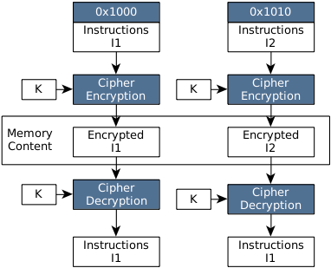
ISR-ECB - mode
Common adopted approach
e.g. ASIST

Slide 50
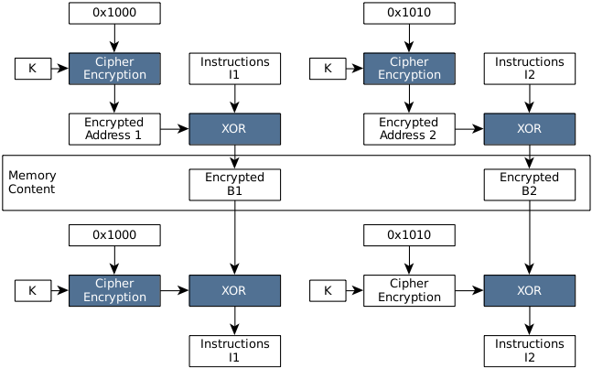
ISR-CTR - mode
e.g. Polyglot

Slide 51
Diversification
Counter attacks by making difficult for the attacker to predict the results of their activities

Slide 52
Run-time Defenses:
Address Space Randomization
randomize location of key data structures
  stack, heap, global data
  using random shift for each process
large virtual address range on modern systems means negligible impact
also randomize location of standard library functions

Slide 53
Run-time Defenses:
Address Space Randomization
randomize location of key data structures
  stack, heap, global data
  using random shift for each process
large virtual address range on modern systems means negligible impact
also randomize location of standard library functions
echo 0 | sudo tee /proc/sys/kernel/randomize_va_space
S
D
C
V
X

Slide 54
Run-time Defenses:
Address Space Randomization
Stack randomization
  Base of the process stack is initialized by the OS and saved in a special register (Stack Pointer)
  Different processes have different stack pointer
Difficult for the attacker to cast a
pointer to a buffer in the stack
(e.g. to set the return address to
a stack's buffer containing a
payload)
Stack
Stack
Heap
Heap
Global Data
Global Data
Program Code
Program Code

Slide 55
Run-time Defenses:
Address Space Randomization
Heap randomization
  Dynamically allocated memory depends on OS and language runtime
    ptr = malloc(1024);
  OS randomizes order of
  allocation of virtual pages
Difficult for the attacker to predict
location of critical data-structures
Stack
Stack
Global Data
Global Data
Program Code
Program Code

Slide 56
Run-time Defenses:
Address Space Randomization
Global randomization
  Programs must use indirection to access global variables
  MOV R0, 1MB
  LOAD R1, [R0]
  ---------------------
  MOV R0, &Goffset
  LOAD R1, [R0]
  MOV R0, 1MB
  LOAD R1, [R1+R0]
Stack
Stack
Heap
Heap
Global Data
Global Data
Program Code
Program Code

Slide 57
Run-time Defenses:
Address Space Randomization
Base program randomization
  Programs must use location independent code
  1MB: JMP [1MB+2KB]
  ---------------------
  1MB: JMP [PC + 2KB]
Difficult for the attacker to identify
addresses of useful functions and
gadgets
Stack
Stack
Heap
Heap
Global Data
Global Data
Program Code
Program Code

Slide 58
Compile-time Defenses:
Use polymorphic technique of malware
every instance of the application is different
  different order of arguments
  int memcpy(dst, src, size) { => int memcpy(size, src, dst) {
    …
  }
  memcpy(dst, src, 1024); => memcpy(1024, src, dst);

Slide 59
Run-time Defenses:
Use polymorphic technique of malware
every instance of the application is different
  different order of arguments
  different number / order of local variables
  int x = y + 20; => int z = 20;
            => int x = y + z

Slide 60
Run-time Defenses:
Use polymorphic technique of malware
every instance of the application is different
  different order of arguments
  different number / order of local variables
  different alignment of data-structures
  struct Book { => struct Book {
    char[100] tilte; char * text;
    Author * author; char[42] dummy;
    char * text; char[110] title;
  } Author * author;
                }

Slide 61
Run-time Defenses:
Use polymorphic technique of malware
every instance of the application is different
  different order of arguments
  different number / order of local variables
  different alignment of data-structures
  different number of instructions
  X = Y + 20; => X = (2 * Y + 40) / 2
  for (int i=0; i<100; i++) { => for (int i=0; i<100; i+=2) {
    Code(i); Code(i);
  } if (i < 100) Code (i+1);
                }

Slide 62
Run-time Defenses:
Use polymorphic technique of malware
every instance of the application is different
  different order of arguments
  different number / order of local variables
  different alignment of data-structures
  different number of instructions
a buffer overflow in one instance can not be used in another one
difficult to predict position of functions and gadgets
S
D
C
V
X

Slide 63
Run-time Defenses:
Use polymorphic technique of malware
every instance of the application is different
a buffer overflow in one instance can not be used in another one
difficult to predict position of functions and gadgets
Use of intermediate languages (e.g. LLVM)
  C program is compiled to IR (e.g. using CLANG)
  IR is optimized
  IR is compiled to machine language

Slide 64
Run-time Defenses:
Use polymorphic technique of malware
every instance of the application is different
a buffer overflow in one instance can not be used in another one
difficult to predict position of functions and gadgets
Use of intermediate languages (e.g. LLVM)
  C program is compiled to IR (e.g. using CLANG)
  IR is transformed to add randomization
  IR is optimized
  IR is compiled to machine language

Slide 65
System security
Low level SW (e.g. operating system) can not be written with safe languages
It is difficult to write bug free code
Reduce as much as possible the critical code base
  1 line of code = 1 liability (1 or more bugs)
Isolate critical components from failures of the non-critical ones

Slide 66
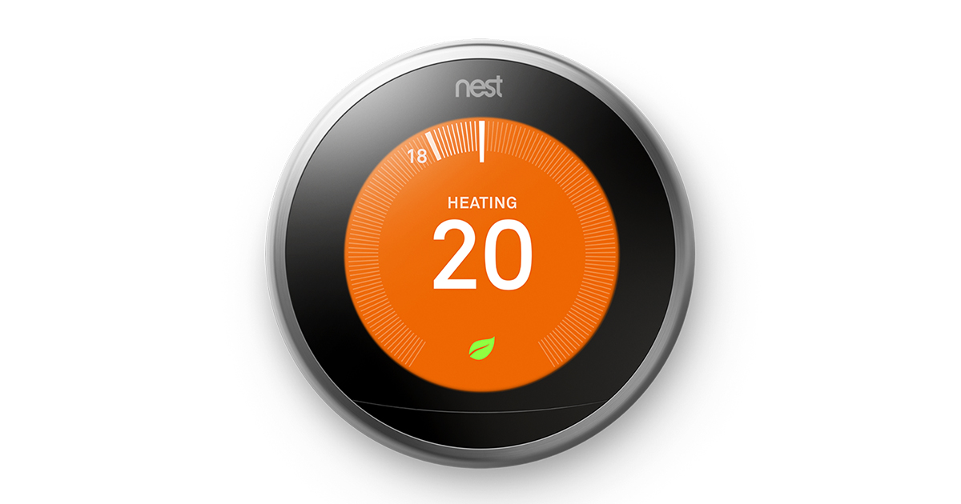
System security
Smart thermostat
  Control heating unit
  Keep safe limits (e.g. 15 C min)
  Programmable
  Wi-Fi

Slide 67
System security
Smart thermostat
  Control heating unit
  Keep safe limits (e.g. 15 C min)
  Programmable
  Wi-Fi
  Machine learning algorithms

Slide 68
System security
Smart thermostat
  Control heating unit
  Keep safe limits (e.g. 15 C min)
  Programmable
  Wi-Fi
  Machine learning algorithms

Slide 69
System security
Smart thermostat
  Control heating unit
  Keep safe limits (e.g. 15 C min)
  Programmable
  Wi-Fi
  Machine learning algorithms
Linux 2.6.37
  ~10 million lines of code
  98 vulnerabilities

Slide 70
System security
  Integer signedness error in the CIFSFindNext function in fs/cifs/cifssmb.c in the Linux kernel before 3.1 allows remote CIFS servers to cause a denial of service (memory corruption) or possibly have unspecified other impact via a large length value in a response to a read request for a directory.
Smart thermostat
  Control heating unit
  Keep safe limits (e.g. 15 C min)
  Programmable
  Wi-Fi
  Machine learning algorithms
Linux 2.6.37
  ~10 million lines of code
  98 vulnerabilities

Slide 71
Microkernels
L4 is the most famous
“A concept is tolerated inside the microkernel only if moving it outside the kernel, i.e., permitting competing implementations, would prevent the implementation of the system's required functionality”
  address spaces
  threads
  scheduling
  inter-thread communication
Everything else is outside the kernel (e.g. drivers)
15 thousands lines of code

Slide 72

Microkernels

Slide 73
Software Fault Isolation
Sandbox non-critical code
Google Chrome Native Client
Modify binary to ensure that overflows can not access critical resources
Critical
Resources
0x01000000
0x00FFFFFF
Non-critical
Resources

Slide 74
Software Fault Isolation
Sandbox non-critical code
Google Chrome Native Client
Modify binary to ensure that overflows can not access critical resources
…
Store (X, Y)
...
Critical
Resources
0x01000000
0x00FFFFFF
Non-critical
Resources

Slide 75
Software Fault Isolation
Sandbox non-critical code
Google Chrome Native Client
Modify binary to ensure that overflows can not access critical resources
…
Store (X, Y)
...
…
X = X & 0x00FFFFFF
Store (X, Y)
...
Critical
Resources
0x01000000
0x00FFFFFF
Non-critical
Resources

Slide 76
Software Fault Isolation
Sandbox non-critical code
Google Chrome Native Client
Modify binary to ensure that overflows can not access critical resources
…
Store (X, Y)
X = X+1
Store(X+1,Y)
...
…
X = X & 0x00FFFFFF
Store (X, Y)
X = X+1
X = X & 0x00FFFFFF
Store (X, Y)
...
Critical
Resources
0x01000000
0x00FFFFFF
Non-critical
Resources

Slide 77
Software Fault Isolation
Sandbox non-critical code
Google Chrome Native Client
Modify binary to ensure that overflows can not access critical resources
…
Store (X, Y)
X = X+1
Store(X+1,Y)
...
…
X = X & 0x00EFFFFF
Store (X, Y)
X = X+1
Store (X, Y)
...
Critical
Resources
0x01000000
0x00FFFFFF
Non-critical
Resources

Slide 78
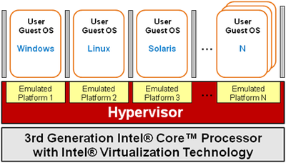
Hypervisors
Execute below OS
Isolate complete OSes from each other
Can inspect the behavior of a (possibly) buggy OS

Slide 79
Hypervisors
Execute below OS
Isolate complete OSes from each other
Can inspect the behavior of a (possibly) buggy OS
  Run-time monitor checking code signature
  Behavioral monitoring
  Resource usage analysis
  Quarantine
  Honeypots

Slide 80
Hypervisors
Microsoft HyperV – XEN
Paravirtualization
  Hypervisor runs in unrestricted mode, takes control of
    MMU (Page tables)
    Interrupts
    DMA configuration
  OSes and processes run in restricted mode
  Does not requires HW support
  OS must be modified to invoke hypercalls to change HW configurations

Slide 81
Hypervisors
Microsoft HyperV – XEN
Paravirtualization
Hardware assisted virtualization
  Processes run in restricted mode
  OSes run in unrestricted mode
  Hypervisor runs in a new special mode
  Two stages MMU
    Stage 1: translates virtual addresses to intermediate one
    Stage 2: translates intermediate addresses to physical one
  Stage 1 configured by OS, Stage 2 configured by the hypervisor

Slide 82
THANKS!
Any questions?
You can find me at robertog@kth.se

