Slide 1

Software Safety and Security DD2460
Memory Safety
Roberto Guanciale

Slide 2



Memory safety
Prevent memory errors
Very common problems for programs
written using C/C++ (i.e. manual memory
management and pointer arithmetic)
Memory problems are one of the most
dangerous security threat
  XBox
  Hearthbleed (OpenSSL)
  Stagefright (Android media-stack)

Slide 3
Memory safety (in Java)
int a[] = new int[5];
int b;
a[20] = 10; // IndexOutOfBoundsException
a[1] == 0; // true (array component are initialized with a default value)
a[1] = b; // Compiler error: variable b might not have been initialized
List x = null;
x.add(a[1]);// NullPointerException
x = new Vector();
x.add(new Dog());
((Cat)x.get(0)).miaow(); // ClassCastException

Slide 4
Buffer Over-read/Overflow - basics
Caused by programming error
  Reads more data than the capacity
  Allows more data to be stored than capacity
Reading adjacent memory locations
  leakage of secret data
Overwriting adjacent memory locations
  corruption of program data
  unexpected transfer of control
  memory access violation
  execution of code chosen by attacker

Slide 5
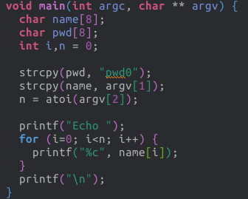
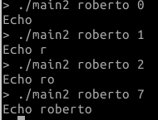
Buffer Overread - Example

Slide 6
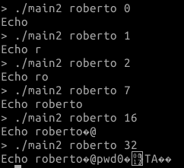
Buffer Overread - Example

Slide 7
Buffer Overread - Example
https://gist.github.com/simonwagner/10271224

Slide 8
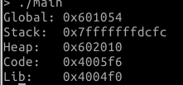
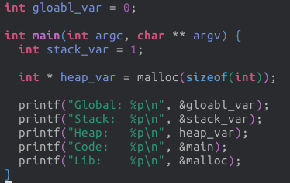
Memory layout of a process
Stack
Heap
Global Data
Program Code

Slide 9
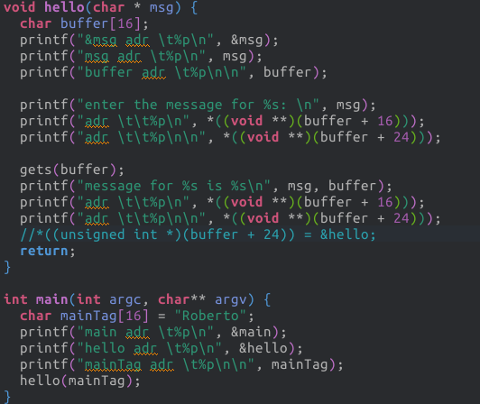
Stack

Slide 10
Stack
0x7...d00: mainTag: Roberto

Slide 11
Stack
0x7...d00: mainTag: Roberto
0x7...cd0: buffer: ???????

Slide 12
Stack
0x7...d00: mainTag: Roberto
0x7...cd0: buffer: ???????
0x7...cc8: msg: ??????

Slide 13
Stack
0x7...d00: mainTag: Roberto
0x7...cd0: buffer: ???????
0x7...cc8: msg: ??????

Slide 14
Stack
0x7...d00: mainTag: Roberto
0x7...cd0: buffer: ???????
0x7...cc8: msg: 0x7...d00

Slide 15
Stack
0x7...d00: mainTag: Roberto
?
0x7...cd0: buffer: ???????
0x7...cc8: msg: 0x7...d00

Slide 16
Stack
0x7...d00: mainTag: Roberto
0x7...cd0: buffer: ???????
0x7...cc8: msg: 0x7...d00

Slide 17
Stack
0x7...d00: mainTag: Roberto
0x7...ce8: returnPtr: ????
0x7...cd0: buffer: ???????
0x7...cc8: msg: 0x7...d00

Slide 18
Stack
0x7...d00: mainTag: Roberto
0x7...ce8: returnPtr: ????
0x7...cd0: buffer: ???????
0x7...cc8: msg: 0x7...d00

Slide 19
Stack
0x7...d00: mainTag: Roberto
0x7...ce8: returnPtr: 0x4006fb
0x7...ce0: framePtr: 0x7...d10
0x7...cd0: buffer: ???????
0x7...cc8: msg: 0x7...d00

Slide 20
Stack
0x7...d00: mainTag: Roberto
0x7...ce8: returnPtr: 0x4006fb
0x7...ce0: framePtr: 0x7...d10
0x7...cd0: buffer: ???????
0x7...cc8: msg: 0x7...d00

Slide 21
Stack Buffer Overflow
occurs when buffer is located on stack
  used by Morris Worm
local variables below saved frame pointer and return address
overflow of a local buffer can potentially overwrite these key control elements

Slide 22
Global Data Overflow
can attack buffer located in global data
can manipulate critical data structures
no return address
  hence no easy transfer of control
can target function pointers (e.g. C++ virtual tables, exception handlers)

Slide 23
Global Data Overflow
can target function pointers (e.g. C++ virtual tables, exception handlers)
int compare_int( const void* a, const void* b) {
int int_a = * ( (int*) a );
int int_b = * ( (int*) b );
if ( int_a == int_b ) return 0;
else if ( int_a < int_b ) return -1;
else return 1;
}
void do_damage() {...}
int (*my_compare)(const void*,const void*) = NULL;
char buffer[16];
int main() {
my_compare = &compare_int;
…
qsort( a, 6, sizeof(int), my_compare);
}

Slide 24
Heap Overflow
attack buffer located in heap
no return address
can target function pointers
or manipulate critical data structures

Slide 25
Other memory safety problems
Dangling pointers: do not point to a valid object of the appropriate type
  wrong dynamic cast of pointers
  missing update of pointers when memory is released (explicitly with free, implicitly by destroying the stack frame)
  missing initialization of pointers
Usage of non-initialized memory
Memory leaks

Slide 26
Other memory safety problems
Dangling pointers: do not point to a valid object of the appropriate type
  wrong dynamic cast of pointers
  missing update of pointers when memory is released (explicitly with free, implicitly by destroying the stack frame)
  missing initialization of pointers
Usage of non-initialized memory
Memory leaks
Dog * x = malloc(sizeof(Dog));
add(list, x);
…
void * y = get(list,0);
miaow((Cat *) y);

Slide 27
Other memory safety problems
Dangling pointers: do not point to a valid object of the appropriate type
  wrong dynamic cast of pointers
  missing update of pointers when memory is released (explicitly with free, implicitly by destroying the stack frame)
  missing initialization of pointers
Usage of non-initialized memory
Memory leaks
Dog * x = malloc(sizeof(Dog));
free(x);
… // location of x is reused for allocating a Cat
woof(x);

Slide 28
Other memory safety problems
Dangling pointers: do not point to a valid object of the appropriate type
  wrong dynamic cast of pointers
  missing update of pointers when memory is released (explicitly with free, implicitly by destroying the stack frame)
  missing initialization of pointers
Usage of non-initialized memory
Memory leaks
void f() {
int x = 42
…
}
void g() {
Dog * x; // Uninitialized
woof(x);
}
void main() {
f();g();

Slide 29
Other memory safety problems
Dangling pointers: do not point to a valid object of the appropriate type
  wrong dynamic cast of pointers
  missing update of pointers when memory is released (explicitly with free, implicitly by destroying the stack frame)
  missing initialization of pointers
Usage of non-initialized memory
Memory leaks
void f() {
int pwd = 123456;
…
}
int g() {
int public_var; // Uninitialized
return public_var;
}
void main() {
f();printf(“%d”, g());

Slide 30
Other memory safety problems
Dangling pointers: do not point to a valid object of the appropriate type
  wrong dynamic cast of pointers
  missing update of pointers when memory is released (explicitly with free, implicitly by destroying the stack frame)
  missing initialization of pointers
Usage of non-initialized memory
Memory leaks
void f() {
char * pwd = malloc(64);
...
return
}
void main() {
for (i=0; …; i++ ){
f();
}
}

Slide 31
Defenses (Prevention):
Analysis tools (like valgrind)
Instrument binary (almost every memory instruction)
  keep track of
    Validity (all unallocated memory starts as invalid)
    Addressability (pointers to non-freed memory block)
  replaces the standard C memory allocator (e.g. to delay reusage of memory)
Can identify several problems (e.g. use of uninitialized memory, overflow on heap, accesses to freed memory, memory leaks)
Need test input

Slide 32
Defenses (Detection):
Stack protection
add entry and exit code to check stack for signs of corruption
use random (different for every execution) canary
  e.g. Stackguard, Win /GS

Slide 33
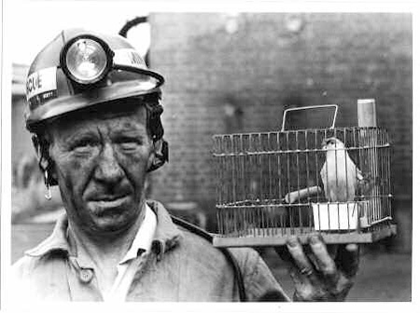
Defenses (Detection):
Stack protection
add entry and exit code to check stack for signs of corruption
use random (different for every execution) canary
  e.g. Stackguard, Win /GS
Canaries were used in coal mines
to detect the presence of
carbon monoxide

Slide 34
Defenses (Detection):
Stack protection
add entry and exit code to check stack for signs of corruption
use random (different for every execution) canary
  e.g. Stackguard, Win /GS
check for overwrite between local variables and saved frame pointer and return address
  abort program if change found
  issues: recompilation, debugger support
ReturnPtr
FramePtr
Var 1
Var 2
Par 1

Slide 35
Defenses (Detection):
Stack protection
add entry and exit code to check stack for signs of corruption
use random (different for every execution) canary
  e.g. Stackguard, Win /GS
check for overwrite between local variables and saved frame pointer and return address
  abort program if change found
  issues: recompilation, debugger support
ReturnPtr
FramePtr
Canary: 12354
Var 1
Var 2
Par 1

Slide 36
Defenses (Detection):
Stack protection
add entry and exit code to check stack for signs of corruption
use random (different for every execution) canary
  e.g. Stackguard, Win /GS
check for overwrite between local variables and saved frame pointer and return address
  abort program if change found
  issues: recompilation, debugger support
ReturnPtr
FramePtr
Canary: df3werw3
Var 1
Var 2
Par 1

Slide 37
Defenses (Prevention):
Use polymorphic technique of malware
every instance of the application is different
  different number of local variables
  different alignment of data-structures
  different number of instructions
a buffer overflow in one instance can not be used in another one
X = Y * Z;
X = Y*2;
X += Y*(Z-2);
int i;
X = 1;
for (i=0; i < Z; i++) {
X = X + Y;
}

Slide 38
Defenses (Prevention):
Stack protection
save/check safe copy of return address
shadow stack
  e.g. Stackshield, RAD
  -fstack-protector
Shadow Stack
Stack
Heap
Global Data
Program Code

Slide 39
Defenses (Prevention):
Executable Address Space Protection
need HW support in MMU
A page can be either writable or executable, but not both
  Executable: program code
  Writable: global data/stack/heap
It is not possible to inject malware into executable code

Slide 40
Defenses (Prevention):
Executable Address Space Protection
need HW support in MMU
A page can be either writable or executable, but not both
  Executable: program code
  Writable: global data/stack/heap
It is not possible to inject malware into executable code
issues: support for executable stack/heap code
  needed for JIT (e.g. Java) or nested functions
  need special provisions

Slide 41
Defenses (Prevention):
Address Space Randomization
randomize location of key data structures
  stack, heap, global data
  using random shift for each process
large address range on modern systems means negligible impact
also randomize location of standard library functions

Slide 42
Defenses (Prevention):
Use polymorphic technique of malware
every instance of the application is different
  different number of local variables
  different alignment of data-structures
  different number of instructions
a buffer overflow in one instance can not be used in another one
X = Y * Z;
X = Y*2;
X += Y*(Z-2);
int i;
X = 1;
for (i=0; i < Z; i++) {
X = X + Y;
}

Slide 43
Defenses (Detection):
Guard Pages
Stack
place guard memory pages between critical regions of memory
  configured in MMU as illegal addresses
  any access aborts process
  can be placed between stack frames and heap buffers
  can be placed before critical data
Guard-page
Heap
Critical heap data
Guard-page
Heap
Global Data

Slide 44
Software Fault Isolation (Prevention)
Sandbox non-critical code
Google Chrome Native Client
Modify binary to ensure that overflows can not access critical resources
Critical
Resources
0x01000000
0x00FFFFFF
Non-critical
Resources

Slide 45
Software Fault Isolation (Prevention)
Sandbox non-critical code
Google Chrome Native Client
Modify binary to ensure that overflows can not access critical resources
…
Store (X, Y)
...
Critical
Resources
0x01000000
0x00FFFFFF
Non-critical
Resources

Slide 46
Software Fault Isolation (Prevention)
Sandbox non-critical code
Google Chrome Native Client
Modify binary to ensure that overflows can not access critical resources
…
Store (X, Y)
...
…
X = X & 0x00FFFFFF
Store (X, Y)
...
Critical
Resources
0x01000000
0x00FFFFFF
Non-critical
Resources

Slide 47
Software Fault Isolation (Prevention)
Sandbox non-critical code
Google Chrome Native Client
Modify binary to ensure that overflows can not access critical resources
…
Store (X, Y)
X = X+1
Store(X,Y)
...
…
X = X & 0x00FFFFFF
Store (X, Y)
X = X+1
X = X & 0x00FFFFFF
Store (X, Y)
...
Critical
Resources
0x01000000
0x00FFFFFF
Non-critical
Resources

Slide 48
Software Fault Isolation (Prevention)
Sandbox non-critical code
Google Chrome Native Client
Modify binary to ensure that overflows can not access critical resources
…
Store (X, Y)
X = X+1
Store(X,Y)
...
…
X = X & 0x00FFFFF0
Store (X, Y)
X = X+1
Store (X, Y)
...
Critical
Resources
0x01000000
0x00FFFFFF
Non-critical
Resources

Slide 49
THANKS!
Any questions?
robertog@kth.se

Slide 50
Software Safety and Security DD2460
Other system security mechanisms
Roberto Guanciale

Slide 51
Other three security mechanisms
Honeypots
Malware-detection
Port-scanning

Slide 52
Honeypots
Detect and deflect attempts of unauthorized use of a systems
Deploy fake data (or systems) that appears to be a legitimate
Isolate data (e.g. never use it for legitimate functions)
Monitor data
Block accesses

Slide 53
Honeypots
Detect and deflect attempts at unauthorized use of a systems
Deploy fake data (or systems) that appears to be a legitimate
Isolate data (e.g. never use it for legitimate functions)
Monitor data
Block accesses
For SPAM
Register fake email addresses and use them in forums
Never use these address for proper communications
Monitor mail
Report SMTP servers used for incoming e-mails

Slide 54
Honeypots
Detect and deflect attempts at unauthorized use of a systems
Deploy fake data (or systems) that appears to be a legitimate
Isolate data (e.g. never use it for legitimate functions)
Monitor data
Block accesses
For SQL-Injection
Create fake tables/records (e.g. fake users)
Never use these tables for proper functions
Monitor accesses to data
Block request accessing them

Slide 55
Honeypots for memory safety
Stack Canaries (canaries are not read or modified by licit code)
Define pointers to unmapped virtual-addresses
  If attacker discovers pointer, accesses will raise data-abort
Deploy unused functions mapped as non-executable
  If attacker discovers function, execution will raise exception
Deploy application in a safe environment (e.g. virtualized environment), allowing attacker to compromise it and trigger alerts (e.g. by accessing monitored files)

Slide 56
Malware detection
(execution of illicit code)
Monitor behavior of application
  Possibly in conjunction of honeypots
Code signature
  When an application is executed, check signature
    Using a database of valid signatures
    Using public key of application's vendor
  Problem with JIT

Slide 57
Malware detection
(execution of illicit code)
Malware Code signature
  When an application is executed, check signature using a database of known viruses

Slide 58
Malware detection
(execution of illicit code)
Malware Code signature
  When an application is executed, check signature using a database of known viruses
Malware can encrypt itself
At infection time
  Generate key
  Encrypt the malware body
  Modify the bootstrap
  Copy the bootstrap (decryption engine with key) and
  the encrypted virus body
At execution time
  Decrypt the virus body
  Execute payload

Slide 59

Malware detection
(execution of illicit code)
V
P2
Dec
P1

Slide 60

Malware detection
(execution of illicit code)
V
P2
Dec
P1
V

Slide 61
Malware detection
(execution of illicit code)
V
P2
Dec
P1
V
P2

Slide 62
Malware detection
(execution of illicit code)
V
P2
Dec
Dec
P1
V
V
P2
P2

Slide 63
Malware detection
(execution of illicit code)
Malware Code signature
  When an application is executed, check signature using a database of known malwares
Malware can encrypt itself
Generic descriptors
  Use W ^ X policy
  When a page is made executable it is not writable
    Malware has decrypted itself
    Scan the page for known malwares

Slide 64
Portscanning
Today, a common attacker goal is to obtain remote access
A port scanner is an application designed to probe a host for IP open ports
  A port scan sends client requests to a range of server port, with the goal of finding an active port
SYN-scans (to find listening TCP servers)
UDP scanning (difficult due to connectionless)
FIN-scans (received RST messages disclose closed ports)

Slide 65
Portscanning
The good:
  Can be used to remotely monitor an host
  Identify if an attacker get control an opened ports
  Discover services running in a IoT device
The bad:
  Commonly used by attackers to find victims
    Find a vulnerability in a service (e.g. a buffer overflow or missing input validation in handling network packets)
    Scan the network for hosts running the vulnerable service
    Attack the service

Slide 66
THANKS!
Any questions?
robertog@kth.se

