Slide 1
Salary expectation in Data Analytics
----Analysis on data analytics jobs 2020-2023
Andrew Makowski
Guang Yang

Slide 2

Purpose of the Analysis
Interested in Data analytics jobs?
Feel confusing how much can data analytics job make?
What’s the salary expectation should we have after the bootcamp?
What’s the salary trend these years?
What are the main factors that are impacting the job salary?
Provide a reference for the rest of the class
/anyone new to this field an idea of salary expectation

Slide 3
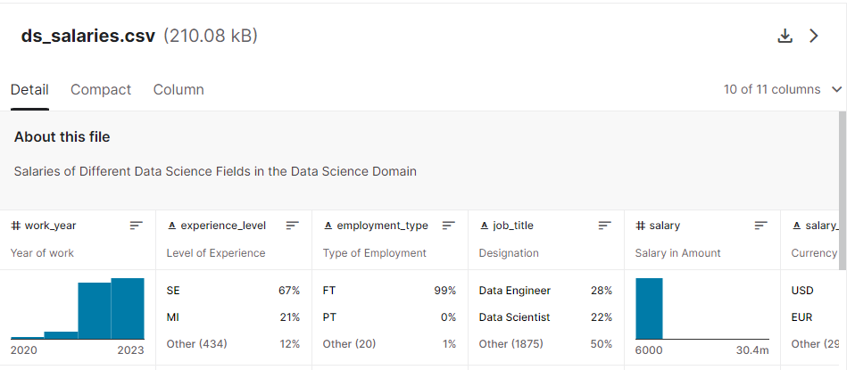
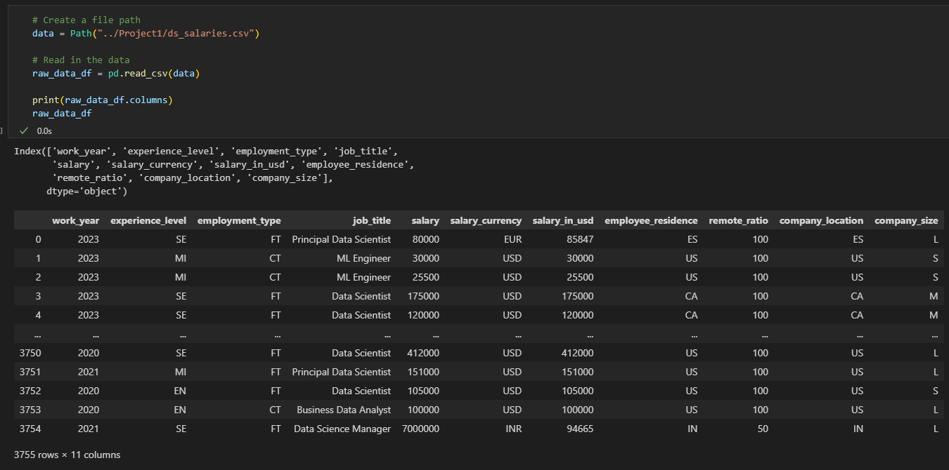
Dataset

Slide 4
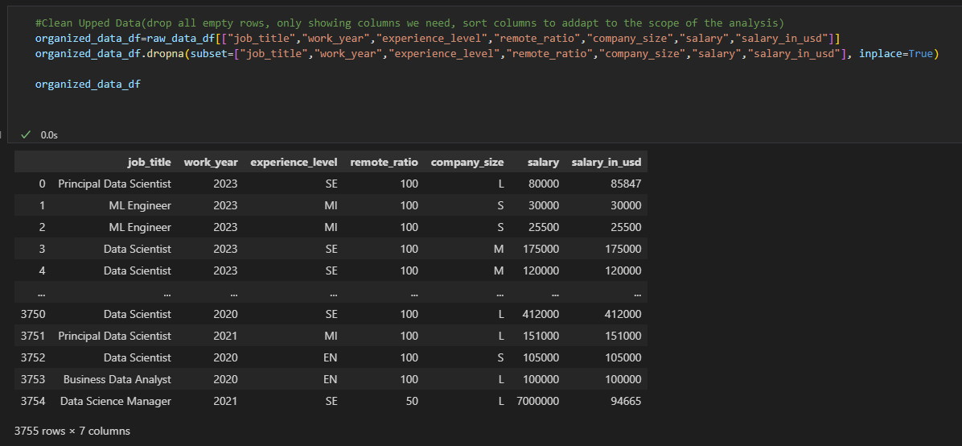
The process of data cleaning
Step 1:choose the related column for our analysis and adjust the column position
Step 2: drop empty values in Pandas Data Frame
Notes:
Consider talking about:
Data requirements
Data collection
Data processing
Data cleaning
Exploratory data analysis
Modeling and algorithms
Data product
Communication

Slide 5
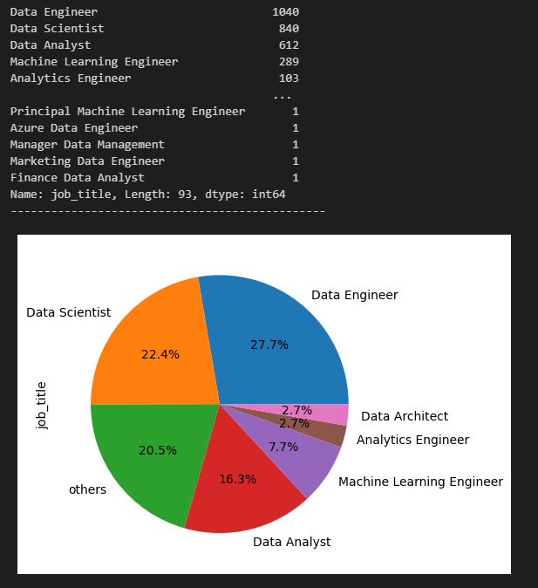
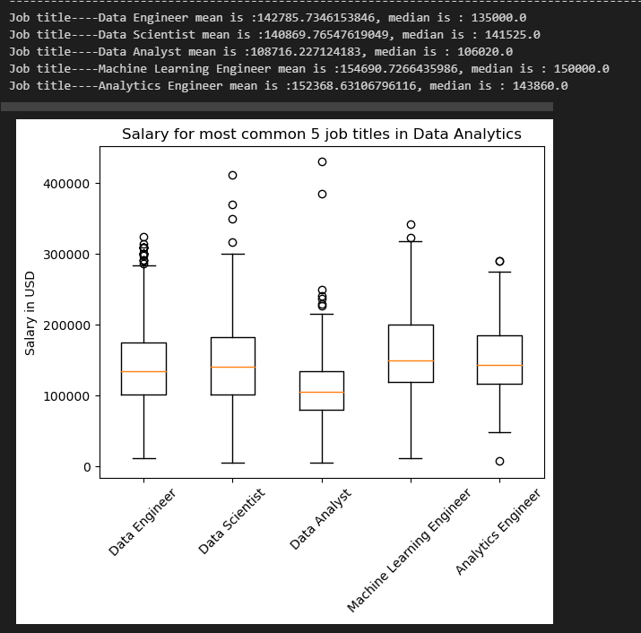
Job title impact on salaries
There are more than 93 different job titles in the data sets
Sorted out the most common job titles (>=3%)
Discussion the most common 5 jobs
Data analyst salary is the lowest among all 5, in 100K range Per year
The other 4 job common job titles has no significant different in average & Median salary, in 140-150K range

Slide 6
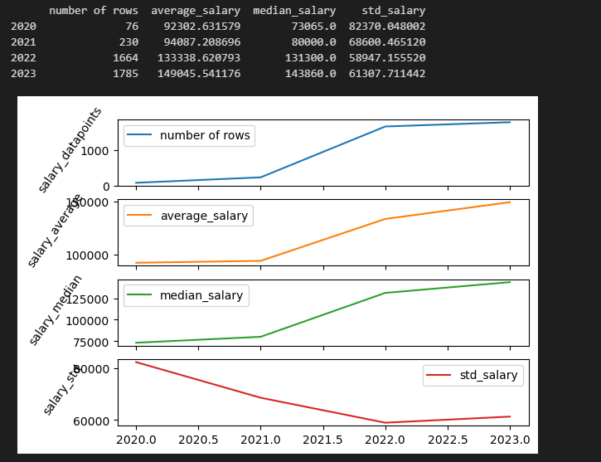
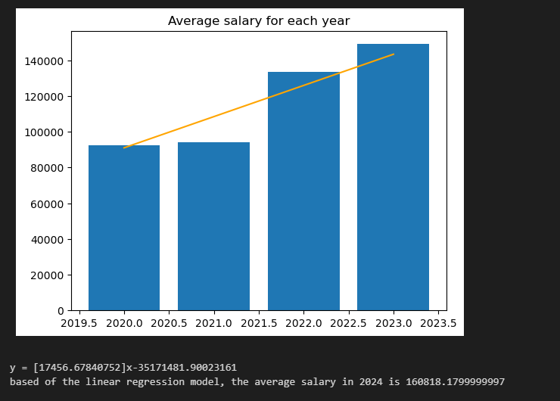
Work year impact on salaries
Average salary & Median salary are going trending up since 2020
The average anticipated salary for data analytics in general is around 160K

Slide 7
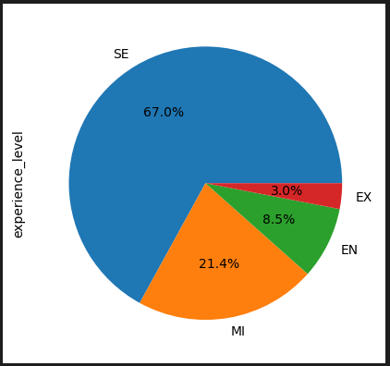
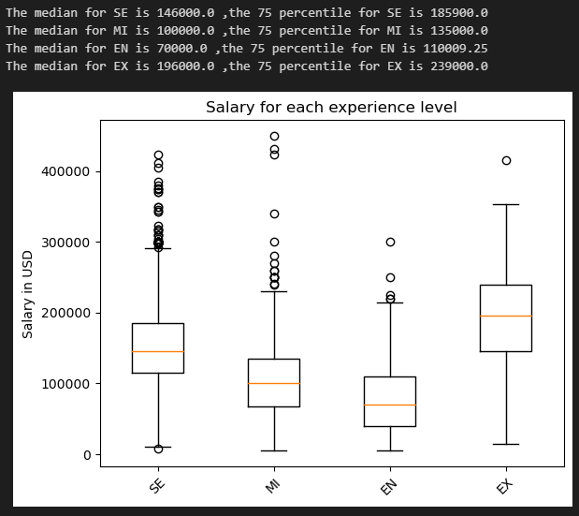
Experience Level impact on salaries
Majority of the sample points are senior level jobs
Each level of jobs are about 30-40K salary differences

Slide 8
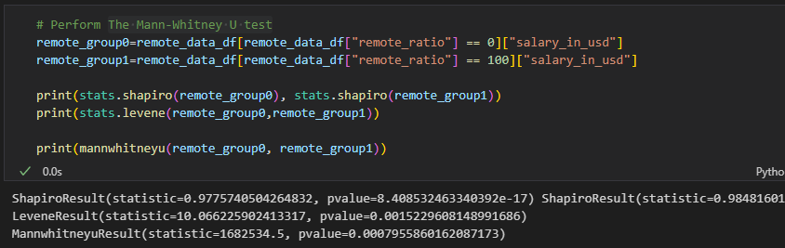
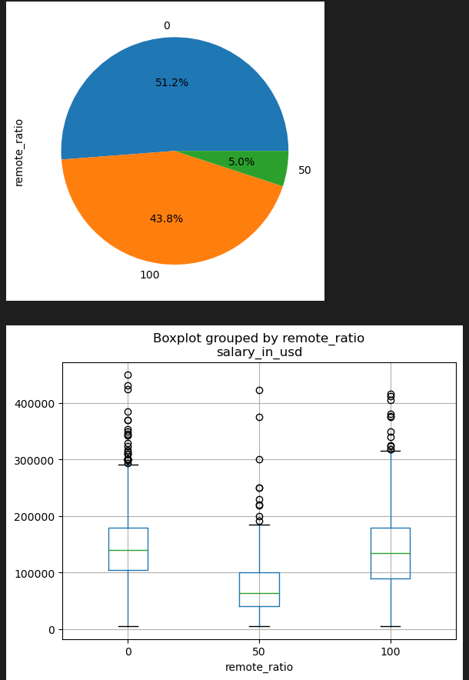
Remote impact on salaries
Fail to accept the Null Hypothesis—there is significant differences on salary between work remotely or not
Hybrid had the lowest salary in the data set

Slide 9
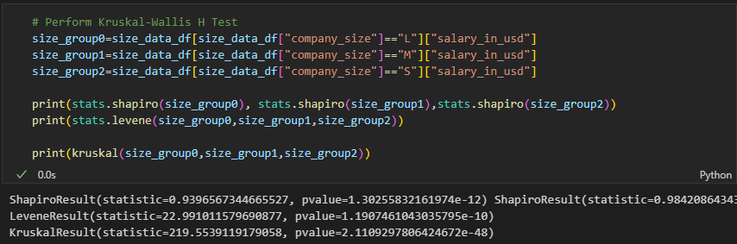
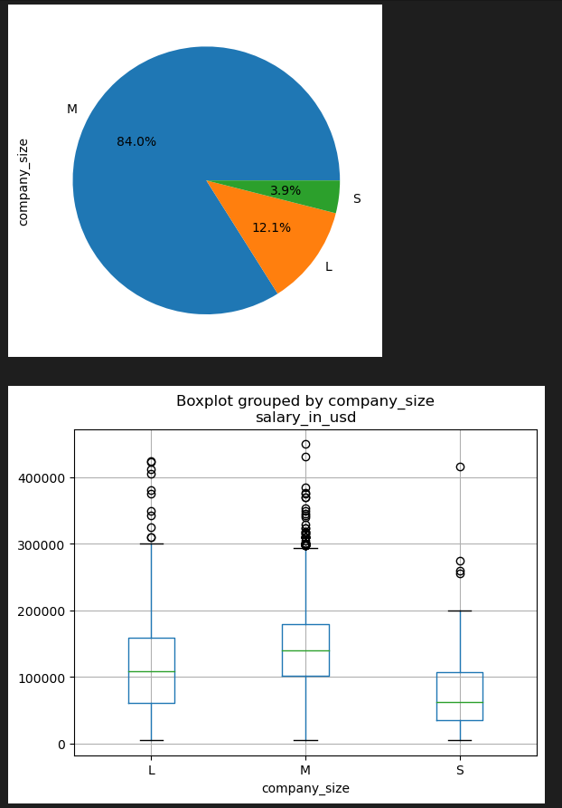
company size impact on salaries
Fail to accept the Null Hypothesis—there is significant differences on salary based off company sizes
Mid-size company pays out the most

Slide 10
Limitations of the Analysis
This data set and analysis does not include job location’s impact for salaries
This analysis is more discussing single factor impact on job salary, does not considering the potential relationships between factors
Notes:
Consider talking about:
Smart buildings
Analytics and business intelligence
Education

Slide 11
Summary
Using these data sets we are able to see the Data Analytics salaries though the past three year and the trends company are using since the start of covid-19. One popular trend that company using is the used of remote and hybrid jobs, which sound great, but will that change our expected salaries. Now we can use the charts form slid 8 what possible salaries could be if we go for remote jobs. The same can be done if we search for jobs with small or large companies, popular job title, and even how our experience level can impact our possible salaries. With this data base we can now have a better understanding of what we should expect in going into the Data Analytics job field.
Notes:
Consider talking about:
Smart buildings
Analytics and business intelligence
Education

