Slide 1
Service Mesh Patterns
WORKSHOP
Peter Jausovec Consulting Member of Technical Staff Twitter: pjausovec GitHub: peterj
Sherwood Zern Consulting Solution Architect

Slide 3
Agenda
Microservices
Service Mesh
Traffic Management
Handling Failures
Security

Slide 4
Microservices
Why?
Faster & independent deployments
Smaller teams → better communication
Use best tools & languages for the job
How?
Breaking up the monolith into smaller units → microservices
Challenges
Network
1 monolith → 1 deployment; 100 microservices → 100 deployments
“Solutions”
Custom libraries to solve these problems

Slide 5
Service mesh
Why?
Libraries were language & platform specific
Hard to write new services
Rewriting libraries in different languages doesn’t scale, costs $$$
How?
Containers to the rescue – package everything in an image
Push the library functionality out of the service
Service Mesh
Adds additional functionality to your services

Slide 6
How it works?

Slide 7
How it works?

Slide 8
How it works?

Slide 9
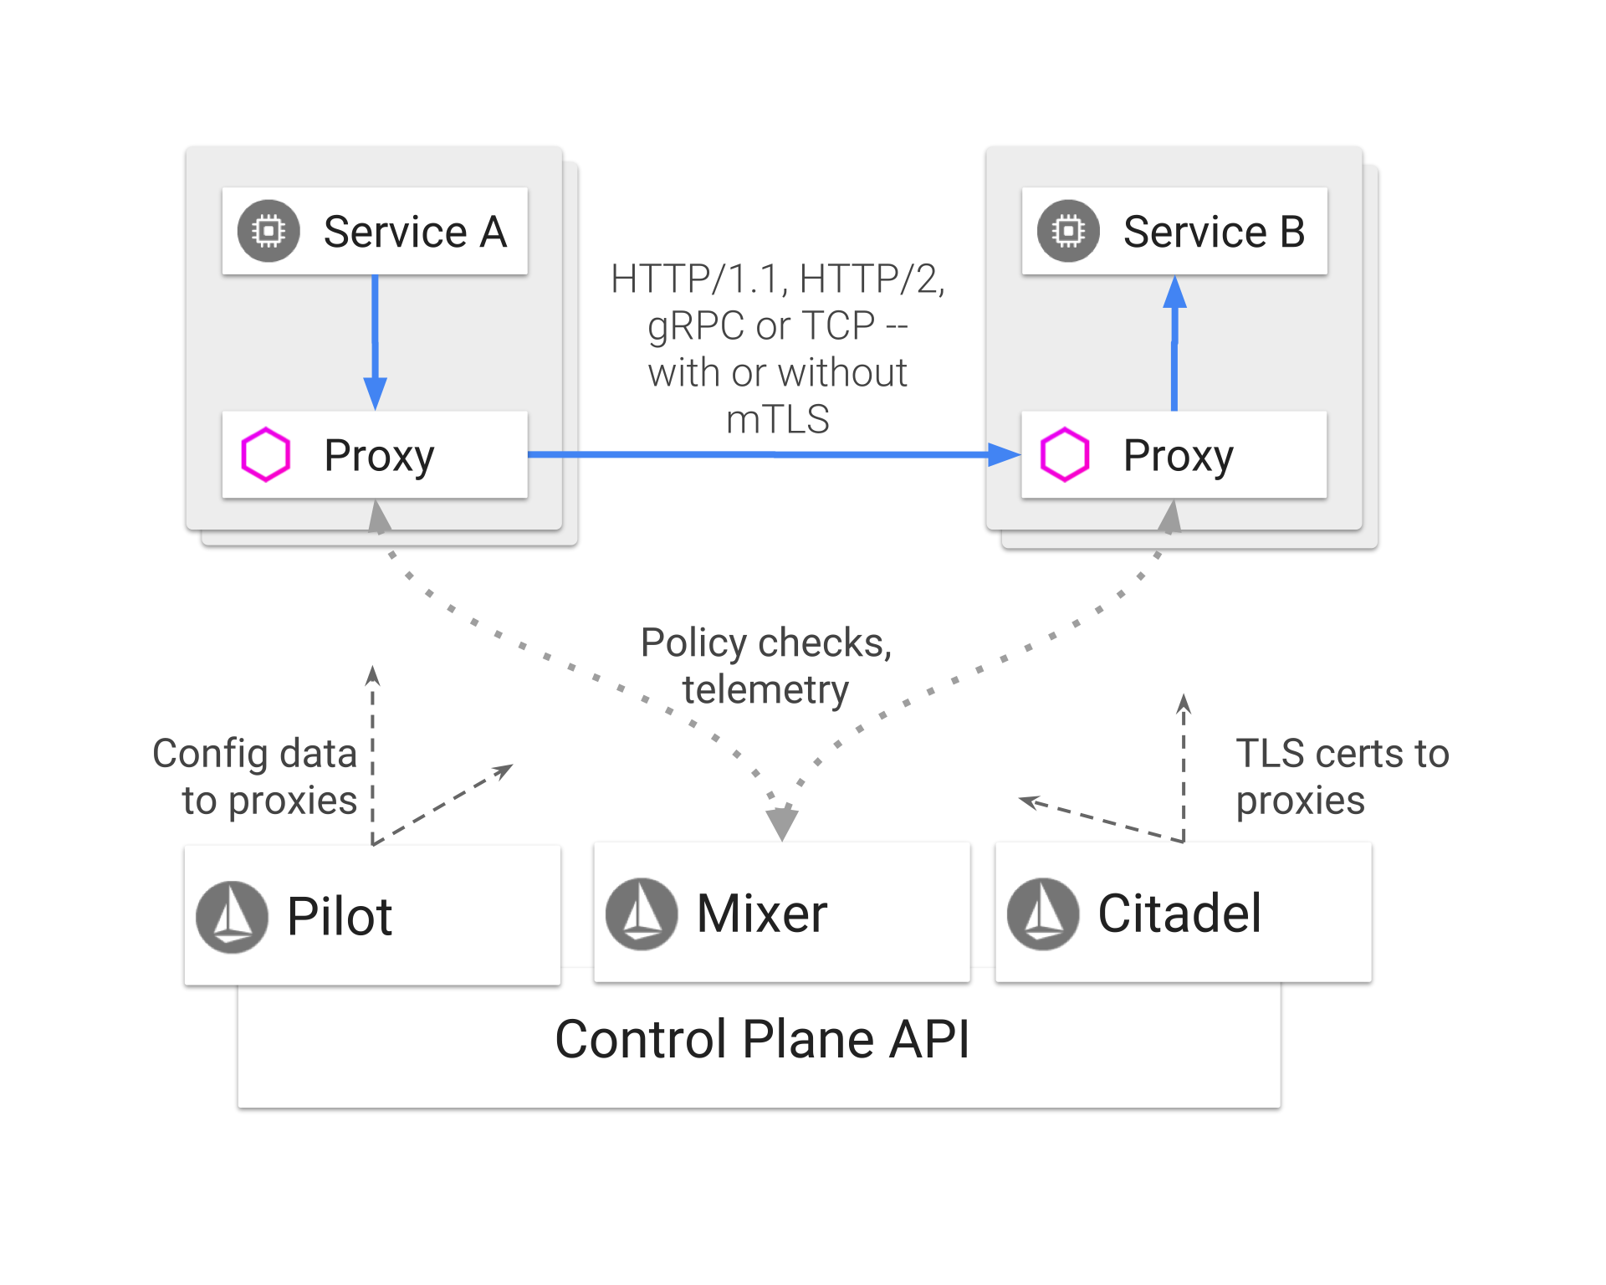

Slide 10
Traffic Management

Slide 11
Traffic Management – Sample Application
Greeter Service (v1)
Hello Web
Greeter Service (v2)
Greeter Service (v3)

Slide 12
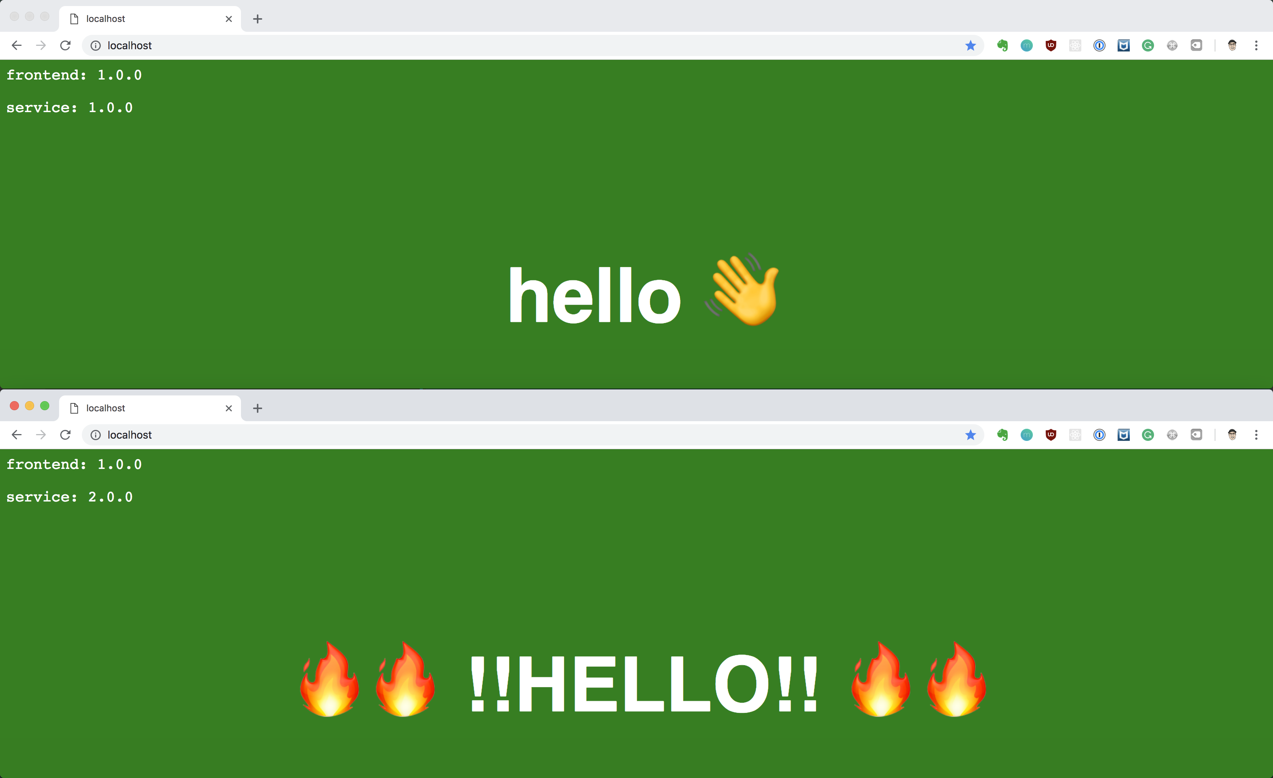

Slide 13
Traffic Management
Gateway (ingress)
Virtual Services
Destination Rules
Service entry (egress)

Slide 14
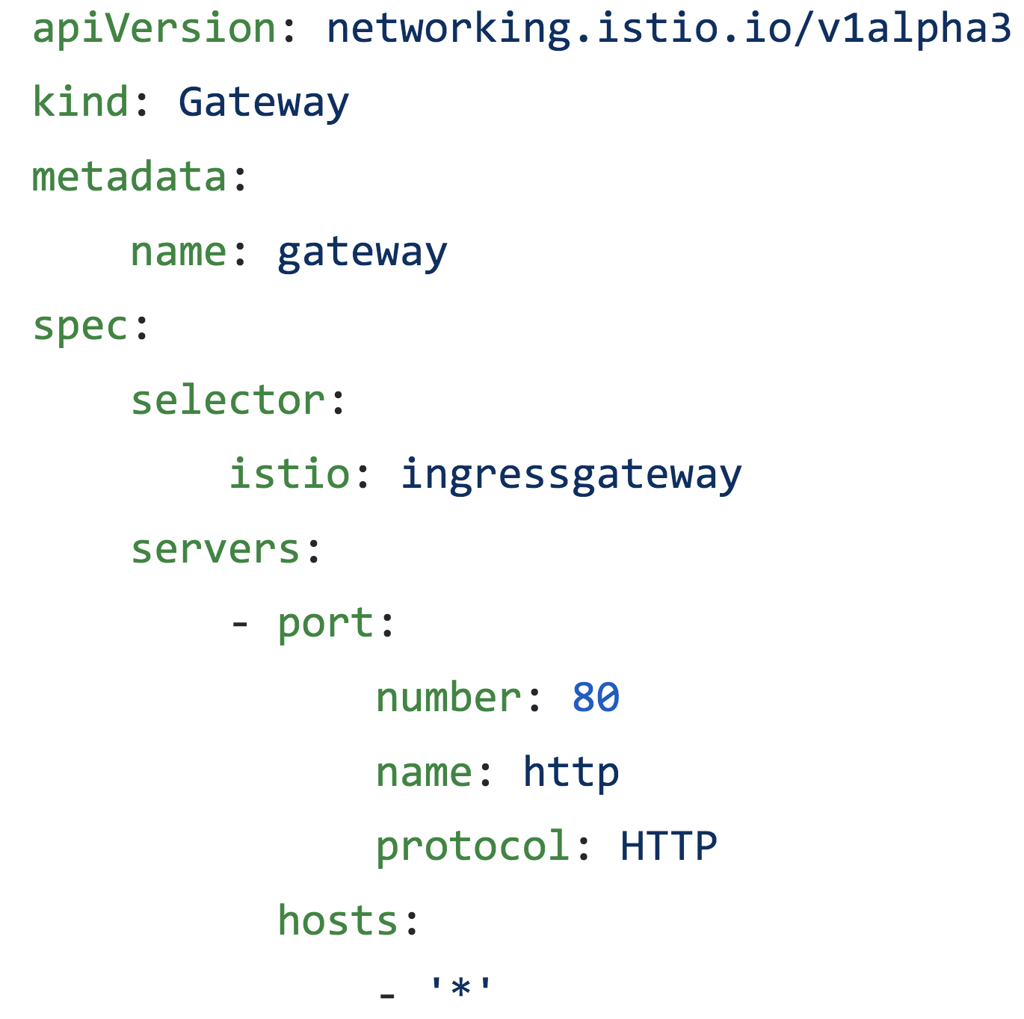
Gateway

Slide 15
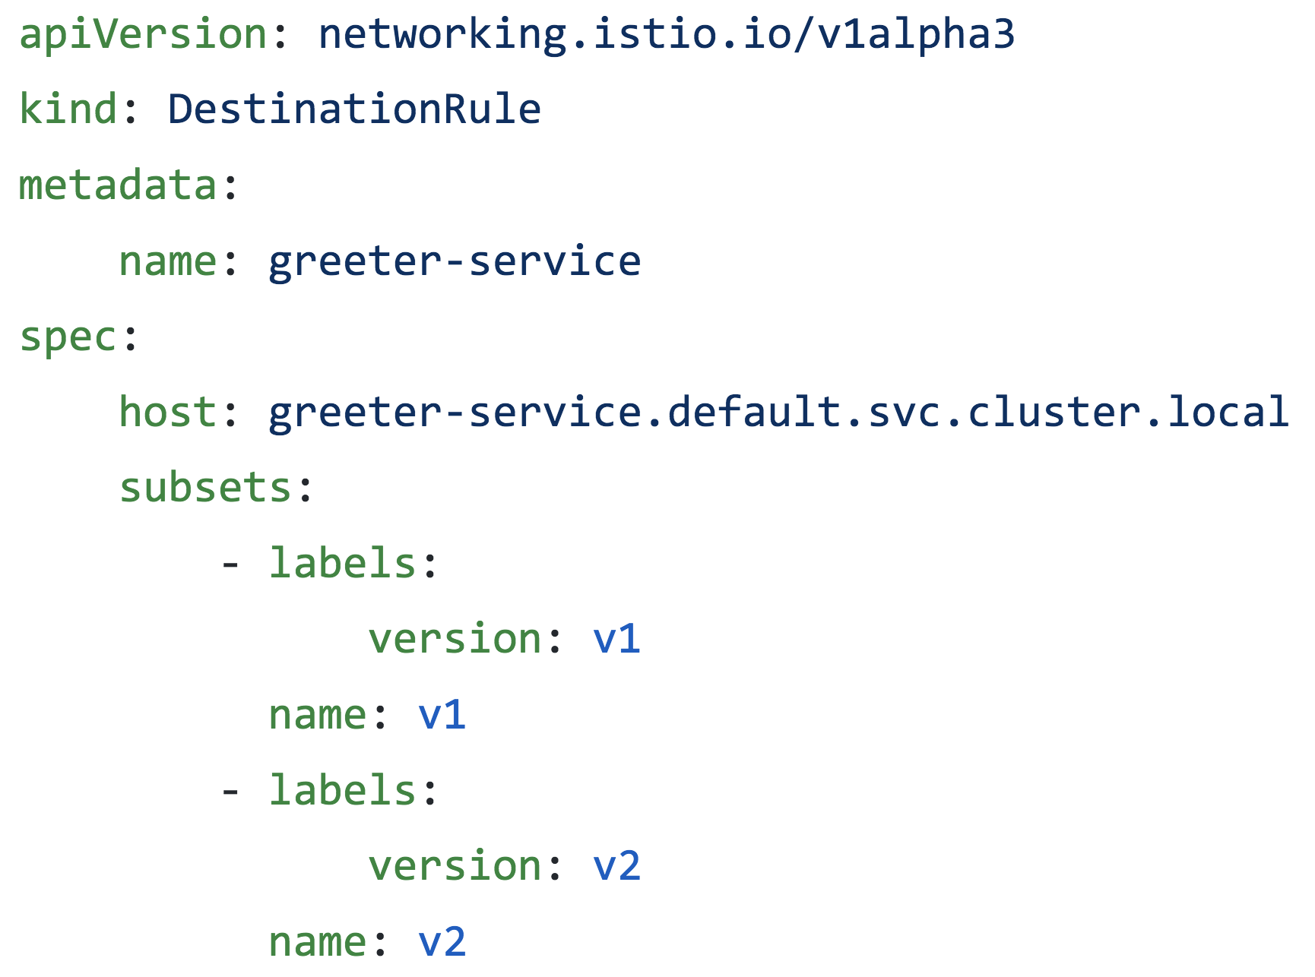
Destination Rule

Slide 16
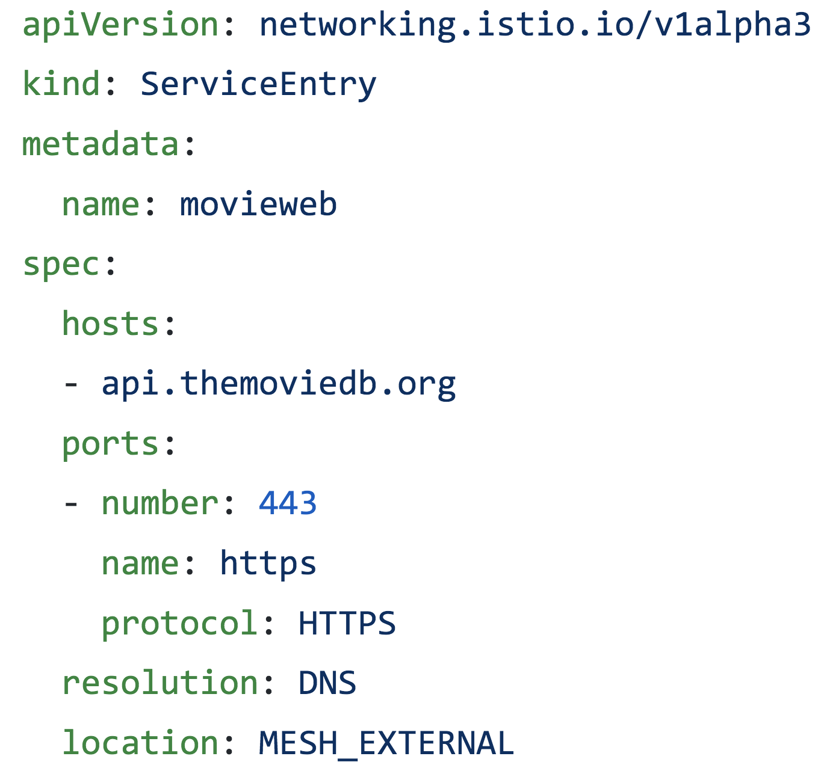
Service Entry

Slide 17
Traffic Management – Hands on
Objectives
Deploy & access the Hello Web
Deploy destination rule and v2 of Greeter service
Split traffic between v1 and v2 version of the Greeter service
Deploy v3 of Greeter service and route all traffic to it
Advanced traffic routing by browser/headers
Deploy & access Movie Web
Enable access to external API

Slide 18
Exercises and Instructions
bit.ly/snowcamp-istio

Slide 19
Observability and Monitoring

Slide 20
Observability and Monitoring
Why?
More services == more issues and problems
Services are hard to debug, test and diagnose when they fail
How?
Force services to fail or be more resilient
Grafana & Jaeger

Slide 21
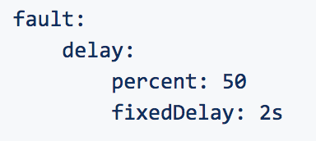
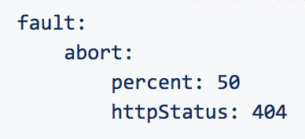
Breaking Stuff
Slowing services down
Simulate network latency
Injecting HTTP delays
Making services fail
Simulate unresponsive services or certain conditions
Aborting requests

Slide 22
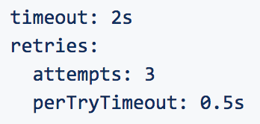
Making it resilient
Timeouts
Define service timeouts outside of the service
Retries
Define HTTP retries

Slide 23
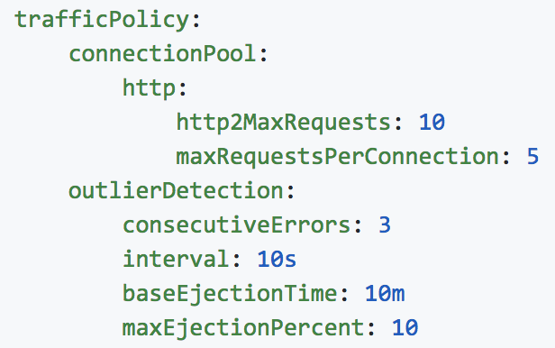
Circuit Breakers
Prevent additional failures
”X failed calls within Y seconds”

Slide 24
Observability and Monitoring – Hands on
Objectives
Access and look around Grafana and Jaeger
Slow down the Greeter service – observe in Grafana/Jaeger
Inject failures and observe in Grafana/Jaeger
Advanced scenario

Slide 25
Exercises and Instructions
bit.ly/snowcamp-istio

Slide 26
Security

Slide 27
Kubernetes Security - Overview
API Server
Responsible for Authentication and Authorization
Can be configured with one or more authentication plugins
When a request is received, the API Server goes through the list of authentication plugins
The first plugin to satisfy the request returns the username, user ID, and the group(s) the client belongs to
The API Server then begins the authorization process

Slide 28
Kubernetes Security - Overview
Types of Clients
Human Clients
Must be managed by an external system
No such resource in Kubernetes
You cannot create, update, or delete users through the API Server
Clients use a jwt token for authentication
Pods (your application)
Use service accounts
Service accounts are created and stored in the cluster as ServiceAccounts resources
Application can use the ServiceAccount if it needs to communicate with the API Server
ServiceAccounts use jwt tokens for authentication

Slide 29
Kubernetes Security - Overview
ServiceAccounts
Creation of a ServiceAccount triggers the creation of a secret
The secret is attached to and managed by the ServiceAccount
The secret contains a jwt token
The jwt token is written to the /var/run/secrets/kubernetes.io/serviceaccount/token
Let’s now peek into the ServiceAccounts
Notes:
$ kubectl get sa
NAME SECRETS AGE
default 1 14d
$ kubectl describe sa default
Name: default
Namespace: default
Labels: <none>
Annotations: <none>
Image pull secrets: <none>
Mountable secrets: default-token-4sq86
Tokens: default-token-4sq86
Events: <none>
kubectl describe secret default-token-4sq86

Slide 30
Security with the Service Mesh
Mutual TLS Authentication
Globally enable mTLS using a MeshPolicy resource
For namespace or service enablement of mTLS use a Policy resource
Istio tunnels service-to-service communication through the client-side and server-side Envoy proxies
Istio re-routes the outbound traffic from a client to the client’s local proxy (Envoy).
The client side proxy starts a mutual TLS handshake with the service side proxy. During the handshake, the client side proxy also does a secure naming check to verify that the service account presented in the server certificate is authorized to run the target service.
The client side proxy and the server side proxy establish a mutual TLS connection, and Istio forwards the traffic from the client side proxy to the server side proxy
After authorization, the server side proxy forwards the traffic to the server service through local TCP connections
Where did the certificates come from in step 2?
The certificates came from the ServiceAccount certificates
Notes:
$ kubectl get sa
NAME SECRETS AGE
default 1 14d
$ kubectl describe sa default
Name: default
Namespace: default
Labels: <none>
Annotations: <none>
Image pull secrets: <none>
Mountable secrets: default-token-4sq86
Tokens: default-token-4sq86
Events: <none>
kubectl describe secret default-token-4sq86

Slide 31
Security – mTLS Hands on

Slide 32
Exercises and Instructions
bit.ly/snowcamp-istio

Slide 33
Security with the Service Mesh
Authorization
To enable Istio authorization deplay a CustomResourceDefinition object: RbacConfig
RbacConfig has multiple modes
OFF: Istio authorization is disabled
ON: Istio authorization is enabled for services in the mesh
ON_WITH_CONCLUSION: Istio authorization is enabled only for services and namespaces specified in the inclusion field.
ON_WITH_EXCLUSION: Istio authorization is enabled for all services in the mesh except the services and namespaces specified in the exclusion field.
Notes:
Look at the RbacConfig object
$ kubectl apply –f src/main/istio/authorization/greeter-weather-svc-sa.yaml
$ kubectl apply –f src/main/istio/authorization/greeter-weather-virtualservice.yaml
$ kubectl apply –f src/main/istio/authorization/dest-rule.yaml
$ kubectl apply –f src/main/istio/authorization/weather-proxy-svc-sa.yaml
$ kubectl apply –f src/main/istio/authorization/rbac-config-enable.yaml

Slide 34
Security with the Service Mesh
Authorization
ServiceRole : Defines a group of permissions to access services
ServiceRoleBinding: Grants a ServiceRole to particular subjects or a service
The combination of ServiceRole and ServiceRoleBinding specifies: who is allowed to do what under which conditions
Who: refers to the subjects section in ServiceRoleBinding.
What: refers to the permissions section in ServiceRole.
Which conditions: refers to the conditions section you can specify with the Istio attributes in ServiceRole or ServiceRoleBinding.
Notes:
Look at the RbacConfig object
$ kubectl apply –f src/main/istio/authorization/greeter-weather-svc-sa.yaml
$ kubectl apply –f src/main/istio/authorization/greeter-weather-virtualservice.yaml
$ kubectl apply –f src/main/istio/authorization/dest-rule.yaml
$ kubectl apply –f src/main/istio/authorization/weather-proxy-svc-sa.yaml
$ kubectl apply –f src/main/istio/authorization/rbac-config-enable.yaml

Slide 35
Security Authorization – Hands On
Authorization by namespace
Authorization by service

Slide 36
Exercises and Instructions
bit.ly/snowcamp-istio

Slide 37
Thank you & Questions
bit.ly/snowcamp-istio cloud.oracle.com/tryit
Peter email: peter.jausovec@oracle.com, twitter: pjausovec , github: peterj
Sherwood email: sherwood.zern@oracle.com, github: sherwoodzern

