Slide 1
Summary of work

Slide 2
It is the physicial model
l₁ (mm) | l₂ (mm) | g (mm) | l_{q} (mm)
32.5~35.5 | 32.5~35.5 | 0.5~3.5 | 11.0~15.0

Slide 3
0, 0.450819, 0.3850784, 0.5928939, 0
0.450819, 0.2277666, 0, 0, 0.450819
0.3850784, 0, -1.516766, 0, 0.3850784
0.5928939, 0, 0, -0.7525186, -0.5928939
0, 0.450819, 0.3850784, -0.5928939, 0
0 | M_{S1} | M_{S2} | M_{S3} | M_{SL}
M_{1s} | M₁₁ | M₁₂ | M₁₃ | M_{1L}
M_{2s} | M₂₁ | M₂₂ | M₂₃ | M_{2L}
M_{3s} | M₃₁ | M₃₂ | M₃₃ | M_{3L}
M_{LS} | M_{L1} | M_{L2} | M_{L3} | 0
the input data is originated from the matrix.And it is [M_{S1}M_{S2}M_{S3} M₁₁ M₂₂ M_{33]}
]

Slide 4
this week I do not use the k fold verification ,and the results are as follows

Slide 5
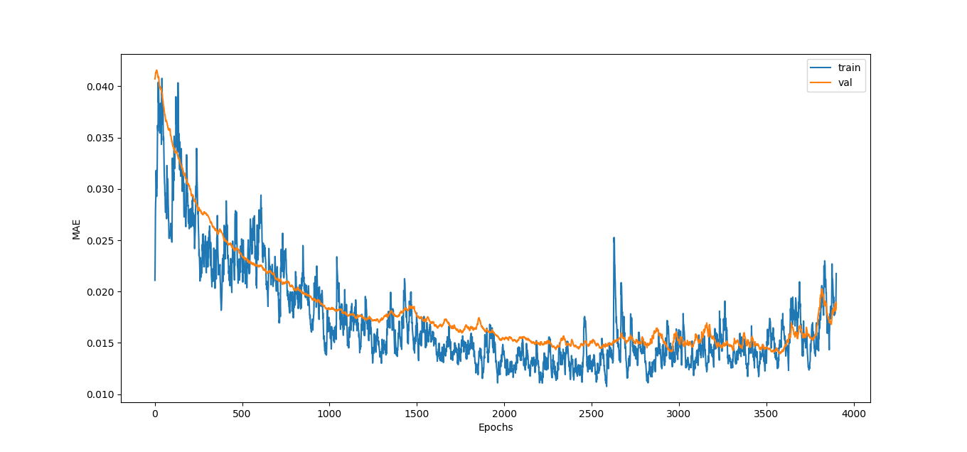

Slide 6
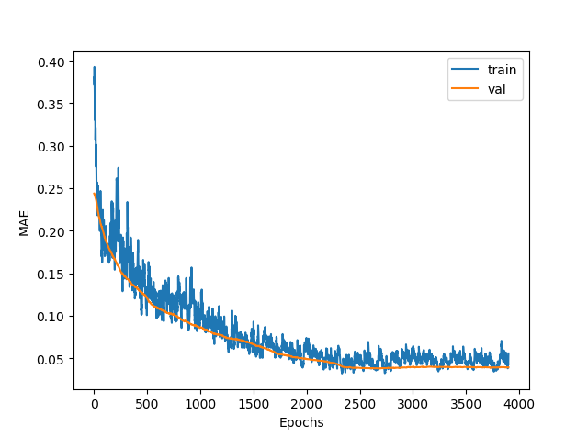

Slide 7
I also use the predict result to make the circuit simulation and compare it with the theory.The reults are as follows.

Slide 8
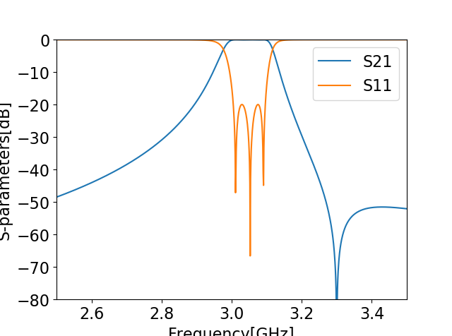
this picture is generated by theory

Slide 9
this picture is generated by simulation

Slide 10
