Slide 1
Study summary
Use python to analyze the xml files and draw the sketch
Study goals
Learn knowledge about TensorFlow

Slide 2
Use python to analyze the xml files and draw the sketch
In the last week,I try to learn to use opencv to
draw the sketch, when I learn the edge detection,
I think it may help me to solve the problem.
Finally I use the Canny to make the edge detectio
--n .

Slide 3
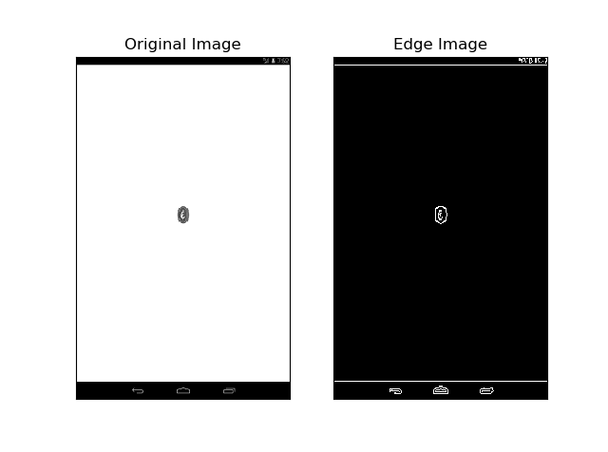
This is a example of screenshots

Slide 4
Learn knowledge about TensorFlow
Try to build a simple netural network

