Slide 1
Study summary
Use python to analyze the xml files and draw the sketch
Study goals
Learn Clustering and try to change the parameter

Slide 2
Use python to analyze the xml files and draw the sketch
In the last week,successfully draw the sketch
The results are as follows

Slide 3
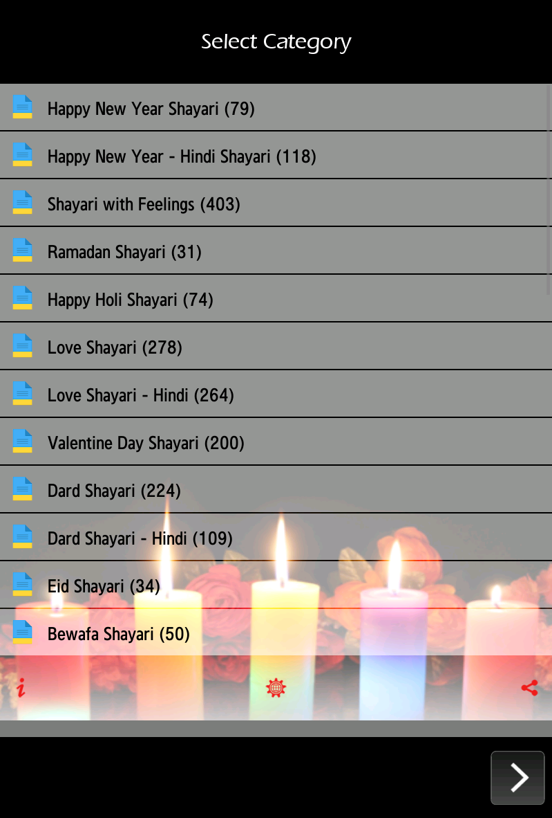
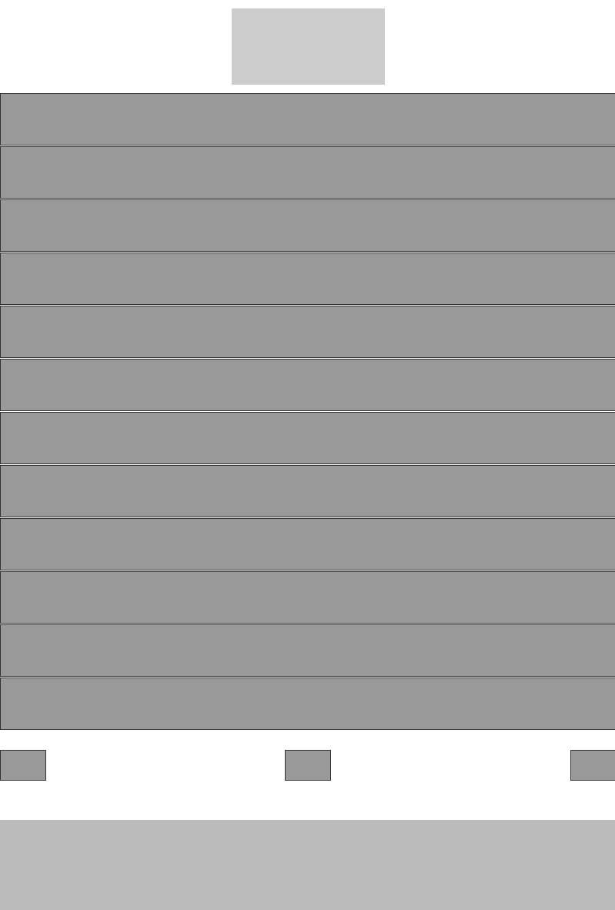

Slide 4
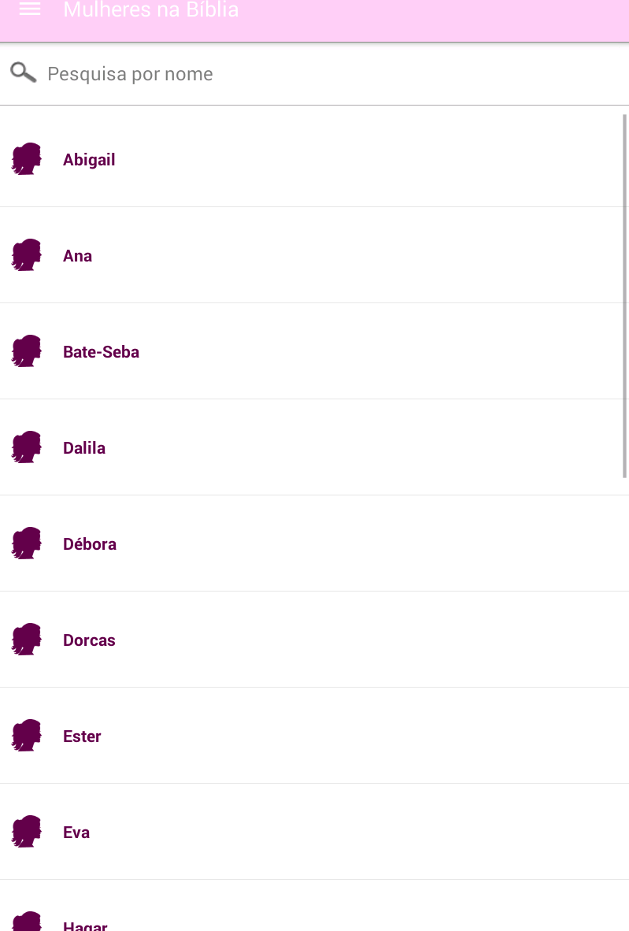
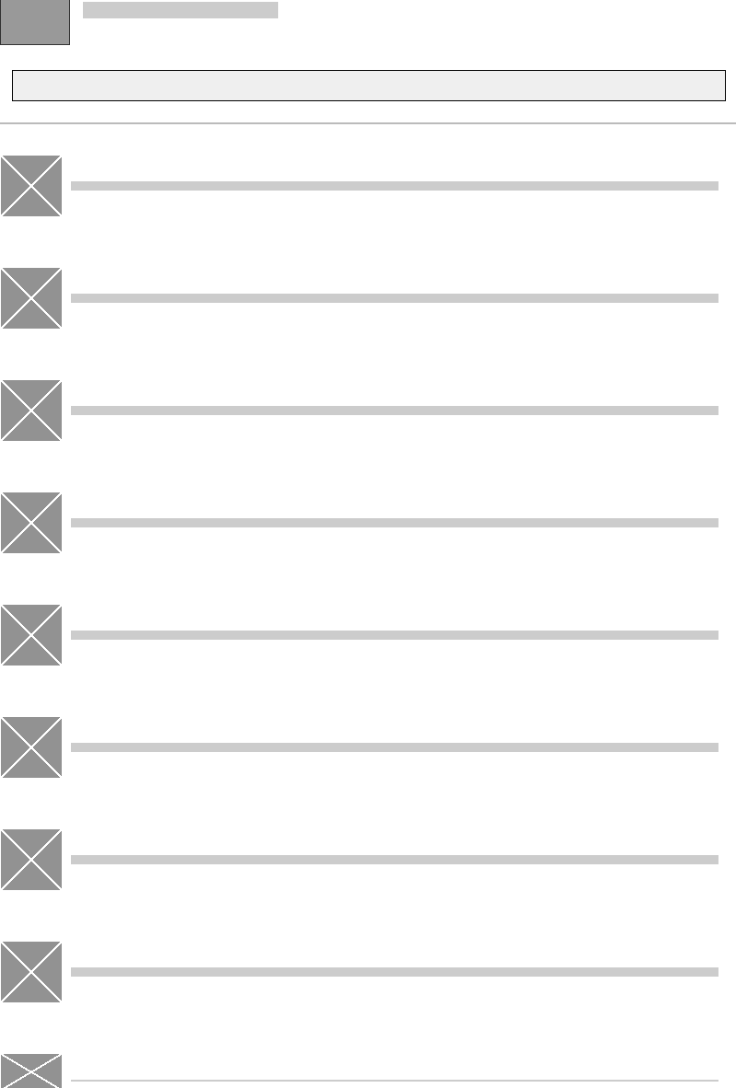

Slide 5
Clustering
In the last week,I try to learn Clustering.Finally I
use the Hierarchical Clustering to analyze the
Pictures.And I change the parameter .The results
are follow

Slide 6
