Slide 1
Summary of work

Slide 2
Something about CNN visualizing
Use keras to bulid the CNN to achieve the CNN
Visualizing. The data is from Kaggle.

Slide 3
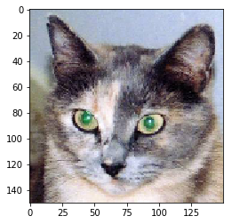
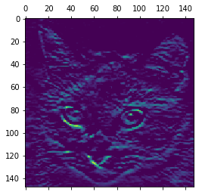
Show the original picture
This picture is extracted from channel = 3

Slide 4
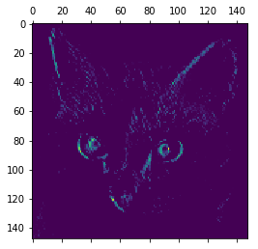
This picture is extracted from channel =31

Slide 5
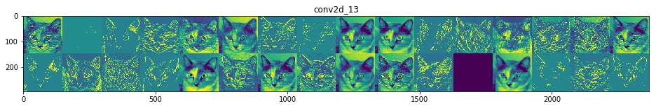
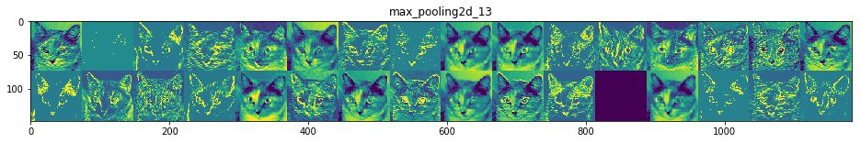
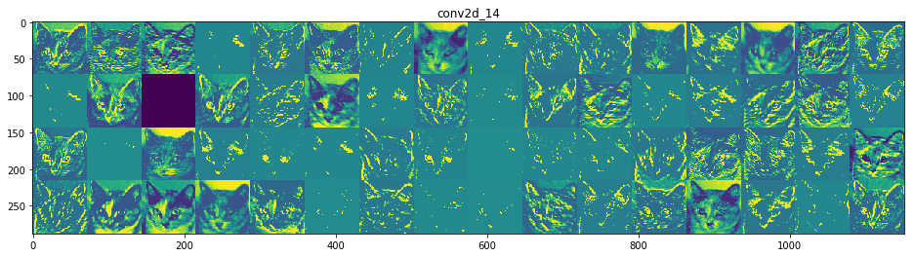

Slide 6
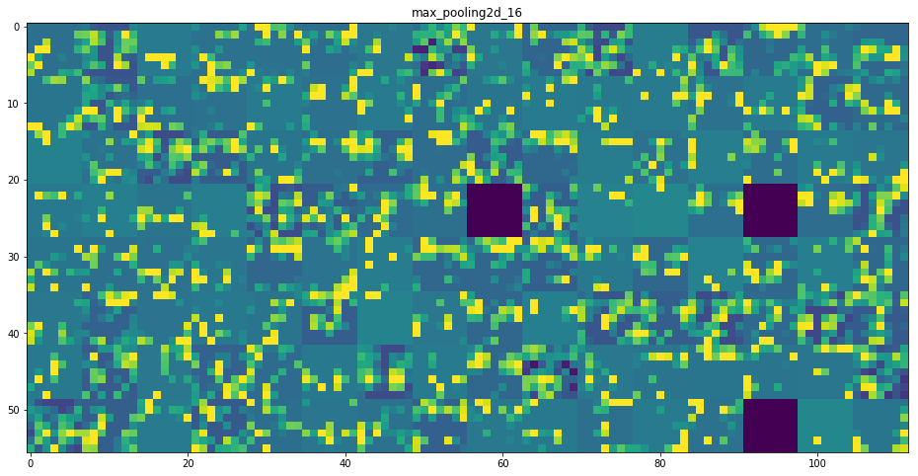
From these results , we can see with the higher layer , the message from the pict
-ures will be more abstract.

