Slide 1
The summary of work

Slide 2
Title | Author | Publication
Automatic Classification of Fetal Heart Rate Based on Convolutional Neural Network | Igor Gotlibovych | KDD’18 Deep Learning Day, August 2018, London, UK
Machine Learning in Rehabilitation Assessment for Thermal and Heart Rate Data Processing | Oldřich Vyšata | IEEE Transactions on Neural Systems and Rehabilitation Engineering
Automatic Classification of Fetal Heart Rate Based on Convolutional Neural Network | Jianqiang Li | IEEE Internet of Things Journal

Slide 3
End-to-end Deep Learning from Raw Sensor Data: Atrial Fibrillation Detection using Wearables
In this paper,author uses convolutional-recurrent architecture as is shown in the picture.
A convolutional-recurrent architecture for classi- cation of raw time-series data. While the receptive eld of each neuron in the convolutional (Conv) layers is well de- ned, the recurrent long short-term memory (LSTM) layer can learn variable-length correlations.

Slide 4
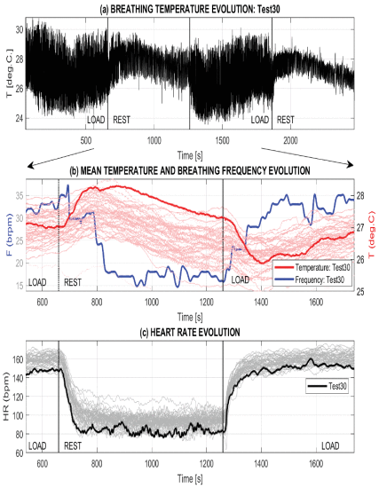
Machine Learning in Rehabilitation Assessment for Thermal and Heart Rate Data Processing
The plot of (a) the mean breathing temperature in the selected mouth area detected by the thermal camera during an activity 40 minutes long including two load periods and two rest periods, 10 minutes each, for a selected experiment; (b) the average breathing temperature and breathing frequency changes evaluated for 56 experiments, and (c) the heart rate detected by the heart rate sensor over a time range of 20 minutes.

Slide 5
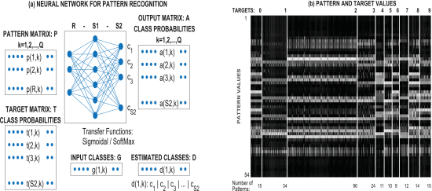
Machine Learning in Rehabilitation Assessment for Thermal and Heart Rate Data Processing
A two-layer neural network with sigmoidal and softmax transfer functions to recognize individual digits and to find changing temperature ranges of the thermal camera system presenting (a) the system structure and (b) pattern and target values for processing 240 digits separated into matrices of 9 by 6 pixels forming R=54 features for the definition of each one of them.

Slide 6
Machine Learning in Rehabilitation Assessment for Thermal and Heart Rate Data Processing
This paper presented selected methods of machine learning and digital signal and image processing to evaluate specific biomedical signals during physical activities. The data streams were acquired by a thermal camera and heart rate sensors to study an exercise-based rehabilitation program.

Slide 7
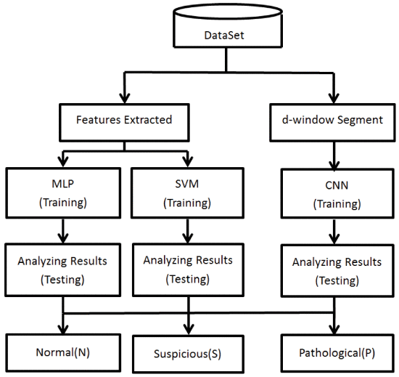
Automatic Classification of Fetal Heart Rate Based on Convolutional Neural Network
This picture shows steps of data processing.

Slide 8
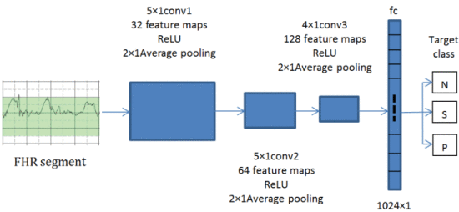
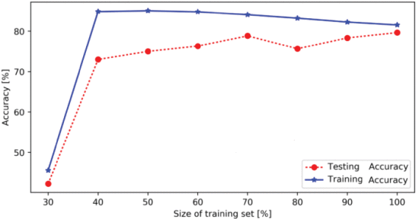
Automatic Classification of Fetal Heart Rate Based on Convolutional Neural Network
This picture shows the architecture of the proposed CNN.
size of training set and classing accuracy for SVC.

Slide 9
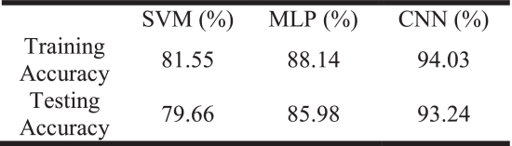
Automatic Classification of Fetal Heart Rate Based on Convolutional Neural Network
In the end, the author compares these three methods. Finally CNN behaves better than the other.

