Slide 1
The summary of work

Slide 2
In the last week, I do two projects as follows.
Project1： Orbital disease image classification
Project2： Predict the recovery of patient

Slide 3
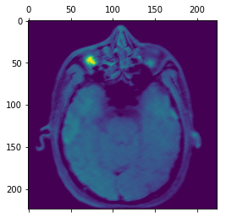
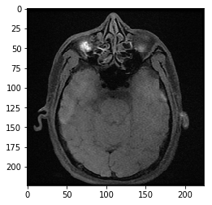
Project1： Orbital disease image classification
Visualize what convnets learn

Slide 4
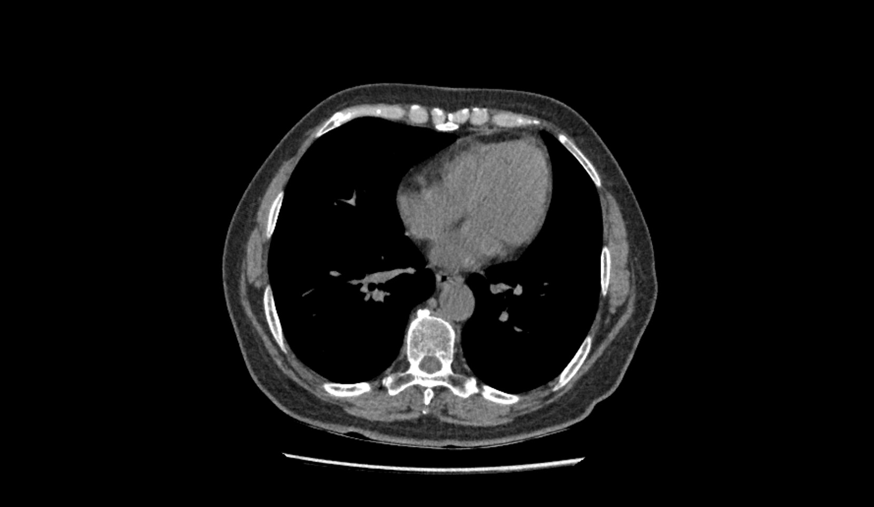

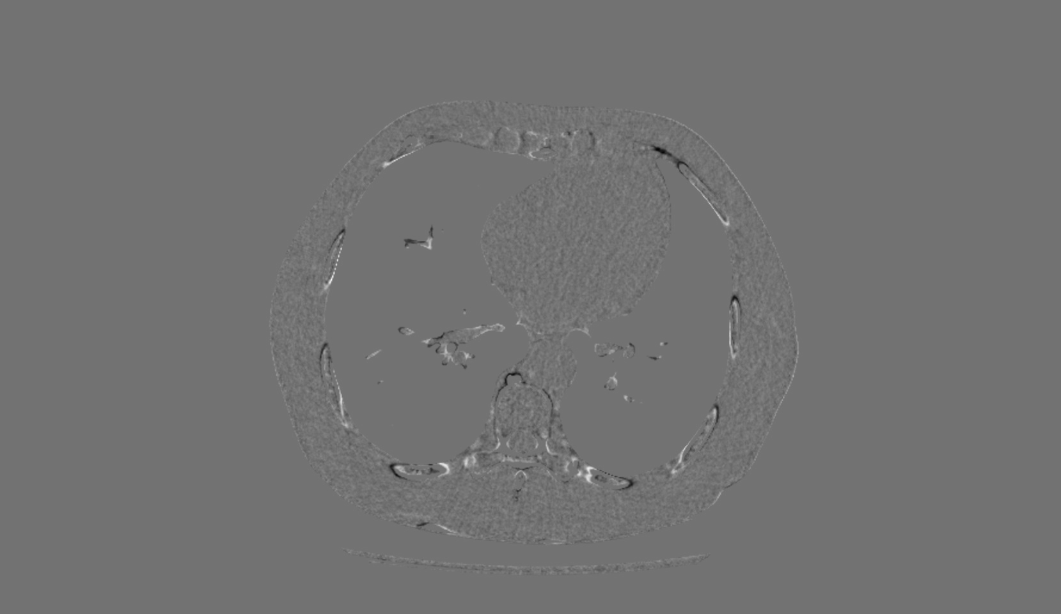
Project2： Predict the recovery of patient
We divide the task into two parts, one part is Medical image registration ,another part is video classification prediction

Slide 5
About the video classification prediction we have some questions
Whether we do not need image registration, and put all the pictures to train

