Slide 1
The summary of work

Slide 2
Dataset structure
0 = No lesions
1 = Benign lesions
2 = Malignant lesion
0 : 2091 images 24 patients
1 : 2136 images 25 patients
2 : 2035 images 43 patients
Train datasets
0 : 300 images 3 patients
1 : 355 images 9 patients
2 : 378 images 6 patients
Val datasets
0 : 312 images 3 patients
1 : 416 images 10 patients
2 : 298 images 5 patients
Test datasets

Slide 3
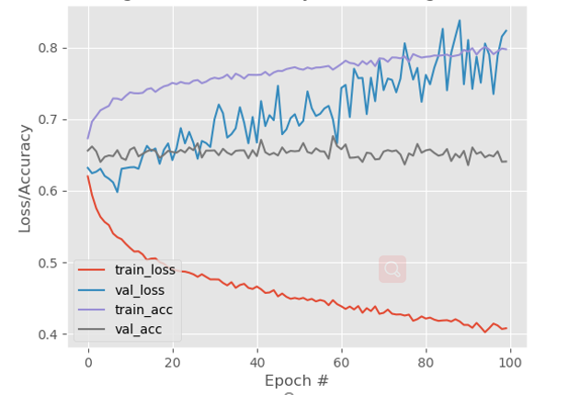

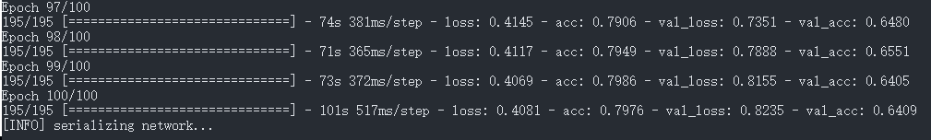
Some baseline methods
VGG16,VGG19,InceptionV3,Xception,MobileNet,AlexNet,LeNet,ZF_Net,ResNet18,ResNet34,ResNet50,ResNet101,ResNet152
Some parameters
EPOCHS = 100 INIT_LR = 1e-5 BS = 32 norm_size = 224
Methods : LeNet

Slide 4
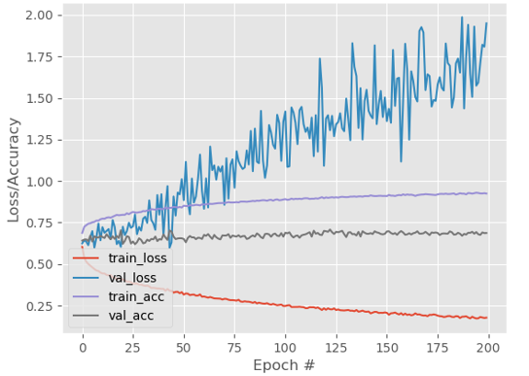
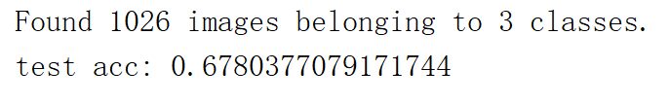
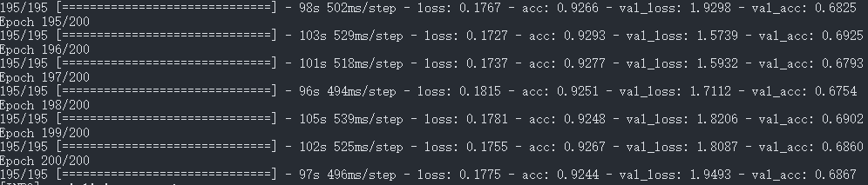
Some parameters
EPOCHS = 200 INIT_LR = 1e-4 BS = 32 norm_size = 224
Methods : LeNet
Test results
Train results

Slide 5
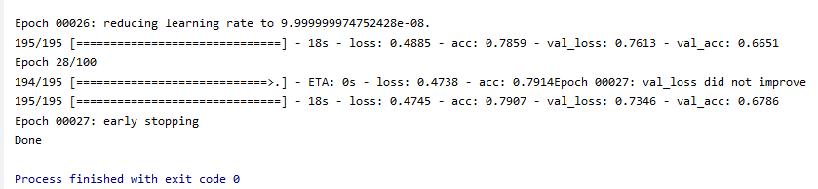
Some parameters
EPOCHS = 100 INIT_LR = 1e-5 BS = 32 norm_size = 64
Methods : VGG16

Slide 6
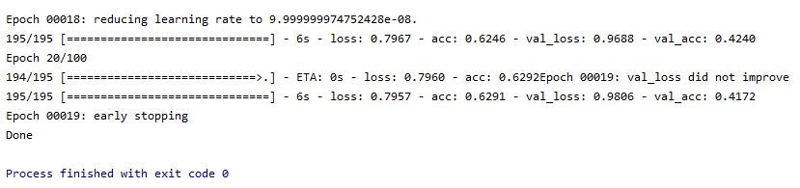
Some parameters
EPOCHS = 100 INIT_LR = 1e-5 BS = 32 norm_size = 64
Methods : AlexNet

Slide 7
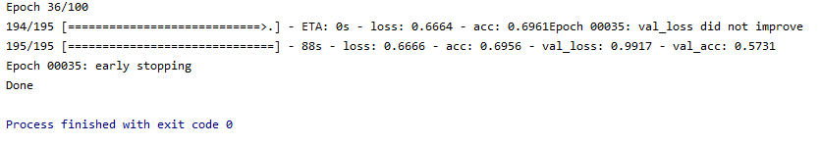
Some parameters
EPOCHS = 100 INIT_LR = 1e-5 BS = 32 norm_size = 64
Methods : ResNet50

Slide 8
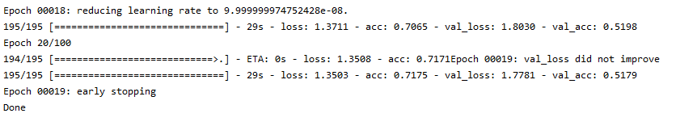
Some parameters
EPOCHS = 100 INIT_LR = 1e-5 BS = 32 norm_size = 64
Methods : ResNet101

