Slide 1
The summary of work

Slide 2
In the last week, I do four tasks as follows.
retrain the model with new datasets
pick the misclassified pictures
visualize what convnets learn
read the paper

Slide 3
Retrain the model with new datasets
This week I adjust the the composition of the data set, include internal datasets and external datasets
Internal datasets
 | Training pictures | Validation pictures | Testing pictures | Number of patients
Abnormal | 6747 | 771 | 1912 | 150
Normal | 8636 | 930 | 2363 | 79
External datasets
 | Testing pictures | Number of patients
Abnormal | 3764 | 20
Normal | 1195 | 17

Slide 4
Pick the misclassified pictures
When I pick the misclassified pictures , I find most of the pictures belong the same patient

Slide 5
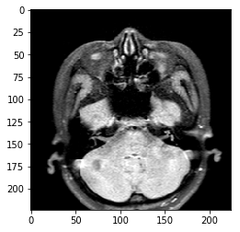
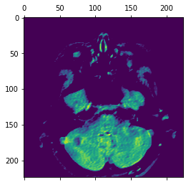
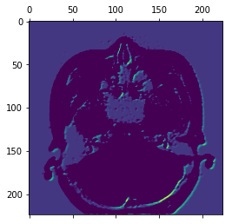
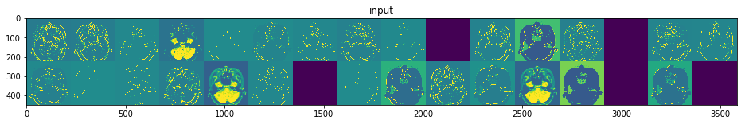
Visualize what convnets learn

Slide 6
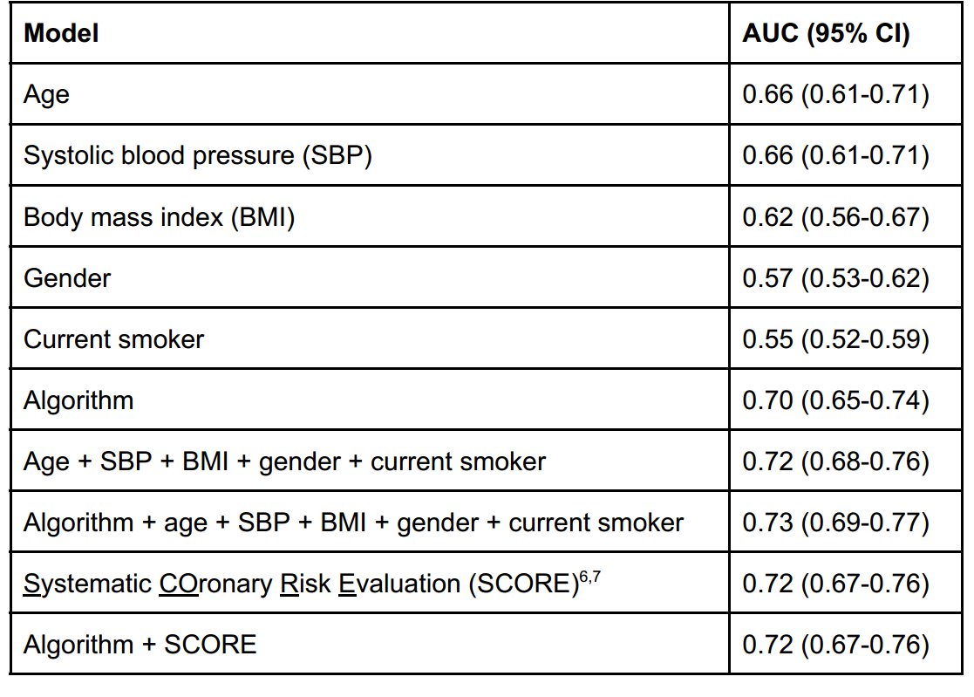
Read the paper

