Slide 1
Summary of work

Slide 2
Read paper in order to know how to write the paper I need
In IEEE Transactions on Microwave Theory and Techniques I find a paper titled “Multivalued Neural Network Inverse Modeling and Applications to Microwave Filters”.This paper is
similiar to my research.

Slide 3
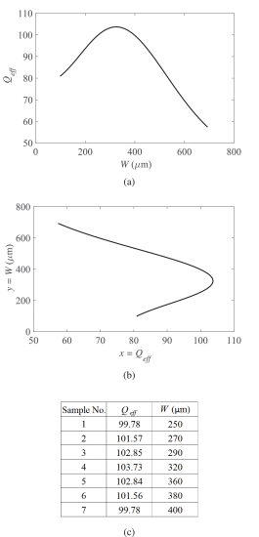
First show the model in the paper .It wants to use the Q to predict the y .The y is the physical
parameter.Because it has multi values.
It needs to do the choose.And it changes the loss function.Generally it
use the first method

Slide 4
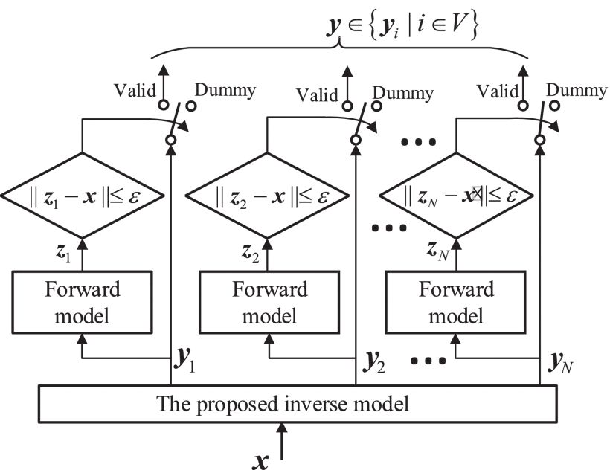
It shows how to select the Valid Values of the Proposed Inverse Model

Slide 5
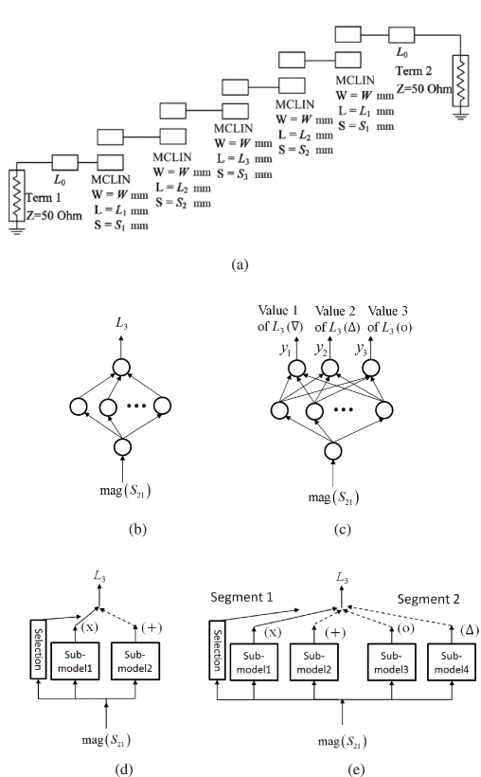
Next the paper shows a example

Slide 6
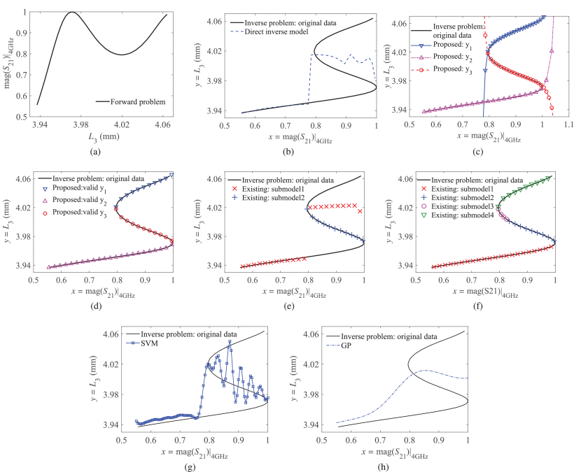
This is the result of the paper . It has a comparison about SVM and GP

Slide 7
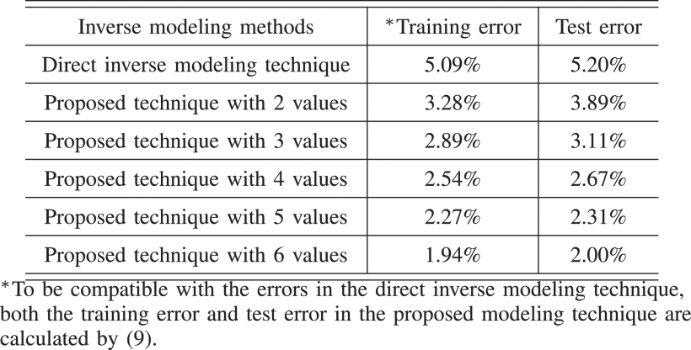

Slide 8
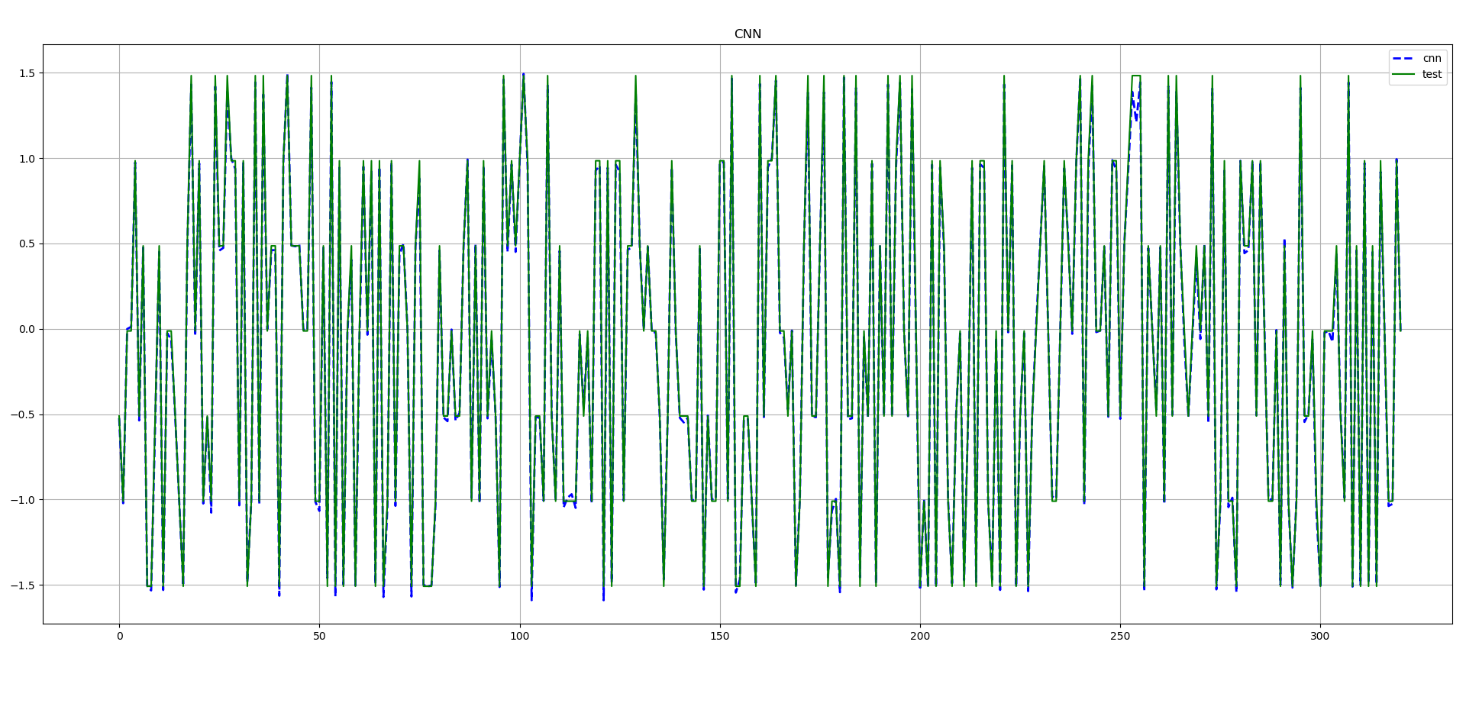
This is the result of CNN

