Slide 1
Summary of work

Slide 2
Something about three papers
1：Artificial neural networks for RF and microwave design - from theory to practice
2：Automated Knowledge-Based Neural Network Modeling for Microwave Applications
3：Microwave Integrated Circuits Design with Relational Induction Neural Network

Slide 3
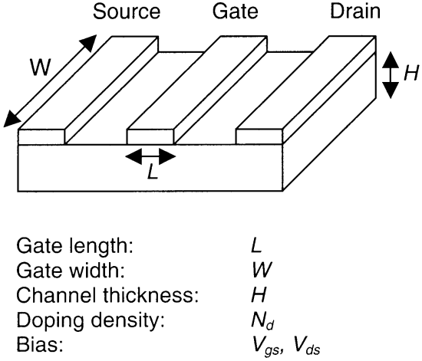
Artificial neural networks for RF and microwave design - from theory to practice

Slide 4
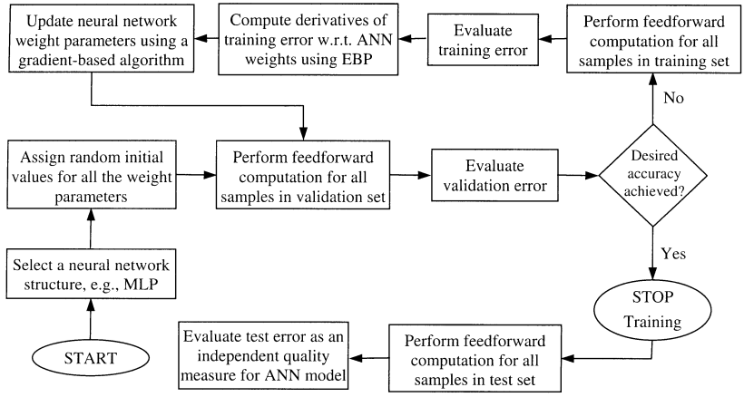
Artificial neural networks for RF and microwave design - from theory to practice

Slide 5
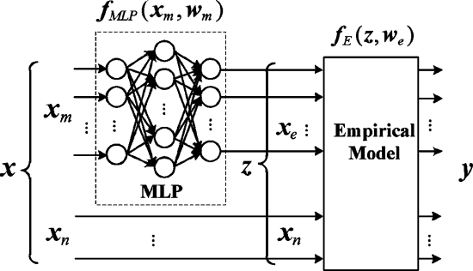
Automated Knowledge-Based Neural Network Modeling for Microwave Applications
The knowledge-based structure used in the proposed algorithm. It cons- ists of an MLP fMLP(xm,wm) and an empirical model fE(z,we)

Slide 6
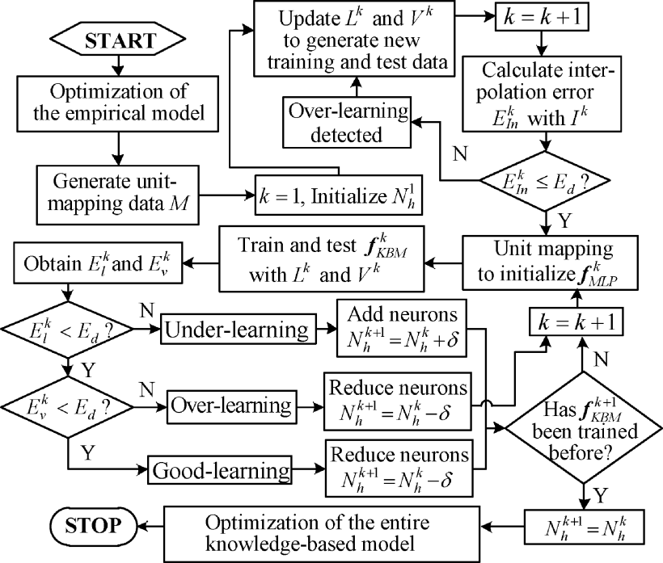
Automated Knowledge-Based Neural Network Modeling for Microwave Applications

Slide 7
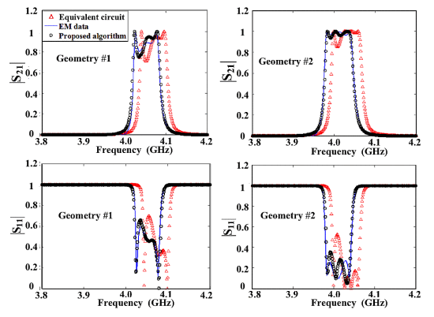

Slide 8
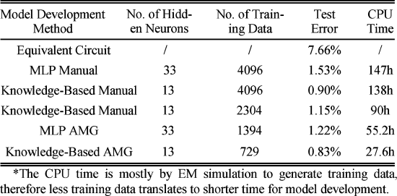

Slide 9
Microwave Integrated Circuits Design with Relational Induction Neural Network

Slide 10
Microwave Integrated Circuits Design with Relational Induction Neural Network

