Slide 1
CS 6476 Project 6
Guangyu Cui
gcui8@gatech.edu
gcui8
903136762

Slide 2
Parts 4 & 5: mIoU of different models
Add each of the following (keeping the changes as you move to the next row):
 | Training mIoU | Validation mIoU
Simple Segmentation Net (no pretrained weights) | 0.4833 | 0.3724
ImageNet-Pretrained backbone | 0.5825 | 0.5521
Data augmentation | 0.4923 | 0.4954
ImageNet-Pretrained PSPNet w/ Data Aug. without PPM | 0.5680 | 0.5745
PSPNet with PPM | 0.5738 | 0.5937
PSPNet with auxiliary loss | 0.5801 | 0.5922

Slide 3
Parts 4 & 5: Per class IoUs
Report your model’s IoU for the 11 Camvid classes (you can find the order they are listed in at dataset_lists/camvid-11/camvid-11_names.txt):
Class Index | Class name | Simple Segmentation Net Class IoU | PSPNet Class IoU
0 | Building | 0.8429 | 0.9024
1 | Tree | 0.7870 | 0.9916
2 | Sky | 0.8610 | 0.9083
3 | Car | 0.4952 | 0.7493
4 | SignSymbol | 0.0000 | 0.0000
5 | Road | 0.8867 | 0.9568
6 | Pedestrian | 0.0458 | 0.0630
7 | Fence | 0.3201 | 0.3522
8 | Column_Pole | 0.0000 | 0.0000
9 | Sidewalk | 0.6756 | 0.8278
10 | Bicyclist | 0.0000 | 0.0000

Slide 4
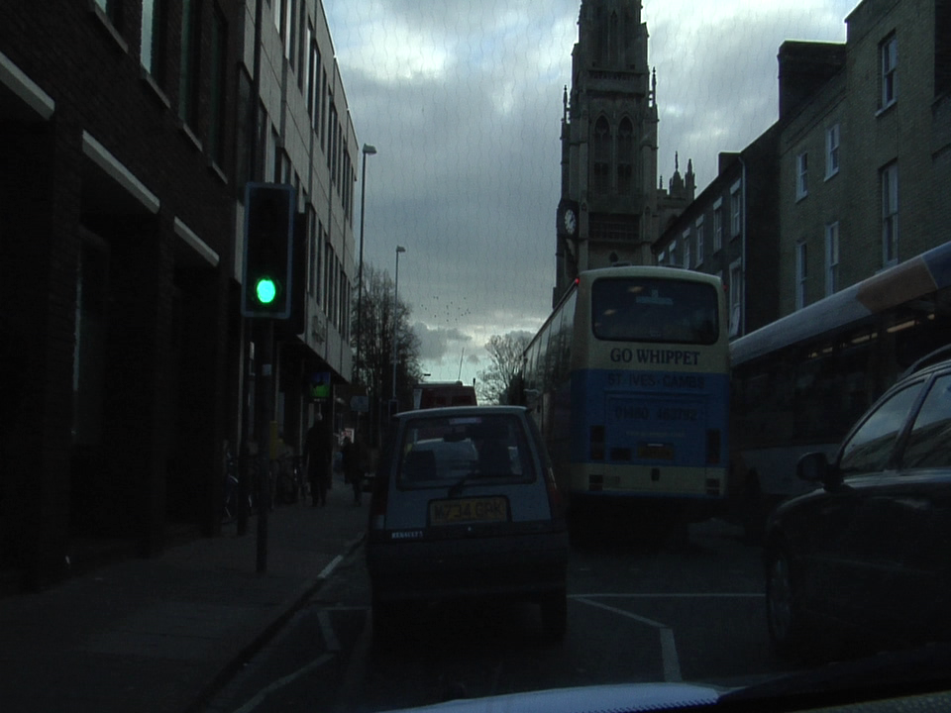
Parts 4 & 5: Most difficult classes
[Which classes have the lowest mIoU? Why might they be the most difficult? Provide an example RGB image from Camvid that illustrates your point]
SignSymbol and Column Pole
The column poles are aligned with the vertical edges of the building, making them hard to distinguish.

Slide 5
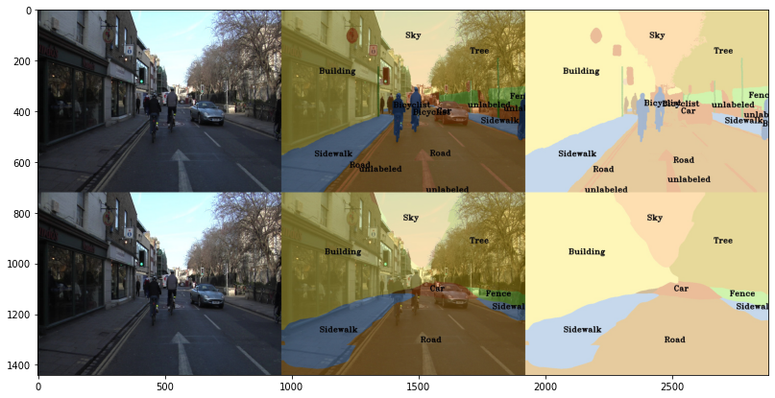
Part 4: Simple segmentation net qualitative results
[Paste a figure of the generated semantic segmentation from Colab. It should be a 2x3 grid, with ground truth on the top row, and your predictions on the bottom row.]

Slide 6
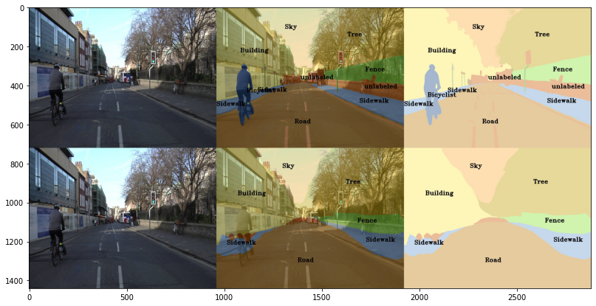
Part 5: PSPNet qualitative results
[Paste a figure of the generated semantic segmentation from Colab. It should be a 2x3 grid, with ground truth on the top row, and your predictions on the bottom row.]

Slide 7
Part 6: Transfer Learning
Report your model’s IoU for the Kitti Dataset.
 | mIoU | mAcc/ | allAcc
Train result | 0.8612 | 0.9238 | 0.9475
Val result | 0.8562 | 0.9242 | 0.9611
Class Index | Class name | iou | accuracy
0 | Road | 0.8021 | 0.8524
1 | Not_Road | 0.9420 | 0.9725

Slide 8
Part 6: Transfer Learning
Compare the training loss generated when training on Kitti dataset and Camvid dataset. Which decreases at a faster rate? If Camvid or Kitti training loss decreases at a faster rate than the other, why do you think this happened? Or, if the loss decreases at a similar rate, why do you think that is so?
The training loss of Kitti is faster, since it was trained on the pre-trained model, and the number of classes is 2, which is much smaller than 11 from Camvid.

