Slide 1
TASSEL5 v2 Tutorial
Narinder Singh
Apr 18, 2017

Slide 2
Pre-requisites
Java 1.8
Download JDK 8xxx from https://goo.gl/oC5YLc
where xxx is a version name, download the latest
Beocat account
Request one if needed at https://account.beocat.ksu.edu/user
Install an ftp/sftp client
GUI Cyberduck for mac and windows: https://cyberduck.io/?l=en
Filezilla: https://filezilla-project.org/
Install terminal
Putty for windows: http://www.putty.org/
Mac already has terminal

Slide 3
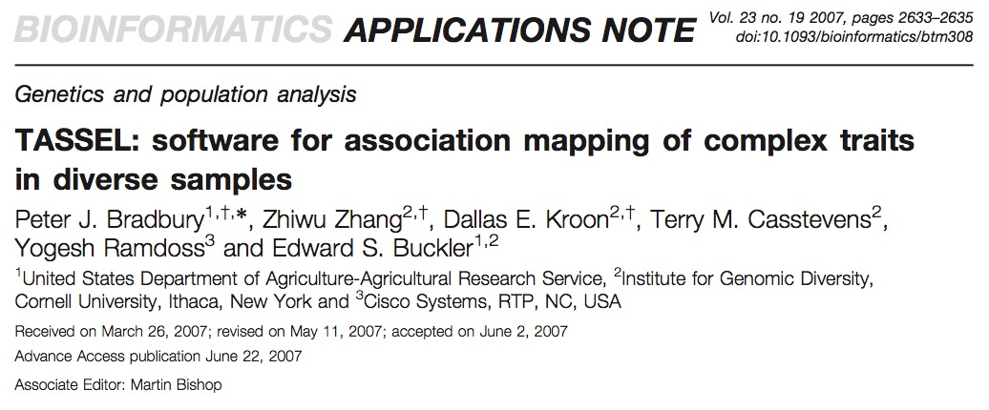
Introduction
Developed by Ed Buckler’s group at Cornell
Originally published in 2007
maizegenetics.net
TASSEL5 – GUI and CL
Install or update to Java 1.8
Notes:
Since 2007 many versions, currently 5 v2

Slide 4
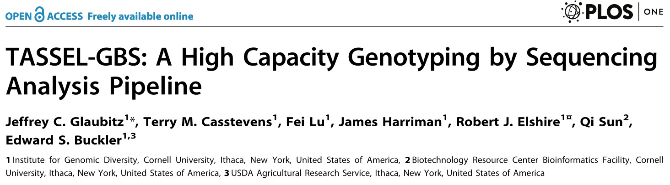
TASSEL-GBS
TASSEL-GBS pipeline introduced in 2014 for genotyping-by-sequencing data
Command line based interaction – set of multiple plugins
Scalable – generally run on servers

Slide 5
Pipeline
Input files
TASSEL Plugins

Slide 6
Pipeline
Input files
TASSEL Plugins

Slide 7
Pipeline
Input files
TASSEL Plugins

Slide 8
Required files to run pipeline
Pipeline shell script: https://goo.gl/YDL1FP
.sh extension
Only update ‘user’ and ‘name’ variables
Update resource requirements
Keyfile - .txt extension
Fastq files folder path
Username

Slide 9
Keyfile
Keyfile is the ‘key’ file in this pipeline
Has the info regarding barcodes, flowcell and lane info for each sample associated with a sample name
Required headers – Flowcell, Lane, Barcode and FullSampleName
.txt extension
Poland lab use Navicat or SQL workbench to make keyfile

Slide 10
Recommended folder structure and naming
/homes/eID
Home directory
gbs
Parent folder
jobs
.sh and keyfile
projects
TASSEL output
Name the keyfile and shell file same as the ‘name’ variable with appropriate extensions
For example
name=Tassel5v2_tutorial
Keyfile=Tassel5v2_tutorial.txt
shell file=Tassel5v2_tutorial.sh

Slide 11
Test run
Go to https://goo.gl/YDL1FP
Copy the script and create a ‘Tassel5v2_tutorial.sh’ in text editor
Create a keyfile – use Navicat/SQL workbench or otherwise
Upload these two files in the ‘gbs/jobs’ folder with cyberduck
Login to beocat using terminal
ssh eid@headnode.beocat.ksu.edu
Enter password (tip: you won’t see the password getting typed, so don’t freak out)

Slide 12
Test run continued…
Navigate to your gbs/jobs folder
cd gbs/jobs
cd = change directory
When inside the ‘jobs’ folder run
qsub Tassel5v2_tutorial.sh
Once the job is submitted, check status of your job
status -r
This will tell you if your job is running and on which node
Just relax and wait until your job is finished and you have a hap file

Slide 13
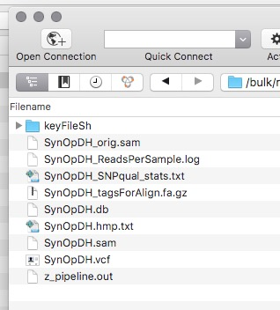
Desired output

Slide 14
Resources
TASSEL5 v2 wiki: https://bitbucket.org/tasseladmin/tassel-5-source/wiki/Tassel5GBSv2Pipeline
Poland Lab wiki: http://wheatgenetics.org/wiki/index.php?title=Poland_Lab_Wiki
http://www.maizegenetics.net/tassel
Youtube: https://www.youtube.com/channel/UCS1SdXlyMI1OsSf5yA_oFqw

