Slide 1
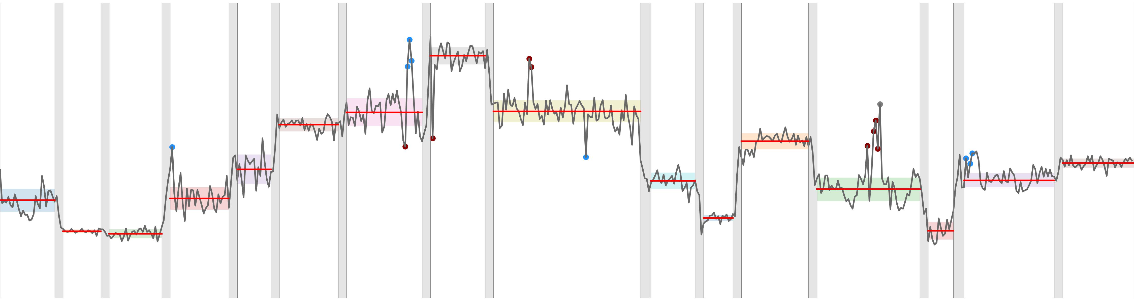
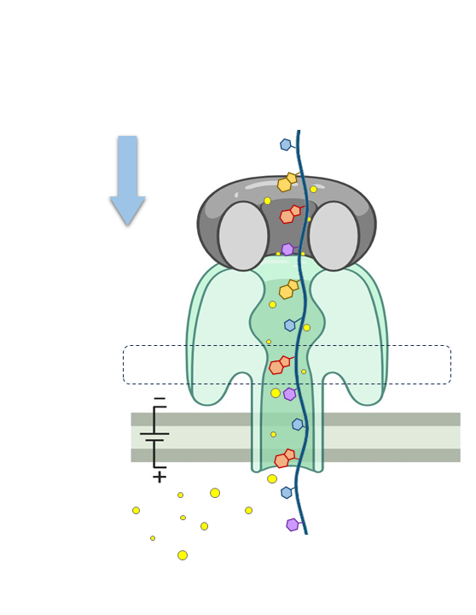
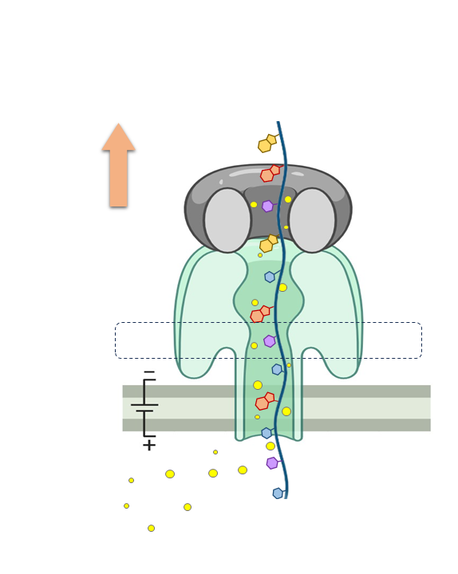
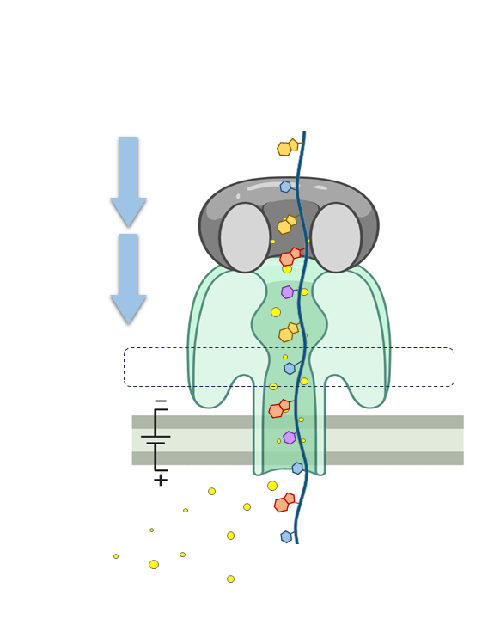




“prev” state
“next” state
“noise” state
transition bloc (“T”)
mean of base bloc (“B”)
Nanopore signal (pA)
$$t_{1}$$
$$t_{2}$$
$$t_{3}$$
Time
curr
$${(t=t}_{1})$$
prev
$${(t=t}_{2})$$
next
$${(t=t}_{3})$$

